Slide 1
DPAS Defense Priorities & Allocations System for the Contractor
DCMA Technical Directorate
Controlled Unclassified Information

Slide 2
Intent of Presentation
This presentation is intended to provide interpretation to DCMA personnel on requirements established in 15 CFR 700 for administration purposes on DCMA administered contracts only.
Condensed versions of the Defense Priorities and Allocations System (DPAS) this presentation can be created by Command Management Office (CMO) DPAS Officers to educate contractors on regulation requirements.
→

Slide 3
ATTENTION
It is important to inform contractors that they are not allowed to request DPAS ratings on contracts. DPAS ratings are incorporated by the buying activity representatives. There are instances when coordination may be required with the Office of the Undersecretary of Defense (OUSD) to the Department of Commerce (DOC).
→

Slide 4
DPAS for the CONTRACTOR
Any person who places or receives a rated order should be thoroughly familiar with, and must comply with, the provisions of 15 CFR 700 http://www.ecfr.gov
This training is a representation of the basic requirements that a person must adhere to when accepting DPAS rated orders from activities or services of the Department of Defense

Slide 5
DPAS for the CONTRACTOR
Contractors should ensure that DPAS is integrated into their Production Planning and Control System in order to demonstrate that rated orders are given consideration and priority in compliance with 15 CFR 700.

Slide 6
DPAS for the CONTRACTOR
Program Overview
Definitions
DPAS Authority
Purpose
Objectives
Priority ratings for DoD
Provisions
Special Priorities Assistance (SPA)
Compliance
Protection Against Claims
Applicability

Slide 7
Definitions
Person - any individual, corporation, partnership, association, or any other organized group of persons, or legal successor or representative thereof.
Approved program - A program determined as necessary or appropriate for priorities and allocations support to promote the national defense by the Secretary of Defense.
Delegate Agency - A government agency authorized by delegation from the Department of Commerce to place priority ratings on contracts or orders needed to support approved programs.
→

Slide 8
Definitions
Official action - An action taken by Commerce under the authority of the Defense Production Act, the Selective Service Act and related statutes, and 15 CFR 700. Such actions include the issuance of Set-asides, Rating Authorizations, Directives, Letters of Understanding, Demands for Information, Inspection Authorizations, and Administrative Subpoenas.
Rated order - A prime contract, a subcontract, or a purchase order in support of an approved program issued in accordance with the provisions of 15 CFR 700.
→

Slide 9
Definitions
Defense Production Act - the Defense Production Act of 1950, as amended (50 U.S.C. App. 2061, et seq.).
Selective Service Act and related statutes - Section 18 of the Selective Service Act of 1948 (50 U.S.C. app. 468), 10 U.S.C. 2538, and 50 U.S.C. 82.
Stafford Act -Title VI (Emergency Preparedness) of the Robert T. Stafford Disaster Relief and Emergency Assistance Act, as amended (42 U.S.C. 5195 et seq.).
National Defense - Includes programs for military and energy production or construction, military or critical infrastructure assistance to any foreign nation, homeland security, stockpiling, space, and any directly related activity.

Slide 10
DPAS Authority
Defense Production Act of 1950
President’s primary authority to mobilize resources and expedite critical industrial items for national defense
Does not require an emergency declaration
Require priority in acceptance
Require priority in scheduling
→

Slide 11
DPAS Authority
Defense Priorities and Allocations System (DPAS)
A regulation administered by the Department of Commerce (DoC) that implements the priorities and allocations authority contained in Title 1 of the Defense Production Act (DPA) of 1950 with respect to industrial resources. The purpose of DPAS is to ensure the timely availability of industrial resources to meet national defense and emergency preparedness requirements. Certain national defense, energy, and homeland security programs are approved for priorities and allocations support. The DoC has delegated authority to DoD to place priority ratings on its contracts in accordance with DPAS and DoD issues approximately 300,000 rated orders annually. DoD uses two priority ratings: DX and DO. DX rated programs and their orders are of the highest national defense urgency and are approved by the Secretary of Defense (SECDEF) or Deputy Secretary of Defense (DEPSECDEF). DO rated orders are of lower priority than DX-rated orders but take precedence over unrated orders. DPAS cannot be used to prioritize food, energy, health, water, or civil transportation resources.

Slide 12
DPAS Authority
Title 1 of the DPA: Priorities and Allocation
Allows the President to require persons (including businesses and corporations) to prioritize and accept contracts for materials and services as necessary to promote the national defense.
→

Slide 13
DPAS Authority
Title 1 of the Defense Production Act (DPA) of 1950 is the statutory basis for the Defense Priorities and Allocations System (DPAS). Title 1 is also one of the non-permanent provisions of the DPA that needs to be periodically reauthorized, which Congress has done in the past for periods of 1 to 5 years. The DPA provides the President with the authority to require acceptance and priority performance on contracts and orders, and to allocate materials, services, and facilities to support national defense and emergency preparedness requirements. The President has delegated priority and allocation authority to the Department of Defense, the Department of Homeland Security, and the Department of Energy according to resource required.

Slide 14
DPAS Authority
How Title 1 Works
Congress
Defense Production Act of 1950 Title 1
Office of Federal Procurement Policy
President
Executive Order 13603
Federal Acquisition Regulation 11.604
Department of Commerce
DPAS Regulation 15 CFR 700 & Delegation 1
Contract Clauses 52.211 14&15
Department of Defense
Priority & Allocation Manual 4400.1-M
Contracts and Purchase Orders
→

Slide 15
DPAS Authority
Section 201 of Executive Order 13603 delegates the authority granted the President in Section 101 of the DPA
Agriculture Defense
Food Resources and Related Facilitates, Domestic Distribution of Farm Equipment and Commercial Fertilizer
Defense
Water Resources
Energy
All Forms of Energy
Transportation
All Forms of Energy Civil Transportation
Health and Human Services
Health Resources
Commerce All other materials, Services & Facilities (Including Construction Materials). Generally called “industrial resources”
→
DPAS

Slide 16
DPAS Authority
Executive Order 13603
Part II-Priorities and Allocations, Section 201-Delegation of Priorities and Allocations, authorizes the Secretary of Commerce to re-delegate to the Secretary of Defense, and the heads of other departments and agencies as appropriate, authority for the priority rating of contracts and orders for all materials, services, and facilities needed in support of programs approved under Section 202 of Executive Order 13603.
→

Slide 17
DPAS Authority
Priorities and Allocations (P&A) Manual 4400.1-M
The DoC implements its P&A authority by issuing, administering, and enforcing the DPAS Regulation 15 CFR 700. The Secretary of Commerce has re-delegated authority under the DPAS to the Secretary of Defense to rate contracts and orders that support national defense programs.
Department of Defense
Priority & Allocation Manual 4400.1-M
DPAS Priority
Contracts and Purchase Orders

Slide 18
DPAS Purpose
700.1 (excerpt): Establishes procedures for the placement, acceptance, and performance of priority rated contracts and orders and for the allocation of materials, services and facilities.
→

Slide 19
DPAS Introduction
700.2 (excerpt): Certain national defense and energy programs are approved for priorities and allocations support. Approved programs are listed in Schedule 1 of 15 CFR 700.
→

Slide 20
DPAS Introduction
700.2 (excerpt): Department of Commerce administers DPAS and may exercise priorities and allocations authority to ensure the timely delivery of industrial items to meet approved program requirements.
→

Slide 21
DPAS Introduction
700.2 (excerpt): Department of Commerce has delegated authority to place priority ratings on contracts or orders necessary to promote national defense to certain government agencies that issue such contracts or orders. Delegation authorize includes authorizing recipients of rated orders to place ratings on contracts or orders to contractors, subcontractors and suppliers.

Slide 22
Priority Ratings
DPAS rules are standard part of U.S. defense contracting process: (15 CFR 700.11 (a))
Two levels of priority ratings:
(DX) Highest national defense urgency
All DX rated orders have equal priority and take preference over DO and unrated orders (based on ship schedule)
(DO) Critical to national defense
All DO rated orders have equal priority and take preference over unrated orders (based on ship schedule)

Slide 23
Priority Ratings for DoD
$$Priority Rating=\left(Rating Level\right)+\left(Program ID Symbol\right)$$
$$DOA1=\left(DO\right)+\left(A1\right)$$
<Aircraft>
Examples:
$$DXA4=\left(DX\right)+\left(A4\right)$$
<MRAP Vehicles>
Question: How do I know what a Program ID Symbol identifies?
Answer: Schedule I to 15 CFR Part 700—Approved Programs and Delegate Agencies
(Program identification symbols, in themselves, do not connote any priority)

Slide 24
Program Symbols

Slide 25
Priority Ratings for DoD
Question: How do I know which programs are approved for DX rating?
Answer: You can retrieve an updated copy of programs that have been approved by the Secretary of Defense for the use of DX ratings on contracts, subcontracts, and purchase orders by going to US DoC Bureau of Industry and Security and viewing the list of DPAS Program Resources.

Slide 26
DX PROGRAMS
Updated: Nov 2018
The Department of Defense has authority under the Defense Priorities and Allocations System (15 CFR 700) to place industrial priority ratings on its contracts. DoD uses two ratings: "DO" and "DX." If necessary to meet required delivery dates at any level in the supply chain, DO­ rated orders must be given production preference over unrated (commercial) orders, and DX­ rated orders must be given preference over DO-rated orders and unrated orders.
In accordance with DoD 4400.1-M, "Department of Defense Priorities and Allocations Manual," DO ratings are placed on the vast majority of DoD contracts. DX ratings can only be approved by the Secretary of Defense. DoD components are currently authorized to use DX industrial priority ratings in support of the following programs:
Department of Defense
• Program 390
• Integrated Ballistic Missile Defense System
Department of the Navy
• Presidential Helicopter VH-92
• Presidential Helicopter VH-3D
• Presidential Helicopter VH-60N
• Fleet Ballistic Missile Weapons System, Trident System1
• Program 341
• E-6B - Airborne Strategic Command, Control and Communications System
Department of the Air Force
• Space-Based Infrared System (SBIRS) High
• Intercontinental Ballistic Missile, Minuteman III
• B-2 Stealth Bomber
• VC-25A Presidential Aircraft
• VC-25B (Presidential Aircraft Recapitalization)

Slide 27
What Is A Rated Order
A rated order is a prime contract, a subcontract or a purchase order in support of an approved program issued in accordance with the provisions of 15 CFR 700.
Supported by four key elements:
Priority Rating (DOA1)
A required delivery date (on or about or asap will not do)
Manual or electronic signature
A statement that reads in substance: "This is a rated order certified for national defense use, and you are required to follow all provisions of the Defense Priorities and Allocations System regulation (15 CFR 700).“ (FAR 52.211-15)”
→

Slide 28
Rated Orders
The four elements of a properly rated order on the previous slide must appear on every contract, purchase order, or delivery order.
A person receiving a rated order must ensure during the receipt and review process determining acceptance or rejection of the order, that all four elements are present.
The elements of a rated order are discussed in section 700.12 (a) & (b)

Slide 29
Basic Provisions
Acceptance and Rejection of Rated Orders. (Section 700.13)
Preferential Scheduling (Section 700.14)
Extension of Priority Ratings (Section 700.15)

Slide 30
BASIC PROVISIONS
Mandatory Acceptance or Rejection of Rated Orders (Section 700.13)
A person shall accept every rated order received and must fill such orders regardless of any other rated or unrated orders
A person shall not discriminate against rated orders
A person shall not accept a rated order for delivery on a specific date if unable to fill the order by that date. However, the person must inform the customer of the earliest date on which delivery can be made. Additional criteria can be found in 700.13 (b)
Optional rejection criteria is cited in 700.13 (c)
→

Slide 31
Basic Provisions
Customer notification requirements:
A person must accept or reject a rated order and transmit the acceptance or rejection in writing (hard copy), or in electronic format, within fifteen (15) working days after receipt of a DO rated order and within ten (10) working days after receipt of a DX rated order. If the order is rejected, the person must also provide the reasons for the rejection, pursuant to paragraphs (b) and (c) of this section, in writing (hard copy) or electronic format.
If a rated order is placed for the purpose of emergency preparedness requirements and expedited action is necessary or appropriate to meet these requirements and the order includes the statement set forth in §700.12(b), a person must accept or reject the rated order and transmit the acceptance or rejection in writing or in an electronic format within the time specified in the rated order.

Slide 32
Basic Provisions
Customer notification requirements: (Continued)
The minimum times for acceptance or rejection that such orders may specify are six (6) hours after receipt of the order if the order is issued by an authorized person in response to a hazard that has occurred, or twelve (12) hours after receipt if the order is issued by an authorized person to prepare for an imminent hazard.
If a person has accepted a rated order and subsequently finds that shipment or performance will be delayed, the person must notify the customer immediately, give the reasons for the delay, and advise of a new shipment or performance date. If notification is given verbally, written (hard copy) or electronic confirmation must be provided within one working day of the verbal notice.

Slide 33
Basic Provisions
Preferential Scheduling (Section 700.14)
A person must schedule operations, including the acquisition of all needed production items, in a timely manner to satisfy the delivery requirements of each rated order. Modifying production or delivery schedules is necessary only when required delivery dates for rated orders cannot otherwise be met.
→

Slide 34
Basic Provisions
Examples: If a person receives a DO rated order with a delivery date of June 3 and if meeting that date would mean delaying production or delivery of an item for an unrated order, the unrated order must be delayed. If a DX rated order is received requiring delivery on July 15 and a person has a DO rated order requiring delivery on June 2 and operations can be scheduled to meet both deliveries, there is no need to alter production schedules to give any additional preference to the DX rated order.
→

Slide 35
BASIC PROVISIONS
Conflicting rated orders:
If a person finds that delivery or performance against any accepted rated orders conflicts with the delivery or performance against other accepted rated orders of equal priority status, the person shall give preference to the conflicting orders in the sequence in which they are to be delivered or performed (not to the receipt dates). If the conflicting rated orders are scheduled to be delivered or performed on the same day, the person shall give preference to those orders which have the earliest receipt dates.
If a person is unable to resolve rated order delivery or performance conflicts under this section, the person should promptly seek special priorities assistance as provided in §§700.50 through 700.54. If the person's customer objects to the rescheduling of delivery or performance of a rated order, the customer should promptly seek special priorities assistance as provided in §§700.50 through 700.54. For any rated order against which delivery or performance will be delayed, the person must notify the customer as provided in §700.13(d)(3).

Slide 36
Basic Provisions
Extension of Priority Ratings (Section 700.15)
A person must use rated orders with suppliers to obtain items needed to fill a rated order. The person must use the priority rating indicated on the customer's rated order, except as otherwise provided in 15 CFR 700 or as directed by the Department of Commerce.
→

Slide 37
Basic Provisions
For example, if a person is in receipt of a DO-A3 rated order for a navigation system and needs to purchase semiconductors for its manufacture, that person must use a DO-A3 rated order to obtain the needed semiconductors.
The priority rating must be included on each successive order placed to obtain items needed to fill a customer's rated order. This continues from contractor to subcontractor to supplier throughout the entire procurement chain.

Slide 38
Special Priorities Assistance
§700.50 General provisions.
Once a priority rating has been authorized pursuant to this part, further action by the Department of Commerce generally is not needed.
DCMA interpretation: The DPAS is designed to be largely self-executing.
Special Priorities Assistance (SPA) is a service provided to alleviate problems that do arise.
SPA should be sought from the Delegate Agency through the contract administration office.
→

Slide 39
Special Priorities Assistance
§700.51 Requests for priority rating authority
If a rated order is likely to be delayed because a person is unable to obtain items not normally rated under this part, the person may request the authority to use a priority rating in ordering the needed items.
Rating authority for production or construction equipment. (Department of Defense Form DD 691.)
Rating authority in advance of a rated prime contract. Must follow guidance of 700.51 (c) (1-5)
→

Slide 40
Special Priorities Assistance
§700.52 Examples of assistance
While special priorities assistance may be provided for any reason in support of this regulation, it is usually provided in situations where:
A person is experiencing difficulty in obtaining delivery against a rated order by the required delivery date.
A person cannot locate a supplier for an item needed to fill a rated order.
Other examples of other potential special priorities assistance is also addressed in this section of 15 CFR 700.
→

Slide 41
Special Priorities Assistance
§700.53 Criteria for assistance
Requests for special priorities assistance should be timely, i.e., the request has been submitted promptly and enough time exists for the Delegate Agency or Commerce to effect a meaningful resolution to the problem, and must establish that:
There is an urgent need for the item
The applicant has made a reasonable effort to resolve the problem
→

Slide 42
Special Priorities Assistance
§700.54 Instances where assistance will not be provided
Special priorities assistance is provided at the discretion of the Delegate Agencies and the Department of Commerce…not in situations when a person is attempting to:
Secure a price advantage
Obtain delivery prior to the time required to fill a rated order
Gain competitive advantage
Disrupt an industry apportionment…designed to provide…unwarranted share of scarce items
Overcome a supplier's regularly established terms of sale or conditions of doing business
→

Slide 43
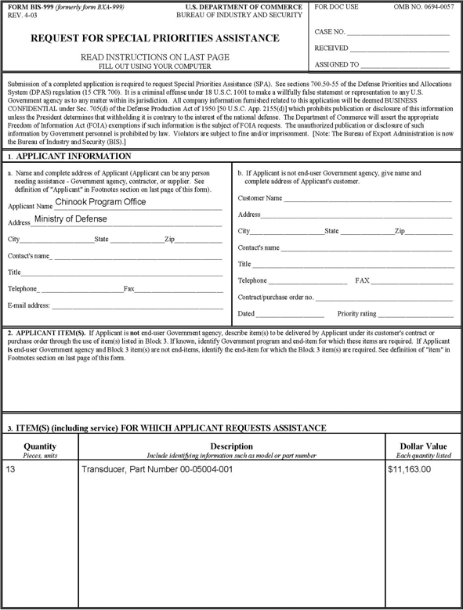
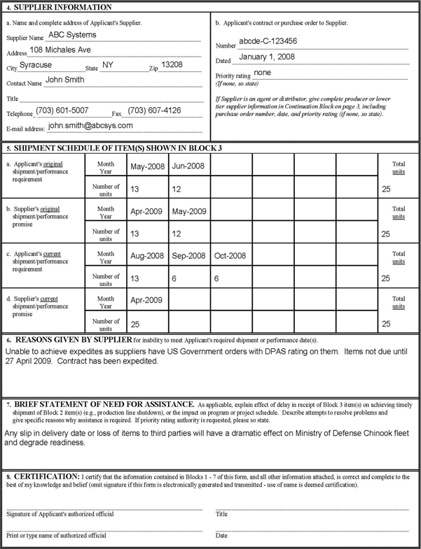
Special Priorities Assistance
FORM BIS 999
This form can be found as Appendix I to 15 CFR 700
Your local DCMA DPAS POC will assure that the BIS 999 is complete.

Slide 44
Compliance
§700.70 General provisions
Compliance actions may be taken for any reason necessary or appropriate to the enforcement or the administration of the Defense Production Act, the Selective Service Act and related statutes, this part, or an official action. Such actions include audits, investigations, or other inquiries.
Willful violation of any of the provisions of Title I or section 705 of the Defense Production Act or this part, or an official action of the Department of Commerce, is a criminal act, punishable as provided in the Defense Production Act and as set forth in §700.74 of this part.
→

Slide 45
Compliance
§700.71 Audits and investigations
(a) Audits and investigations are official examinations of books, records, documents, other writings and information to ensure that the provisions of the Defense Production Act, the Selective Service Act and related statutes, and this part have been properly followed. An audit or investigation may also include interviews and a systems evaluation to detect problems or failures in the implementation of this part.
→

Slide 46
Compliance
§700.72 Compulsory process
If a person refuses to permit a duly authorized representative of Commerce to have access to any premises or source of information necessary to the administration or the enforcement of the Defense Production Act or this part, the Department of Commerce may seek compulsory process. Compulsory process means the institution of appropriate legal action, including ex parte application for an inspection warrant or its equivalent, in any forum of appropriate jurisdiction.
→

Slide 47
Compliance
§700.72 Compulsory process (Continued)
Compulsory process may be sought in advance of an audit, investigation, or other inquiry, if, in the judgment of the Director of the Office of Strategic Industries and Economic Security, U.S. Department of Commerce, in consultation with the Chief Counsel for Industry and Security, U.S. Department of Commerce, there is reason to believe that a person will refuse to permit an audit, investigation, or other inquiry, or that other circumstances exist which make such process desirable or necessary.

Slide 48
Compliance
§700.73 Notification of failure to comply
…Commerce may inform the person in writing where compliance with the requirements of the Defense Production Act, the Selective Service Act and related statutes, or this part, were not met.
In cases where Department of Commerce determines that failure to comply with provisions of the Defense Production Act, the Selective Service Act and related statutes, or this part, was inadvertent, the person may be informed in writing of the particulars involved and the corrective action to be taken.

Slide 49
Compliance
§700.74 Violations, penalties, and remedies
Willful violation of the provisions of Title I or Sections 705 or 707 of the Defense Production Act, the priorities provisions of the Selective Service Act and related statutes or this part is a crime and upon conviction, a person may be punished by fine or imprisonment, or both. The maximum penalty provided by the Defense Production Act is a $10,000 fine, or one year in prison, or both. The maximum penalty provided by the Selective Service Act is a $50,000 fine, or three years in prison, or both.

Slide 50
COMPLIANCE
§700.75 Compliance conflicts
If compliance with any provision of the Defense Production Act, the Selective Service Act and related statutes, this regulation, or an official action would prevent a person from filling a rated order or from complying with another provision of the Defense Production Act, this regulation, or an official action, the person must immediately notify the Department of Commerce for resolution of the conflict.

Slide 51
Protection Against Claims
A person shall not be held liable for damages or penalties for any act or failure to act resulting directly or indirectly from compliance with the DPAS, or an official action, notwithstanding that such provision or action shall subsequently be declared invalid by judicial or other competent authority.

Slide 52
Applicability
§700.92 Applicability of this part and official actions
This part and all official actions, unless specifically stated otherwise, apply to transactions in any state, territory, or possession of the United States and the District of Columbia.
This part and all official actions apply not only to deliveries to other persons but also include deliveries to affiliates and subsidiaries.

Slide 53
References
Department of Commerce Regulation
15 CFR 700
DOD Priorities and Allocation Manual
DoD 4400.1M

Slide 54
DPAS Assistance
Contractors requiring assistance or interpretation on DPAS requirements must contact the Contracting Officer for the Buying Office who awarded the contract.
If the contract is administered by DCMA, contact can be initiated to the assigned DPAS Officer at the CMO.
CMO DPAS Officers requiring assistance must contact the Operational Units/Regional POCs and if escalation is necessary, contact the DPAS HQ representatives.
CUI

