Slide 1



ITCSO Training Academy
Contract Audit Follow-Up (CAFU) 3.5
Reports Overview and Access
November 2009
Notes:
1

Slide 2
Course Topics
Course Topics
Note: Links will only work in PowerPoint's slide show view.
Module One | CAFU Reporting Interface
Lesson One | CAFU Overview
Topic One | CAFU Overview
Topic Two | CAFU Reporting Overview
Topic Three Topic Four | How to Access CAFU Reporting CAFU Reporting Interface
Topic Five | CAFU Reports Overview
Topic Six Topic Seven | CAFU Ad hoc Overview CAFU Query Studio Overview
2

Slide 3
Course Objectives
At the end of the guide you should be able to:
Get an overview of CAFU 3.5 application and reports Access CAFU 3.5 Reporting Portal
Understand the three ways of accessing data (Pre-defined, Cubes, and Ad hoc Reports)
3
Notes:
3

Slide 4
Course Module
Course Module
Module One CAFU Reporting Interface
4

Slide 5
Module One – CAFU Reporting Interface
Module One
CAFU Reporting Interface
Notes:
5

Slide 6
Lesson One – CAFU Overview
Lesson One Topics
Topic One | CAFU Overview
Topic Two | CAFU Reporting Overview
Topic Three | How to Access CAFU Reporting
Topic Four | CAFU Reporting Interface
Topic Five | CAFU Reports Overview
Topic Six | CAFU Ad hoc Overview
Topic Seven | CAFU Query Studio Overview
6
Notes:
6

Slide 7
Topic One – CAFU Overview
CAFU Overview
  The CAFU 3.5 web application has been constructed in consonance with the independent, decision-making role of the contracting officer, and the financial advisory role of the contract auditor. It is designed to receive new audit reports from the Defense Contract Auditing Agency (DCAA) and audits to Contracting Officers (COs).
  CAFU supports the following agencies:
    AIR FORCE
    ARMY
    DCMA
    NAVY
    TRICARE
    DoDIG
7
Notes:
7

Slide 8
Topic Two – CAFU Reporting Overview
CAFU Reporting Overview
  The data found in CAFU reports and cubes comes from the Contract Audit Follow-Up (CAFU) 3.5 Application and the SDW (also known as IDB). Data in SDW is populated from MOCAS. MOCAS, a mainframe application, is the prime source for contract related information. A nightly job extracts data from MOCAS and loads it into local SDW tables that all applications can utilize.
  The CAFU reports list includes a series of status reports which provide the user the ability to see the status of all audits based on length of time overage.
  These reports include:
    CAFU Status Over 12 Months Report
    CAFU Status 6 to 12 Months Report
    CAFU Status Less than 6 Months Report
    CAFU Status In Litigation Report
    CAFU Status Involved in Criminal Investigation Report
    CAFU Status Closed Report
    CAFU Historical Status Report
    CAFU Monthly Status Report
    CAFU Semi-Annual Report
    CAFU Semi-Annual Open Report
    CAFU Semi-Annual Closed Report
8
Notes:
8

Slide 9
Topic Two – CAFU Reporting Overview
CAFU Reporting Overview (Continued)
Below is a description of some of the status reports for CAFU listed above:
CAFU Status Over 12 Months
  The CAFU Status Over 12 Months Report will allow the user to view audit reports that are over 12 months from the Audit Report Date, sorted by MC and reportable/non-reportable status. The user will be prompted to choose all or a specific MC and all audits or only reportable or non-reportable audits
  CAFU Status 6 to 12 Months
  The CAFU Status 6 to 12 Months Report will allow the user to view audit reports that are 6 to12 months from the Audit Report Date, sorted by MC and reportable/non-reportable status. The user will be prompted to choose all or a specific MC and all audits or only reportable or non-reportable audits
  CAFU Status Less Than 6 Months
  The CAFU Status Less Than 6 Months Report will allow the user to view audit reports that are less than 6 months from the Audit Report Date, sorted by MC and reportable/non­reportable status. The user will be prompted to choose all or a specific MC and all audits or only reportable or non-reportable audits
9
Notes:
.
9

Slide 10
Topic Two – CAFU Reporting Overview
CAFU Reporting Overview (Continued)
CAFU Status In Litigation Report
  The CAFU Status In Litigation Report will allow the user to view audit reports that are in litigation sorted by MC and reportable/non-reportable status. The user will be prompted to choose all or a specific MC and all audits or only reportable or non-reportable audits
  CAFU Status Involved in Criminal Investigation
  The CAFU Status Involved in Criminal Investigation Report will allow the user to view audit reports that are involved in criminal investigation sorted by MC and reportable/non­reportable status. The user will be prompted to choose all or a specific MC and all audits or only reportable or non-reportable audits
  CAFU Status Closed Report
  The CAFU Status Closed Report will allow the user to view audit reports that are closed sorted by MC and reportable/non-reportable status. The user will be prompted to choose all or a specific MC and all audits or only reportable or non-reportable audits. Closed audits will display an actual disposition date
10
Notes:
.
10

Slide 11
Topic Two – CAFU Reporting Overview
CAFU Reporting Overview (Continued)
CAFU Semi-Annual Open Report
  The CAFU Semi-Annual Open Report will allow the user to view specific contract audit reports. This report displays open reportables. There are no parameters for this report and is run on September 30 and March 31 each year
  CAFU Semi-Annual Closed Report
  The CAFU Semi-Annual Open Report will allow the user to view specific contract audit reports. This report displays closed reportable. There are no parameters for this report and is run on September 30 and March 31 each year
11
Notes:
.
11

Slide 12
Topic Two – CAFU Reporting Overview
CAFU Reporting Overview (Continued)
  In addition, DCMA reports list includes non-status reports that provide various audit information.
  These reports include:
    CAFU Individual Contract Audit Inquiry
    CAFU Inquiry by Type of Audit
    CAFU Summary of Contract Audits Inquiry
    CAFU Summary by Type of Audit
    CAFU Unresolved Audits Over Six Months
    CAFU Added/Deleted Audit Report
    CAFU Audit List
    CAFU Import Failure Report
    CAFU Summary By Type Of Audit With Cost Question Summary
    CAFU Summary Of All Audits
    CAFU Top Level Summary by Type
    CAFU User Access Report
12
Notes:
.
12

Slide 13
Topic Two – CAFU Reporting Overview
CAFU Reporting Overview (Continued)
Below is a description of some of the non-status reports for CAFU listed above:
  CAFU Individual Contract Audit Inquiry
  The CAFU Individual Contract Audit Inquiry displays information for individual audits. The user is prompted to select an Audit Report Number. The report will provide detailed information for the selected audit such as dates, figures, codes, and descriptions
  CAFU Inquiry by Type of Audit
  The CAFU Inquiry by Type of Audit Report will allow the user the ability to view audits by MC, audit type, and reportable or non-reportable status. The user will be prompted to select all or a specific MC, audit type and reportable or non-reportable status. CAFU Unresolved Audits Over Six Months
  The CAFU Unresolved Audits Over Six Months Report allows the user to view unresolved audits over six months from the Audit Report Date. The report has no actual resolution date. The user will be prompted to select all or a specific MC and reportable/non­reportable status
  CAFU Added/Deleted Audit Report
  This report displays audits that were added and deleted. The transaction message and audit information is displayed
13
Notes:
.
13

Slide 14
Topic Two – CAFU Reporting Overview
CAFU Reporting Overview (Continued)
  CAFU Audit List
  Displays information on non-reportable and reportable audits as to status in the CAFU system pipeline, contractor's name and issue date of the audit. User can click on the audit number to obtain other details
  CAFU Import Failure Report
  This report displays audits that have failed to import to the IDB database. The error message and audit information is displayed
  CAFU Summary by Type Of Audit With Cost Question Summary
  Displays the amount of questioned cost for each type of audit and displays summary by totals by CMO, District, and all of DCMA
  CAFU Summary of All Audits
  Displays ACO codes and age status of audits, contractor name, cage code, audit type, cost questioned and cost sustained amounts, depending on user's filter choice of open or closed status
14
Notes:
.
14

Slide 15
Topic Two – CAFU Reporting Overview
CAFU Reporting Overview (Continued)
  CAFU Top Level Summary by Type
  Displays the total number of open audit reports by category type for an office, the DCE Group, District or all of DCMA ( All)
  CAFU User Access Report
  This report displays user access information. The user type, first and last name, and/or the ACO code are displayed
  Service Report Details
  Service Reports are available to all service CAFU users to view metrics, statistics and summary of audits
15
Notes:
.
15

Slide 16
Topic Two – CAFU Reporting Overview
CAFU Reporting Overview (Continued)
Two Ways Of Viewing Data:
Reports
Ad hoc
Reports | Also known as “managed” or “canned” reports Predetermined reports created by the IT eTools development team The columns and categories are predetermined by DCMA users
Ad hoc | Ad hoc queries are customized reports generated based on specific sets of data fields that you designate. Ad hoc queries can be saved for future execution without the need to re-create
16
Notes:
16

Slide 17
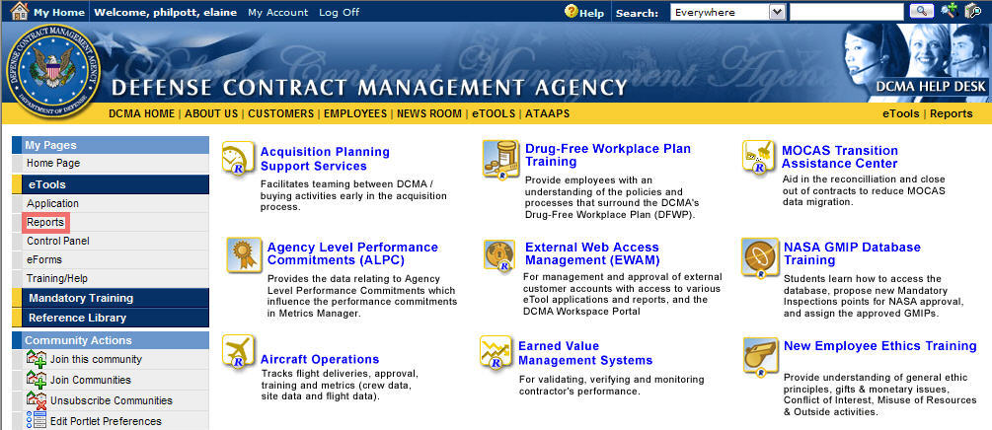

Topic Three – How to Access CAFU Reporting
There are two ways to access the CAFU Reporting Interface:
Option 1 – Reports Portal
Once you have logged into eTools, the CAFU Reporting Interface can be accessed by selecting the Reports link under the My Pages menu on the Portal page.
1
How to open CAFU Reporting Interface from the Portal. (Graphics 1.1 - 1.2)
 | Click on the Reports link on My Pages.
 | Click on the Contract Audit Follow-Up icon. CAFU’s Reporting Interface 3.5 will display. (Graphic 1.6)
Graphic 1.1: Accessing CAFU Reports
2
Graphic 1.2: Accessing CAFU Reports Icon
17
Notes:
17

Slide 18
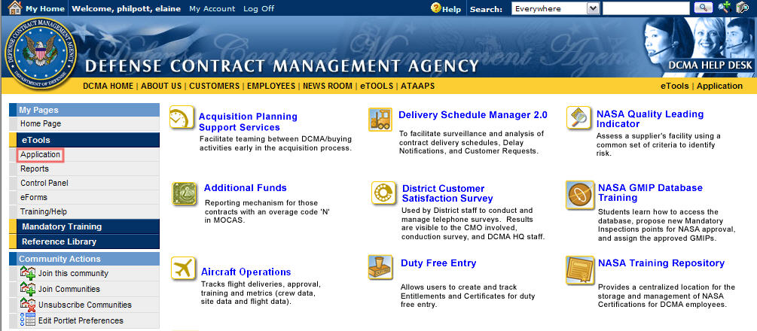

Topic Three – How to Access CAFU Reporting
Option 2 – CAFU Application
Once you have logged into eTools, the CAFU Reporting Interface can be accessed by selecting the Application link under the My Pages menu on the Portal page.
How to open CAFU Reporting Interface from the CAFU application. (Graphics 1.3 - 1.4)
1. | Click on the Application link on the My Pages.
2. | Click on the Contract Audit Follow-Up icon. CAFU’s 3.5 Application will display. (Graphic 1.6)
1
Graphic 1.3: Accessing Reports from the CAFU 2.0 Application
2
Graphic 1.4: Accessing CAFU Application Icon
18
Notes:
18

Slide 19
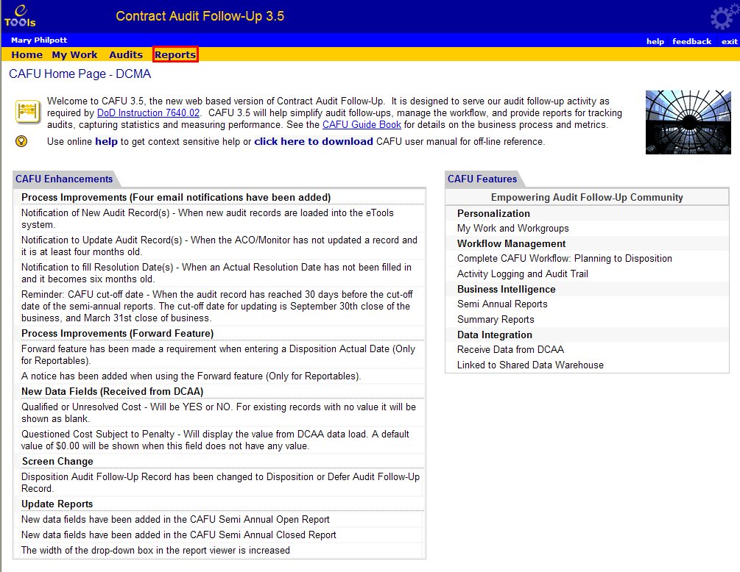
Topic Three – How to Access CAFU Reporting
Option 2 – CAFU Application
Once you have logged into the CAFU 3.5 Application, the CAFU Reporting Interface can be accessed by selecting the Reports link from the application menu bar.
3
How to open CAFU Reporting Interface from the CAFU application. (Graphics 1.5 - 1.6)
3. | Click on the Reports link on the application menu bar to access CAFU’s Reporting Interface.
Graphic 1.5: Accessing Reports from the CAFU Application
19
Notes:
19

Slide 20
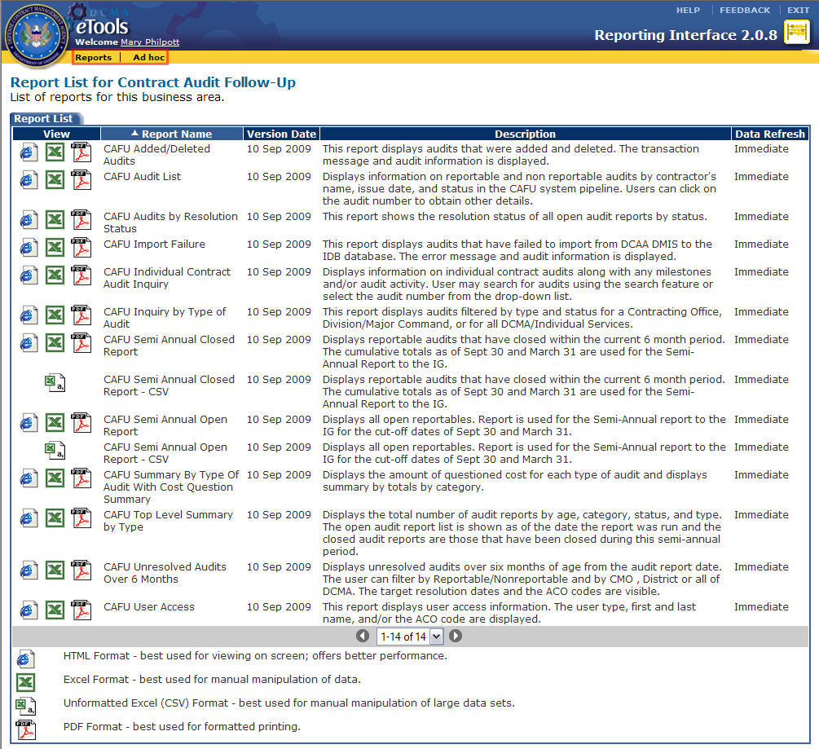
Topic Four – CAFU Reporting Interface
CAFU Report List
1
The Report list displays all available Report and Ad hoc Reports for the application.
How to access the Reports and Ad hoc Reports. (Graphic 1.6)
 | From within the CAFU Reporting Interface, there will be two links on the reports menu bar from which to choose.
 | Click the link on the menu bar to run the appropriate report type.
Graphic 1.6 Reporting Interface
20
Notes:
20

Slide 21
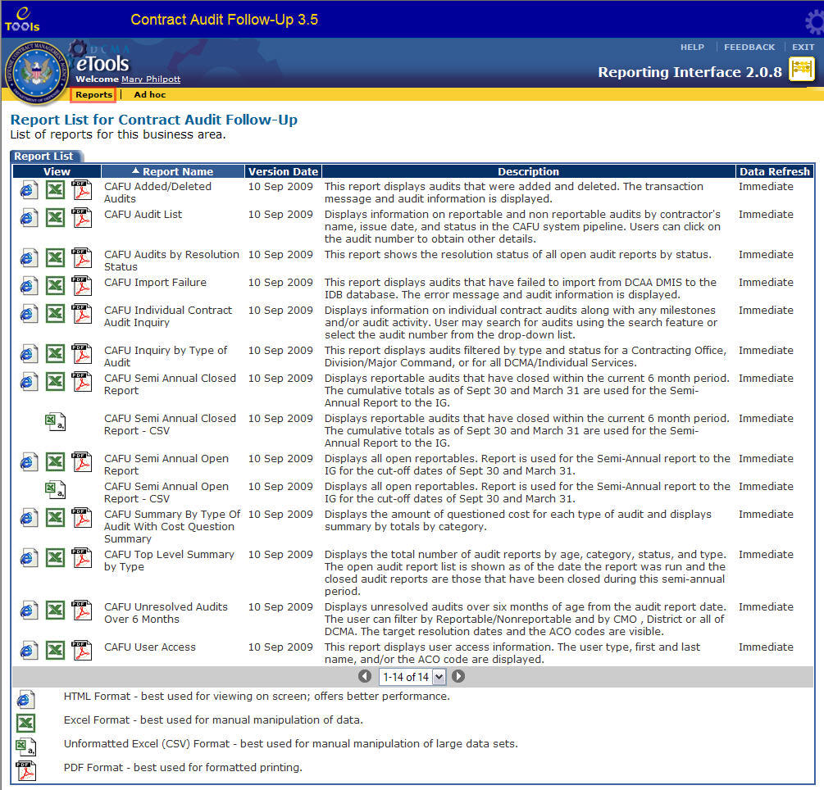
Topic Five – CAFU Reports Overview
CAFU Report List
Reports are accessed by clicking on the Reports link from the reports menu bar. The Reports Interface defaults to the Reports List screen. (Graphic 1.7)
Graphic 1.7: Report List
21
Notes:
21

Slide 22
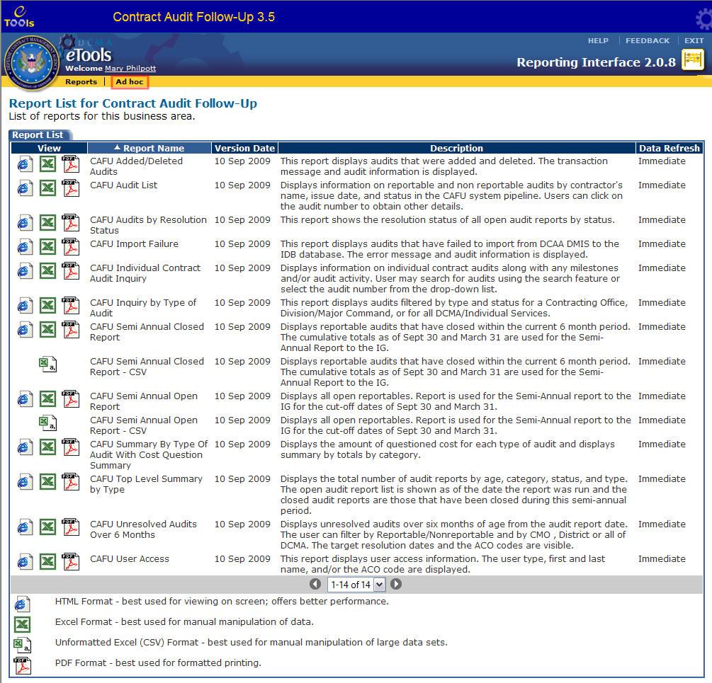
Topic Six– CAFU Ad hoc Overview
CAFU Ad hoc View
Ad hoc Reports are accessed by clicking on the Ad hoc link from the reports menu bar. (Graphic 1.8)
Graphic 1.8: Reports List
22
Notes:
22

Slide 23
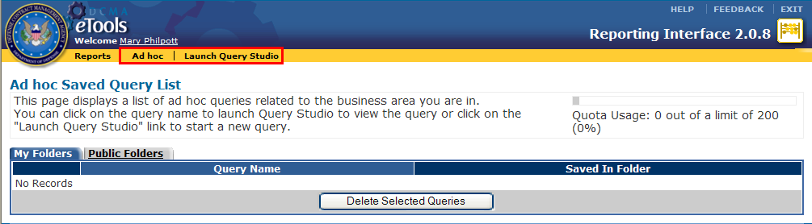
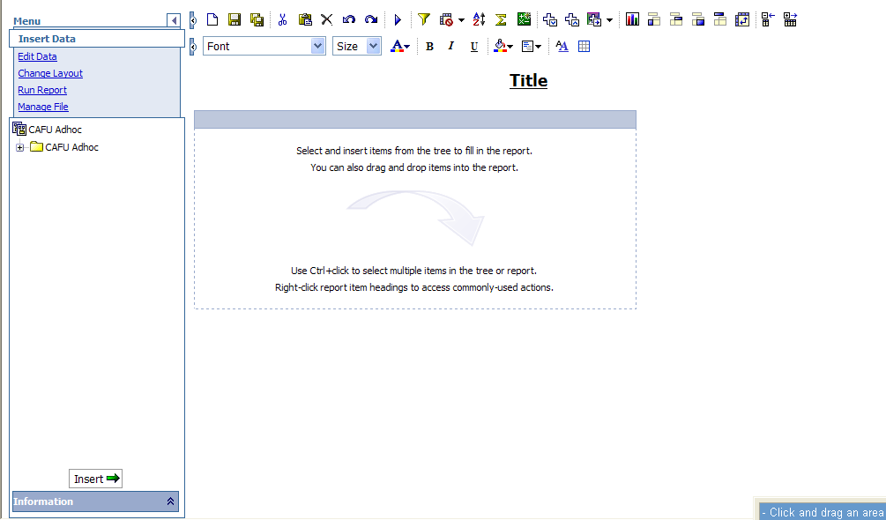
Topic Seven – CAFU Query Studio Overview
CAFU Query Studio View
After clicking the Ad hoc link, the Launch Query Studio (Graphic 1.9) link appears. Clicking on this link launches the Query Studio interface. (Graphic 1.10)
Graphic 1.9: Ad hoc and Launch Query Studio Links
Graphic 1.10: Query Studio View
23
Notes:
23

Slide 24
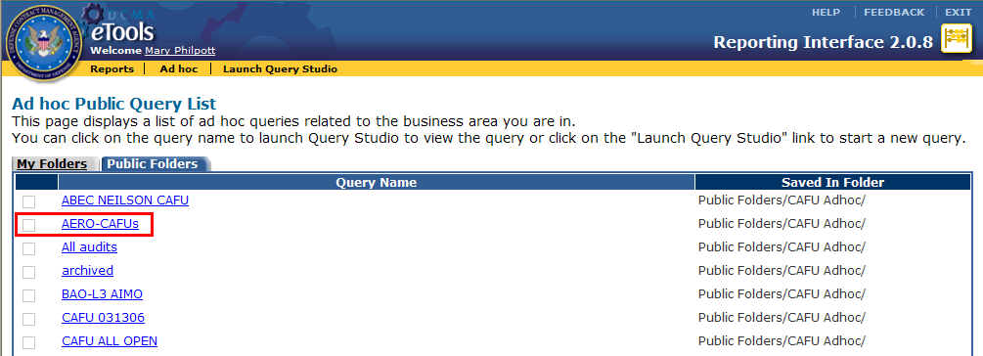
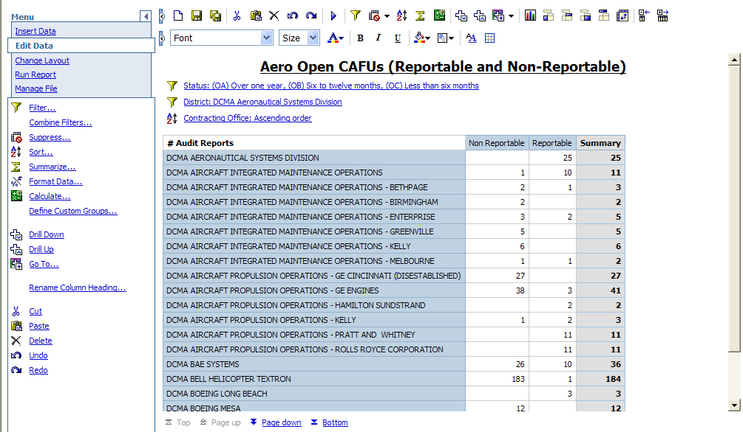
Topic Seven – Query Studio Overview
CAFU Query Studio Overview (Continued)
Click a query name under My Folders tab or Public Folders (Graphic 1.11) tab to launch the saved query in Query Studio.
Graphic 1.11: Public Folders Query
Graphic 1.12: Query Studio View
24
Notes:
24

Slide 25
Module One – Review
Module One Covered the Following Topics:
Topic One | CAFU Overview
Topic Two | CAFU Reporting Overview
Topic Three | How to Access CAFU Reporting
Topic Four | CAFU Reporting Interface
Topic Five | CAFU Reports Overview
Topic Six | CAFU Ad hoc Overview
Topic Seven | CAFU Query Studio Overview
25
Notes:
25

