Slide 2
Course Topics
Course Topics
Note: Links will only work in PowerPoint’s slide show view.
PASS 2.0 Reports
Lesson One | Predefined Reports
Topic One | Report Types
Topic Two | Report Filters
Topic Three | Accessing Reports
Topic Four | Running Reports
2
Notes:
2

Slide 3
Objectives
At the end of this training you will be able to:
List the Predefined Report types
Identify the Predefined Report filters
Access the Predefined Reports
Run the Predefined Reports
Course Topics
3
Notes:
3

Slide 4
Lesson One – Predefined Reports
Lesson One
Predefined Reports
Course Topics
4
Notes:
4

Slide 5
Lesson One Topics
Lesson One Topics
Topic One | Report Types
Topic Two | Report Filters
Topic Three | Accessing Reports
Topic Four | Running Reports
Course Topics
5
Notes:
5

Slide 6
Topic One – Report Types
Predefined Reports and Descriptions
The table below lists the four (4) Predefined Reports for PASS 2.0 and provides descriptions for each:
Predefined Report | Description | Data Refresh
Completed Preaward Surveys | A detailed listing of completed Preaward Surveys by CMO. | Immediate
In Progress Preaward Surveys | A detailed listing of in-progress Preaward Surveys by Surveying Activity. | Immediate
Preaward Survey Delivery Negotiation | A listing of the Preaward Survey Requests where the PASM and the Requesting Activity are in the process of negotiating a deadline for completion of the survey. | Immediate
Preaward Survey Evaluation Factors | A listing of in progress and/or completed Preaward Surveys with evaluation factor information. | Immediate
Course Topics
6

Slide 7
Topic Two – Report Filters
Predefined Report Filter Options
The table below lists the PASS 2.0 filter options for the four (4) Predefined Reports:
Predefined Report | Filter Options
Completed Preaward Surveys | Starting Period of Survey Completion * Ending Period of Survey Completion * Division * Surveying Activity Requesting Activity | Recommendation Solicitation Number Include completed surveys lacking Completion Date? *
In Progress Preaward Surveys | Starting Period of Survey Due Date * Ending Period of Survey Due Date * Division * | Surveying Activity Solicitation Number
Preaward Survey Delivery Negotiation | Division * Surveying Activity Requesting Activity
Preaward Survey Evaluation Factors | Starting Period of Request Date * Ending Period of Request Date * Division * Surveying Activity | Survey Status Solicitation Number Include surveys lacking Created Date? *
Note: required filter options are marked with a red asterisk (*)
Course Topics
7

Slide 8
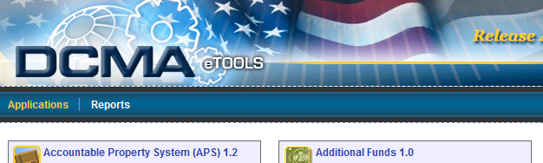

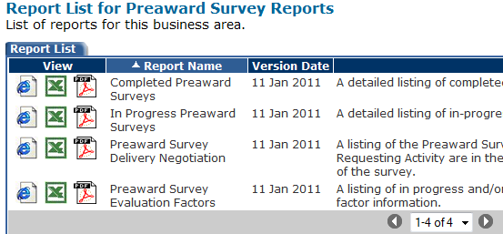
Topic Three – Accessing Reports
How to Access Predefined Reports
Navigate to http://etools.dcma.mil
Must be registered as an external user via EWAM
Click the Reports link
Click the Pre-Award Survey System (PASS) 2.0 icon
The Report List appears
Course Topics
8
Notes:
8

Slide 9



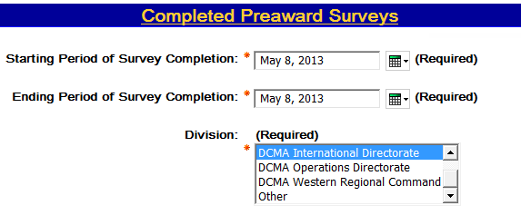
Topic Four – Running Reports
How to Run Predefined Reports
Select the report view from the Report List
 | HTML | Offers better performance and best used for onscreen viewing
 | Excel | Best used when you need to manually manipulate the report data
 | PDF | Best used for formatted printing
Select all required filter options and any optional filter options
Click the Finish button at the bottom of the page
Course Topics
9
Notes:
9

Slide 10

Need Help With EWAM?
Need Help Registering in EWAM?
You must be a registered External User in EWAM to access
PASS 2.0 Reports.
Access the EWAM Training page at the IT Training Academy:
http://www.dcma.mil/ITCSO/cbt/EWAM/
Or get registered here:
http://www.dcma.mil/aboutetools.cfm
Course Topics
10

Slide 11
Objectives
You have learned how to:
List the Predefined Report types
Identify the Predefined Report filters
Access the Predefined Reports
Run the Predefined Reports
Course Topics
11
Notes:
11

