Slide 1
Plant Clearance Automated Reutilization Screening System (PCARSS) 3.0 Reporting Functionality
February 2010

Slide 2
Course Topics
Course Topics
Note: Links will only work in PowerPoint's slide show view.
Module One | Using Pre-defined Reports
Lesson One | About Reports
Topic One | Accessing Pre-defined Reports
Topic Two | Report Formats
Topic Three | Running a Report
Lesson Two | About PCARSS Reports
Topic One | About PCARSS Reports
Topic Two | Active Case Summary Reports
Topic Three | Active Referrals Report
Topic Four | Case Acceptance Report
Topic Five | Customer Excess Property Report
Topic Six | Demilitarization Sale Report
Topic Seven | Established Cases With FSC Report
Topic Eight | Established/Closed Cases Summary Report
Topic Nine | Established/Closed Referrals Report
2

Slide 3
Course Topics
Course Topics
Note: Links will only work in PowerPoint's slide show view.
Module One | Using Pre-defined Reports
Lesson Two | About PCARSS Reports
Topic Ten | Opened/Completed Sale Report
Topic Eleven | Overage Cases Report
Topic Twelve | PCARSS Informal MIR Report
Topic Thirteen | Screening Complete Case Report
Topic fourteen | Successful Bidders by Commodity Code Report
Topic Fifteen | Timely Property Disposition Detail Report
3

Slide 4
Course Topics
Course Topics
Note: Links will only work in PowerPoint's slide show view.
Module Two | PCARSS Cubes
Lesson One | Cube Overview
Topic One | Accessing Cubes
Topic Two | Cube Components
Topic Three | Dimensions Folders
Topic Four | Dimensions Bar
Topic Five | Cube View
Topic Six | Toolbar
Lesson Two | Using Cubes
Topic One | Filtering Using Dimensions Folders
Topic Two | Filtering Using Dimensions Bar
Topic Three | Drill Down
Topic Four | Expanding
Topic Five | Nesting
Topic Six | Using Basic Tools
4

Slide 5
Course Topics
Course Topics
Note: Links will only work in PowerPoint's slide show view.
Module Two | PCARSS Cubes
Lesson Three | Using PCARSS Cubes
Topic One | Accepted Cases Cube
Topic Two | Active Cases Cube
Topic Three | Closed Referral Cube
Topic Four | Completed Sale Cube
Topic Five | Established Closed Cases Cube
Topic Six | Overage Cases Cube
Topic Seven | Property Disposition Cube
Lesson Four | Advanced Topics
Topic One | Calculation
Topic Two | Ranking
Topic Three | Custom Exception Highlighting
Topic Four | Custom Subsets
Topic Five | Drill Through
5

Slide 6
Course Topics
Course Topics
Note: Links will only work in PowerPoint's slide show view.
Module Three | Using PCARSS Ad Hoc Reports
Lesson One | About PCARSS Ad Hoc Reports
Topic One | Ad Hoc Reports Overview
Topic Two | Using PCARSS Ad Hoc Reports
6

Slide 7
Module One – Using Pre-defined Reports
Module One
Using Pre-defined Reports
7
Notes:
7

Slide 8
Module One Objectives
At the end of this module you should be able to:
Access the pre-defined reports
Select different filters in the reports
Run the reports
View the reports
8
Notes:
8

Slide 9
Module One – Using Pre-defined Reports
Module One Lessons
Lesson One | About Reports
Lesson Two | About PCARSS Reports
9
Notes:
9

Slide 10
Module One – Using Pre-defined Reports
Lesson One
About Reports
10
Notes:
10

Slide 11
Lesson One – About Reports
Lesson One Topics
Topic One | Accessing Pre-Defined Reports
Topic Two | Report Formats
Topic Three | Running a Report
Topic Four | Viewing a Report
11
Notes:
11

Slide 12
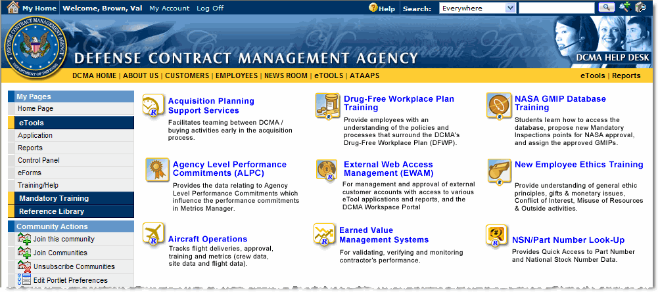
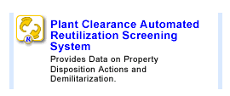
Topic One – Accessing Pre-defined Reports
Accessing Pre-defined Reports
Once you have logged into eTools, the Reports portal can be accessed by selecting the Reports link under the My Pages menu on the Portal page (Graphic 1.1.1 – Graphic 1.1.2).
Viewing the eTools Reports Portal (Graphic 1.1.1)
1. | Log into the eTools portal.
2. | In the My Pages list of options, click Reports (Graphic 1.1.1.). Report portal page appears.
3. | On the report portal page, Click the report icon or highlighted report text to access the report lists (Graphic 1.1.2).
Graphic 1.1.1: Accessing eTools Reports
Graphic 1.1.2: Plant Clearance Automated Reutilization Screening System Reports Icon
12
Notes:
12

Slide 13
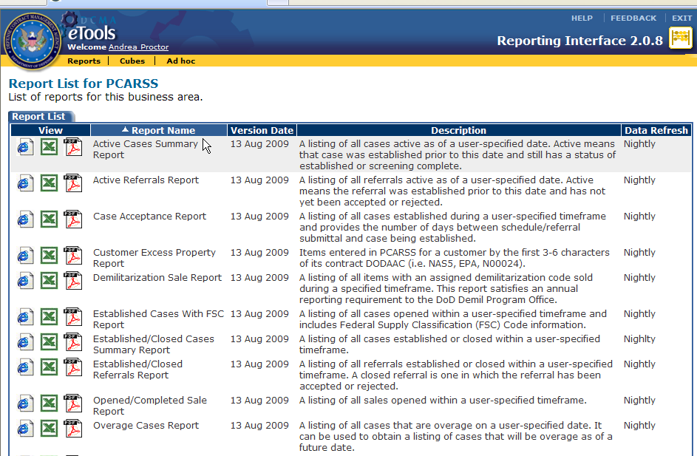
Topic One – Accessing Report Lists
Report List
The Report List displays when you click the icon on the reports portal. Reports are displayed by default if they are present (Graphic 1.1.3).
The yellow menu bar displays links to view reports, cubes and ad hoc reports.
Separate trainings describe using cubes and ad hoc.
Graphic 1.1.3: Report List View
13
Notes:
13

Slide 14
Topic Two – Report Formats
Report Formats
The file formats used to display reports are defined at the bottom of the Report List page for each application. If an icon does not display next to a report name, that format is not available for that report.
To see data in a specific report format, click the icon for the type of file you need. Once you select the filters for the report and click the Finish button, the data selected will display in the type of file that you selected.
 | HTML | Report prompts page displays in a new web page. When you choose to run the report, the results display in a web page.
 | Excel | Report prompts page displays in a new web page. When you choose to run the report, the results display in Excel. Excel’s Save As option will save the file as a comma separated value (CSV) format.
 | CSV | Not a view option for PCARSS.
 | PDF | Report prompts page displays in a new web page. When you choose to run the report, the results display in Adobe Acrobat *.pdf format.
14

Slide 15
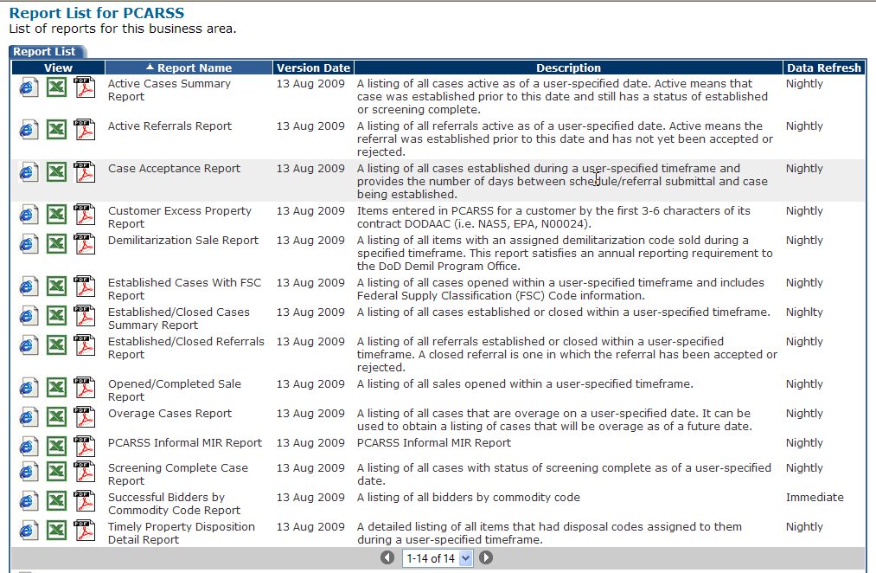
Topic Three – Running a Report
Step One: Selecting a Report and Report Format
This topic describes how to run any report. Lesson Two provides details about each of the PCARSS reports.
Selecting a Report and a Report Format (See Graphic 1.1.4)
1. | Click the icon displayed next to the report you wish to run for the report format you want (Graphic 1.1.4).
2. | Proceed to the next slide for Step Two: Selecting Filters.
Graphic 1.1.4: Report List View
15
Notes:
15

Slide 16
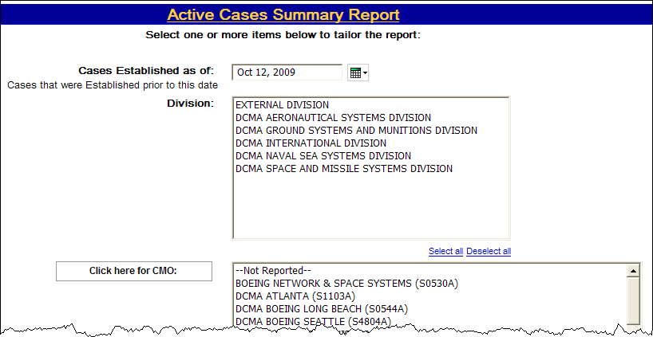
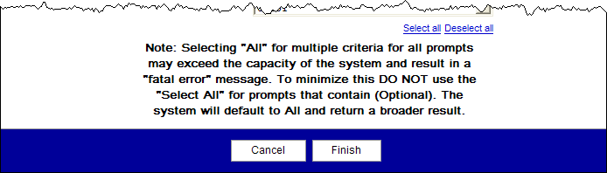
Topic Three – Running a Report
Step Two: Selecting Filters
After clicking the pre-defined report and view format, the report filter page appears (Graphic 1.1.5). This page allows you to select specific criteria for filtering the data you will see on your report.
Example on how to run a report
1. | Select a date for Case Established as of
 | Select one, two, more, or all of the filters in the list box. Use the shift key to select a range. To select two or more filters that are separated, use the CTRL key. Some list boxes have a button next to it. Your selections in the previous box determine the filters in the list box. Click on the button to repopulate the list box.
4. | Click on Select all or Deselect all to select or deselect all filters.
5. | Scroll down and click the Finish button at the bottom of the page to run the report.
Graphic 1.1.5: Example Report Filter Page
16

Slide 17
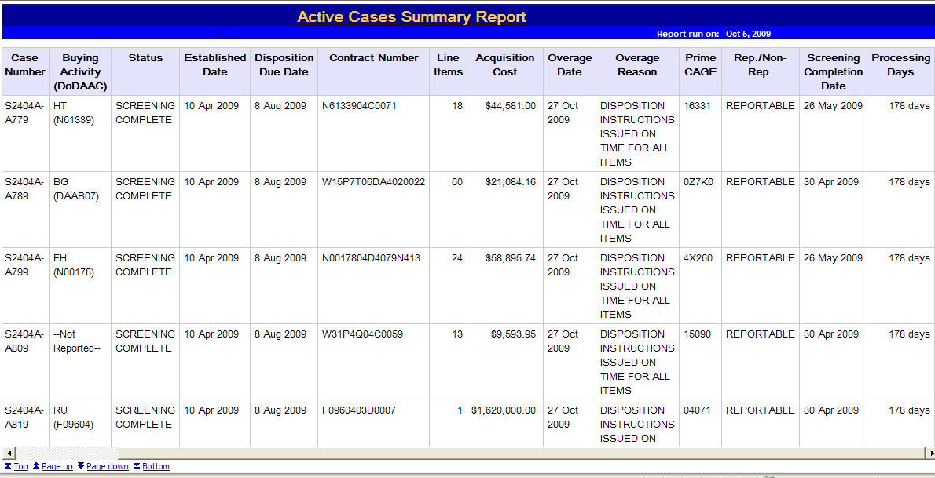

Topic Four – Viewing a Report
Step One: Viewing the Report (HTML Selection)
If you selected the HTML version, the report results display in a web page (Graphic 1.1.6).
Links at the bottom (Graphic 1.1.7) of the page allow you to:
Return to the top of the report .
Go to one page up.
Go to one page down.
Bottom link takes you to the end of the report where the filters you specified are displayed.
Graphic 1.1.6: Example PCARSS Report Filters, HTML Report Selected
Graphic 1.1.7: Enlarged View of the Links at the Bottom
17

Slide 18
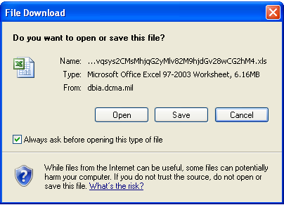
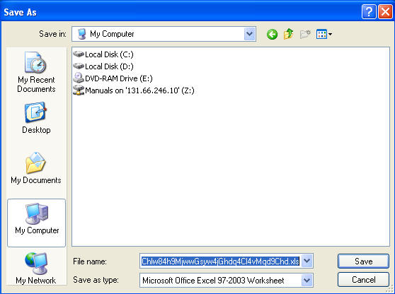
Topic Four – Viewing a Report
Step Two: Saving and Viewing the Report (Excel Selection)
If you selected the Excel version, a dialog box prompts you to save the Excel file (Graphic 1.1.8).
Save the file. You can review the information later without re-running the report and share the file with others who need the information.
Saving and Viewing an Excel File (Graphic 1.1.8 – 1.1.9)
1. | The File Download dialog box displays (Graphic 1.1.8). Click the Save button.
 | The Save As dialog box displays (Graphic 1.1.9). Type a file name for the file, then select a location to save the file.
3. | Click the Save button.
4. | Launch Excel.
5. | Open the saved file in Excel.
6. | See the next slide for the report results.
Graphic 1.1.8: File Download Dialog Box
Graphic 1.1.9: File Save Dialog Box
18

Slide 19
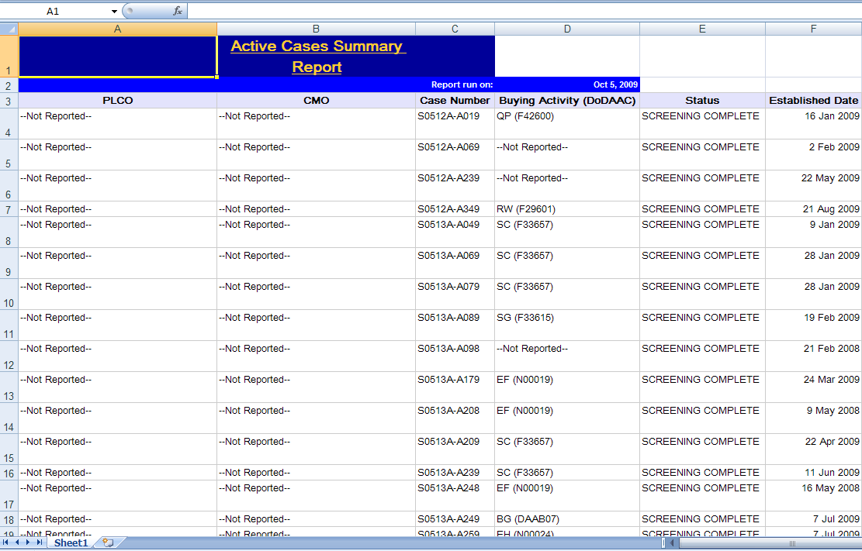
Topic Four – Viewing a Report
Step Three: Viewing the Report (Excel Selection)
Excel displays the report results similar to the presentation in Graphic 1.1.10.
Graphic 1.1.10: Example Report, Excel Selected
19

Slide 20
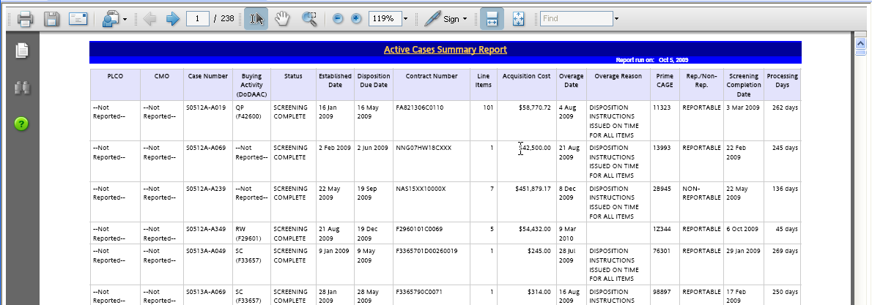
Topic Four – Viewing a Report
Step Four: Viewing the Report (Adobe Acrobat PDF Selection)
If you selected Adobe Acrobat PDF, the report results display in a web page similar to the presentation in Graphic 1.1.11.
Graphic 1.1.11: Example PCARSS Report, Adobe Acrobat PDF Selected
20

Slide 21
Lesson One Review
Lesson One covered the following topics:
Topic One | Accessing Pre-Defined Reports
Topic Two | Report Formats
Topic Three | Running a Report
Topic Four | Viewing a Report
21
Notes:
21

Slide 22
Lesson Two – About PCARSS Reports
Lesson Two
About PCARSS Reports
22
Notes:
22

Slide 23
Lesson Two – About PCARSS Reports
Lesson Two Topics
Topic One | About PCARSS Reports
Topic Two | Active Cases Summary Report
Topic Three | Active Referrals Report
Topic Four | Case Acceptance Report
Topic Five | Customer Excess Property Report
Topic Six | Demilitarization Sale Report
Topic Seven | Established Cases With FSC Report
Topic Eight | Established/Closed Cases Summary Report
Topic Nine | Established/Closed Referrals Report
Topic Ten | Opened/Completed Sale Report
Topic Eleven | Overage Cases Report
Topic Twelve | PCARSS Informal MIR Report
Topic Thirteen | Screening Complete Case Report
Topic Fourteen | Successful Bidders by Commodity Code Report
Topic Fifteen | Timely Property Disposition Detail Report
23
Notes:
23

Slide 24
Topic One – About PCARSS Reports
Pre-Defined PCARSS Reports
There are a total of fourteen pre-defined PCARSS Reports.
Report Name | Description of Report Results
Active Cases Summary Report | A listing of all cases active as of a user-specified date. Active means that case was established prior to this date and still has a status of established or screening complete.
Active Referrals Report | A listing of all referrals active as of a user-specified date. Active means the referral was established prior to this date and has not yet been accepted or rejected.
Case Acceptance Report | Items entered in PCARSS for a customer by the first 3-6 characters of its contract DODAAC (i.e. NAS5, EPA, N00024).
Customer Excess Property Report | Part description, part number, contract number, scheduled quantities, scheduled and final delivery dates, contractor name and address and CMO name, by selected NSN.
Demilitarization Sale Report | A listing of all items with an assigned demilitarization code sold during a specified timeframe. This report satisfies an annual reporting requirement to the DoD Demil Program Office.
Established Cases With FSC Report | A listing of all cases opened within a user-specified timeframe and includes Federal Supply Classification (FSC) Code information.
Established/Closed Cases Summary Report | A listing of all cases established or closed within a user-specified timeframe.
24
Notes:
24

Slide 25
Topic One – About PCARSS Reports
Pre-Defined PCARSS Reports (continued from previous page)
There are fourteen pre-defined reports for PCARSS Reports.
Report Name | Description of Report Results
Established/Closed Referrals Report | A listing of all referrals established or closed within a user-specified timeframe. A closed referral is one in which the referral has been accepted or rejected.
Opened/Completed Sale Report | A listing of all sales opened within a user-specified timeframe.
Overage Cases Report | A listing of all cases that are overage on a user-specified date. It can be used to obtain a listing of cases that will be overage as of a future date.
PCARSS Informal MIR Report | PCARSS Informal MIR Report
Screening Complete Case Report | A listing of all cases with status of screening complete as of a user-specified date.
Successful Bidders by Commodity Code Report | A listing of all bidders by commodity code
Timely Property Disposition Detail Report | A detailed listing of all items that had disposal codes assigned to them during a user-specified timeframe.
25
Notes:
25

Slide 26
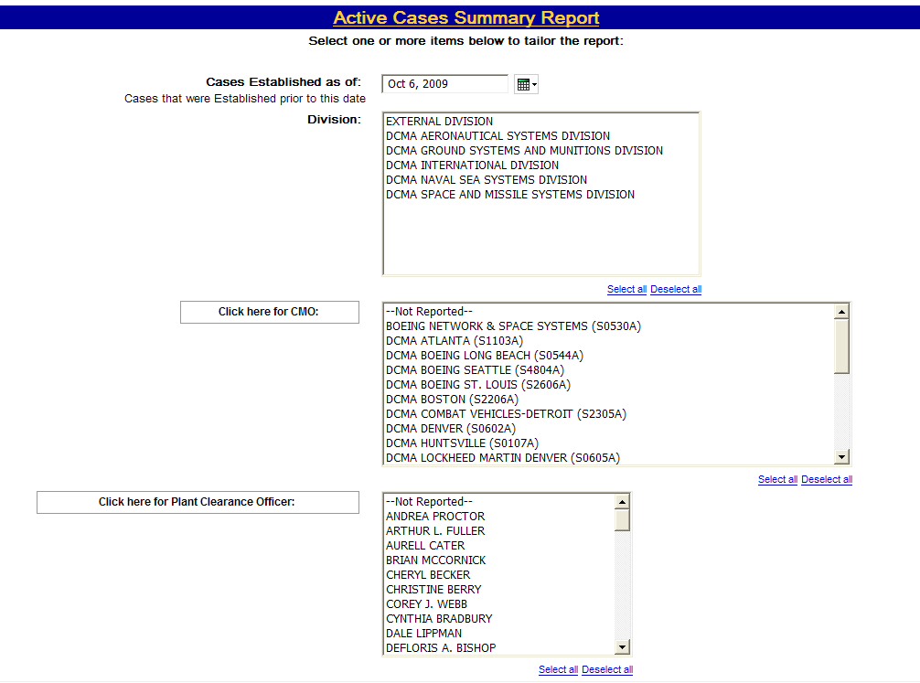
Topic Two – Active Cases Summary Report
Selecting Filters
The filter selection page (Graphic 1.2.1) displays the following selection criteria:
Cases Established as of
Division
CMO (click button to repopulate)
Plant Clearance Officer (click button to repopulate)
(continued on next page)
Graphic 1.2.1: Active Cases Summary Report Filter Selection Page
26
Notes:
26

Slide 27
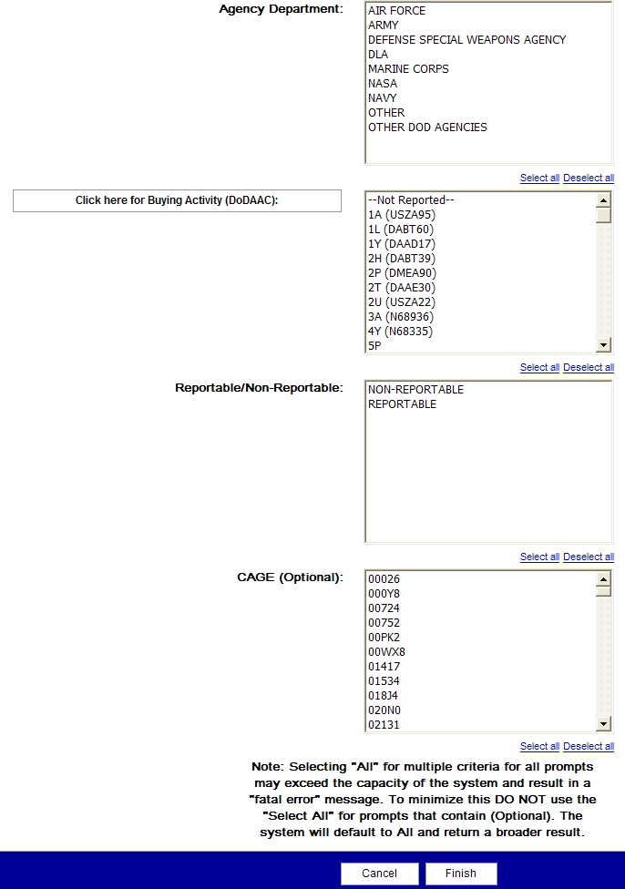
Topic Two – Active Cases Summary Report
Selecting Filters
The filter selection page (Graphic 1.2.2) displays the following selection criteria:
Agency Department
Buying Activity (DoDAAC) (click button to repopulate)
Reportable/Non-Reportable
CAGE (Optional)
Graphic 1.2.2: Active Cases Summary Report Filter Selection Page
27
Notes:
27

Slide 28
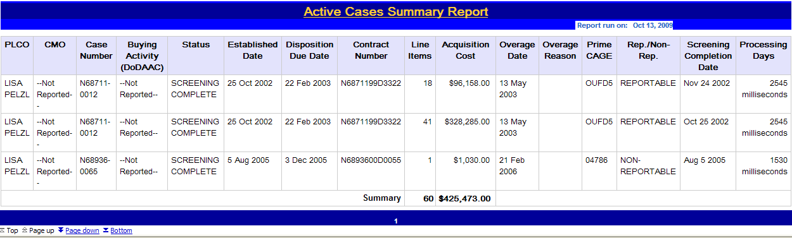
Topic Two – Active Cases Summary Report
HTML Report
The results you have filtered through are displayed in the HTML format (Graphic 1.2.3).
Graphic 1.2.3: Active Cases Summary Report, HTML Format
28
Notes:
28

Slide 29
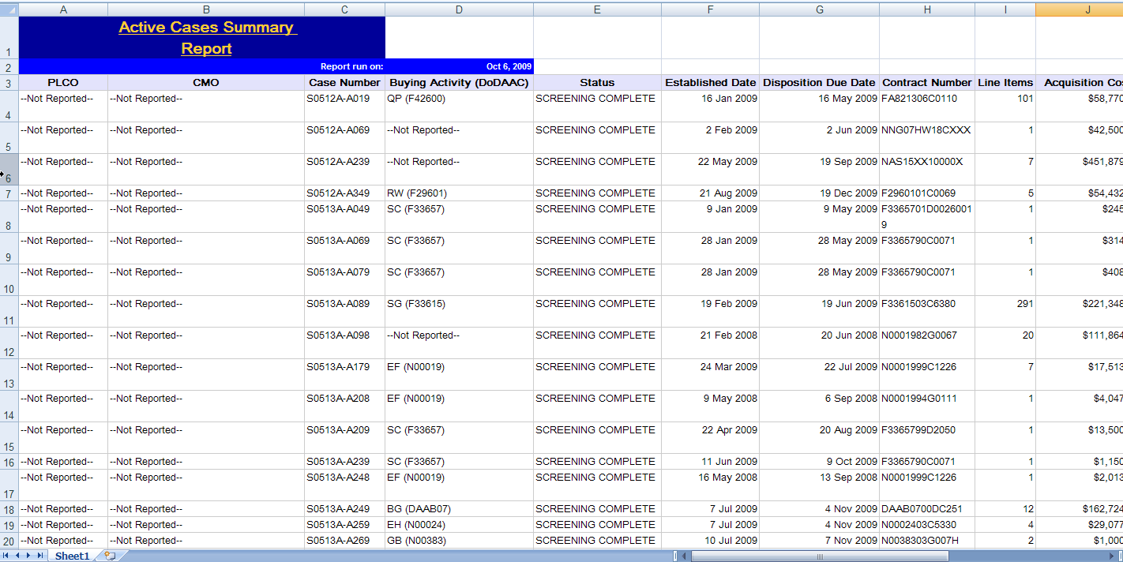
Topic Two – Active Cases Summary Report
Excel Report
The results you have filtered through are displayed in the Excel format (Graphic 1.2.4).
Graphic 1.2.4: Active Cases Summary Report, Excel Format
29
Notes:
29

Slide 30
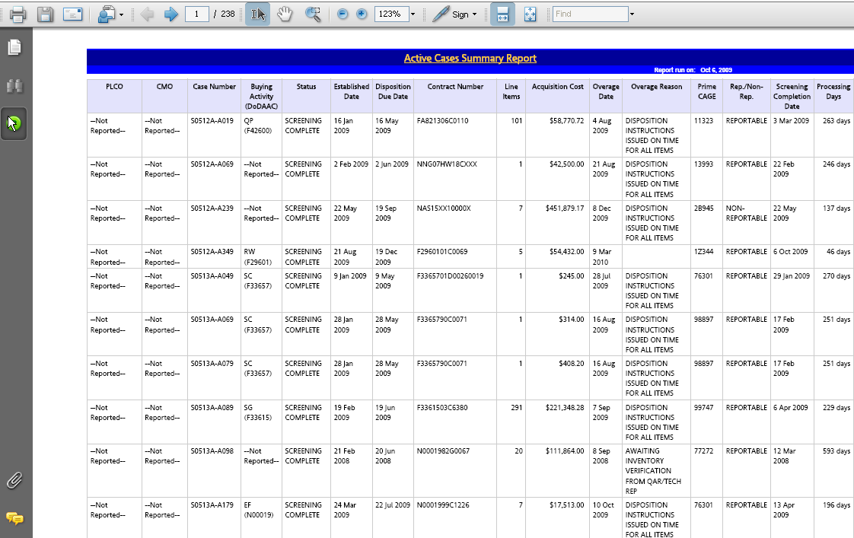
Topic Two – Active Cases Summary Report
Adobe Acrobat PDF Report
The web page displays the report in Adobe Acrobat (Graphic 1.2.5). To save the file, click the Save button in the Acrobat toolbar.
Graphic 1.2.5: Active Cases Summary Report, Adobe Acrobat PDF
30
Notes:
30

Slide 31
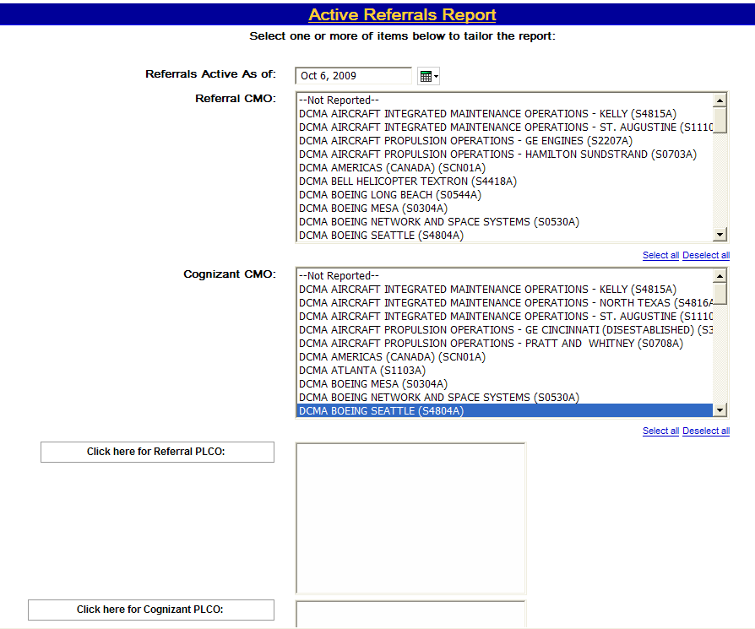
Topic Three – Active Referrals Report
Selecting Filters
The filter selection page (Graphic 1.2.6) displays the following selection criteria:
Referrals Active As of
Referral CMO
Cognizant CMO
Referral PLCO (click button to repopulate)
Cognizant PLCO (click button to repopulate)
(continued on next page)
Graphic 1.2.6: Active Referrals Report Filter Selection Page
31
Notes:
31

Slide 32
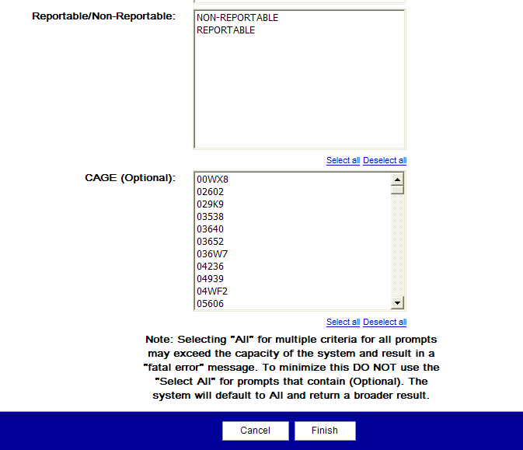
Topic Three – Active Referrals Report
Selecting Filters
The filter selection page (Graphic 1.2.7) displays the following selection criteria:
Reportable/Non-Reportable
CAGE (Optional)
Graphic 1.2.7: Active Referrals Report Filter Selection Page
32
Notes:
32

Slide 33
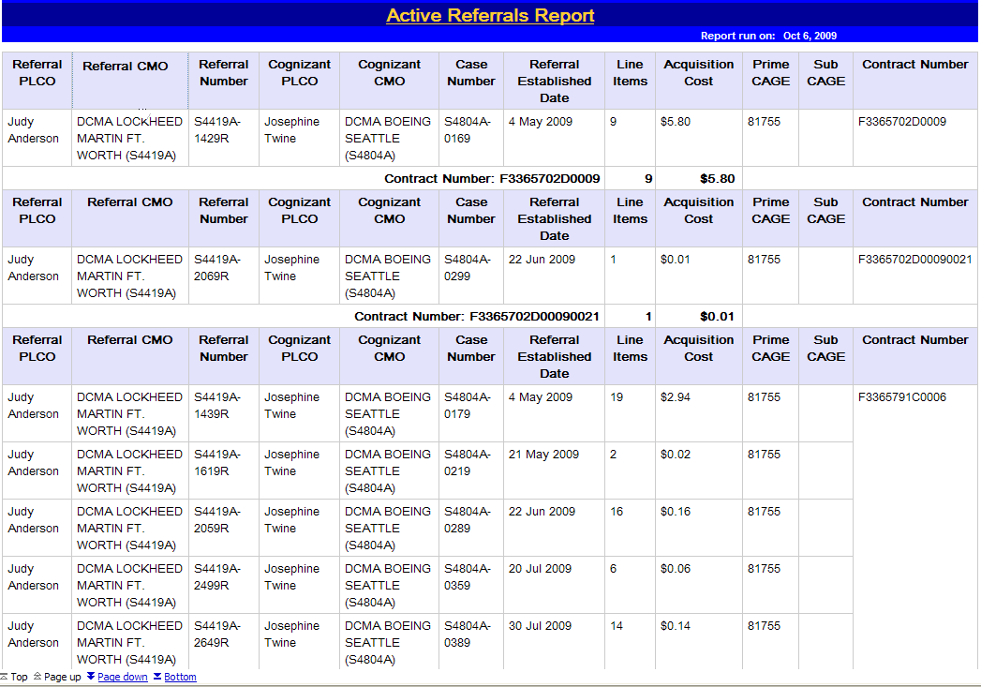
Topic Three – Active Referrals Report
HTML Report
The results you have filtered through are displayed in the HTML format(Graphic 1.2.8). Columns displayed in the report results are:
Referral PLCO
Referral CMO
Referral Number
Cognizant PLCO
Cognizant CMO
Case Number
Referral Established Date
Line Items
Acquisition Cost
Prime CAGE
Sub CAGE
Contract Number
Graphic 1.2.8: Active Referrals Report, HTML Format
33
Notes:
33

Slide 34
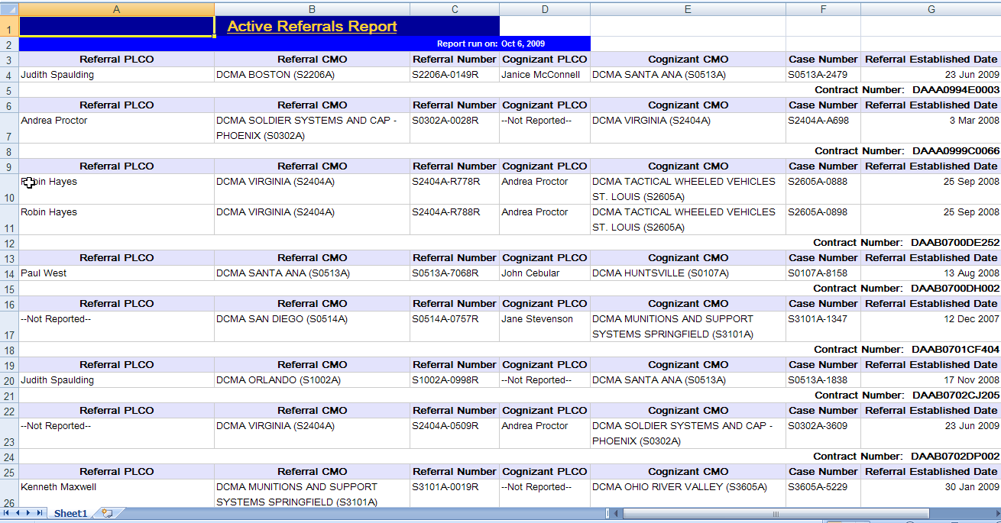
Topic Three – Active Referrals Report
Excel Report
The results you have filtered through are displayed in the Excel format (Graphic 1.2.9).
Graphic 1.2.9: Active Referrals Report, Excel Format
34
Notes:
34

Slide 35
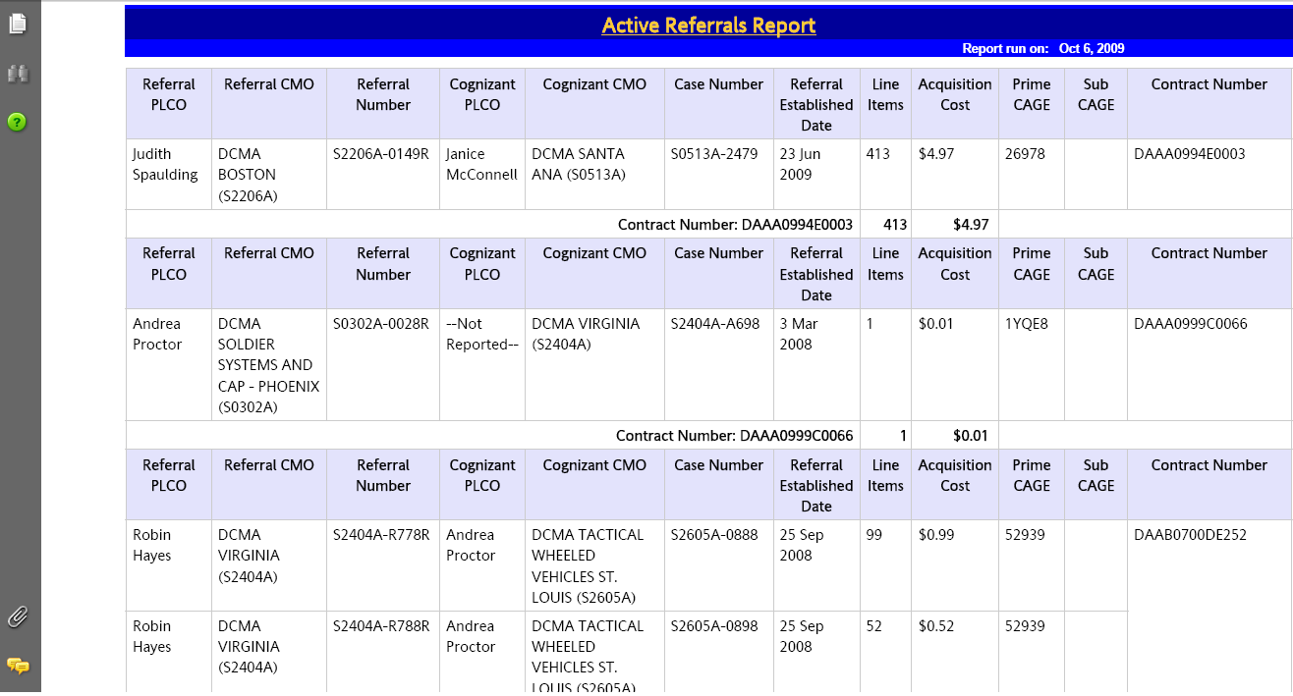
Topic Three – Active Referrals Report
Adobe Acrobat PDF Report
The web page displays the report in Adobe Acrobat (Graphic 1.2.10). To save the file, click the Save button in the Acrobat toolbar.
Graphic 1.2.10: Active Referrals Report, Adobe Acrobat PDF
35
Notes:
35

Slide 36
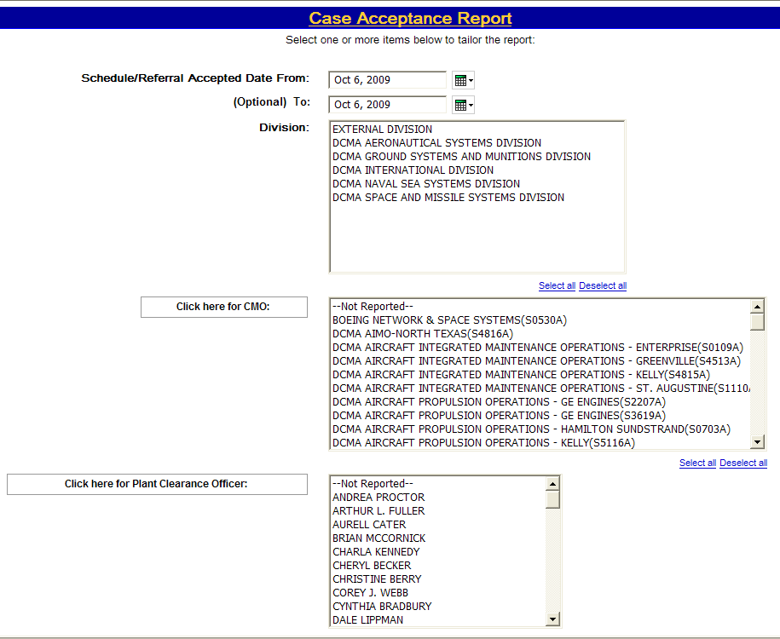
Topic Four – Case Acceptance Report
Selecting Filters
The filter selection page (Graphic 1.2.11) displays the following selection criteria:
Scheduled/Referral Acceptance
Date From and To
Division
CMO (click button to repopulate)
Plant Clearance Officer (click button to repopulate)
(continued on next page)
Graphic 1.2.11: Case Acceptance Report Filter Selection Page
36
Notes:
36

Slide 37
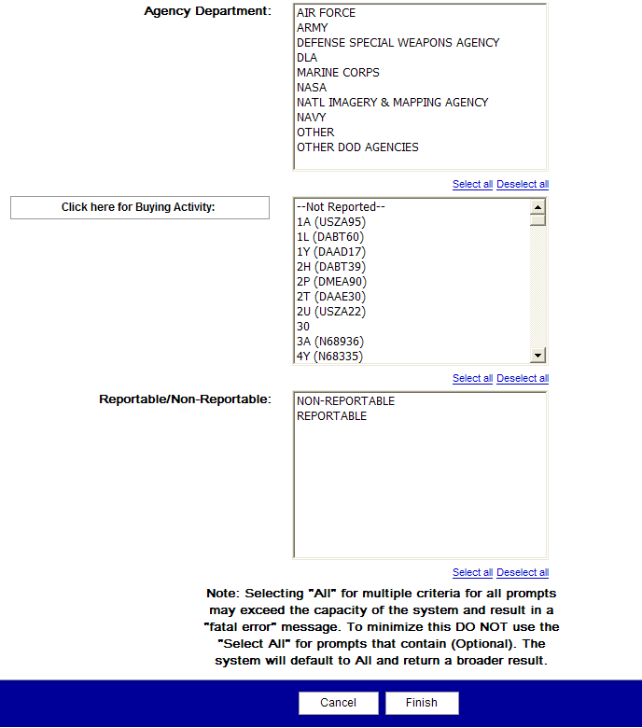
Topic Four – Case Acceptance Report
Selecting Filters
The filter selection page (Graphic 1.2.12) displays the following selection criteria:
Agency Department
Buying Activity (Click button to repopulate)
Reportable/Non-Reportable
Graphic 1.2.12: Case Acceptance Report Filter Selection Page
37
Notes:
37

Slide 38
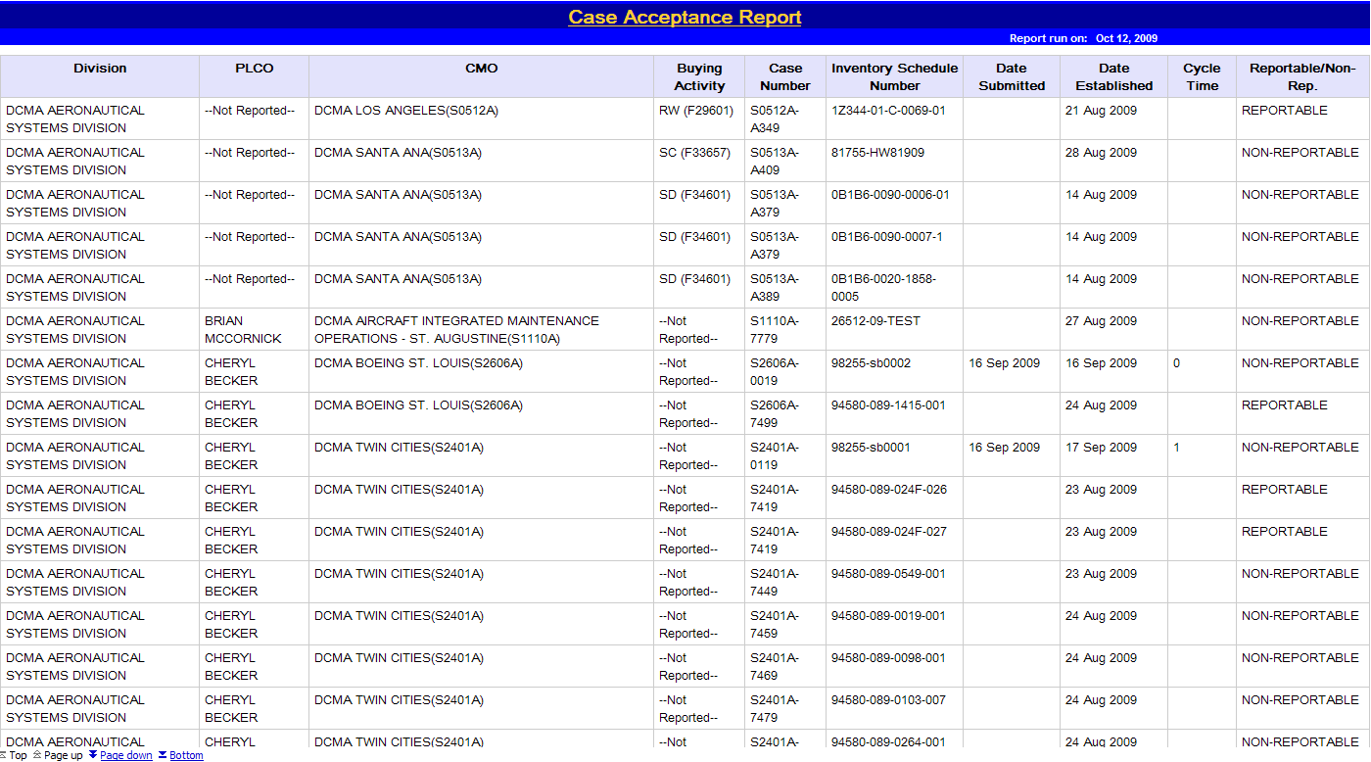
Topic Four – Case Acceptance Report
HTML Report
The results you have filtered through are displayed in HTML format (Graphic 1.2.13). Columns displayed in the report results are:
Division
PLCO
CMO
Buying Activity
Case Number
Inventory Schedule Number
Date Submitted
Date Established
Cycle Time
Reportable/Non-Rep.
Graphic 1.2.13: Case Acceptance HTML Report
38
Notes:
38

Slide 39
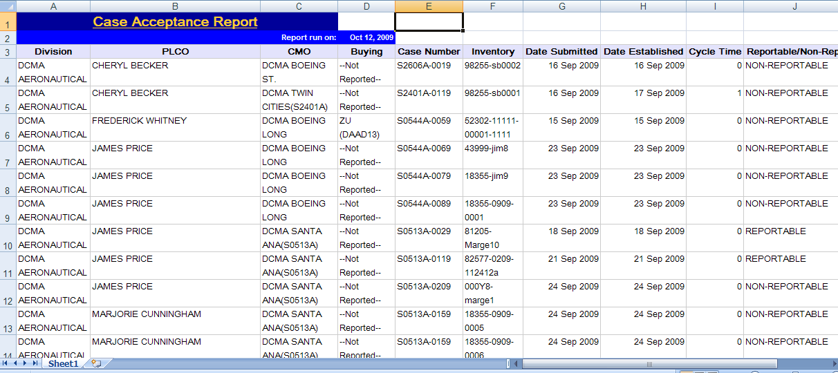
Topic Four – Case Acceptance Report
Excel Report
The results you have filtered through are displayed in the Excel format (Graphic 1.2.14).
Graphic 1.2.14: Case Acceptance Report, Excel Format
39
Notes:
39

Slide 40
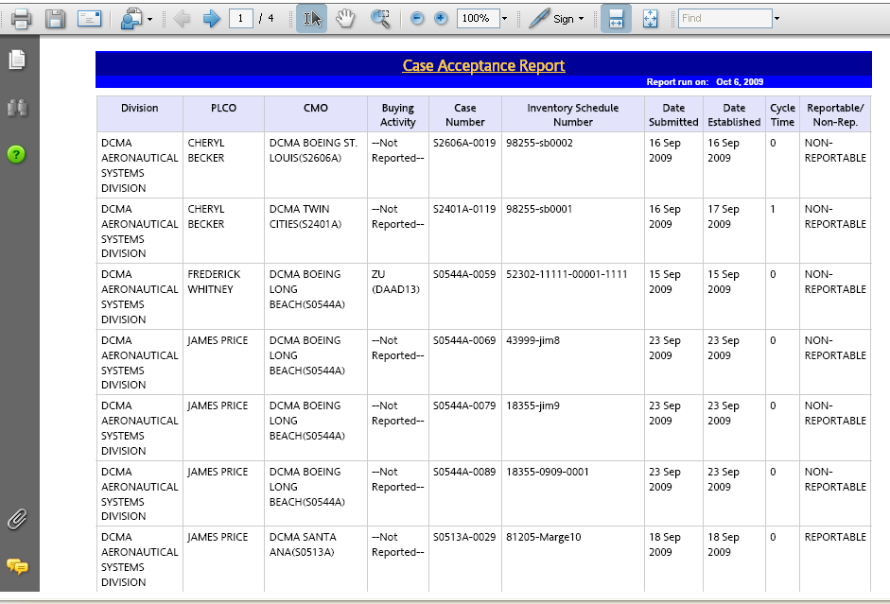
Topic Four – Case Acceptance Report
Adobe Acrobat PDF Report
The web page displays the report in Adobe Acrobat (Graphic 1.2.15). To save the file, click the Save button in the Acrobat toolbar.
Graphic 1.2.15: Case Acceptance Report, Adobe Acrobat PDF
40
Notes:
40

Slide 41
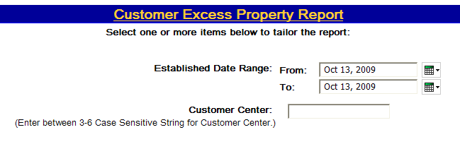
Topic Five – Customer Excess Property Report
Selecting Filters
The filter selection page (Graphic 1.2.16) displays the following selection criteria:
Established Date Range: From
Established Date Range: To
Customer Center
Graphic 1.2.16: Customer Excess Property Report Filter Selection Page
41
Notes:
41

Slide 42
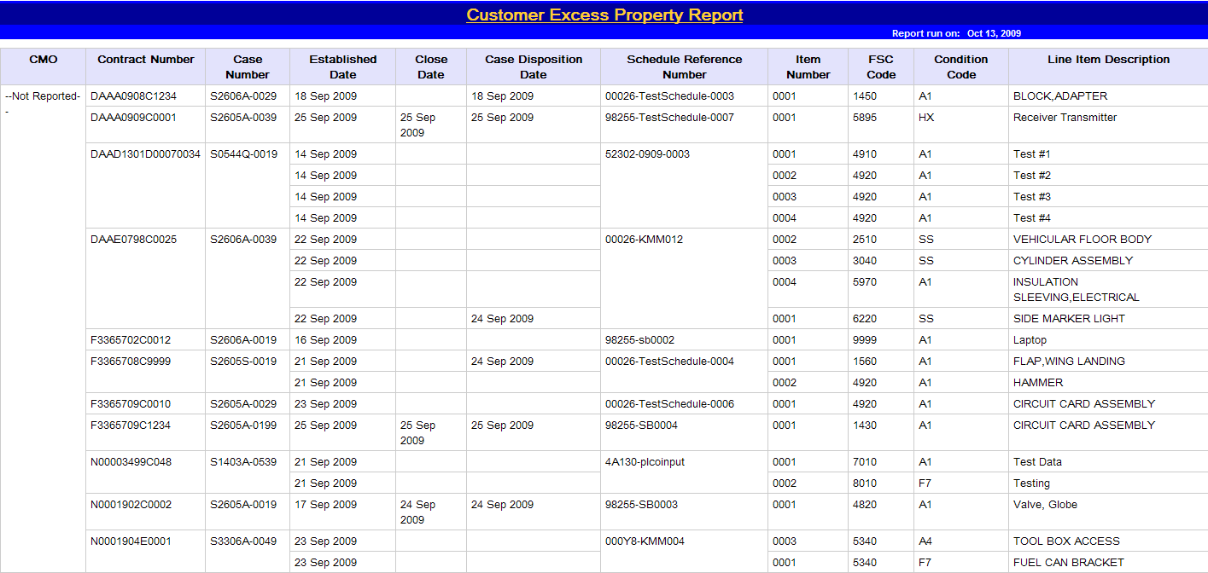
Topic Five – Customer Excess Property Report
HTML Report
The results you have filtered through are displayed in the HTML format (Graphic 1.2.17). Columns displayed in the report results are:
CMO
Contact Number
Case Number
Established Date
Close Date
Case Disposition Date
Schedule Reference
Number
Item Number
FSC Code
Condition Code
Line Item Description
Graphic 1.2.17: Customer Excess Property Report, HTML Format
42
Notes:
42

Slide 43
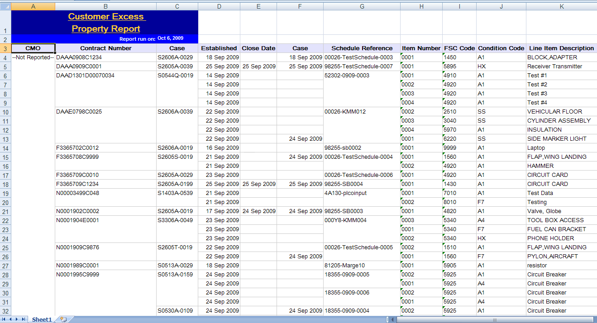
Topic Five – Customer Excess Property Report
Excel Report
The results you have filtered through are displayed in the Excel format (Graphic 1.2.18).
Graphic 1.2.18 Customer Excess Property Report, Excel Format
43
Notes:
43

Slide 44
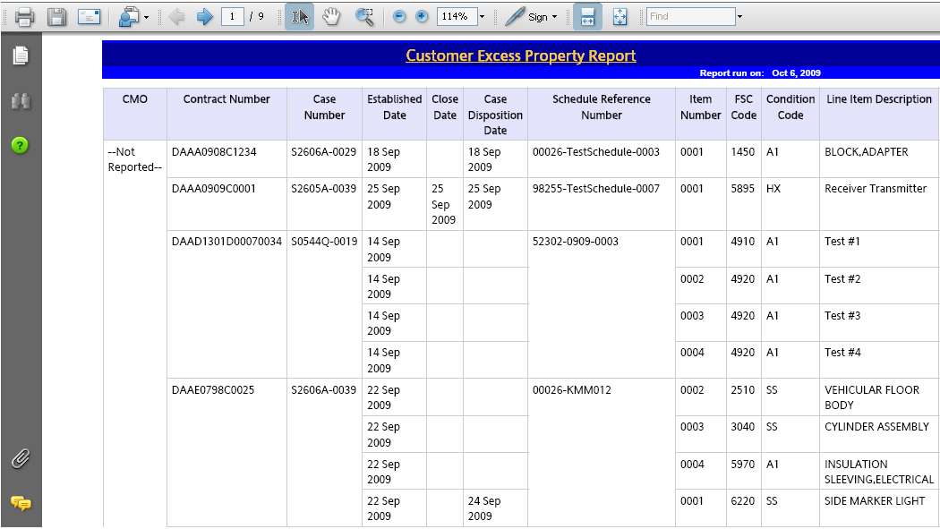
Topic Five – Customer Excess Property Report
Adobe Acrobat PDF Report
The web page displays the report in Adobe Acrobat (Graphic 1.2.19). To save the file, click the Save button in the Acrobat toolbar.
Graphic 1.2.19: Customer Excess Property Report, Adobe Acrobat PDF
44
Notes:
44

Slide 45
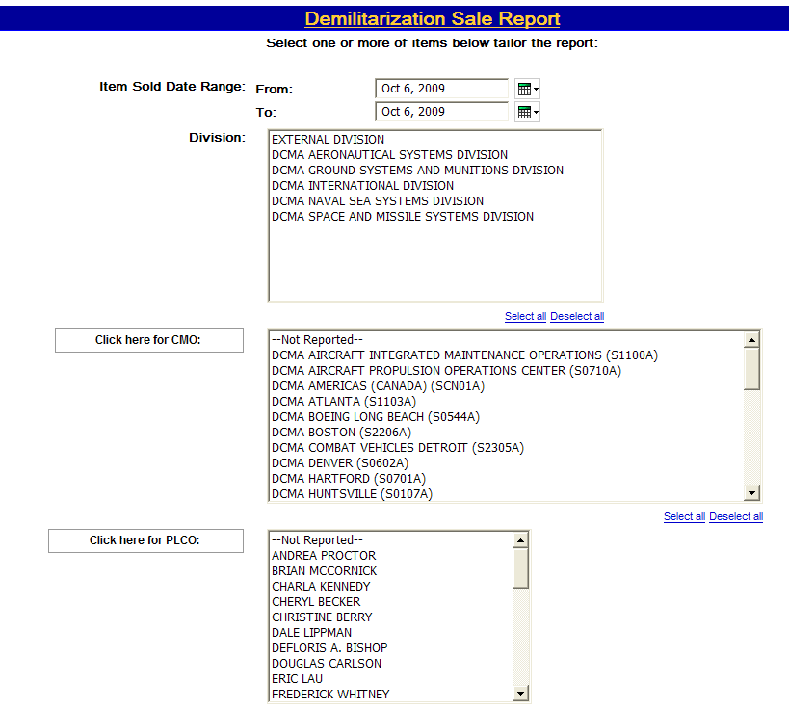
Topic Six – Demilitarization Sale Report
Selecting Filters:
The filter selection page (Graphic 1.2.20) displays the following selection criteria:
Item Sold Date Range From and To
Division
CMO (click button to repopulate)
PLCO (click button to repopulate)
(continued on next page)
Graphic 1.2.20: Demilitarization Sale Report Filter Selection Page
45
Notes:
45

Slide 46
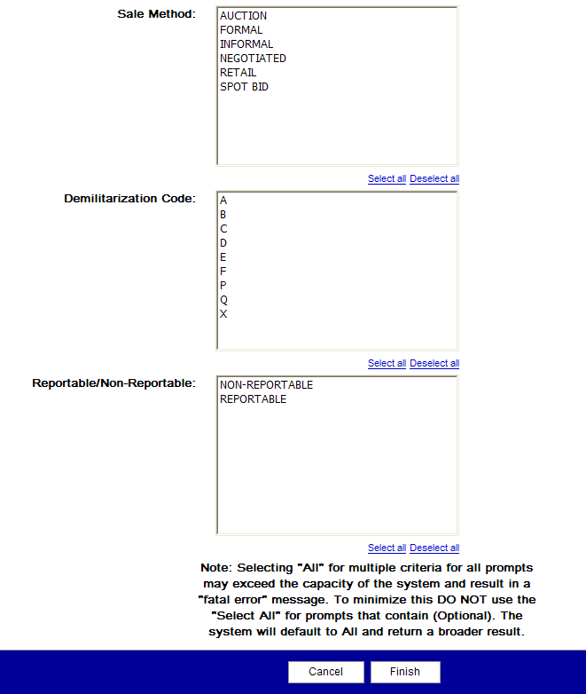
Topic Six – Demilitarization Sale Report
Selecting Filters:
The filter selection page (Graphic 1.2.21) displays the following selection criteria:
Sale Method
Demilitarization Code
Reportable/Non-Reportable
Graphic 1.2.21: Demilitarization Sale Report Filter Selection Page
46
Notes:
46

Slide 47
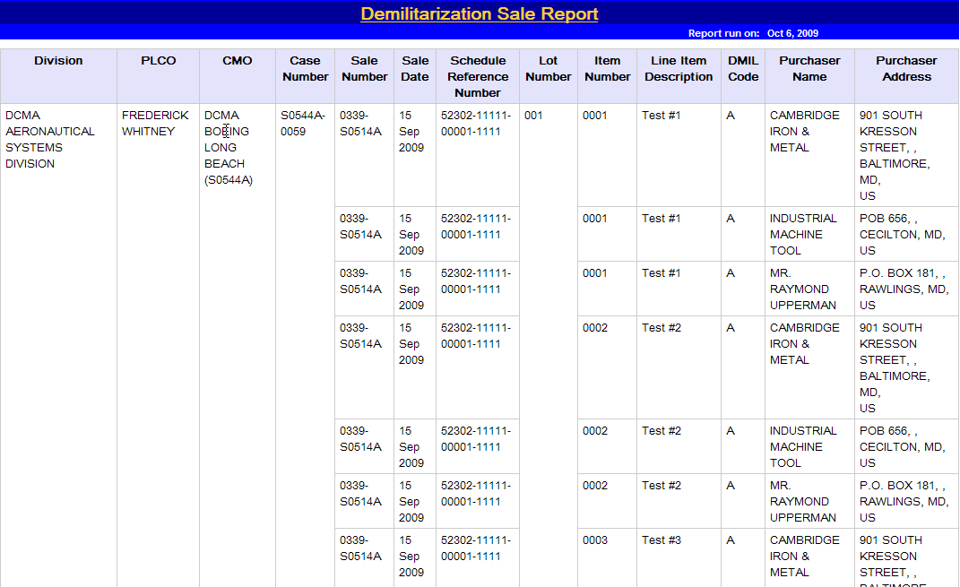
Topic Six – Demilitarization Sale Report
HTML Report
The results you have filtered through are displayed in the HTML format(Graphic 1.2.22). Columns displayed in the report results are:
Division
PLCO
CMO
Case Number
Sale Number
Sale Date
Schedule Reference number
Lot Number
Item Number
Line Item Description
DMIL Code
Purchaser Name
Purchaser Address
Graphic 1.2.22: Demilitarization Sale Report, HTML Format
47
Notes:
47

Slide 48
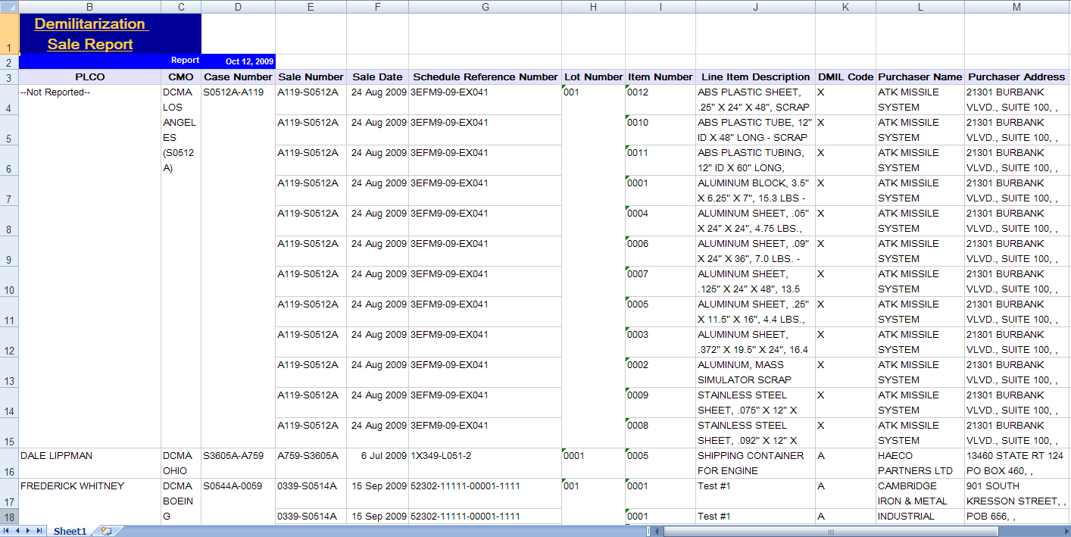
Topic Six – Demilitarization Sale Report
Excel Report
The results you have filtered through are displayed in the Excel format (Graphic 1.2.23).
Graphic 1.2.23: Demilitarization Sale Report, Excel Format
48
Notes:
48

Slide 49
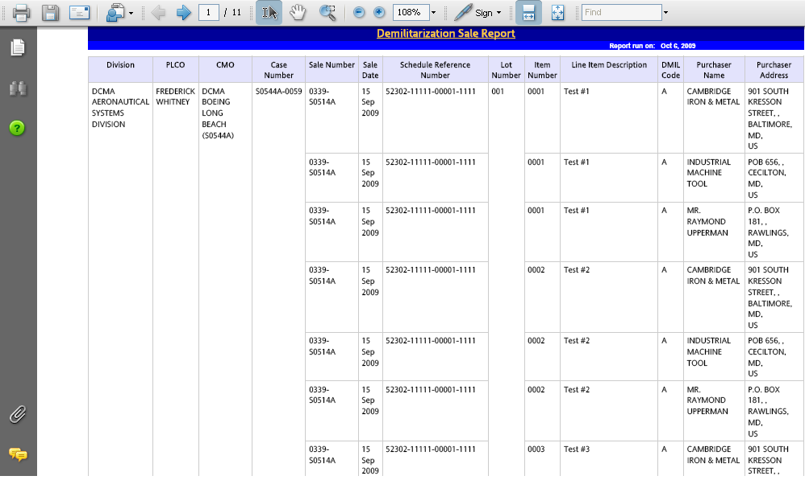
Topic Six – Demilitarization Sale Report
Adobe Acrobat PDF Report
The web page displays the report in Adobe Acrobat (Graphic 1.2.24). To save the file, click the Save button in the Acrobat toolbar.
Graphic 1.2.24: Demilitarization Sale Report, Adobe Acrobat PDF
49
Notes:
49

Slide 50
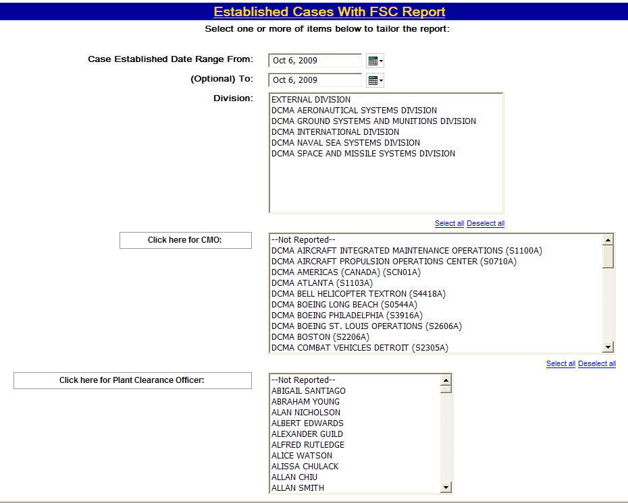
Topic Seven – Established Cases With FSC Report
Selecting Filters
The filter selection page (Graphic 1.2.25) displays the following selection criteria:
Case Established Date Range From and To
Division
CMO (click button to repopulate)
Plant Clearance Officer (click button to repopulate)
(continued on next page)
Graphic 1.2.25: Established Cases With FSC Report Filter Selection Page
50
Notes:
50

Slide 51
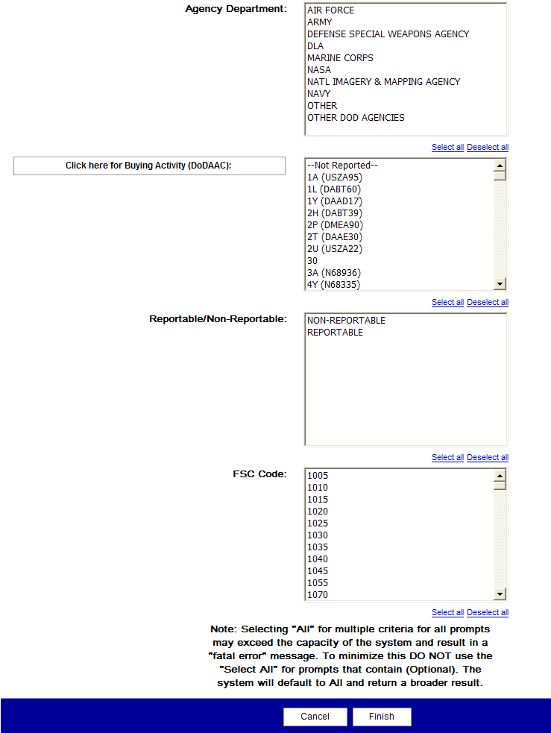
Topic Seven – Established Cases With FSC Report
Selecting Filters
The filter selection page (Graphic 1.2.26) displays the following selection criteria:
Agency Department
Buying Activity (DoDAAC) (click button to repopulate)
Reportable/Non-Reportable
FSC Code
Graphic 1.2.26: Established Cases With FSC Report Filter Selection Page
51
Notes:
51

Slide 52
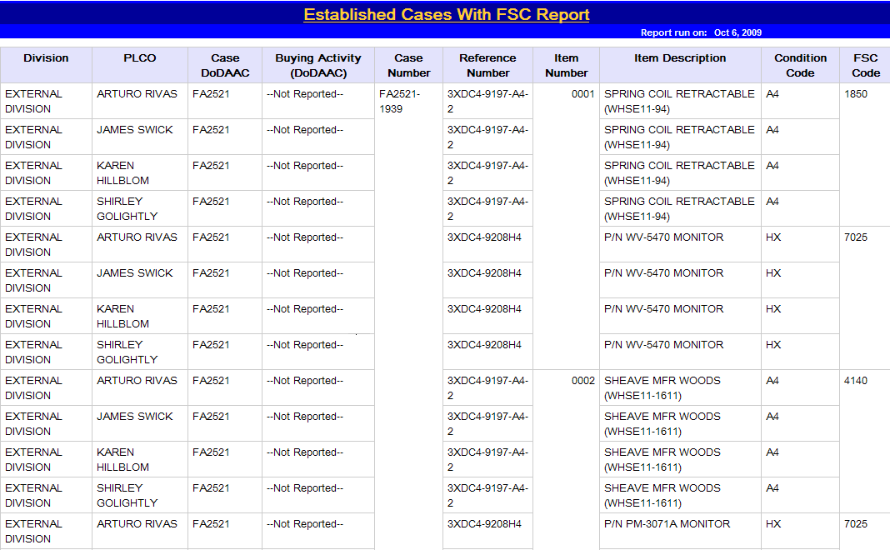
Topic Seven – Established Cases With FSC Report
HTML Report
Report results are displayed in HTML format (Graphic 1.2.27). Columns displayed in the report results are:
Division
PLCO
Case DoDAAC
Buying Activity (DoDAAC)
Case Number
Reference Number
Item Number
Item Description
Condition Code
FSC Code
Graphic 1.2.27: Established Cases With FSC Report, HTML Format
52
Notes:
52

Slide 53
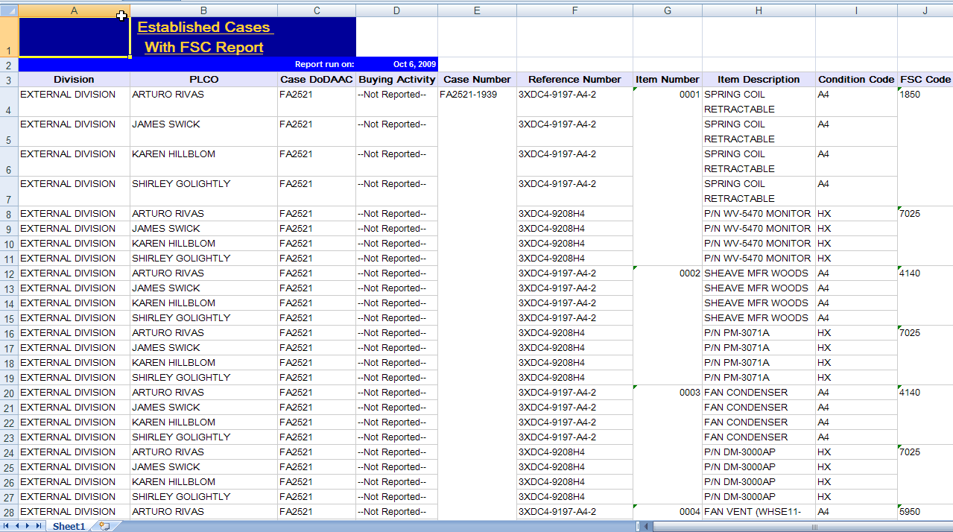
Topic Seven – Established Cases With FSC Report
Excel Report
The results you have filtered through are displayed in the Excel format (Graphic 1.2.28).
Graphic 1.2.28: Established Cases With FSC Report, Excel Format
53
Notes:
53

Slide 54
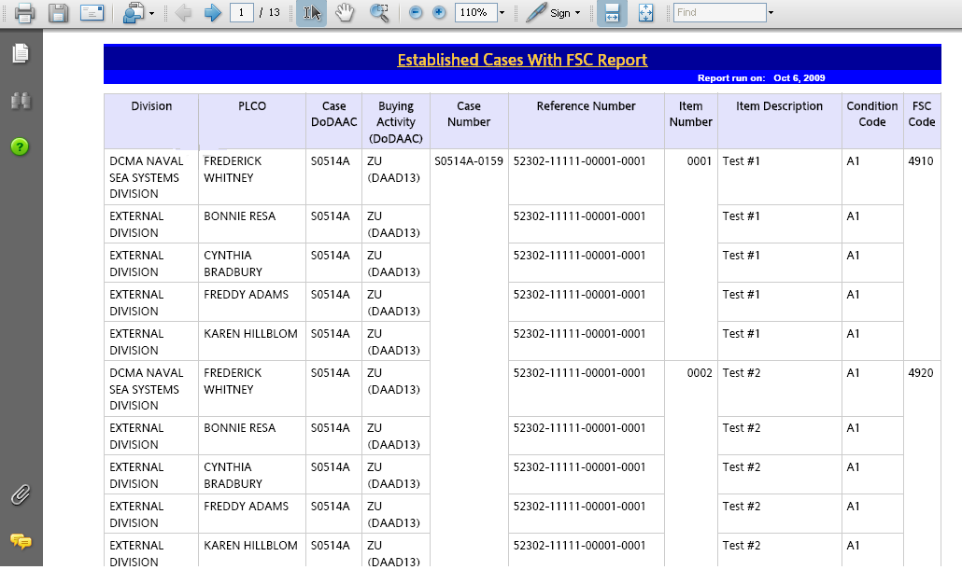
Topic Seven – Established Cases With FSC Report
Adobe Acrobat PDF Report
The web page displays the report in Adobe Acrobat (Graphic 1.2.29). To save the file, click the Save button in the Acrobat toolbar.
Graphic 1.2.29: Established Cases With FSC Report, Adobe Acrobat PDF
54
Notes:
54

Slide 55
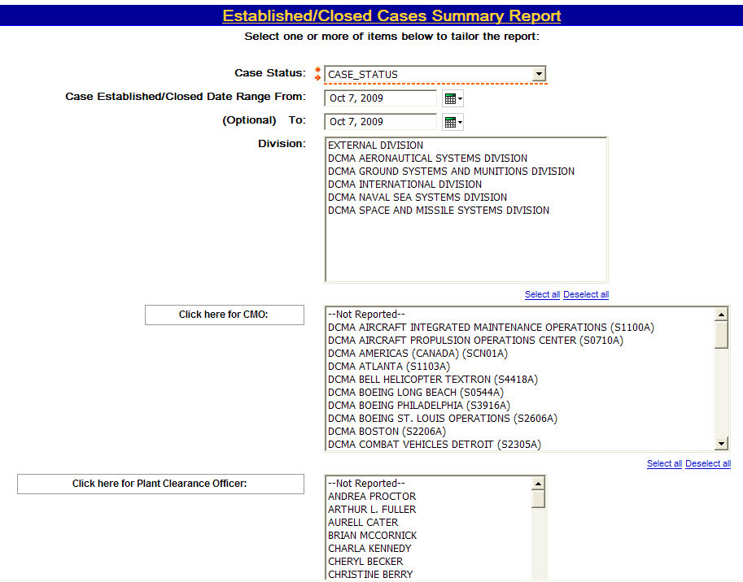
Topic Eight – Established/Closed Cases Summary Report
Selecting Filters
The filter selection page (Graphic 1.2.30) displays the following selection criteria:
Case Status (required)
Case Established/Closed Date Range From and To
Division
CMO (click button to repopulate)
Plant Clearance Officer (click button to repopulate)
(continued on next page)
Graphic 1.2.30: Established/Closed Summary Cases Report Filter Selection Page
55
Notes:
55

Slide 56
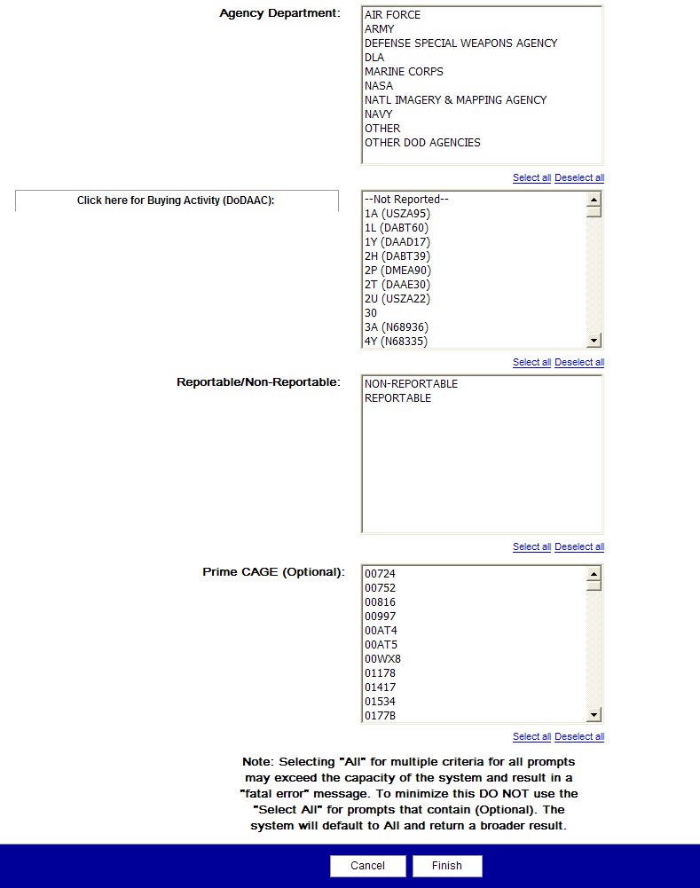
Topic Eight – Established/Closed Cases Summary Report
Selecting Filters
The filter selection page (Graphic 1.2.31) displays the following selection criteria:
Agency Department
Buying Activity (DoDAAC) (click button to repopulate)
Reportable/Non-Reportable
Prime CAGE (Optional)
Graphic 1.2.31: Established/Closed Cases Summary Report Filter Selection Page
56
Notes:
56

Slide 57
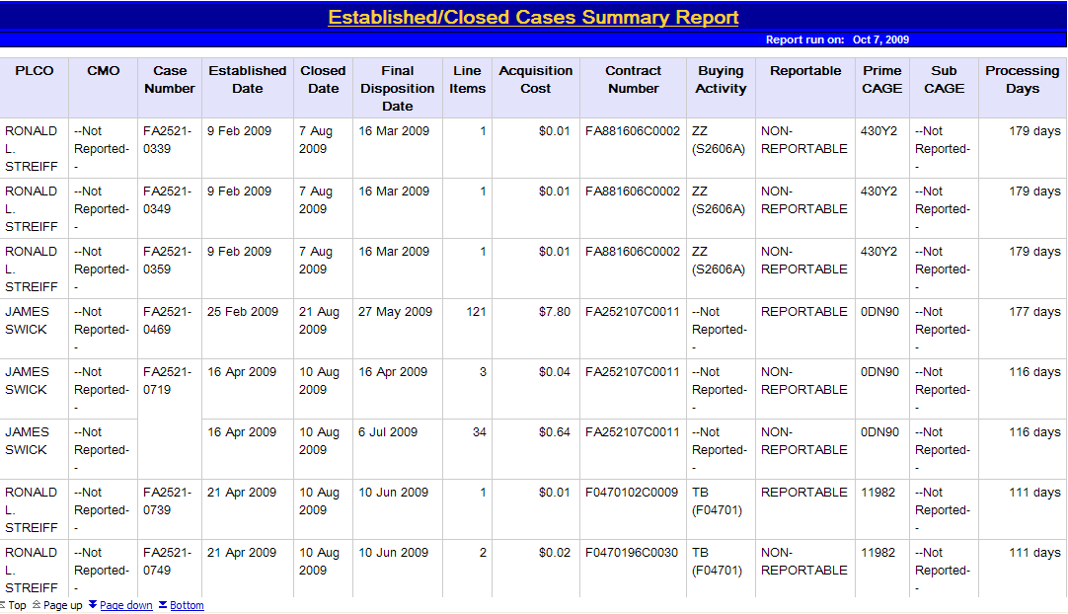
Topic Eight – Established/Closed Cases Summary Report
HTML Report
The results you have filtered through are displayed in the HTML format (Graphic 1.2.32). Columns displayed in the report results are:
PLCO
CMO
Case Number
Established Date
Closed Date
Final Disposition Date
Line Items
Acquisition Cost
Contract Number
Buying Activity
Reportable
Prime CAGE
Sub CAGE
Processing Days
Graphic 1.2.32: Established/Closed Cases Summary Report, HTML Format
57
Notes:
57

Slide 58
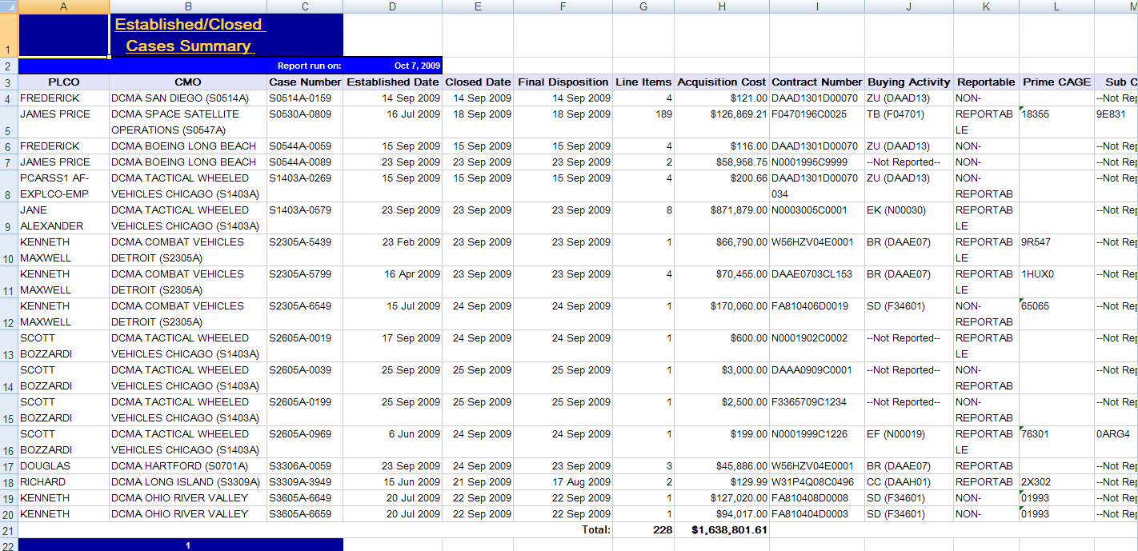
Topic Eight – Established/Closed Cases Summary Report
Excel Report
The results you have filtered through are displayed in the Excel format (Graphic 1.2.33).
Graphic 1.2.33: Established/Closed Cases Summary Report, Excel Format
58
Notes:
58

Slide 59
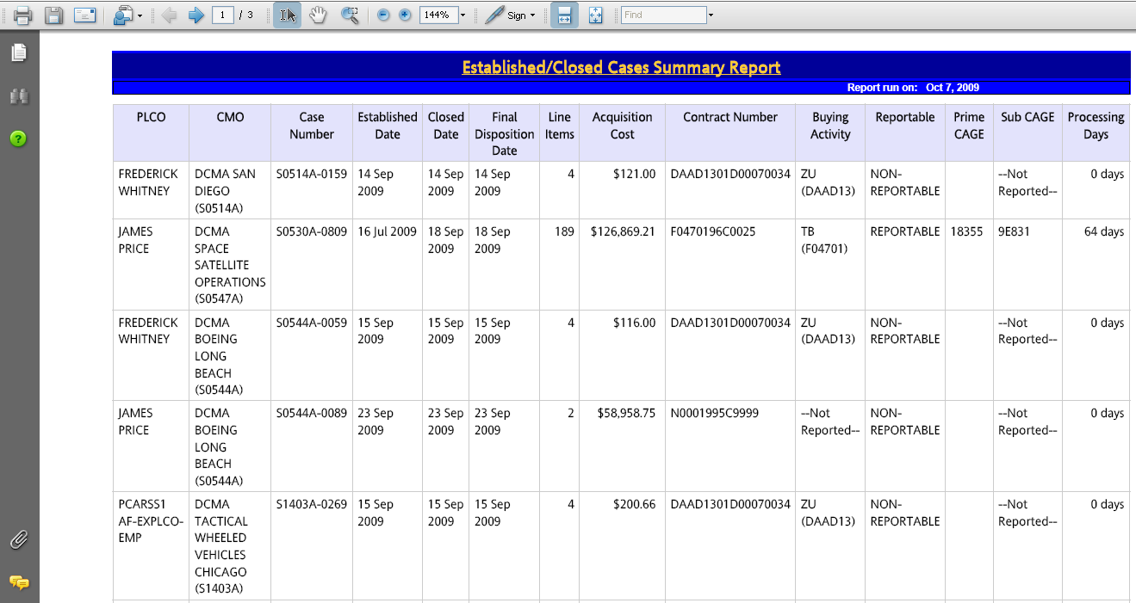
Topic Eight – Established/Closed Cases Summary Report
Adobe Acrobat PDF Report
The web page displays the report in Adobe Acrobat (Graphic 1.2.34). To save the file, click the Save button in the Acrobat toolbar.
Graphic 1.2.34: Established/Closed Cases Summary Report, Adobe Acrobat PDF
59
Notes:
59

Slide 60
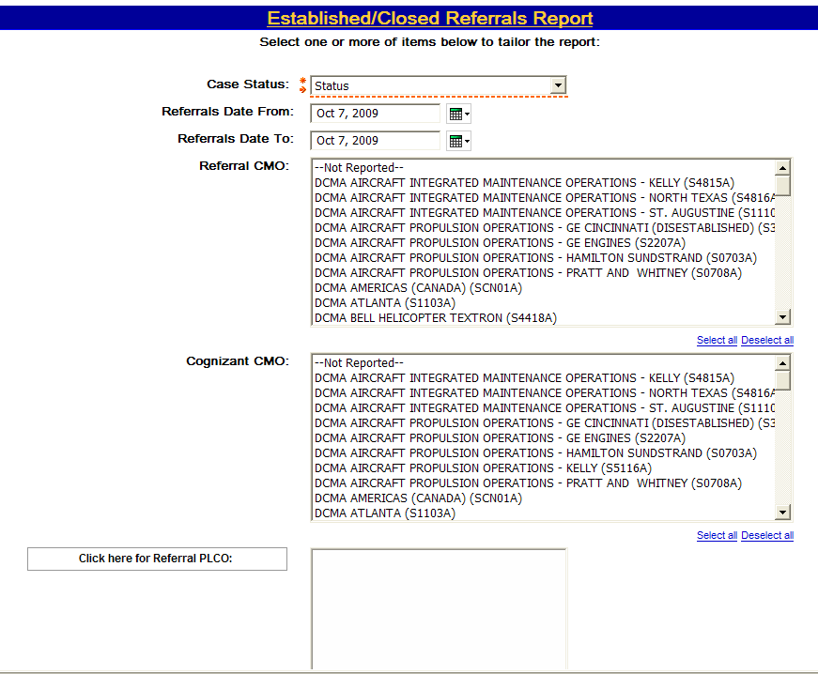
Topic Nine – Established/Closed Referrals Report
Selecting Filters
The filter selection page (Graphic 1.2.35) displays the following selection criteria:
Case Status (required)
Referrals Date Range From and To
Referral CMO
Cognizant CMO
Referral PLCO (click button to repopulate)
(continued on next page)
Graphic 1.2.35: Established/Closed Referrals Report Filter Selection Page
60
Notes:
60

Slide 61
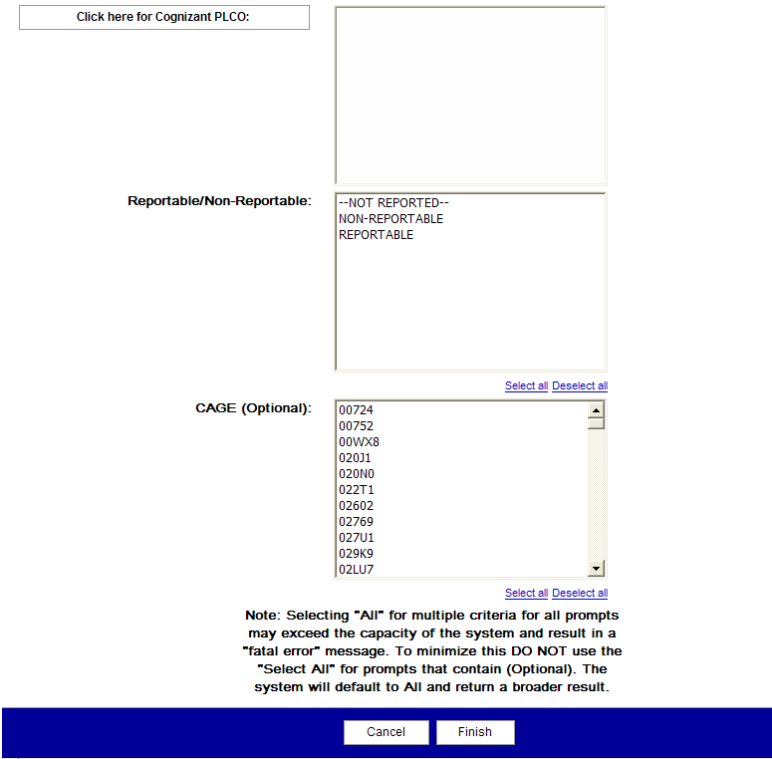
Topic Nine – Established/Closed Referrals Report
Selecting Filters
The filter selection page (Graphic 1.2.36) displays the following selection criteria:
Agency Department
Buying Activity (DoDAAC) (click button to repopulate)
Reportable/Non-Reportable
Prime CAGE (Optional)
Graphic 1.2.36: Established/Closed Referrals Report Filter Selection Page
61
Notes:
61

Slide 62
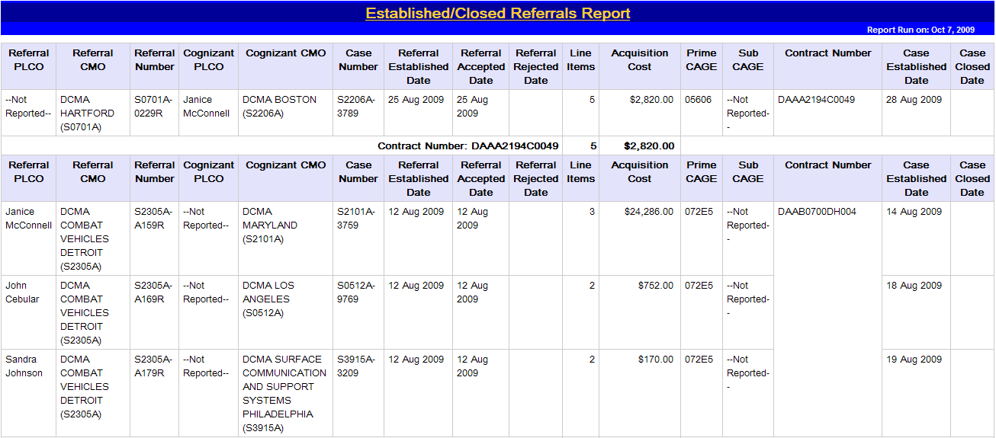
Topic Nine – Established/Closed Referrals Report
HTML Report
The results you have filtered through are displayed in the HTML format(Graphic 1.2.37). Columns displayed in the report results are:
Referral PLCO
Referral CMO
Referral Number
Cognizant PLCO
Cognizant CMO
Case Number
Referral Established Date
Referral Accepted Date
Referral Rejected Date
Line Items
Acquisition Cost
Prime Case
Sub CAGE
Contract Number
Case Established Date
Case Closed Date
Graphic 1.2.37: Established/Closed Referral Report, HTML Format
62
Notes:
62

Slide 63
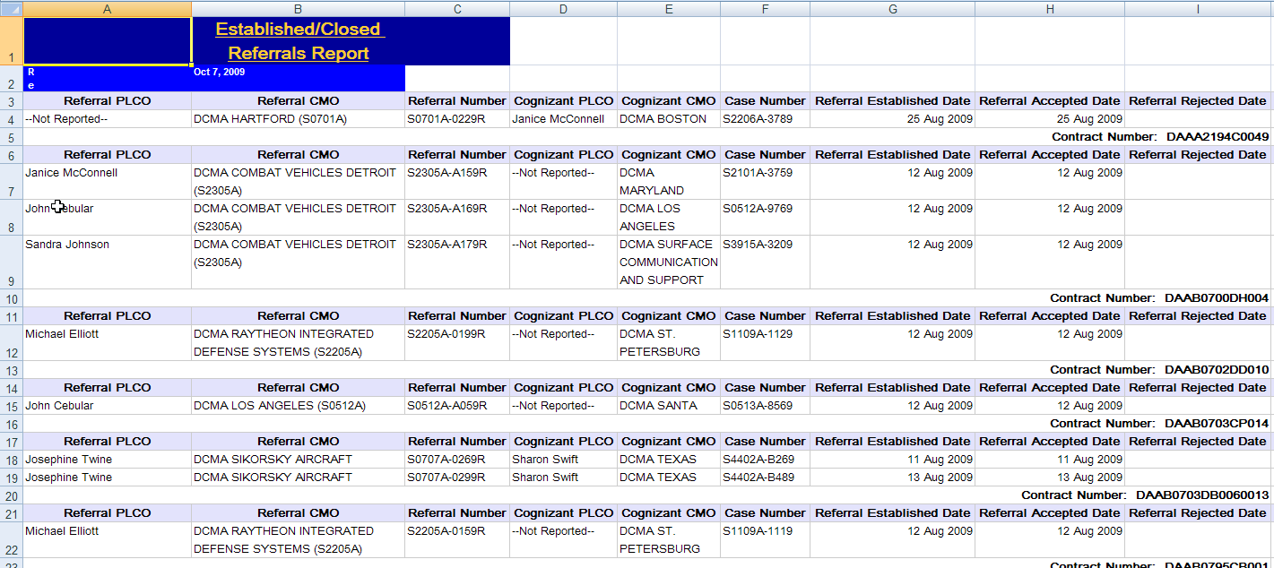
Topic Nine – Established/Closed Referrals Report
Excel Report
The results you have filtered through are displayed in the Excel format (Graphic 1.2.38).
Graphic 1.2.38 Established/Closed Referral Report, Excel Format
63
Notes:
63

Slide 64
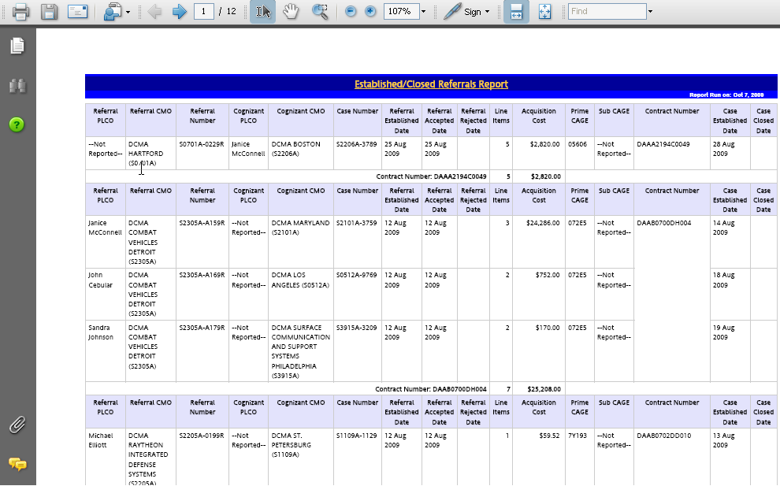
Topic Nine – Established/Closed Referrals Report
Adobe Acrobat PDF Report
The web page displays the report in Adobe Acrobat (Graphic 1.2.39). To save the file, click the Save button in the Acrobat toolbar.
Graphic 1.2.39: Established/Closed Referrals Report, Adobe Acrobat PDF
64
Notes:
64

Slide 65

Topic Ten – Opened/Completed Sale Report
Selecting Filters
The filter selection page (Graphic 1.2.40) displays the following selection criteria:
Case Status (required)
Sale Opened/Closed Date Range From and To
Division
CMO (click button to repopulate)
PLCO (click button to repopulate)
Agency Department
(continued on next page)
Graphic 1.2.40: Opened/Completed Sale Report Filter Selection Page
65
Notes:
65

Slide 66

Topic Ten – Opened/Completed Sale Report
Selecting Filters
The filter selection page (Graphic 1.2.41) displays the following selection criteria:
Buying Activity
Sale Method
Sale Type
Reportable/Non-Reportable
Graphic 1.2.41: Opened/Completed Sale Report Filter Selection Page
66
Notes:
66

Slide 67

Topic Ten – Opened/Completed Sale Report
HTML Report
The results you have filtered through are displayed in the HTML format (Graphic 1.2.42). Columns displayed in the report results are:
PLCO
CMO
Sale Number
Case Number
Sale Date
Contract Number
Sale Method
Sale Type
Line Items
Acquisition Cost
Graphic 1.2.42: Opened/Completed Sale Report, HTML Format
67
Notes:
67

Slide 68

Topic Ten – Opened/Completed Sale Report
Excel Report
The results you have filtered through are displayed in the Excel format(Graphic 1.2.43).
Graphic 1.2.43: Opened/Completed Sale Report, Excel Format
68
Notes:
68

Slide 69

Topic Ten – Opened/Completed Sale Report
Adobe Acrobat PDF Report
The web page displays the report in Adobe Acrobat (Graphic 1.2.44). To save the file, click the Save button in the Acrobat toolbar.
Graphic 1.2.44: Opened/Completed Sale Report, Adobe Acrobat PDF
69
Notes:
69

Slide 70

Topic Eleven – Overage Cases Report
Selecting Filters
The filter selection page (Graphic 1.2.45) displays the following selection criteria:
Cases Overage as of
Division
CMO (click button to repopulate)
PLCO (click button to repopulate)
Agency Department
(continued on next page)
Graphic 1.2.45: Overage Cases Report Filter Selection Page
70
Notes:
70

Slide 71

Topic Eleven – Overage Cases Report
Selecting Filters
The filter selection page (Graphic
1.2.46) displays the following selection criteria:
Buying Activity (click button to repopulate)
Overage Reason
Reportable/Non-Reportable
CAGE (Optional)
Graphic 1.2.46: Overage Cases Report Filter Selection Page
71
Notes:
71

Slide 72

Topic Eleven – Overage Cases Report
HTML Report
The results you have filtered through are displayed in the HTML format (Graphic 1.2.47). Columns displayed in the report results are:
Division
PLCO
CMO
Case Number
Established Date
Overage Date
Overage Code
CAGE
Contract Name
Contract Number
Graphic 1.2.47: Overage Cases Report, HTML Format
72
Notes:
72

Slide 73

Topic Eleven – Overage Cases Report
Excel Report
The results you have filtered through are displayed in the Excel format (Graphic 1.2.48).
Graphic 1.2.48: Overage Cases Report, Excel Format
73
Notes:
73

Slide 74

Topic Eleven – Overage Cases Report
Adobe Acrobat PDF Report
The web page displays the report in Adobe Acrobat (Graphic 1.2.49). To save the file, click the Save button in the Acrobat toolbar.
Graphic 1.2.49: Overage Cases Report, Adobe Acrobat PDF
74
Notes:
74

Slide 75

Topic Twelve – PCARSS Informal MIR Report
Selecting Filters
The filter selection page (Graphic 1.2.50) displays the following selection criteria:
Date Range (Required)
Division
CMO (click button to repopulate)
PLCO (click button to repopulate)
(continued on next page)
Graphic 1.2.50: PCARSS Informal MIR Report Filter Selection Page
75
Notes:
75

Slide 76

Topic Twelve – PCARSS Informal MIR Report
Selecting Filters
The filter selection page (Graphic 1.2.51) displays the following selection criteria:
Agency Department
Property Class Code
Property Sub-Class Code
(continued on next page)
Graphic 1.2.51:PCARSS Informal MIR Report Filter Selection Page
76
Notes:
76

Slide 77

Topic Twelve – PCARSS Informal MIR Report
Selecting Filters
The filter selection page (Graphic 1.2.52) displays the following selection criteria:
Demilitarization Code
Case Type
CAGE Code
Contract Number
Graphic 1.2.52: PCARSS Informal MIR Report Page
77
Notes:
77

Slide 78

Topic Twelve – PCARSS Informal MIR Report
HTML Report
The results you have filtered through are displayed in the HTML format (Graphic 1.2.53). Columns displayed in the report results are:
Cases
Line Items
Acquisition Cost
Proceeds
Percent Return
Graphic 1.2.53: PCARSS Informal MIR Report, HTML Format
78
Notes:
78

Slide 79

Topic Twelve – PCARSS Informal MIR Report
Excel Report
The results you have filtered through are displayed in the Excel format (Graphic 1.2.54).
Graphic 1.2.54: PCARSS Informal MIR Report, Excel Format
79
Notes:
79

Slide 80

Topic Twelve – PCARSS Informal MIR Report
Adobe Acrobat PDF Report
The web page displays the report in Adobe Acrobat (Graphic 1.2.55). To save the file, click the Save button in the Acrobat toolbar.
Graphic 1.2.55: PCARSS Informal MIR Report, Adobe Acrobat PDF
80
Notes:
80

Slide 81

Topic Thirteen – Screening Complete
Case Report
Selecting Filters
The filter selection page (Graphic 1.2.56) displays the following selection criteria:
Screening Complete As of
Division
CMO (click button to repopulate)
PLCO (click button to repopulate)
(continued on next page)
Graphic 1.2.56: Screening Complete Case Report Filter Selection Page
81
Notes:
81

Slide 82

Topic Thirteen – Screening Complete
Case Report
Selecting Filters
The filter selection page (Graphic 1.2.57) displays the following selection criteria:
Agency Department
Buying Activity (DoDAAC) (click button to repopulate)
Reportable/Non-Reportable
CAGE (Optional)
Graphic 1.2.57: Screening Complete Case Report Filter Selection Page
82
Notes:
82

Slide 83

Topic Thirteen – Screening Complete
Case Report
HTML Report
The results you have filtered through are displayed in the HTML format (Graphic 1.2.58). Columns displayed in the report results are:
PLCO
CMO
Case Number
Buying Activity
Cases Established Date
Screening Completion Date
Disposition Due Date
Contract Number
Line Items
Acquisition Cost
Overage Date
Overage Reason
Prime CAGE
Reportable
Processing Days
Graphic 1.2.58: Screening Complete Case Report, HTML Format
83
Notes:
83

Slide 84

Topic Thirteen – Screening Complete
Case Report
Excel Report
The results you have filtered through are displayed in the Excel format (Graphic 1.2.59).
Graphic 1.2.59: Screening Complete Case Report, Excel Format
84
Notes:
84

Slide 85

Topic Thirteen – Screening Complete
Case Report
Adobe Acrobat PDF Report
The web page displays the report in Adobe Acrobat (Graphic 1.2.60). To save the file, click the Save button in the Acrobat toolbar.
Graphic 1.2.60: Screening Complete Case Report, Adobe Acrobat PDF
85
Notes:
85

Slide 86

Topic Fourteen – Successful Bidders by Commodity Code Report
Selecting Filters
The filter selection page (Graphic 1.2.61) displays the following selection criteria:
Commodity Code (Required)
FSC
Bidder Name
ZIP
In the Bidder Name field, enter a bidder name. In the ZIP field, enter a ZIP code and then click on Insert button. More than one ZIP code can be inserted into the Choices box. Click Remove button to remove unwanted ZIP from Choices box.
(continued on next page)
Graphic 1.2.61: Successful Bidders by Commodity Code Report Filter Selection Page
86
Notes:
86

Slide 87

Topic Fourteen – Successful Bidders by Commodity Code Report
Selecting Filters
The filter selection page (Graphic 1.2.62) displays the following selection criteria:
City
State
In the City and State fields, enter a city and state respectively. Click on Insert button to insert the city and state into the Choices box. More than one city and state can be inserted into the Choices box. Click on Remove button to remove unwanted city and state.
Graphic 1.2.62: Successful Bidders by Commodity Code Report Filter Selection Page
87
Notes:
87

Slide 88

Topic Fourteen – Successful Bidders by Commodity Code Report
HTML Report
The results you have filtered through are displayed in the HTML format (Graphic 1.2.63). Columns displayed in the report results are:
Name
Address 1
Address 2
City
State
ZIP
E-Mail
Phone
FSC
Commodity Code
Graphic 1.2.63: Successful Bidders by Commodity Code Report, HTML Format
88
Notes:
88

Slide 89

Topic Fourteen – Successful Bidders by Commodity Code Report
Excel Report
The results you have filtered through are displayed in the Excel format (Graphic 1.2.64).
Graphic 1.2.64: Successful Bidders by Commodity Code Report, Excel Format
89
Notes:
89

Slide 90

Topic Fourteen – Successful Bidders by Commodity Code Report
Adobe Acrobat PDF Report
The web page displays the report in Adobe Acrobat (Graphic 1.2.65). To save the file, click the Save button in the Acrobat toolbar.
Graphic 1.2.65: Successful Bidders by Commodity Code Report, Adobe Acrobat PDF
90
Notes:
90

Slide 91

Topic Fifteen – Timely Property Disposition
Detail Report
Selecting Filters
The filter selection page (Graphic 1.2.66) displays the following selection criteria:
Items with Disposal Determined From and To
Division
CMO (click button to repopulate)
PLCO (click button to repopulate)
(continued on next page)
Graphic 1.2.66: Timely Property Disposition Detail Report Filter Selection Page
91
Notes:
91

Slide 92

Topic Fifteen – Timely Property Disposition
Detail Report
Selecting Filters
The filter selection page (Graphic 1.2.67) displays the following selection criteria:
Agency Department
Buying Activity (DoDAAC)
Disposal Code
Reportable/Non-Reportable
Graphic 1.2.67: Timely Property Disposition Detail Report Filter Selection Page
92
Notes:
92

Slide 93

Topic Fifteen – Timely Property Disposition
Detail Report
HTML Report
The results you have filtered through are displayed in the HTML format (Graphic 1.2.68). Columns displayed in the report results are:
Division
PLCO
CMO
Case Number
Established Date
Schedule Reference Number
Item Number
Line Item Description
On-Time
Disposition Code
Disposition Date
Number of Days to Disposition
Graphic 1.2.68: Timely Property Disposition Detail Report, HTML Format
93
Notes:
93

Slide 94

Topic Fifteen – Timely Property Disposition
Detail Report
Excel Report
The results you have filtered through are displayed in the Excel format (Graphic 1.2.69).
Graphic 1.2.69: Timely Property Disposition Detail Report, Excel Format
94
Notes:
94

Slide 95

Topic Fifteen – Timely Property Disposition
Detail Report
Adobe Acrobat PDF Report
The web page displays the report in Adobe Acrobat (Graphic 1.2.70). To save the file, click the Save button in the Acrobat toolbar.
Graphic 1.2.70: Timely Property Disposition Detail Report, Adobe Acrobat PDF
95
Notes:
95

Slide 96
Lesson Two Review
Lesson Two covered the following topics
Topic One | About PCARSS Reports
Topic Two | Active Cases Summary Report
Topic Three | Active Referrals Report
Topic Four | Case Acceptance Report
Topic Five | Customer Excess Property Report
Topic Six | Demilitarization Sale Report
Topic Seven | Established Cases With FSC Report
Topic Eight | Established/Closed Cases Summary Report
Topic Nine | Established/Closed Referrals Report
Topic Ten | Opened/Completed Sale Report
Topic Eleven | Overage Cases Report
Topic Twelve | PCARSS Informal MIR Report
Topic Thirteen | Screening Complete Case Report
Topic Fourteen | Successful Bidders by Commodity Code Report
Topic Fifteen | Timely Property Disposition Detail Report
96
Notes:
96

Slide 97
Module One Review
This module covered the following lessons:
Lesson One | About Reports
Lesson Two | About PCARSS Reports
97
Notes:
97

Slide 98
Module One Objectives Review
Now that you have completed this module, you should be able to:
Access the pre-defined reports
Select different criteria to filter through the data you need in the report
Run the report
View the report
98

Slide 99
Module Two – PCARSS Cubes
Module Two
PCARSS Cubes
Notes:
99

Slide 100
Module Two Topics
Course Topics
Note: Links will only work in PowerPoint's slide show view.
Module Two | PCARSS Cubes
Lesson One | Cube Overview
Topic One | Accessing Cubes
Topic Two | Cube Components
Topic Three | Dimensions Folders
Topic Four | Dimensions Bar
Topic Five | Cube View
Topic Six | Toolbar
Lesson Two | Using Cubes
Topic One | Filtering Using Dimensions Folders
Topic Two | Filtering Using Dimensions Bar
Topic Three | Drill Down
Topic Four | Expanding
Topic Five | Nesting
Topic Six | Using Basic Tools
Notes:
100

Slide 101
Module Two Topics
Course Topics
Note: Links will only work in PowerPoint's slide show view.
Module Two | PCARSS Cubes
Lesson Three | PCARSS Cubes
Topic One | Accepted Cases Cube
Topic Two | Active Cases Cube
Topic Three | Closed Referral Cube
Topic Four | Completed Sale Cube
Topic Five | Established Closed Cases Cube
Topic Six | Overage Cases Cube
Topic Seven | Property Disposition Cube
Lesson Four | Advanced Topics
Topic One | Calculation
Topic Two | Ranking
Topic Three | Custom Exception Highlighting
Topic Four | Custom Subsets
Topic Five | Drill Through
101
Notes:
101

Slide 102
Module Two Objectives
At the end of this module you should be able to:
Access PCARSS cubes
Locate each component of PCARSS cubes
Use the dimensions folders to filter through data
Use the dimensions bar to filter through data
Drill down data
Expand data
Nest data
Use cube tools
102
Notes:
102

Slide 103
Module Two – PCARSS Cubes
Module Two Lessons
Lesson One | Cube Overview
Lesson Two | Using Cubes
Lesson Three | PCARSS Cubes
Lesson Four | Advanced Topics
Notes:
103

Slide 104
Lesson One – Cube Overview
Lesson One
Cube Overview
Notes:
104

Slide 105
Lesson One – Cube Overview
Lesson One Topics
Topic One | Accessing Cubes
Topic Two | Cube Components
Topic Three | Dimensions Folders
Topic Four | Dimensions Bar
Topic Five | Cube View
Topic Six | Toolbar
Notes:
105

Slide 106
Topic One – Accessing Cubes
Accessing Cubes
Once you have logged into eTools, the Reports portal can be accessed by selecting the Reports link under the My Pages menu on the Portal page (Graphic 2.1.1 – Graphic 2.1.2).
Viewing the eTools Reports Portal (See Graphic 2.1.1 and Graphic 2.1.2)
1. | Log into the eTools portal.
2. | In the My Pages list of options, click Reports (Graphic 2.1.1.). The eTools Reports portal page displays
3. | Click the report icon or highlighted report text on the Reports portal page to access the reports (Graphic 2.1.2).
Graphic 2.1.1: Accessing eTools Reports
Graphic 2.1.2: Plant Clearance Automated Reutilization Screening System Reports Icon
Notes:
106

Slide 107

Topic One – Accessing Cubes
Reports List
The Reports List displays after you click the PCARSS icon or text on the reports portal. Reports are displayed by default if they are present (Graphic 2.1.3).
The yellow menu bar displays links to access cubes. Click on Cubes to go to the Cubes page (Graphic 2.1.4).
Graphic 2.1.4: Cubes Link
Graphic 2.1.3: Report List View
107
Notes:
107

Slide 108

Topic One – Accessing Cubes
Accessing Individual Cube
The Cube List for PCARSS displays after you click the Cubes link on the yellow bar. There are seven PCARSS cubes. Click on the Internet Explorer icon to access each individual cube (Graphic 2.1.5).
Graphic 2.1.5: Accessing Individual Cube

Slide 109

Topic Two – Cubes Components
Cube Components
After you click on the Internet Explorer icon, a page displays the cube. A cube has the following components: a cube view, a dimensions bar , a dimensions folders, and a toolbar (Graphic 2.1.6). These features help you to manipulate how the data are displayed.
Dimensions bar
Dimensions folders
Cube View
Toolbar
Graphic 2.1.6: Cube Components
Notes:
109

Slide 110

Topic Three – Dimensions Folders
Dimensions Folders
The dimensions folders display a hierarchy of the information you can select for the cube view. By opening a folder, you see the information at that level of the hierarchy.
To open a folder, click the plus sign next to the folder. The plus sign becomes a minus sign and more information displays in the hierarchy (Graphic 2.1.7).
Graphic 2.1.7: Dimensions Folders

Slide 111


Topic Four – Dimensions Bar
Dimensions Bar
The dimensions bar is located at the top of the cube view (Graphic 2.1.8). You can change the dimension by clicking the drop-down arrow to the right of the desired dimension and selecting from the drop down menu that appears (Graphic 2.1.9).
Dimensions Bar
Graphic 2.1.8: Dimensions Bar
Graphic 2.1.9: Drop-down Menu on the Dimensions Bar
Drop-down Menu

Slide 112

Topic Five – Cube View
Cube View
The cube view shows the currently selected measure, dimensions, and values. Graphic 2.1.10 shows:
The measure as Number of Cases as values in the upper left cell of the cube view.
The dimension in the column heading is Established Date
The dimension in the row heading is DCMA.
Column Heading
Measure
Row Heading
Graphic 2.1.10: Cube View

Slide 113

Topic Six – Toolbar
Toolbar
Graphic 2.1.11 shows the toolbar with some basic tools circled that can be used to manipulate how data are displayed.
Icon | Name | Description
 | Crosstab | View the data as a table (default display)
 | Chart | View the data as a bar chart, graph, or other graphic
 | Swap | Switch columns to rows, or vice versa
 | Zero suppression | Show or hide zero values
 | File | Export data to Adobe Acrobat, Excel, or a comma-separated value file
Graphic 2.1.11: Cubes Toolbar

Slide 114
Lesson One – Review
Lesson One covered the following topics:
Topic One | Accessing Cubes
Topic Two | Cubes Components
Topic Three | Dimensions Folders
Topic Four | Dimensions Bar
Topic Five | Cube View
Topic Six | Toolbar
Notes:
114

Slide 115
Lesson Two – Using Cubes
Lesson Two
Using Cubes
Notes:
115

Slide 116
Lesson Two – Using Cubes
Lesson Two Topics
Topic One | Filtering Using Dimensions Folders
Topic Two | Filtering Using Dimensions Bar
Topic Three | Drill Down
Topic Four | Expanding
Topic Five | Nesting
Topic Six | Using Basic Tools
Notes:
116

Slide 117

Topic One – Filtering Using Dimensions Folders
Filtering Using Dimensions Folders
Filtering will limit the view of information within the cube and show only the information based on the selection you have made.
Filtering Using Dimensions Folder s (See Graphics 2.2.1)
 | Right-click on desired folder. In the example, DCMA NAVAL SEA SYSTEMS DIVISION was right-clicked. A drop-down menu appears.
2. | Select Filter from the drop-down menu. The cube dimension will only show information related to DCMA NAVAL SEA SYSTEMS DIVISION.
Graphic 2.2.1: Dimensions Folders

Slide 118

Topic One – Filtering Using Dimensions Folder
Result of Filtering Using Dimensions Folder
In the previous page, we used the Dimensions Folders to select DCMA NAVAL SEA SYSTEMS DIVISION as the filter. Graphic 2.2.2 shows the filtered result displaying all the divisions of DCMA NAVAL SEA SYSTEMS. You can see that DCMA NAVAL SEA SYSTEMS DIVISION is now highlighted in blue on the Dimensions Bar, indicating that you have used it as a filter.
Graphic 2.2.2: Result of Filtering Using Dimensions Folders

Slide 119

Topic Two – Filtering Using Dimensions Bar
Filtering Using Dimensions Bar
Dimensions bar is another way to filter through data. Any of the categories can be selected by clicking on the down arrow.
Filtering Using Dimensions Bar (See Graphics 2.2.3)
 | From the dimensions bar, click the down arrow next to the desired category. A list of all relevant sub-categories appears.
 | Select the desired sub-category. In our example, we selected MARINE CORPS.
Graphic 2.2.3: Filtering Using Dimensions Bar

Slide 120

Topic Two – Filtering Using Dimensions Bar
Filtering Using Dimensions Bar
In the previous page, we used the Dimensions Bar to select MARINE CORPS as the filter. Graphic 2.2.4 shows the filtered result. You can see that MARINE CORPS is now highlighted in BLUE on the Dimensions Bar, indicating that you have used it as the filter.
Graphic 2.2.4: Result of Filtering Using Dimensions Bar

Slide 121


Topic Three – Drill Down
Drill Down
Drilling down means that you will go to a lower level of a dimension to see more information. Graphic 2.2.5 shows the data by all fiscal years before drilling down. Graphic 2.2.6 shows the data for each month after you drill down the FY2003 dimension.
Graphic 2.2.5 Before Drilling Down
Graphic 2.2.6 After Drilling Down

Slide 122

Topic Three – Drill Down
Drill Down
In the following example, you can give it a try to drill down to the Fiscal Year 2003.
Drill Down (See Graphics 2.2.7)
 | Click on FY2003 to drill down. All the months of FY2003 will be displayed (see next page). (Continued on next page)
Graphic 2.2.7: Drill Down

Slide 123

Topic Three – Drill Down
Drill Down
After you clicked on the FY2003 dimension in the previous page, the data for each month of fiscal year 2003 displays. You can see that FY2003 is now highlighted on the Dimensions Bar, indicating that you are now under a new dimension, which is FY2003 (Graphic 2.2.8).
Graphic 2.2.8 Result of Drill -down

Slide 124


Topic Four – Expanding
Expanding
Expanding is similar to drilling down. The difference is that expanding also shows the dimension name of the higher level. Graphic 2.2.9 shows the By Property Class dimension before it is expanded. Graphic 2.2.10 shows the By Property Class dimension after it has been expanded to include DCMA.
Graphic 2.2.9: Data Before Expanding
Graphic 2.2.10: Data After Expanding

Slide 125


Topic Four – Expanding
Expanding
In the following example, you will expand By Property Class to view more information.
Expanding (See Graphics 2.2.11– 2.2.12)
1. | Move the mouse cursor over the narrow cell under the measure cell. The narrow cell turns gray with a down arrow in the middle.
2. | Right-click on the gray cell. The gray cell turns blue and a drop-down menu appears.
3. | From the drop-down menu, click on Expand to expand the By Property Class dimension.
Graphic 2.2.11: Expanding Step 1.
Graphic 2.2.12: Expanding Step 2 and 3.

Slide 126

Topic Four – Expanding
Expanding
In the previous page, you expanded the By Property Class. Graphic 2.2.13 shows DCMA data after the By Property Class has been expanded.
Graphic 2.2.13 Result of Expanding

Slide 127


Topic Five – Nesting
Nesting
Nesting displays one set of data as it relates to another set of data. For example, Graphic 2.2.14 shows DCMA data only. Graphic 2.2.15 shows DCMA data with Contractor data nested to its right, allowing you to see DCMA data in relation to Contractors data.
Graphic 2.2.14 Before Nesting
Graphic 2.2.15: After Nesting

Slide 128


Topic Five – Nesting
Nesting
In the following example, you will give it a try to nest Contractors dimension to DCMA dimension.
Nesting (See Graphics 2.2.16– 2.2.17)
1. | From the Dimensions Folder, left-click on the Contractor folder to select it.
2. | Right –click on Contractor folder. A drop-down menu appears.
3. | From the drop-down menu, select Nest Rows.
Graphic 2.2.16: Nesting Step 1
Graphic 2.2.17: Nesting Step 2 and 3.

Slide 129
Topic Five – Nesting
Nesting
In the previous page, you nested Contractor to DCMA. Graphic 2.2.18 shows DCMA data with all the contractors nested to its right side.
Graphic 2.2.18: Result of Nesting

Slide 130

Topic Six – Using Basic Tools
Using Tools
Tools on the tool bar are used to manipulate how data are displayed. The following example shows you how to use the Chart tool to display data in a graphic view.
Using Chart Tool (See Graphics 2.2.19)
1. | Locate the chart icon on the tool bar at the bottom of the cube.
2. | Click the chart icon to create a graphical display of the data.
Chart icon
Graphic 2.2.19: Using Chart Tool

Slide 131

Topic Six – Using Basic Tools
Using Tools
In the previous page, you used the Tool Bar and clicked on Chart icon. Graphic 2.2.20 shows the chart graph as the result.
Graphic 2.2.20: Data Displayed in Chart Graph

Slide 132
Lesson Two – Review
Lesson Two covered the following topics:
Topic One | Filtering Using Dimensions Folders
Topic Two | Filtering Using Dimensions Bar
Topic Three | Drill Down
Topic Four | Expanding
Topic Five | Nesting
Topic Six | Using Basic Tools

Slide 133
Lesson Three – PCARSS Cubes
Lesson Three
PCARSS Cubes
Notes:
133

Slide 134
Lesson Three – PCARSS Cubes
Lesson Three Topics
Topic One | Accepted Cases Cube
Topic Two | Active Cases Cube
Topic Three | Closed Referral Cube
Topic Four | Completed Sale Cube
Topic Five | Established Closed Cases Cube
Topic Six | Overage Cases Cube
Topic Seven | Property Disposition Cube
Notes:
134

Slide 135

Topic One – Accepted Cases Cube
Accepted Cases Cube
Accepted Cases Cube lists all established cases and provides the number of days between established date and submission date. It has the following dimensions and measures (Graphic 2.3.1):
Dimensions | PLCO Established Date Agency Department Contractor Case Type Reportable
Measures | Number of Cases Number of Line Items Number of Schedules Days to Close Number of Contractors
Graphic 2.3.1.: Dimensions and Measures
Notes:
135

Slide 136

Topic One – Accepted Cases Cube
Default Cube View
The default view of Accepted Cases Cube shows the Number of Cases as Values as the measure . The default dimensions are PLCO and Established Date From this default view, the user can drill down, expand , or filter to view the other dimensions of the cube (Graphic 2.3.2).
Graphic 2.3.2 Default Cube View
136
Notes:
136

Slide 137

Topic One – Accepted Cases Cube
Accepted Cases Cube
Graphic 2.3.3. shows a drill-down view of the number of accepted cases by DCMA Divisions from FY1999 to FY2009. To generate the report, click on the file icon on the Tool Bar and select either PDF, CVS or Excel for report format.
Graphic 2.3.3: Drill-down View
File Tool
Notes:
137

Slide 138

Topic One – Accepted Cases Cube
Accepted Cases Cube
Graphic 2.3.4 shows the Excel report of the number of accepted cases by DCMA Divisions from FY1999 to FY2009.
Graphic 2.3.4: Excel Report View
Notes:
138

Slide 139

Topic Two – Active Cases Cube
Active Cases Cube
Active Case Cube lists all cases active. Active means that case was established and still has a status of established or screening complete. It has the following dimensions and measures (Graphic 2.3.5):
Dimensions | PLCO Established Date Screening Completion Date Agency Department Contractor Case Type Overage Reportable
Measures | Number of Cases Number of Line Items Days to Requisition Acquisition Cost Number of Contractors
Graphic 2.3.5: Dimensions and Measures
Notes:
139

Slide 140

Topic Two – Active Cases Cube
Default Cube View
The default view of Active Cases Cube shows Number of Cases as Values as the measure. The default dimensions are PLCO and Established Date. From this default view, the user can drill down, expand , or use filter to view the other dimensions of the cube (Graphic 2.3.6).
Graphic 2.3.6: Default Cube View
Notes:
140

Slide 141

Topic Two – Active Cases Cube
Active Cases Cube
Graphic 2.3.7 shows a drill-down view of the number of cases by DCMA Divisions from FY2002 to FY2009. To generate the report, click on the file icon on the Tool Bar and select either PDF, CVS or Excel for report format.
Graphic 2.3.7: Drill-down View
File Tool
Notes:
141

Slide 142

Topic Two – Active Cases Cube
Active Cases Cube
Graphic 2.3.8 shows the Excel report of the number of active cases by DCMA Divisions from FY2002 to FY2009.
Graphic 2.3.8: Excel Report View
Notes:
142

Slide 143

Topic Three – Closed Referral Cube
Closed Referral Cube
Closed Referral Cube lists all referrals closed cases. A closed referral is one in which the referral has been accepted or rejected. It has the following dimensions and measures (Graphic 2.3.9):
Dimensions | Prime PLCO Cognizant PLCO Established Date Referral Accepted Date Referral Rejected Date Case Closed Date Agency Department Contractor Case Type Reportable Admin
Measures | Number of Referrals Number of Line Items Number of Cases Number of Schedules Average Acquisition Cost Number of Contractors
Graphic 2.3.9 Dimensions and Measures
Notes:
143

Slide 144

Topic Three – Closed Referral Cube
Default Cube View
The default view of Closed Referral Cube shows Number of Referrals as Values as the measure . The default dimensions are Prime PLCO and Cognizant PLCO. From this default view, the user can drill down, expand , or filter to view the other dimensions of the cube (Graphic 2.3.10).
Graphic 2.3.1:0 Default Cube View
Notes:
144

Slide 145

Topic Three – Closed Referral Cube
Closed Referral Cube
Graphic 2.3.11 shows a drill-down view of the number of referrals by DCMA Divisions and Cognizant PLCO. To generate the report, click on the file icon on the Tool Bar and select either PDF, CVS or Excel for report format.
Graphic 2.3.11: Drill-down View
File Tool
Notes:
145

Slide 146

Topic Three – Closed Referral Cube
Closed Referral Cube
Graphic 2.3.12 shows the Excel report of the number of closed referrals by DCMA Divisions and Cognizant PLCO.
Graphic 2.3.12: Excel Report View
Notes:
146

Slide 147

Topic Four – Completed Sale Cube
Completed Sale Cube
Completed Sale Cube lists completed sale cases with the calculation between sale amount and acquisition cost. It has the following dimensions and measures (Graphic 2.3.13):
Dimensions | PLCO Sale Date Agency Department Contractor Sale Method Sale Type Administrative Dimension1 – Not for Use Administrative Dimension2 – Not for Use
Measures | Number of Sales Number of Cases Number of Line Items Number of Schedules Acquisition Cost Number of Contractors Sale Proceeds
Graphic 2.3.13 Dimensions and Measures
Notes:
147

Slide 148

Topic Four – Completed Sale Cube
Default Cube View
The default view of the Completed Sale Cube shows the Number of Sales as Values as the measure. The default dimensions are PLCO and Sale Date. From this default view, the user can drill down, expand , or filter to view the other dimensions of the cube (Graphic 2.3.14).
Graphic 2.3.14: Default Cube View
Notes:
148

Slide 149

Topic Four – Completed Sale Cube
Completed Sale Cube
Graphic 2.3.15 shows a drill-down view of the number of sales by DCMA Divisions for FY2008 and FY2009. To generate the report, click on the file icon on the Tool Bar and select either PDF, CVS or Excel for report format.
Graphic 2.3.15: Drill-down View
File Tool
Notes:
149

Slide 150

Topic Four – Completed Sale Cube
Completed Sale Cube
Graphic 2.3.16 shows the Excel report of the number of completed sale by DCMA Divisions for FY2008 and FY2009.
Graphic 2.3.16 Excel Report View
Notes:
150

Slide 151

Topic Five – Established Closed Cases Cube
Established Closed Cases Cube
Established Closed Cases Cube lists all cases established or closed. It has the following dimensions and measures (Graphic 2.3.17). :
Dimensions | Case Status PLCO Established Date Closed Date Screening Completion Date Agency Department Contractor Case Type Reportable Overage
Measures | Number of Cases Acquisition Cost Number of Contractors Days to Close Number of Line Items
Graphic 2.3.17: Dimensions and Measures
Notes:
151

Slide 152

Topic Five – Established Closed Cases Cube
Default Cube View
The default view of Established Closed Cases Cube shows Number of Cases as Values as the measure. The default dimensions are Case Status and PLCO. From this default view, the user can drill down, expand , or filter to view the other dimensions of the cube (Graphic 2.3.18).
Graphic 2.3.18: Default Cube View
Notes:
152

Slide 153

Topic Five – Established Closed Cases Cube
Established Closed Cases Cube
Graphic 2.3.19 shows a drill-down view of the number of established and closed cases by DCMA Divisions. To generate the report, click on the file icon on the Tool Bar and select either PDF, CVS or Excel for report format.
Graphic 2.3.19 Drill-down View
File Tool
Notes:
153

Slide 154

Topic Five – Established Closed Cases Cube
Established Closed Cases Cube
Graphic 2.3.20 shows the Excel report of the number of established and closed cases by DCMA Divisions.
Graphic 2.3.20 Excel Report View
Notes:
154

Slide 155

Topic Six - Overage Cases Cube
Overage Cases Cube
Overage Cases Cube lists all cases that have overage date. It can be used to obtain a listing of cases that will be overage as of a future date. It has the following dimensions and measures (Graphic 2.3.21):
Dimensions | PLCO Established Date Agency Department Contractor Case Type Overage Code Reportable
Measures | Number of Cases Number of Line Items Number of Schedules Days to Close Number of Contractors Percentage of Overage Cases
Graphic 2.3.21 Dimensions and Measures
Notes:
155

Slide 156

Topic Six - Overage Cases Cube
Default Cube View
The default view of the Overage Cases Cube shows the Number of Cases as Values as the measure. The default dimensions are PLCO and Established Date. From this default view, the user can drill down, expand , or filter to view the other dimensions of the cube (Graphic 2.3.22).
Graphic 2.3.22: Default Cube View
Notes:
156

Slide 157

Topic Six - Overage Cases Cube
Overage Cases Cube
Graphic 2.3.23 shows a drill-down view of the number of overage cases by DCMA Divisions from FY1999 to FY2009. To generate the report, click on the file icon on the Tool Bar and select either PDF, CVS or Excel for report format.
Graphic 2.3.23: Drill-down View
File Tool
Notes:
157

Slide 158

Topic Six - Overage Cases Cube
Overage Cases Cube
Graphic 2.3.24 shows the Excel report of the number of Overage Cases by DCMA Divisions from FY1999 to FY2009.
Graphic 2.3.24: Excel Report View
Notes:
158

Slide 159

Topic Seven - Property Disposition Cube
Property Disposition Cube
Property Disposition Cube lists all items that had disposal codes assigned to them. It has the following dimensions and measures (Graphic 2.3.25). :
Dimensions | PLCO Final Disposition Date On-Time Disposition Contractor Case Type Reportable
Measures | Number of Dispositioned Line Items Number of Dispositioned Cases Number of Contractors Number of Items Dispositioned on-Time Percentage of Items Dispositioned On-Time Average Number of Days to Disposition Acquisition Cost Reutilized Acquisition Cost Not Reutilized Number of Items Dispositioned Overage
Graphic 2.3.25: Dimensions and Measures
Notes:
159

Slide 160

Topic Seven - Property Disposition Cube
Default Cube View
The default view of the Property Disposition Cube shows the Measures as Values as the measure. The default dimensions are DCMA and FY2008 as highlighted on the dimensions bar. From this default view, the user can drill down, expand , or filter to view the other dimensions of the cube (Graphic 2.3.26).
Graphic 2.3.26: Default Cube View
Notes:
160

Slide 161

Topic Seven - Property Disposition Cube
Property Disposition Cube
Graphic 2.3.27 shows a drill-down view of property disposition measures by DCMA Divisions for the year FY2003. Both DCMA and FY2003 are highlighted on the dimensions bar indicating the dimensions selected. Because measures are used as values, you can see different measures represented by different colors in the bar chart. To generate the report, click on the file icon on the Tool Bar and select either PDF, CVS or Excel for report format.
Graphic 2.3.27: Drill-down View
File Tool
Notes:
161

Slide 162

Topic Seven - Property Disposition Cube
Property Disposition Cube
Graphic 2.3.28 shows the Excel report of the property disposition measures by DCMA Divisions for FY2003.
Graphic 2.3.28: Excel Report View
Notes:
162

Slide 163
Lesson Three – Review
Lesson Three covered the following topics:
Topic One | Accepted Cases Cube
Topic Two | Active Cases Cube
Topic Three | Closed Referral Cube
Topic Four | Completed Sale Cube
Topic Five | Established Closed Cases Cube
Topic Six | Overage Cases Cube
Topic Seven | Property Disposition Cube
Notes:
163

Slide 164
Lesson Four – Advanced Topics
Lesson Four
Advanced Topics
Notes:
164

Slide 165
Lesson Four – Advanced Topics
Lesson Four Topics
Topic One | Calculation
Topic Two | Ranking
Topic Three | Custom Exception Highlighting
Topic Four | Custom Subsets
Topic Five | Drill Through
Notes:
165

Slide 166

Topic One – Calculation
Calculation
Calculation allows you to further analyze the data by performing various calculation operations. The four operation types are: Arithmetic, Percentage, Analytic, and Financial (Graphic 2.4.1).
Operation type
Graphic 2.4.1.: Four Types of Calculations
Notes:
166

Slide 167

Topic One – Calculation
Calculation
In the following example, you will calculate the average number of accepted cases for DCMA divisions from FY1999 to FY2010 (Graphic 2.4.2).
Calculation (See Graphics 2.4.2)
1. | Click a row heading to select the row. To perform calculation, you must select a row or column first. In our example, we selected the row DCMA GROUND SYSTEMS AND MUNITIONS DIVISION.
2. | From the tool bar, click on Calculation tool. . Calculation tool dialog box pops up (see Graphic 2.4.3 on next page). (Continue on next page)
Graphic 2.4.2.: Performing Calculation
Calculation tool
Notes:
167

Slide 168

Topic One – Calculation
Calculation
Calculation (See Graphics 2.4.3)
3. | From the Operation type drop-down list, select Analytic.
4. | From Operation drop-down list, select Average.
5. | In the Calculation name field, type a desired name. In our example, we typed DCMA Average.
6. | At the bottom of the Includes Categories list box, click on Select All to select all DCMA divisions.
7. | Click OK to perform analytic calculation.
Graphic 2.4.3.: Calculation Dialog Box
Notes:
168

Slide 169

Topic One – Calculation
Calculation
Graphic 2.4.4 shows the result of the calculation you performed in the previous page. The calculation has inserted a new row showing in italic the average number of accepted cases for all DCMA divisions from FY1999 to FY2010.
Graphic 2.4.4.: Calculation Result
Calculated Average
Notes:
169

Slide 170

Topic Two – Ranking
Ranking
Ranking allows you to rank the data either in ascending or descending order. You can also limit the ranking to the criteria you set (Graphic 2.4.5).
Graphic 2.4.5: Rank Tool Icon
Rank Tool
Notes:
170

Slide 171

Topic Two – Ranking
Ranking
In the following example, you will use the rank tool to find out the top 3 DCMA divisions that have the most accepted cases in FY2008 (Graphic 2.4.6).
Ranking (See Graphics 1.4.6)
1. | Click on the column heading FY2008 to select the column. To perform ranking, you must select a row or column first. In our example, we selected FY2008.
2. | From the tool bar, click on rank tool. . Rank dialog box pops up (see Graphic 2.4.7 on next page). (Continue on next page)
Graphic 2.4.6 :Use Rank Tool
Rank Tool
Selected Column
Notes:
171

Slide 172

Topic Two – Ranking
Ranking
Ranking (See Graphics 2.4.7)
3. | Select Descending from the Sorting order drop-down list. By default, the column or row heading you have selected in the previous page will be automatically selected in the Rank drop-down list.
4. | Change the rank number by the Show ordinals drop-down list from 10 to 3. By default, the number is 10.
5. | Type a Rank name in the Rank name field. In our example, we typed Top 3 Divisions.
6. | Click OK to start ranking.
Graphic 2.4.7.: Ranking Dialog Box
Notes:
172

Slide 173

Topic Two – Ranking
Rank
Graphic 2.4.8 shows the result of the ranking you performed in the previous page. The rank tool has inserted a new column with the name Top 3 Divisions that you have entered previously for the Fiscal Year 2008, showing the top 3 divisions that have the most accepted cases.
Graphic 2.4.8.: Result of Ranking
Notes:
173

Slide 174

Topic Three – Custom Exception Highlighting
Custom Exception Highlighting
In the data cube, an exception means that the value in a data cell is either higher or lower than an expected standard. Custom exception highlighting tool can help you easily find those exception values. Graphic 2.4.9 shows all the values that are below 10 when a value lower than 10 is considered as an exception.
Graphic 2.4.9: Exception Values Highlighted in Red
Notes:
174

Slide 175

Topic Three – Custom Exception Highlighting
Custom Exception Highlighting
In the following example, you will create an exception rule to highlight all the values that are lower than10. The highlighted area will show which DCMA divisions have less than 10 accepted cases from FY2005 to FY2009 when a value lower than 10 is considered as extremely low.
Custom Exception Highlighting (See Graphics 2.4.10)
1. | Click on Custom Exception Highlighting tool icon. The exception dialog box pops up ((see Graphic 2.4.11 on next page). (continued on next page)
Graphic 2.4.10: Using Custom Exception Highlighting Tool
Custom Exception Highlighting Icon
Notes:
175

Slide 176


Topic Three – Custom Exception Highlighting
Custom Exception Highlighting
Custom Exception Highlighting (See Graphics 2.4.11 – 2.4.12)
2. | From the exception dialog box (Graphic 2.4.11), click on Add. The Exceptions definition box pops up (Graphic 2.4.12).
3. | Type an exception name for your exception definition in the Exception Name field. In our example, we typed Low Accepted Cases.
4. | In the From: drop-down box, select Minimum and in the To: drop-down box type 9.
5. | From the Cell pop-up box, select a color for highlighting effect. In our example we selected red.
6. | Click on OK.
Graphic 2.4.11 Exceptions Dialog Box
Graphic 2.4.12: Exceptions Definition Box
Notes:
176

Slide 177

Topic Three – Custom Exception Highlighting
Custom Exception Highlighting
Custom Exception Highlighting (See Graphics 2.4.13)
7. | Hold down the Ctrl Key and click on FY2005 through FY2009 to make a multiple selection. You need to select a row or column before you can use custom exception highlighting tool.
8. | In the Defined Exceptions list box, select the exception name that you have created in the previous page. In our example, it is Low Accepted Cases which you have entered in the previous page.
9. | Click Apply.
Graphic 2.4.13: Using Custom Exception Highlighting Tool
Notes:
177

Slide 178

Topic Three – Custom Exception Highlighting
Custom Exception Highlighting
Graphic 2.4.14 shows the result of the previous page. Those data cells that have less than 10 accepted cases are highlighted. They show which DCMA divisions have less than 10 accepted cases from FY2005 to FY2009.
Graphic 2.4.14: Using Custom Exception Highlighting Tool
Notes:
178

Slide 179

Topic Four – Custom Subsets
Custom Subsets
Sometimes you may find that some predefined dimensions do not exactly fit your need. The Custom Subsets tool allows you to create customized subsets of dimensions that can better fit your need. Graphic 2.4.15 shows a newly added custom subset for the Established Date dimension. To make subset dimensions stand out from predefined dimensions, the systems place two small circles on the folder icon indicating it is a custom subset (Graphic 2.4.15).
Custom Subset Folder
Graphic 2.4.15: A Custom Subset Added to the Established Date Dimension
Notes:
179

Slide 180


Topic Four – Custom Subsets
Custom Subsets
In the following example, you will add a custom subset to the Established Date dimension. The subset uses a 5 year span from FY2005 to FY2009 as a custom dimension. By creating this custom subset, you can view data from a 5 year dimension in stead of the existing individual year dimensions or a 10 year Established Date dimension.
Custom Subsets (See Graphics 2.4.16 – 2.4.17)
1. | Click on Custom Subsets Tool (Graphic 2.4.16). The Create Custom Subset dialog box pops up (Graphic 2.4.17).
2. | Type a name in the Custom Subset Name filed. In our example, we typed 2005 to 2009.
3 | Select Established Date from the Dimension drop-down box.
4. | Click on Next button. (Continue on next page)
Graphic 2.4.16: Custom Subsets Tool Icon
Custom Subsets Tool
Graphic 2.4.17: Create Custom Subset Dialog Box
Notes:
180

Slide 181

Topic Four – Custom Subsets
Custom Subsets
Custom Subsets (See Graphics 2.4.18)
5. | Hold down the Ctrl key, select FY2005 throughout FY2009 from the Available Categories.
6. | Click on the green right arrow to set the selected categories.
7. | Click Finish.
Graphic 2.4.18: Create Custom Subset By Selecting Categories
Notes:
181

Slide 182

Topic Four – Custom Subsets
Custom Subsets
Graphic 2.4.19 shows the result of the previous page. A new subset has been added to the Established Date dimension in the dimensions folder. It has also been added to the dimensions bar and has been highlighted to indicate the current level of the dimension. The data view shows the data from 2005 to 2009 accordingly.
Graphic 2.4.19: Using Custom Exception Highlighting Tool
Notes:
182

Slide 183

Topic Five – Drill Through
Drill Through
Drill Through allows you to generate a detailed report of the selected dimensions. Unlike the File tool that only generates a report of what is shown on the screen, the Drill Through tool will generate a report of ‘underneath’ data that you would have to drill through the cube to look at. Graphic 2.4.20 shows the cube view from which you can use both the File tool and the Drill Through tool to generate a report .
Graphic 2.4.20: The Cube View of the Data
Drill Through Tool
File Tool
Notes:
183

Slide 184

Topic Five – Drill Through
Drill Through
Graphic 2.4.21 shows the Excel report generated from the cube view using the File tool.
Graphic 2.4.21: The Cube View of the Data
Notes:
184

Slide 185

Topic Five – Drill Through
Drill Through
Graphic 2.4.22 shows the Excel report generated from the same cube view using the Drill Through tool. Unlike the File tool, which only generates the same data shown on the screen, the Drill Through tool produces a report that brings out all the related data.
Graphic 2.4.22: The Data View as a Result of Using Drill Through Tool
Notes:
185

Slide 186
Lesson Four – Review
Lesson Four covered the following topics:
Topic One | Calculation
Topic Two | Ranking
Topic Three | Custom Exception Highlighting
Topic Four | Custom Subsets
Topic Five | Drill Through
Notes:
186

Slide 187
Module Two Review
This module covered the following lessons:
Lesson One | Cube Overview
Lesson Two | Using Cubes
Lesson Three | PCARSS Cubes
Lesson Four | Advanced Topics
Notes:
187

Slide 188
Module Two Objectives Review
Now that you have completed this module, you should be able to:
Access PCARSS cubes
Locate each component of PCARSS cubes
Use the dimensions folder to filter through data
Use the dimensions bar to filter through data
Drill down data
Expand data
Nest data
Use cube tools

Slide 189
Module Three – Using PCARSS Ad Hoc Reports
Module Three
Using PCARSS Ad Hoc Reports
189

Slide 190
Module Three Topics
Module Three Topics
Note: Links only work in PowerPoint's slide show view.
Module Three | Using PCARSS Ad Hoc Reports
Lesson One | About PCARSS Ad Hoc Reports
Topic One | Ad Hoc Reports Overview
Topic Two | Using PCARSS Ad Hoc Reports

Slide 191
Module Three Objectives
At the end of this module you should be able to:
Describe Ad Hoc report
Access and view saved Ad Hoc query
Launch Query Studio to start a new query
Insert and edit data
Change data layout
Run ad hoc report in various report format
Save Ad Hoc report

Slide 192

Topic One – Ad Hoc Reports Overview
About Ad Hoc Reports
Ad hoc is a Latin phrase which means “for this purpose”. An ad hoc report means a report that is created for a specific task and thus can not be adapted to other purposes (Graphic 3.1.1).
An Ad Hoc report provides you with great flexibility to:
Select the types of data to be shown.
Manipulate the data to be shown.
Change the display of selected data.
Report the data in different format.
Save the data for future use.
Graphic 3.1.1: A Sample of Ad Hoc Report for a Specific Task

Slide 193


Topic One – Ad Hoc Report Overview
Access and View a Saved Ad Hoc Query
An ad hoc query is a query that you use to obtain information as the need arises. Because it is neither predefined nor routinely performed, it is also called non-standard inquiry.
Graphic 3.1.2: Ad Hoc Link
Accessing and Viewing Ad Hoc Query (See Graphics 3.1.2 and 3.1.3)
1. | Click on Ad hoc link on the yellow bar on PCARSS main page. The Ad hoc Saved Query List displays Query lists saved in My Folders will be visible only to user who saved it and query lists saved in Public Folders can be viewed by all users.
2. | Click a saved ad hoc query from those listed under My Folders or Public Folders tabs to view it.
Graphic 3.1.3: Ad Hoc Saved Query List

Slide 194
Topic One – Ad Hoc Report Overview
Start a New Query
Start a New Query (See Graphics 3.1.4 and 3.1.5)
1. | Click on Ad hoc link on the yellow bar on PCARSS main page. Launch Query Studio link appears to the right side of Ad hoc link.
2. | Click on Launch Query Studio link to start a new query.
Graphic 3.1.4: Ad Hoc Link
Graphic 3.1.5: Launch Query Studio Link

Slide 195

Topic One – Ad Hoc Report Overview
Ad Hoc Components
The ad hoc for PCARSS has three main components to help the user select, filter, view, and manipulate selected data. The main menu gives the user the options to insert data, edit data, change data layout, run report and manage file. The toolbar provides tools for saving, cutting and pasting, filtering, sorting, and manipulating the data displayed in the report area. The report area holds all the data for the user to view and manipulate (Graphic 3.1.6).
Toolbar
Main Menu
Report area
Graphic 3.1.6: Ad Hoc Report Components

Slide 196
Topic One – Ad Hoc Report Overview
Topic One covered the following:
What is Ad Hoc Reports
How to access and view saved Ad Hoc queries
How to start a new Ad Hoc query
What are Ad Hoc components
Graphic 3.1.6: Ad Hoc Report Components

Slide 197

Topic Two - Using PCARSS Ad Hoc Report
Insert Data for an Ad Hoc Report
Inserting Data for an Ad Hoc Report (Graphic 3.1.7)
1. | Select Insert Data from the main menu if it is not selected. Available data tables appear in the main menu.
2. | Click the “+” sign to expand the data table. Each data table contains a list of data fields.
3. | Do one of the following to insert data: Select a data field and then click on the Insert button at the bottom. Double-click on a data field. Drag and drop a data field into the report area.
Graphic 3.1.7: Insert Data into Report Area

Slide 198

Topic Two - Using PCARSS Ad Hoc Report
Insert Data for an Ad Hoc Report
In this example, we selected Inventory Schedule table and inserted three data fields (Accepted On, Submitted On, and Contract Number) into the report area.
Graphic 3.1.8: Data Inserted into Report Area

Slide 199

Topic Two - Using PCARSS Ad Hoc Report
Edit Data
Editing Data for an Ad Hoc Report (See Graphic 3.1.9)
1. | Select Edit Data from the main Menu. A list of tools for editing data appears.
2. | Click the column heading of the data field in the report area to select it. The column heading turns green after it is selected.
3. | Select the tools in the main menu to edit data. Most of the tools in the main menu are also available on the Toolbar.
Graphic 3.1.9: Edit Data

Slide 200
Topic Two - Using PCARSS Ad Hoc Report
Edit Data
In this example, you perform the following steps to change the data format in the Accepted On data field.
Changing Data Format for an Ad Hoc Report (See Graphic 3.1.10)
1. | Select Edit Data from the main menu.
2. | Select the column heading Accepted On.
3. | Select Format Data from the edit options in the main menu. A Format Data option box appears. (Continued on next page)
Graphic 3.1.10: Edit Data

Slide 201

Topic Two - Using PCARSS Ad Hoc Report
Edit Data
Changing Data Format for an Ad Hoc Report (Graphic 3.1.11)
4. | Select Date and time from the Category drop-down box.
5. | Select August 19, 2003 1:30:55 PM EDT from the Type drop-down box.
6. | Click OK.
Graphic 3.1.11: Edit Data

Slide 202

Topic Two - Using PCARSS Ad Hoc Report
Edit Data
Graphic 3.1.12 shows the result of the previous page and the data in the Accepted On field has been changed to a different date format.
Graphic 3.1.12: Edit Data

Slide 203

Topic Two - Using PCARSS Ad Hoc Report
Change Layout
Changing Layout for an Ad Hoc Report (see Graphic 3.1.13)
1. | Select Change Layout from the main menu. A list of layout options appears in the main menu.
2. | Click the column heading of the data field. The heading turns green after it is selected. You can use Ctrl or Shift key to select multiple or all column headings.
3 | Click on a layout option in the menu bar to change the layout of the data.
Graphic 3.1.13: Change Data Layout

Slide 204


Topic Two - Using PCARSS Ad Hoc Report
Change Layout
In this example, you perform the following steps to change the border style of the data table.
Changing Border Style for data table (see Graphic 3.1.14 and 3.1.15)
1. | Select Change Layout from the main menu.
2. | Select Change Border Styles from the options list. Change Border Styles box appears.
3. | Select 3 pt from the Width drop-down box.
3. | Click OK.
Graphic 3.1.15: Change Data Layout
Graphic 3.1.14: Change Data Layout

Slide 205

Topic Two - Using PCARSS Ad Hoc Report
Change Layout
Graphic 3.1.16 shows the result from the previous page. The border size of the data table has changed to 3 pt which is what you have selected from the Width drop-down box.
Graphic 3.1.16: Change Data Layout

Slide 206

Topic Two - Using PCARSS Ad Hoc Report
Run Report
Running an Ad Hoc Report (See Graphic 3.1.17)
1. | Select Run Report from the main menu.
2. | Select Preview with No Data. A best practice is to select Preview with No Data to set the structure, then to pull only the data that you need. This reduces the number of times you wait for your query to run.
3. | Select a desired format to generate the report. In our example, we selected View in Excel 2007 format. (Continued on next page)
Graphic 3.1.17: Running Report

Slide 207

Topic Two - Using PCARSS Ad Hoc Report
Run Report
Graphic 3.1.18 shows the Excel report as the result.
Graphic 3.1.18: Running Report

Slide 208

Topic Two - Using PCARSS Ad Hoc Report
Manage File
Managing File for Ad Hoc Report (See Graphic 3.1.19)
1. | Select Manage File from the main menu. A list of options appears in the main menu.
2. | Select an option to manage the file. In our example, we selected Save As. A Save As box appears, allowing you to save the query to your folder or a folder at another location.
Graphic 3.1.19: Managing File

Slide 209
Topic Two - Using PCARSS Ad Hoc Report
Topic Two covered the following:
Insert and edit data
Change data layout
Run ad hoc report in various report format
Save Ad Hoc report

Slide 210
Module Three Review
This module covered the following topics:
Topic One | Ad Hoc Reports Overview
Topic Two | Using PCARSS Ad Hoc Report
Notes:
210

Slide 211
Module Three Objectives Review
Now that you have completed this module, you should be able to:
Describe AD Hoc report
Access and view saved ad hoc query
Launch Query Studio to start a new query
Insert and edit data
Change data layout
Run ad hoc report in various report format
Save ad hoc report

