Slide 2
Course Topics
Module One – PCARSS Overview
Lesson One | About PCARSS
Topic One | About PCARSS
Topic Two | Logging into PCARSS
Topic Three | Navigating PCARSS
Lesson Two | User Roles and Processes
Topic One | Inventory Schedule Process
Topic Two | Referral Process
Topic Three | Case Process
Topic Four | PCARSS User Roles

Slide 3
Course Topics
Module Two – PLCO, Support PLCO, and Administrator Roles
Lesson One | Common Tasks
Topic One | Viewing the PLCO Home Page
Topic Two | Viewing the Administrator Home Page
Topic Three | Searching Inventory
Topic Four | Uploading Flat Files
Topic Five | Performing Screener Tasks
Topic Six | Viewing and Editing Preferences
Lesson Two | Contacts
Topic One | Adding a Contact
Topic Two | Editing and Deleting a Contact
Lesson Three | Inventory Schedules
Topic One | Managing the Inventory Schedules Workload
Topic Two | Creating an Inventory Schedule
Topic Three | Copying an Existing Inventory Schedule
Topic Four | Submitting a Draft Inventory Schedule
Topic Five | Deleting an Inventory Schedule
Topic Six | Deleting a Line Item
Topic Seven | Searching for an Inventory Schedule
Topic Eight | Viewing Inventory Schedule History
Topic Nine | Editing an Inventory Schedule

Slide 4
Course Topics
Module Two – PLCO, Support PLCO, and Administrator Roles
Topic Ten | Editing a Line Item
Topic Eleven | Accepting an Inventory Schedule
Topic Twelve | Unaccepting an Inventory Schedule
Topic Thirteen | Rejecting an Inventory Schedule
Topic Fourteen | Applying the Screener Rule
Topic Fifteen | Reviewing Submitted Withdrawal Requests
Topic Sixteen | Resubmitting an Inventory Schedule
Topic Seventeen | Viewing Disposition Instructions and Shipping Items
Lesson Four | Referrals
Topic One | Managing the Referral Workload
Topic Two | Accepting a Referral
Topic Three | Rejecting a Referral
Topic Four | Creating a Referral
Topic Five | Editing a Referral
Topic Six | Withdrawing a Referral
Topic Seven | Searching for a Referral
Lesson Five | Cases
Topic One | Managing the Case Workload
Topic Two | Creating a Case
Topic Three | Establishing a Case

Slide 5
Course Topics
Module Two – PLCO, Support PLCO, and Administrator Roles
Topic Four | Viewing Case History
Topic Five | Searching for a Case
Topic Six | Editing a Case
Topic Seven | Withdrawing a Case
Topic Eight | Re-establishing a Withdrawn Case
Topic Nine | Deleting a Case
Topic Ten | Transferring an Individual Case
Topic Eleven | Completing an Inventory Verification Survey
Topic Twelve | Assigning a Disposition Code
Topic Thirteen | Issuing a Group Disposition
Topic Fourteen | Removing a Disposition Code
Topic Fifteen | Marking a Disposition as Complete
Topic Sixteen | Closing a Case
Topic Seventeen | Reopening a Case
Topic Eighteen | Issuing Shipping Instructions to the Case Workload
Lesson Six | Requisitions
Topic One | Managing the Requisition Workload
Topic Two | Approving Items on a Requisition
Topic Three | Editing Line Item Shipping Information and Approval Status
Topic Four | Rejecting a Requisition
Topic Five | Completing a Requisition
Topic Six | Searching Inventory for Requisition

Slide 6
Course Topics
Module Two – PLCO, Support PLCO, and Administrator Roles
Topic Seven | Viewing the Cart
Topic Eight | Creating a Requisition
Topic Nine | Editing a Requisition
Topic Ten | Canceling a Requisition
Topic Eleven | Resubmitting a Requisition
Topic Twelve | Searching for a Requisition
Topic Thirteen | Issuing a Final Disposition on Requisitioned Inventory
Lesson Seven | Sales
Topic One | Managing the Sales Workload
Topic Two | Creating a Sales Authorization
Topic Three | Editing a Sale
Topic Four | Searching for a Sale
Topic Five | Managing Sales Lots
Topic Six | Searching for Existing Bidders
Topic Seven | Creating a New Bidder
Topic Eight | Entering Bids
Topic Nine | Viewing the Bid Summary
Topic Ten | Awarding the Sale
Topic Eleven | Collecting Proceeds
Topic Twelve | Issuing a Final Disposition on Sold Inventory

Slide 7
Course Topics
Module Two – PLCO, Support PLCO, and Administrator Roles
Lesson Eight | Transfers
Topic One | Performing a Workload Mass Transfer
Topic Two | Transferring Cases
Topic Three | Transferring Inventory Schedules
Lesson Nine | Support PLCO Request Process
Topic One | Requesting a PLCO to Support
Topic Two | Logging in as a PLCO
Topic Three | Approving or Disapproving a Support Request
Topic Four | Revoking a Support Request

Slide 8
Course Topics
Module Three – Contractor Role
Lesson One | Common Tasks
Topic One | Viewing the Contractor Home Page
Topic Two | Uploading Flat Files
Lesson Two | Contacts
Topic One | Adding a Contact
Topic Two | Editing an Deleting a Contact
Lesson Three | Inventory Schedules
Topic One | Managing the Inventory Schedules Workload
Topic Two | Creating an Inventory Schedule
Topic Three | Copying an Existing Inventory Schedule
Topic Four | Submitting a Draft Inventory Schedule
Topic Five | Deleting an Inventory Schedule
Topic Six | Deleting a Line Item
Topic Seven | Viewing Inventory Schedule History
Topic Eight | Editing an Inventory Schedule
Topic Nine | Editing a Line Item
Topic Ten | Requesting Withdrawal of an Inventory Schedule
Topic Eleven | Requesting Withdrawal of a Line Item
Topic Twelve | Resubmitting an Inventory Schedule
Topic Thirteen | Viewing Disposition Instructions and Shipping Items

Slide 9
Course Topics
Module Three – Contractor Role
Lesson Four | Sales
Topic One | Managing the Sales Workload
Topic Two | Managing Sales Lots
Topic Three | Searching for Existing Bidders
Topic Four | Creating a New Bidder
Topic Five | Entering Bids
Topic Six | Viewing the Bid Summary
Topic Seven | Collecting Proceeds

Slide 10
Course Topics
Module Four – Screener and Read-only Screener Roles
Lesson One | Common Tasks
Topic One | Viewing the Property Screener Home Page
Topic Two | Viewing the Read-only Screener Home Page
Lesson Two | Requisitions
Topic One | Managing the Requisition Workload
Topic Two | Searching Inventory for Requisition
Topic Three | Viewing the Cart
Topic Four | Creating a Requisition
Topic Five | Editing a Requisition
Topic Six | Requesting Cancellation of a Requisition
Topic Seven | Resubmitting a Requisition
Lesson Three | Alerts
Topic One | Managing the List of Alerts
Topic Two | Creating a New Alert
Topic Three | Viewing Alert Details

Slide 11
Course Topics
Module Five – QAR Role
Lesson One | Common Tasks
Topic One | Viewing an Inventory Verification Survey
Topic Two | Completing an Inventory Verification Survey

Slide 12
PCARSS Training Guide – Modules
PCARSS Training Guide – Modules
Module One | PCARSS Overview
Module Two | PLCO, Support PLCO, and Administrator Roles
Module Three | Contractor Role
Module Four | Screener and Read-only Screener Roles
Module Five | QAR Role
12

Slide 13
Module One – PCARSS Overview
Module One
PCARSS Overview
13
Notes:
13

Slide 14
Module One – Lessons
Module One Lessons
Lesson One | About PCARSS
Lesson Two | User Roles and Processes
14
Notes:
14

Slide 15
Lesson One – About PCARSS
Lesson One
About PCARSS

Slide 16
Lesson One – Topics
Lesson One Topics
Topic One | About PCARSS
Topic Two | Logging into PCARSS
Topic Three | Navigating PCARSS
16
Notes:
16

Slide 17
Topic One – About PCARSS
About PCARSS
The Plant Clearance Automated Reutilization Screening System (PCARSS) version 3.1 application automates the process for reporting, screening, requisitioning, and dispositioning excess government property located at contractor facilities.
PCARSS allows:
  Acquiring agencies to view excess property, create requisitions, and see the status of current requisitions.
  Plant Clearance Officers (PLCOs) to
    Create, review and accept, modify, or reject inventory schedules
    Create and modify plant clearance cases and referrals
    Create, complete or delegate inventory verifications
    Create, review and accept, modify, or reject requisitions
    Issue shipping instructions, sale instructions or other disposition instructions
  Contractors to
    Create, modify, and submit inventory schedules
    Conduct Sales
    Input shipping and disposition information
PCARSS 3.1 replaces the current client server system used by PLCOs as well as the Web Application for Contractors and Screeners.
All inventory schedules should be submitted to the PLCO via PCARSS upon contract completion, termination, or when property on the contract is no longer needed for performance on the contract.
Plant clearance guidance can be found in:
  FAR Part 45 and 52.245
  DFARS Part 245
  NASA FAR Supplement, Part 1845
  DoD 4160.21-M-1, Defense Demilitarization Manual
  DCMA Plant Clearance Instruction
17
Notes:
17

Slide 18
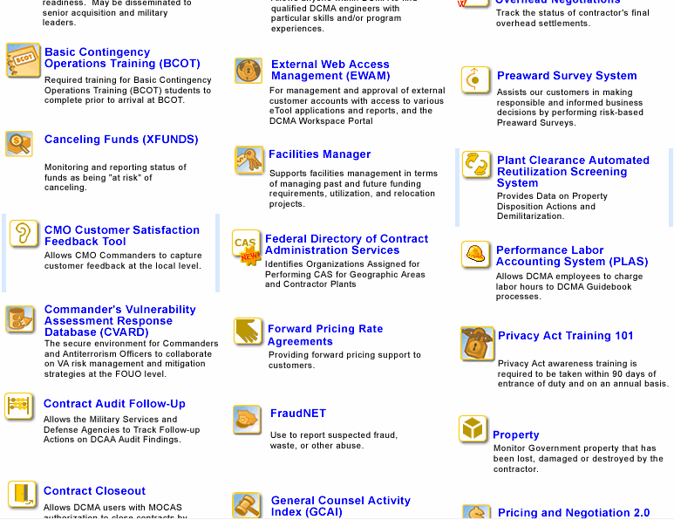
Topic Two – Logging into PCARSS
Logging into PCARSS
You may follow these steps for logging into PCARSS as any user role.
Logging into PCARSS (Graphic 1.1.1)
 | Log into the eTools Portal (Graphic 1.1.1).
 | Double-click the Plant Clearance Automated Reutilization Screening System icon on your portal. The Home Page for your assigned user role in IWAM or EWAM appears.
Graphic 1.1.1 : PCARSS icon on eTools Portal
18
Notes:
18

Slide 19
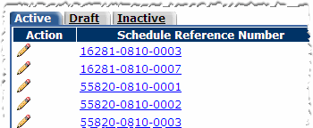

Topic Three – Navigating PCARSS
Navigating PCARSS
Tabs show records with specific statuses. To see information under a tab, click the tab. A tab will appear in blue when it is open (Graphic 1.1.2).
Column headers allow you to sort information in either ascending or descending order. To sort the information, click a column header. Click the column header again to sort the information in reverse order (Graphic 1.1.2).
Action columns may display the or icons, which you can click to edit or delete a record, respectively (Graphic 1.1.2).
The controls at the bottom of the table allow you to move to the first, previous, next, or last request on pages that display multiple records. You may also use the drop-down list box to select the sequence number of the requests you wish to see and click the Go button (Graphic 1.1.3).
Graphic 1.1.2 : Tabs, Table, Columns, and Column Headings
Graphic 1.1.3 : First, Previous, Next, and Last buttons
19

Slide 20
Topic Three – Navigating PCARSS
Navigating PCARSS – Continued
The following icons link to additional functionality in PCARSS. You will see these icons used throughout the application:
PCARSS Icons
 | Opens a page where you may edit a record.
 | Opens a page where you may add a record.
 | Deletes a record.
 | Opens a search page or populates data on a page from the information entered in a field.
 | Displays a calendar that allows you to select a date. In any case where this icon appears, you can also type the date in the text box. Use the format DD MON YYYY (e.g., 01 JAN 2009).
20
Notes:
20

Slide 21
Lesson One – Review
Lesson One covered the following topics:
Topic One | About PCARSS
Topic Two | Logging into PCARSS
Topic Three | Navigating PCARSS
21
Notes:
21

Slide 22
Lesson Two – User Roles and Processes
Lesson Two
User Roles and Processes

Slide 23
Lesson Two – Topics
Lesson Two Topics
Topic One | Inventory Schedule Process
Topic Two | Referral Process
Topic Three | Case Process
Topic Four | PCARSS User Roles
23
Notes:
23

Slide 24
Topic One – Inventory Schedule Process
Inventory Schedule Process
DRAFT
Inventory Schedule
Contractor or PLCO
Inventory Schedule
PLCO
The receiving PLCO accepts the inventory schedule.
He or she assigns the inventory schedule to a case.
The receiving PLCO assigns
the inventory schedule to a
referral to send to another
PLCO.
The receiving PLCO rejects the inventory schedule.
It is sent back to the Contractor or PLCO where it may be updated and resubmitted, or deleted.
24
Notes:
24

Slide 25
Topic Two – Referral Process
Referral Process
Active
Referral
PLCO
The PCLO who receives the referral accepts it.
The referral becomes a draft case.
The PCLO who receives the referral rejects it and sends it back to the PLCO who created it.
The PLCO who originally created the referral views the rejected referral and either resubmits it or deletes it.
25
Notes:
25

Slide 26
Topic Three – Case Process
Case Process
Active
Case
PLCO
A Screener or PLCO performs an inventory search and finds the item(s) in the case. He or she creates a requisition for the item(s) and submits it to the PLCO assigned to the case. The PLCO approves the requisition and issues disposition instructions for the items. The Contractor will then perform the disposal per the PLCO's instructions.
The PLCO creates a sales authorization in an attempt to sell the inventory. The PLCO or Contractor enter the sale data. Once the inventory is sold, the Contractor collects the proceeds from the buyer and ships the inventory.
The item(s) are not requisitioned or sold. The PLCO assigns a final disposition code to dispose of the item and the Contractor performs the disposal per the PLCO's instructions.
When all of the items on the case have been fully dispositioned, the case can be closed.
26
Notes:
26

Slide 27
Topic Four – PCARSS User Roles
PCARSS User Roles
The PCARSS application supports seven user roles. Each role, along with its functionality that distinguishes it from the other roles, is summarized below.
Plant Clearance Officer (PLCO) | Logs in through IWAM or EWAM Oversees all the functionality in PCARSS 3.1
Support PLCO | Logs in through IWAM or EWAM Performs all the tasks of a designated PLCO with approval from the Administrator
Contractor | Logs in through EWAM Submits schedules for excess inventory at their work sites Conducts sales, and completes final disposal actions as directed by the PLCO
Screener | Logs in through EWAM Submits requisitions for the reuse of available items to the PLCO
Read-only Screener | Logs in through EWAM Searches for inventory available for requisition, but does not create requisitions
Administrator | Logs in through IWAM Has all the functionality of the PLCO, and also: Searches for sales and requisitions Performs workload mass transfers, and may transfer or edit any PLCO’s work Approves Support PLCO requests
Quality Assurance Representative (QAR) | Logs in through IWAM Views, edits, and completes the inventory verification surveys sent by the PLCO
27
Notes:
27

Slide 28
Lesson Two – Review
Lesson Two covered the following topics:
Topic One | Inventory Schedule Process
Topic Two | Referral Process
Topic Three | Case Process
Topic Four | PCARSS User Roles
28
Notes:
28

Slide 29
Module One – Review
Module One covered the following lessons:
Lesson One | About PCARSS
Lesson Two | User Roles and Processes
29
Notes:
29

Slide 30
Module Two – PLCO and Administrator Roles
Module Two
PLCO, Support PLCO, and Administrator Roles
30
Notes:
30

Slide 31
Module Two – Lessons
Module Two Lessons
Lesson One | Common Tasks
Lesson Two | Contacts
Lesson Three | Inventory Schedules
Lesson Four | Referrals
Lesson Five | Cases
Lesson Six | Requisitions
Lesson Seven | Sales
Lesson Eight | Transfers
Lesson Nine | Support PLCO Request Process
31
Notes:
31

Slide 32
Lesson One – PLCO and Administrator Common Tasks
Lesson One
Common Tasks
32
Notes:
32

Slide 33
Lesson One – Topics
Lesson One Topics
Topic One | Viewing the PLCO Home Page
Topic Two | Viewing the Administrator Home Page
Topic Three | Searching Inventory
Topic Four | Uploading Flat Files
Topic Five | Performing Screener Tasks
Topic Six | Viewing and Editing Preferences
33
Notes:
33

Slide 34
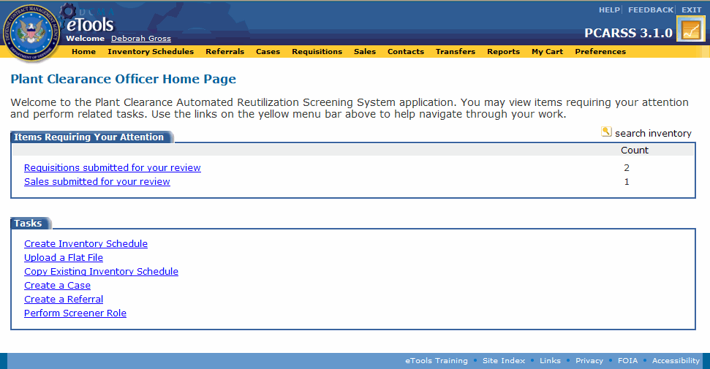
Topic One – Viewing the PLCO Home Page
Viewing the PLCO Home Page
The Plant Clearance Officer Home Page appears when you log into the PCARSS application through IWAM or EWAM as a Plant Clearance Officer (Graphic 2.1.1).
The following tabs appear on the Plant Clearance Officer Home Page:
  Items Requiring your Attention - Items requiring your immediate attention appear under this tab. The number next to a category is the number of items requiring your attention in that category, and the count is updated based on your workloads. PCARSS will not display categories with a count of zero, and if all categories have a count of zero, this tab will not appear at all.
  Tasks - The links under this tab allow you to perform different tasks.
Graphic 2.1.1 : Plant Clearance Officer Home Page
34
Notes:
34

Slide 35
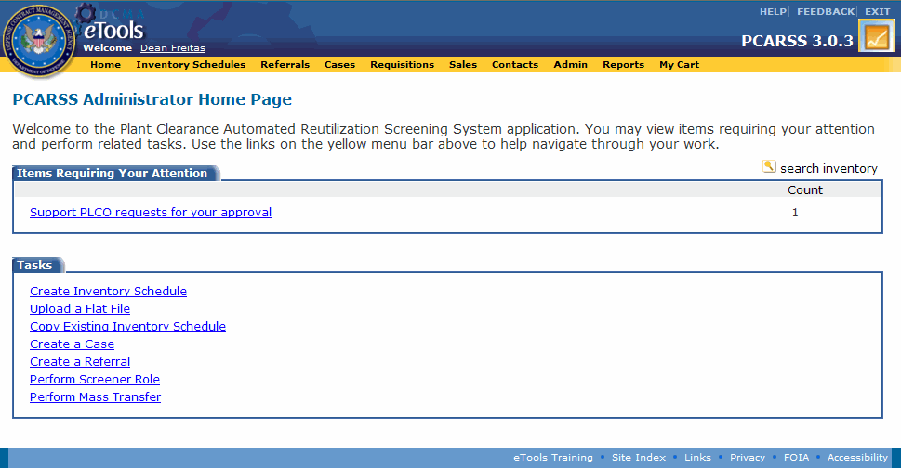
Topic Two – Viewing the Administrator Home Page
Viewing the Administrator Home Page
The Administrator Home Page appears when you log into the PCARSS application through IWAM as an Administrator and click the PCARSS icon on the eTools Portal (Graphic 2.1.2).
The following tabs appear on the Administrator Home Page:
  Items Requiring your Attention - Items requiring your immediate attention appear under this tab. The number next to a category is the number of items requiring your attention in that category, and the count is updated based on your workloads. PCARSS will not display categories with a count of zero, and if all categories have a count of zero, this tab will not appear at all. The following categories may appear:
  Tasks - The links under this tab allow you to perform different tasks.
Graphic 2.1.2 : PCARSS Administrator Home Page
35

Slide 36
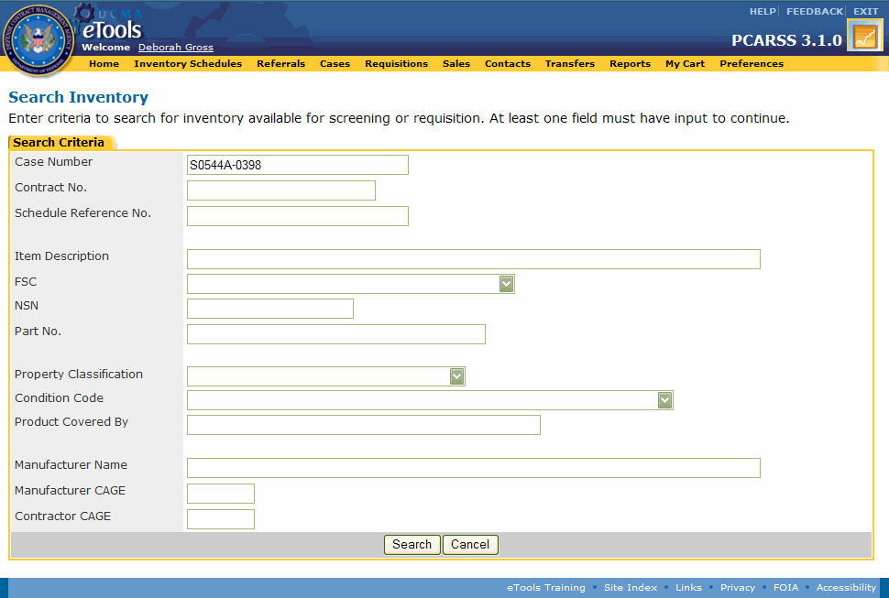
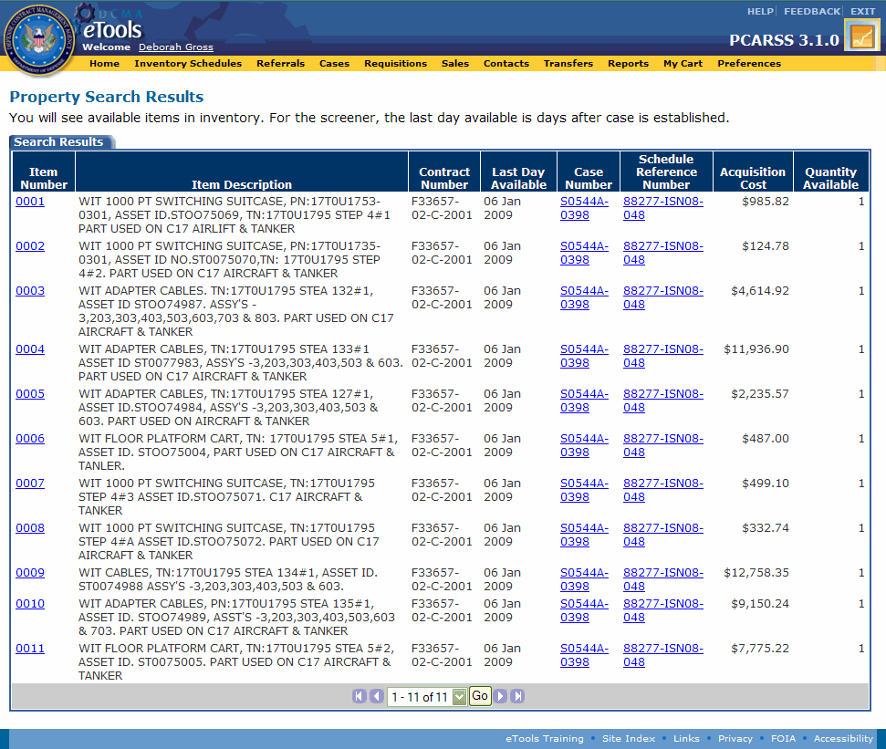
Topic Three – Searching Inventory
Searching Inventory
The PLCO and Administrator roles can view the inventory currently in PCARSS.
PLCOs can only search for work that is their own, but Administrators can search for and modify the work of any user.
Searching Inventory (Graphics 2.1.3 – 2.1.5)
 | Start from the Home Page (Graphic 2.1.3).
 | Click the search inventory link. The Search Inventory page appears (Graphic 2.1.4).
3. | Type search criteria in at least one of the search fields to find the desired inventory.
 | Click the Search button. The Property Search Results page appears (Graphic 2.1.5).
Graphic 2.1.3 : Home Page
Graphic 2.1.4 : Search Inventory page
Graphic 2.1.5 : Property Search Results page
36
Notes:
36

Slide 37
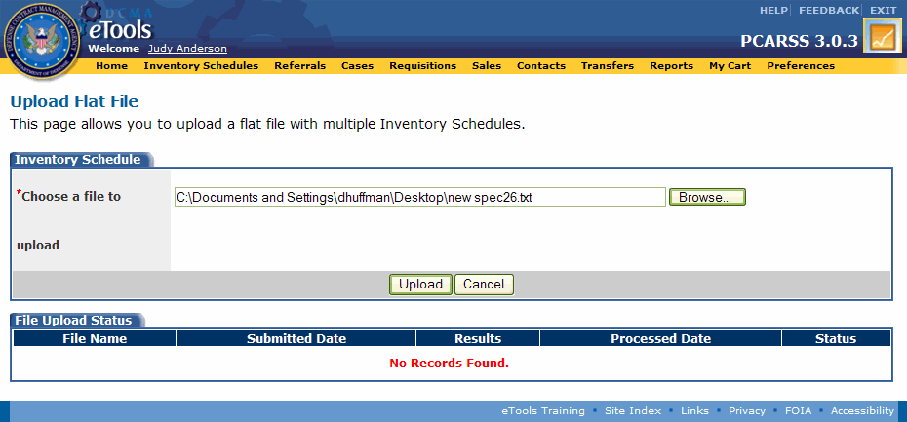
Topic Four – Uploading Flat Files
Uploading Flat Files
The upload flat file function allows you to upload multiple inventory schedules in one file. PLCOs, Administrators, and Contractors have the ability to upload flat files. You may upload flat files by clicking either the Upload a Flat File link on the Home Page or the upload flat file link on the Inventory Schedules Workload page.
For information on how to create a valid flat file, see the PCARSS Flat File Instructions topic in the PCARSS 3.1 users manual or online help.
Uploading Flat Files (Graphics 2.1.6 – 2.1.9)
 | Start from the Home Page (Graphic 2.1.6).
 | Click the Upload Flat Files link. The Upload Flat File page appears (Graphic 2.1.7).
 | Click the Browse button. The file selection box appears.
 | Search for and select the desired flat file.
5. | Click the Open button on the file selection box. The file name and path appear on the Upload Flat File page (Graphic 2.1.7).
Graphic 2.1.6 : Plant Clearance Officer Home Page
Graphic 2.1.7 : Upload Flat File page with filename and path
37
Notes:
37

Slide 38
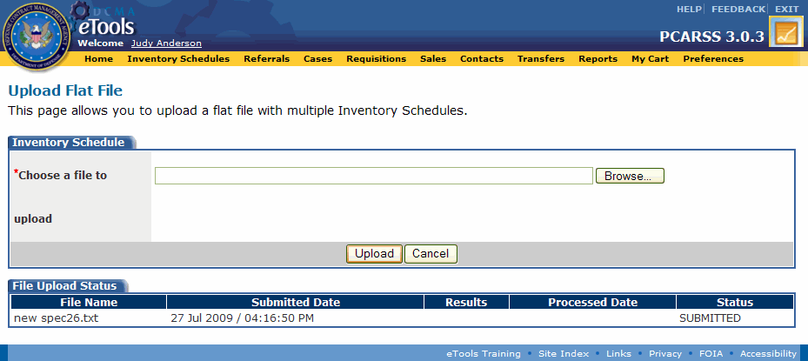
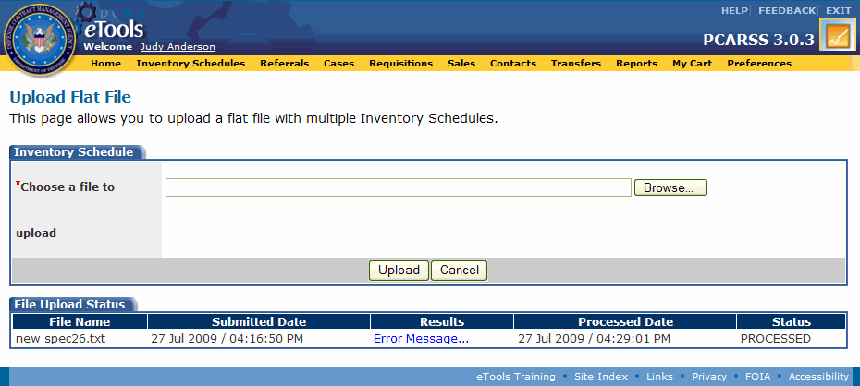
Topic Four – Uploading Flat Files
Uploading Flat Files – Continued
Uploading Flat Files (Graphics 2.1.6 – 2.1.9)
6. | Click the Upload button. The file uploads and appears under the File Upload Status tab with Submitted status (Graphic 2.1.8.)
The flat file process runs every 15 minutes. While the process is running, the submitted flat file will have Pending status.
Once the flat file process has finished, the flat file will have Processed status (Graphic 2.1.9). When the flat file has been processed, if the file does not contain errors, you will be able to find your uploaded inventory schedules in the Inventory Schedules Workload under the Draft tab. If the file contained errors that prevented the schedules from uploading, the errors will be displayed under Results.
A flat file will be removed from the File Upload Status tab after 10 days.
Graphic 2.1.8 : Upload Flat File page with submitted flat file
Graphic 2.1.9 : Upload Flat File page with processed flat file
38

Slide 39
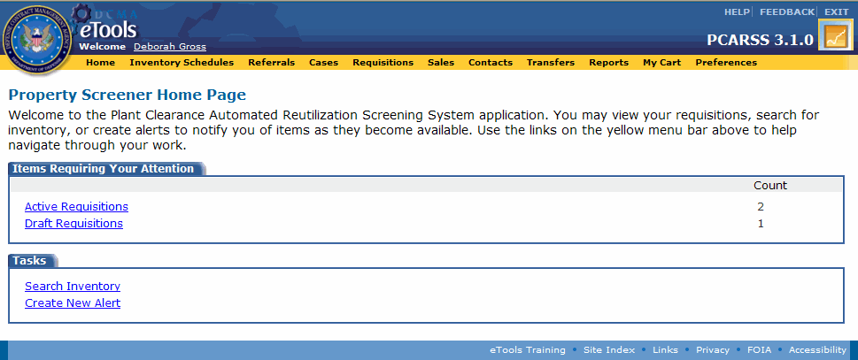
Topic Five – Performing Screener Tasks
Performing Screener Tasks
The PLCO and Administrator roles have access to Screener functionality when they click the Perform Screener Role link on the Home Page. See the Screener Role module for more information on Screener tasks.
Performing Screener Tasks (Graphics 2.1.10 – 2.1.11)
 | Start from the Home Page (Graphic 2.1.10).
 | Click the Perform Screener Role link. The Property Screener Home Page appears (Graphic 2.1.11).
 | Click the Home link to return to the PLCO Home Page at any time.
Graphic 2.1.10 : Plant Clearance Officer Home Page
Graphic 2.1.11 : Property Screener Home Page
39
Notes:
39

Slide 40
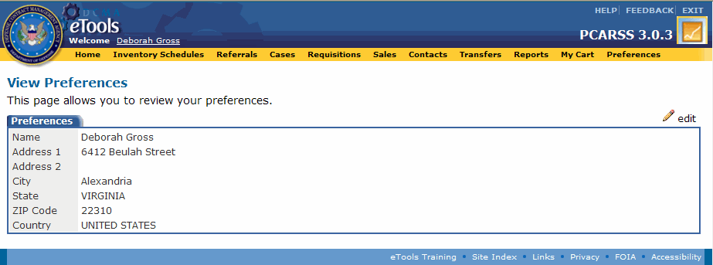
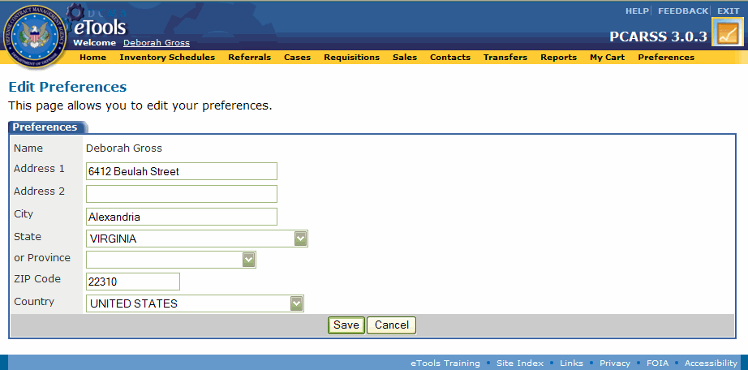
Topic Six – Viewing and Editing Preferences
Viewing and Editing Preferences
The Preferences page displays your address information that will be used whenever you generate a PDF in the PCARSS application. These PDFs include the DD-1641, Inventory Schedule Report, DD-1637, SF-1424, and the Requisition Report.
Only the PLCO role has the ability to save preferences. Administrators must input address information into the PDFs manually.
Viewing and Editing Preferences (Graphics 2.1.12 – 2.1.13)
 | Click the Preferences link on the menu bar (Graphic 2.1.12). The View Preferences page appears (Graphic 2.1.12).
 | Click the edit link. The Edit Preferences page appears (Graphic 2.1.13).
 | Click the Save button when you are finished editing your address information. The View Preferences page will appear and display your changes.
Graphic 2.1.12 : View Preferences page
Graphic 2.1.13 : Edit Preferences page
40
Notes:
40

Slide 41
Lesson One – Review
Lesson One covered the following topics:
Topic One | Viewing the PLCO Home Page
Topic Two | Viewing the Administrator Home Page
Topic Three | Searching Inventory
Topic Four | Uploading Flat Files
Topic Five | Performing Screener Tasks
Topic Six | Viewing and Editing Preferences
41
Notes:
41

Slide 42
Lesson Two – Contacts
Lesson Two
Contacts
42
Notes:
42

Slide 43
Lesson Two – Topics
Lesson Two Topics
Topic One | Adding a Contact
Topic Two | Editing and Deleting a Contact
43
Notes:
43

Slide 44
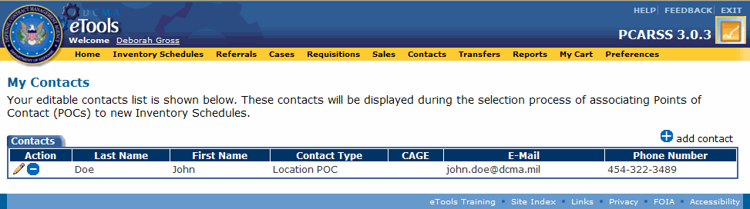
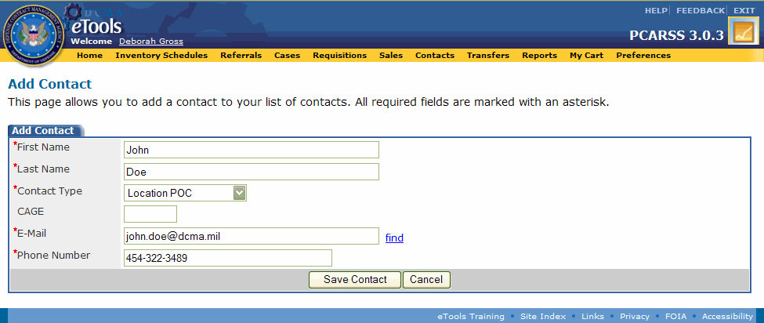
Topic One – Adding a Contact
Adding a Contact
Every PLCO, Administrator, and Contractor has their own set of contacts that they can maintain. The contacts listed on the My Contacts page are available to associate with the inventory schedules you create.
Adding a Contact (Graphics 2.2.1 – 2.2.2)
 | Click the Contacts link on the menu bar. The My Contacts page appears (Graphic 2.2.1).
 | Click the add contact link. The Add Contact page appears (Graphic 2.2.2).
3. | Enter the contact’s E-Mail address.
4. | Click the find link. The contact’s name, contact type, and phone number are populated if the contact was found in the database.
5. | Type information in all appropriate fields if the information was not found.
6. | Click the Save Contact button. The contact is saved in your contacts list.
Graphic 2.2.1 : My Contacts page
Graphic 2.2.2 : Add Contact page
44
Notes:
44

Slide 45
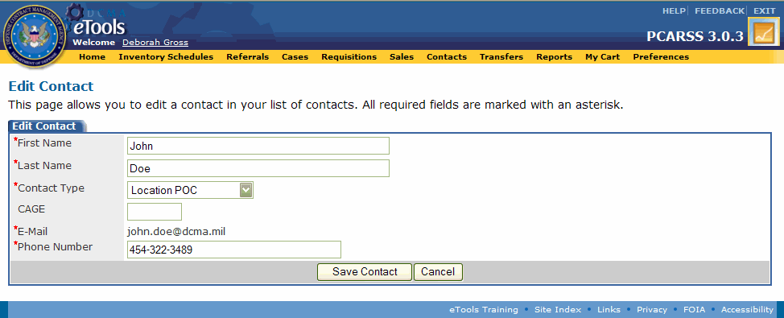
Topic Two – Editing and Deleting a Contact
Editing and Deleting a Contact
You can create new contacts to add to your contacts list on the My Contacts page, as well as edit the information for the contacts already on your list. The icon allows you to edit a contact and the icon deletes a contact.
Editing and Deleting Contact (Graphics 2.2.3 – 2.2.4)
1. | Click the Contacts link on the menu bar. The My Contacts page appears (Graphic 2.2.3).
2. | Click the icon to the left of the contact. The Edit Contacts page appears (Graphic 2.2.4).
3. | Edit appropriate fields.
4. | Click the Save Contact button. The changes made are reflected in the contacts list.
Graphic 2.2.3 : My Contacts page
Graphic 2.2.4 : Edit Contact page
45
Notes:
45

Slide 46
Lesson Two – Review
Lesson Two covered the following topics:
Topic One | Adding a Contact
Topic Two | Editing and Deleting a Contact
46
Notes:
46

Slide 47
Lesson Three – Inventory Schedules
Lesson Three
Inventory Schedules
47
Notes:
47

Slide 48
Lesson Three – Topics
Lesson Three Topics
Topic One | Managing the Inventory Schedules Workload
Topic Two | Creating an Inventory Schedule
Topic Three | Copying an Existing Inventory Schedule
Topic Four | Submitting a Draft Inventory Schedule
Topic Five | Deleting an Inventory Schedule
Topic Six | Deleting a Line Item
Topic Seven | Searching for an Inventory Schedule
Topic Eight | Viewing Inventory Schedule History
Topic Nine | Editing an Inventory Schedule
Topic Ten | Editing a Line Item
Topic Eleven | Accepting an Inventory Schedule
Topic Twelve | Unaccepting an Inventory Schedule
48
Notes:
48

Slide 49
Lesson Three – Topics
Lesson Three Topics
Topic Thirteen | Rejecting an Inventory Schedule
Topic Fourteen | Applying the Screener Rule
Topic Fifteen | Reviewing Submitted Withdrawal Requests
Topic Sixteen | Resubmitting an Inventory Schedule
Topic Seventeen | Viewing Disposition Instructions and Shipping Items
49
Notes:
49

Slide 50
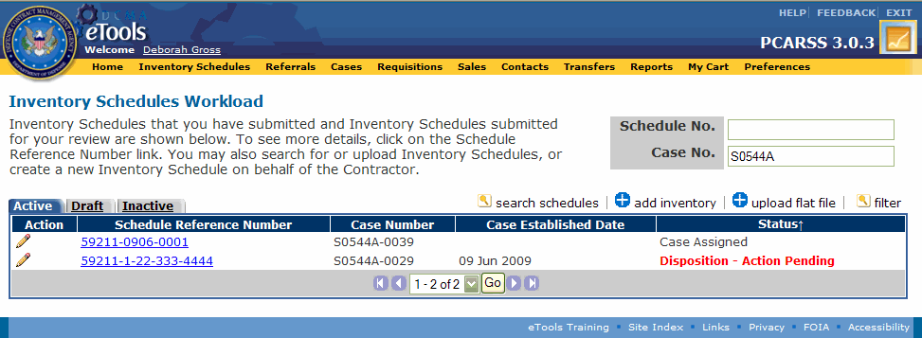
Topic One – Managing the Inventory Schedules Workload
Managing the Inventory Schedules Workload
PLCOs and Administrators may view the Inventory Schedules Workload by clicking the Inventory Schedules link on the menu bar. The Inventory Schedules Workload has three tabs: Active, Draft, and Inactive. The Active tab appears by default.
A submitted inventory schedule becomes overdue after 10 calendar days if it has not been accepted or rejected. When an inventory schedule is overdue, the word, Overdue, will appear with the status. A rejected inventory schedule remains under the Active tab for 60 days after rejection, then it goes to the Inactive tab.
Managing the Inventory Schedules Workload (Graphic 2.3.1)
 | Select the Active tab. Displays inventory schedules in Submitted, Accepted, Rejected, Case Assigned, Disposition-Action Pending, and Disposition-Action Complete statuses (Graphic 2.3.1).
 | Select the Draft tab. Displays inventory schedules in Draft status.
 | Select the Inactive tab. Displays inventory schedules in Withdrawn, Closed, and Rejected statuses.
Graphic 2.3.1 : Inventory Schedules Workload page, Active tab
To search for an inventory schedule within the workload, type the schedule number and/or case number in the corresponding search boxes at the top right corner of the page. You may search on full or partial numbers. Then click the filter link. All tabs in the workload now display only the inventory schedules that match the search criteria you entered and all the rest are filtered out.
To clear a search and display the full workload, remove the search criteria from the Schedule No. and Case No. boxes and click the filter link. The workload tabs now display all of your inventory schedules.
50
Notes:
50

Slide 51
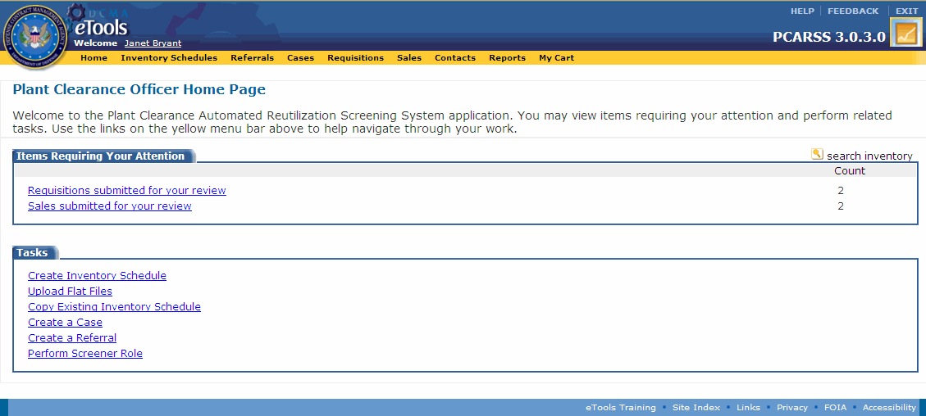
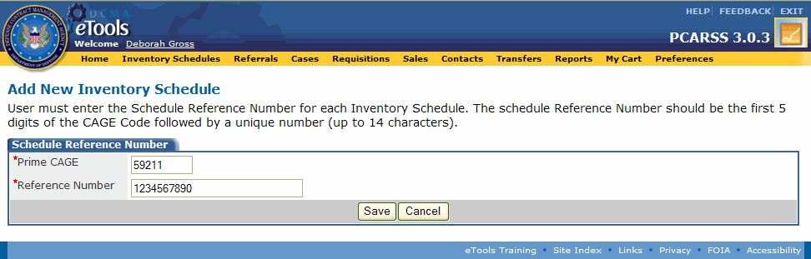
Topic Two – Creating an Inventory Schedule
Creating an Inventory Schedule – Entering the Schedule Reference Number
A PLCO or Administrator may create an inventory schedule on behalf of a contractor by clicking either the Create Inventory Schedule link on the Home Page or the add inventory link on the Inventory Schedules Workload page.
Entering the Schedule Reference Number (Graphics 2.3.2 – 2.4.3)
 | Start from the Home Page (Graphic 2.3.2).
 | Click the Create Inventory Schedule link. The Add New Inventory Schedule page appears (Graphic 2.3.3).
 | Type the Prime CAGE.
 | Type the Reference Number. Note: This number can be in any format up to 20 characters in length. Remember that the reference number you enter must be unique to the prime CAGE.
5. | Click the Save button. You have just created the schedule reference number. The schedule reference number will have the format CAGE-Reference Number (e.g., 55820-12345678).
Steps for entering contract data are continued on the next slide.
Graphic 2.3.2 : Plant Clearance Officer Home Page
Graphic 2.3.3 : Add New Inventory Schedule page
51
Notes:
51

Slide 52
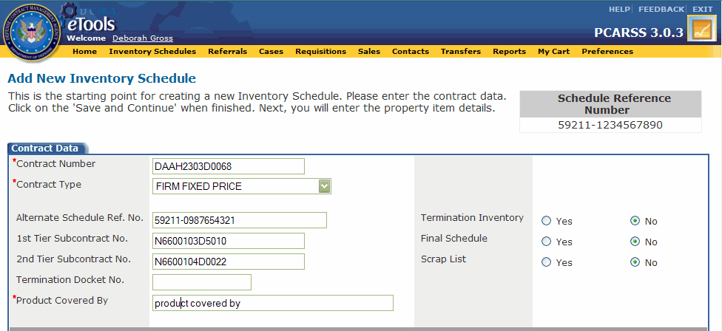
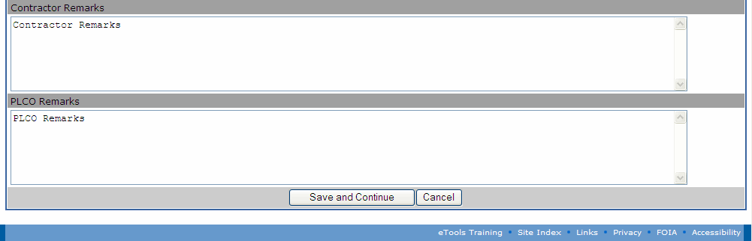
Topic Two – Creating an Inventory Schedule
Creating an Inventory Schedule – Entering Contract Data
The Add New Inventory Schedule page (Graphic 2.3.4) appears after you have finished creating the schedule reference number and allows you to type the basic contract information regarding the inventory schedule. The Add New Inventory Schedule page contains six sections: Contract Data, Prime Contractor Details, 1st-Tier Details, 2nd-Tier Details, Property Location Details, and Remarks. The Contract Data section is displayed at the top of the page.
Entering Contract Data (Graphics 2.3.4 – 2.3.5)
1. | Type information in appropriate fields. Fields marked with an asterisk are required. Note: Some of the fields have an icon next to them. Selecting the icon will populate adjacent field(s).
2. | Click the Save and Continue button. The Property Item Details page appears.
Steps for adding line items are continued on the next slide.
Graphic 2.3.4 : Add New Inventory Schedule page (top)
Graphic 2.3.5 : Add New Inventory Schedule page (bottom)
52
Notes:
52

Slide 53
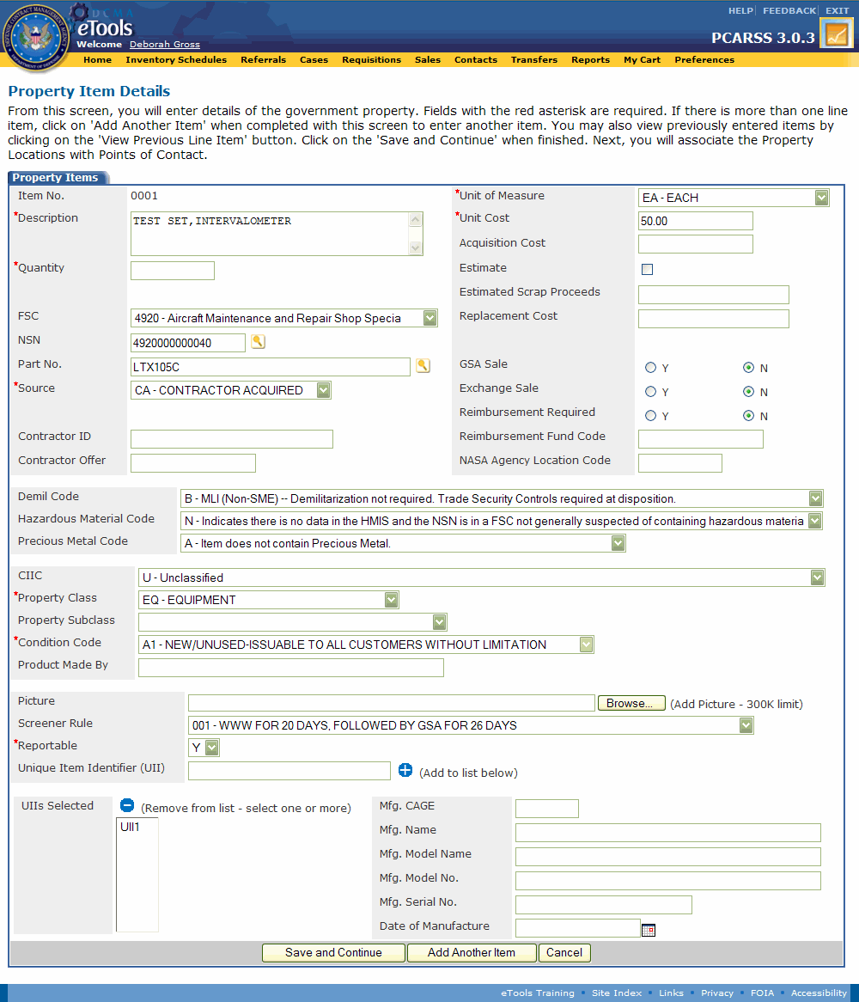
Topic Two – Creating an Inventory Schedule
Creating an Inventory Schedule – Adding Line Items
The Property Item Details (Graphic 2.4.6) page allows you to type the details regarding each line item in the new inventory schedule.
The item number is automatically generated for the item being created. You are not able to change this number.
Adding Line Items (Graphic 2.3.6)
1. | Click the icon to look up item information using the WebFLIS service, or enter an NSN in the NSN box or a part number in the Part Number box and click the icon. Note: See the next slide for information on looking up the NSN or Part Number.
2. | Type information in appropriate fields. Fields marked with an asterisk are required.
3. | Click the Save and Continue button to continue to the POCs page, or Click the Add Another Item button to add another item to the inventory schedule. Note: Do not click Save and Continue if you plan to add another item.
Steps for using the NSN/Part Number Lookup and Selection tool are continued on the next slide.
Graphic 2.3.6 : Property Item Details page
53
Notes:
53

Slide 54
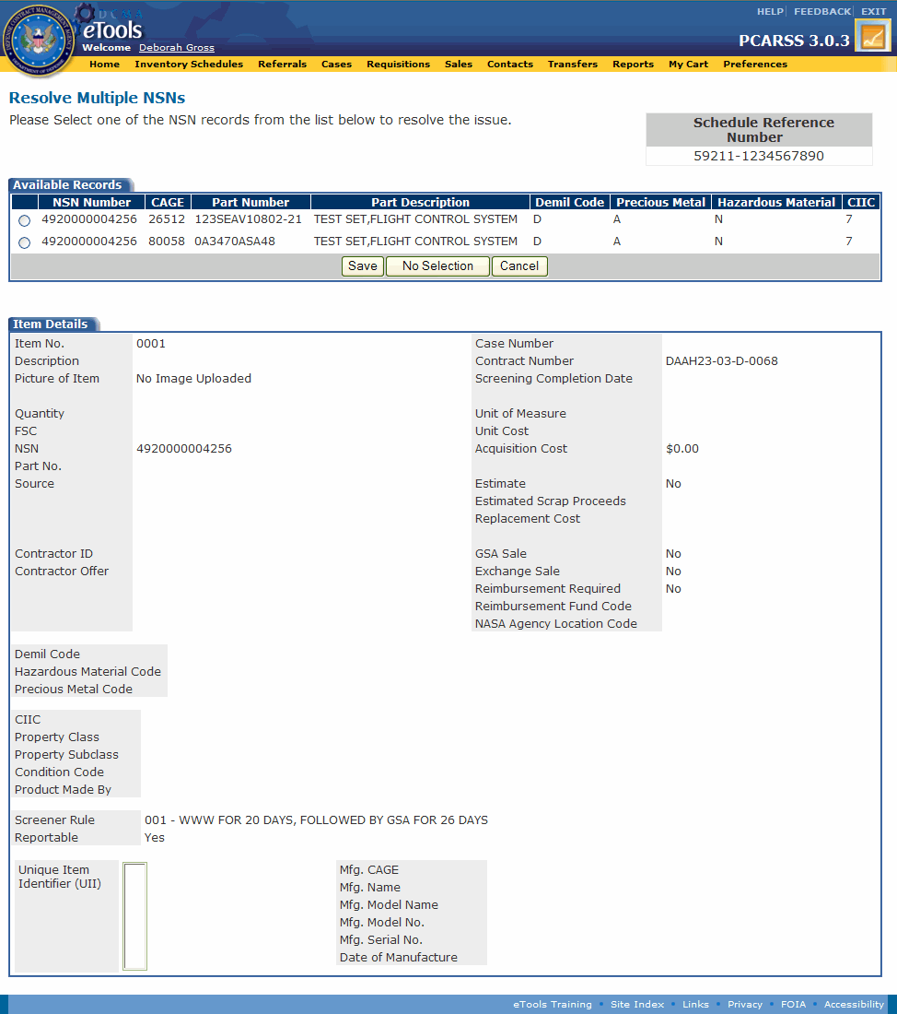
Topic Two – Creating an Inventory Schedule
Creating an Inventory Schedule – Using the NSN/Part Number Lookup
When you type the NSN on the Property Item Details page, you must click the icon. PCARSS will search for the NSN in WebFLIS. If WebFLIS finds a match, it populates the Part Number, Demil Code, Precious Metal Code, Hazardous Material Code and CIIC in their corresponding fields. The part number is populated only when the field is blank. If PCARSS finds more than one match for the NSN you entered, you will be asked to resolve the conflict. The Resolve Multiple NSNs page appears (Graphic 2.3.7).
Using the NSN/Part Number Lookup (Graphics 2.3.7 – 2.3.9)
To select one of the items on the list, click the radio button next to the appropriate item and click the Save button.
To confirm that none of these items match the NSN you entered, click the No Selection button. You will not be prompted again to resolve the conflict if you choose No Selection.
To skip making a selection at this time, click the Cancel button.
Steps for using the NSN/Part Number Lookup and Selection tool are continued on the next slide.
Graphic 2.3.7 : Resolve Multiple NSNs page
54

Slide 55
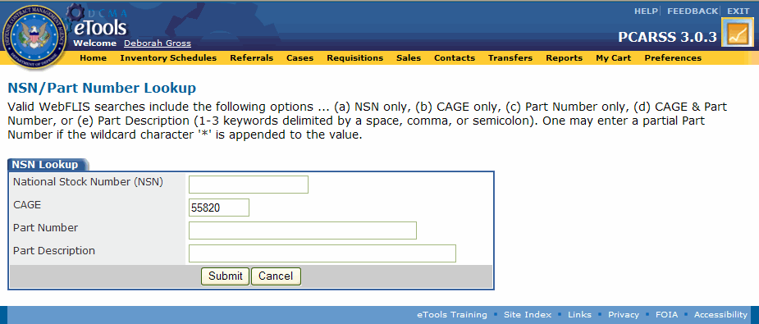
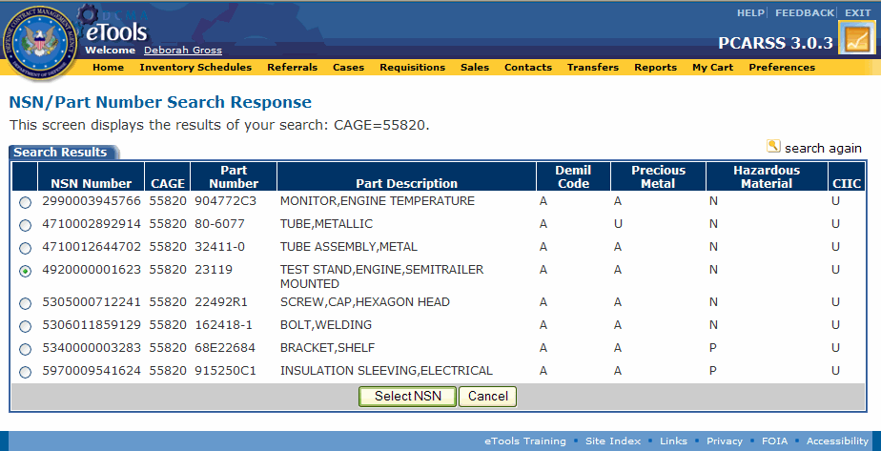
Topic Two – Creating an Inventory Schedule
Creating an Inventory Schedule – Using the NSN/Part Number Lookup – Continued
Using the NSN/Part Number Lookup (Graphics 2.3.7 – 2.3.9)
1. | Click the icon next to either the NSN or Part Number fields on the Property Item Details page, leaving the fields blank. The NSN/Part Number Lookup page appears (Graphic 2.3.8).
2. | Type information in the fields. Note: Part number searches must contain at least 3 alphanumeric characters, including the * wild card entry. A CAGE is also required when performing a part number search. Part description searches may not contain more than 3 keywords.
3. | Click the Submit button on the NSN/Part Number Lookup page. The NSN/Part Number Search Response page appears and displays a maximum of 200 results (Graphic 2.3.9).
4. | Select an item.
5. | Click the Select NSN button. The Property Item Details page reappears. The NSN, Part Number, Demil Code, Precious Metal Code, Hazardous Material Code, and CIIC are populated in their corresponding fields.
Steps for adding POCs are continued on the next slide.
Graphic 2.3.8 : NSN/Part Number Lookup page
Graphic 2.3.8 : NSN/Part Number Search Response page
Graphic 2.3.9 : NSN/Part Number Search Response page
55

Slide 56
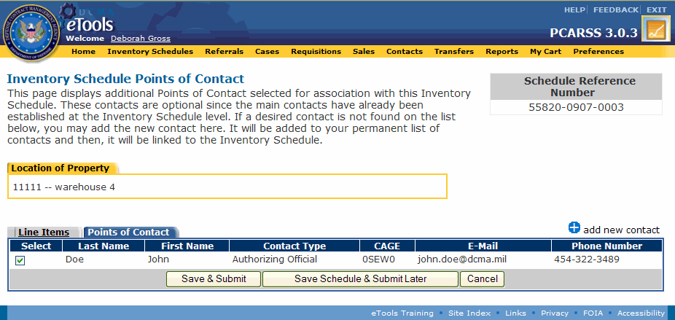
Topic Two – Creating an Inventory Schedule
Creating an Inventory Schedule – Selecting Points of Contact
You may select POCs to associate with your inventory schedule. All of your contacts are displayed under the Points of Contact tab (Graphic 2.3.10) and are available to associate with the inventory schedule.
Selecting Points of Contact (Graphic 2.3.10)
1. | Check the boxes next to the contacts you wish to associate. Note: This step is optional. You do not have to select any contacts.
2. | Click the Save &Submit button to submit the inventory schedule, or Click the Save Schedule & Submit Later button if you wish to save the inventory schedule as a draft.
Steps for routing the inventory schedule are continued on the next slide.
Graphic 2.3.10 : Inventory Schedule Points of Contact page
56
Notes:
56

Slide 57
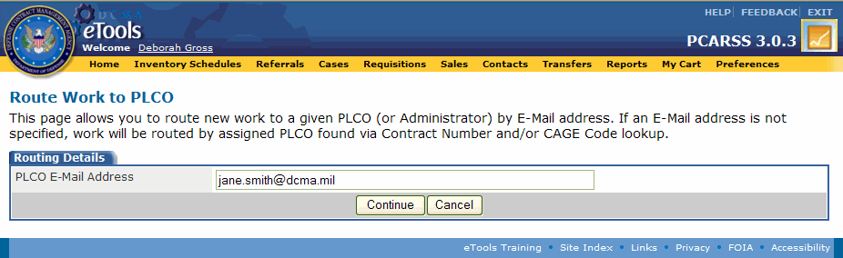
Topic Two – Creating an Inventory Schedule
Creating an Inventory Schedule – Routing the Inventory Schedule
When you click the Save & Submit button on the Inventory Schedule Points of Contact page, the Route Work to PLCO page appears (Graphic 2.3.11). The Route Work to PLCO page allows you to route work directly to a PLCO or an Administrator by typing their E-Mail address. For internal DCMA PLCOs, you may leave this field blank and send the inventory schedule to a PLCO based on CAGE cognizance in CMT. Note: Recommend using email address for all routing.
Graphic 2.3.11 : Route Work to PLCO page
Routing the Inventory Schedule (Graphic 2.3.11)
1. | Type the E-Mail address of the PLCO or Administrator to whom you wish to route the inventory schedule, or leave the field blank to route to an internal PLCO using CMT.
2. | Click the Continue button to submit the inventory schedule. The inventory schedule appears in the Inventory Schedules Workload, under the Active tab with Submitted status.
57
Notes:
57

Slide 58
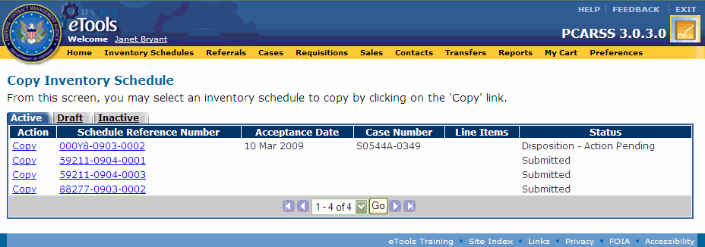
Topic Three – Copying an Existing Inventory Schedule
Copying an Existing Inventory Schedule
PLCOs, Administrators, and Contractors can copy existing inventory schedules and their line items to create new inventory schedules. Copying an existing inventory schedule will take contract data and the selected line items (with the exception of the UII entries) from an existing inventory schedule to create a new draft inventory schedule.
Copying an Existing Inventory Schedule (Graphics 2.3.12 – 2.3.14)
1. | Start from the Home Page (Graphic 2.3.12).
2. | Click the Copy Existing Inventory Schedule link. The Copy Inventory Schedule page appears (Graphic 2.3.13).
3. | Click the Copy link next to any inventory schedule under the Active, Draft, or Inactive tabs. The Copy Line Item page appears (Graphic 2.3.14).
Graphic 2.3.12 : Plant Clearance Officer Home Page
Graphic 2.3.13 : Copy Inventory Schedule page
58
Notes:
58

Slide 59
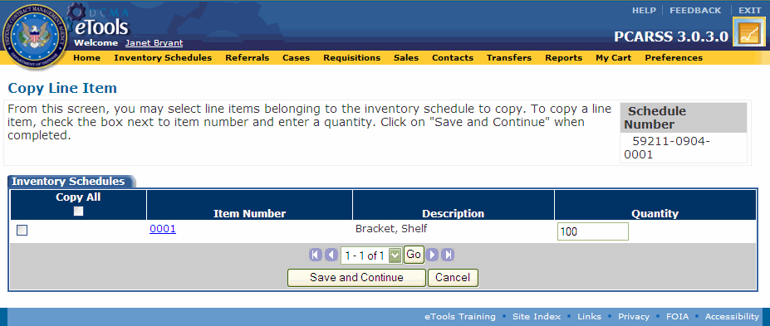
Topic Three – Copying an Existing Inventory Schedule
Copying an Existing Inventory Schedule – Continued
Copying an Existing Inventory Schedule (Graphics 2.3.12 – 2.3.14)
4. | Check the boxes next to the items you would like to copy. You may copy all, some, or none of the items. To copy all the items, click the Select All checkbox.
5. | Type the quantity you wish to have of each item you are copying.
6. | Click the Save and Continue button. The View Inventory Schedule page appears. If you navigate away from this page, you may find the inventory schedule under the Draft tab of the Inventory Schedules Workload.
7. | Remember that PCARSS does not copy UIIs from the original line items when using the copy function.
Graphic 2.3.14 : Copy Line Item
59

Slide 60
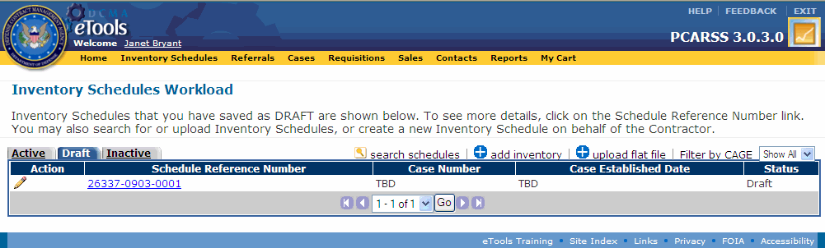
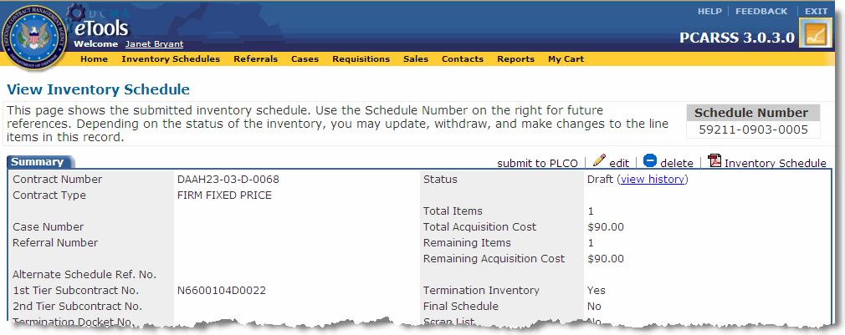
Topic Four – Submitting a Draft Inventory Schedule
Submitting a Draft Inventory Schedule
An inventory schedule with Draft status has been created but not yet submitted. You can edit inventory schedule and line item details on a draft inventory schedule, as well as add new line items and POCs.
Submitting a Draft Inventory Schedule (Graphics 2.3.15 – 2.3.16)
 | Click the Inventory Schedules link on the menu bar.
 | Select the Draft tab (Graphic 2.3.15).
 | Select the inventory schedule you wish to submit. The View Inventory Schedule page appears (Graphic 2.3.16).
4. | Click the submit to PLCO link. The Route to PLCO page appears.
5. | Type the E-Mail address of the PLCO to whom you wish to route the inventory schedule. You may leave this field blank or send the inventory schedule to an internal PLCO based on CAGE cognizance in the CMT.
6. | Click the Continue button.
Graphic 2.3.15 : Inventory Schedules Workload page, Draft tab
Graphic 2.3.16 : View Inventory Schedule page (top)
60
Notes:
60

Slide 61
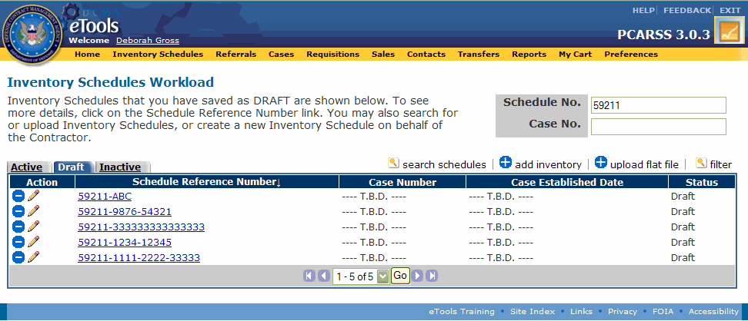
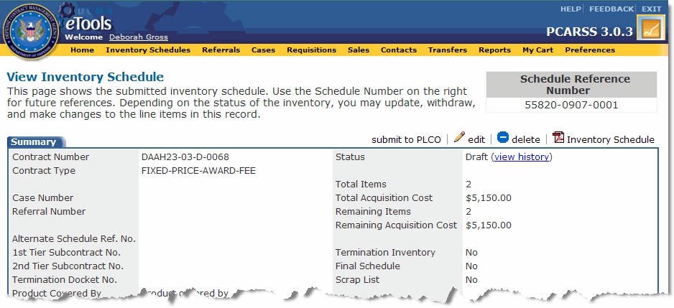
Topic Five – Deleting an Inventory Schedule
Deleting an Inventory Schedule
PLCOs and Administrators can delete inventory schedules in Draft or Rejected status. Remember that once you delete an inventory schedule, you will not be able to retrieve it.
Deleting an Inventory Schedule (Graphics 2.3.17 – 2.3.18)
 | Click the Inventory Schedules link on the menu bar.
2. | Select the Draft tab (Graphic 2.3.17). Note: You can use the icon to delete the inventory schedule.
3. | Select the inventory schedule you wish to delete. The View Inventory Schedule page appears (Graphic 2.3.18).
4. | Click the delete link on the View Inventory Schedule page. A pop-up window appears asking you to confirm the deletion.
5. | Click the OK button on the pop-up window. The inventory schedule is deleted and no longer appears in your Inventory Schedules Workload.
Graphic 2.3.17 : Inventory Schedules Workload page, Draft tab
Graphic 2.3.18 : View Inventory Schedule page (top)
61
Notes:
61

Slide 62
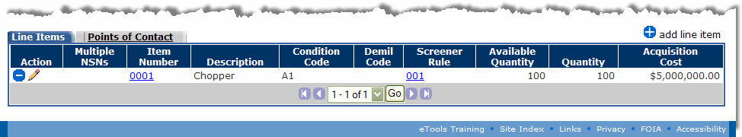
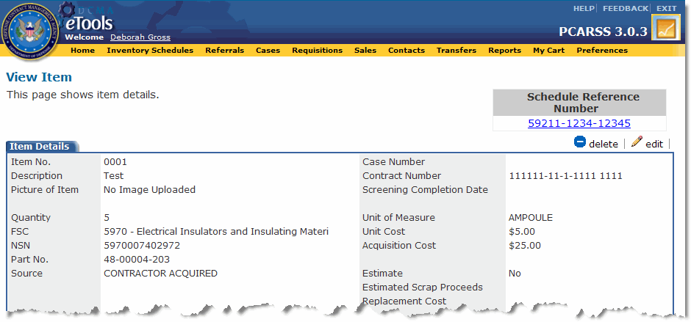
Topic Six – Deleting a Line Item
Deleting a Line Item
PLCOs and Administrators can delete line items from inventory schedules in Draft or Rejected status. Remember that once you delete a line item, you will not be able to retrieve it.
Deleting a Line Item (Graphics 2.3.19 – 2.3.20)
 | Start from the View Inventory Schedule page.
2. | Scroll down to the Line Items tab (Graphic 2.3.19). Note: You can use the icon to delete the line item.
3. | Select the line item you wish to delete. The View Item page appears (Graphic 2.3.20).
4. | Click the delete link on the View Item page. A pop-up window appears asking you to confirm the deletion.
5. | Click the OK button on the pop-up window. The line item is deleted and no longer appears on your inventory schedule.
Graphic 2.3.19 : View Inventory Schedule page, Line Items tab
Graphic 2.3.20 : View Item page (top)
62
Notes:
62

Slide 63
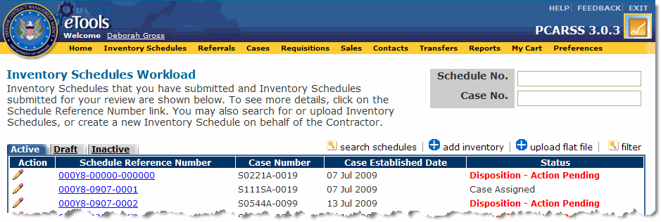
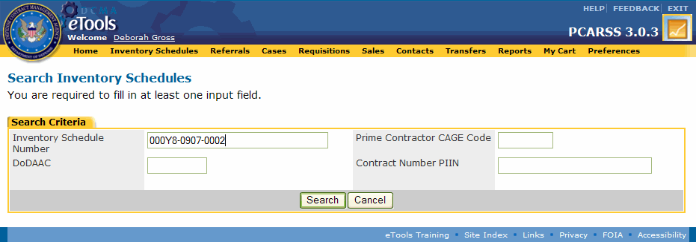
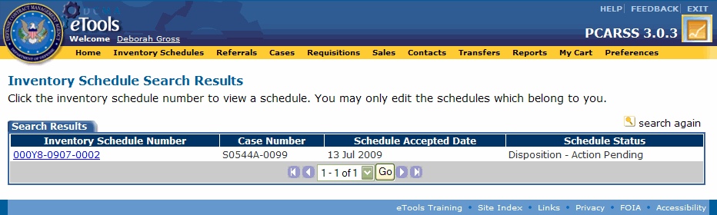
Topic Seven – Searching for an Inventory Schedule
Searching for an Inventory Schedule
PLCOs and Administrators can search for inventory schedules in PCARSS.PLCOs can only search for work that is their own, but Administrators can search for and modify the work of any user.
Searching for an Inventory Schedule (Graphics 2.3.21 – 2.3.23)
1. | Start from the Inventory Schedules Workload page (Graphic 2.3.21)
2. | Click the search schedules link. The Search Inventory Schedules page appears (Graphic 2.3.22).
3. | Type search criteria in at least one of the search fields to find the desired inventory schedule.
4. | Click the Search button. The Inventory Schedule Search Results page appears (Graphic 2.3.23).
5. | Select an inventory schedule to view the inventory schedule details and line items associated with the inventory schedule.
Graphic 2.3.21 : Inventory Schedules Workload page (top)
Graphic 2.3.22 : Search Inventory Schedules page
Graphic 2.3.23 : Inventory Schedule Search Results page
63
Notes:
63

Slide 64
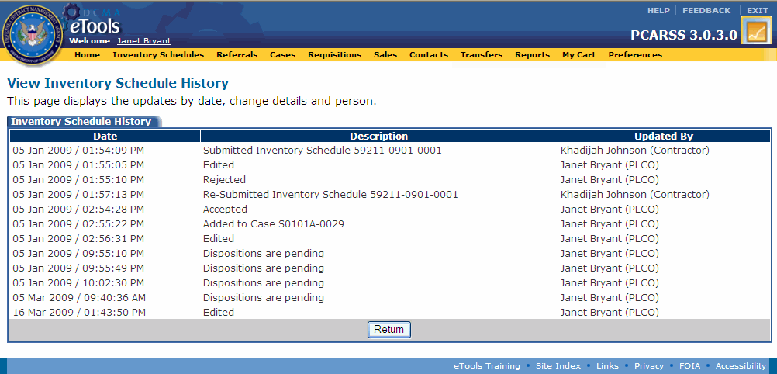
Topic Eight – Viewing Inventory Schedule History
Viewing Inventory Schedule History
PLCOs and Administrators may view the history for any inventory schedule. Information regarding any change made to the inventory schedule appears on the View Inventory Schedule History page.
Viewing Inventory Schedule History (Graphics 2.3.24 – 2.3.25)
1. | Start from the Inventory Schedules Workload page.
2. | Select an inventory schedule. The View Inventory Schedule page appears (Graphic 2.3.24).
3. | Click the view history link to view the inventory schedule’s history. The View Inventory Schedule History page appears (Graphic 2.3.25).
4. | Click the Return button on the View Inventory Schedule History page to return to the View Inventory Schedule page.
Graphic 2.3.24 : View Inventory Schedule page (top)
Graphic 2.3.25 : View Inventory Schedule History page
64
Notes:
64

Slide 65
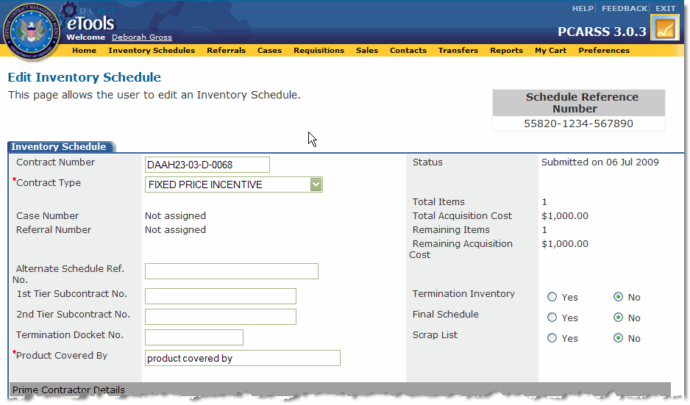
Topic Nine – Editing an Inventory Schedule
Editing an Inventory Schedule
PLCOs can edit inventory schedules as long as the inventory schedule is NOT in Disposition - Action Complete or Closed statuses. Administrators can edit any inventory schedule in PCARSS except for those in Disposition – Action Complete or Closed statuses.
Editing an Inventory Schedule (Graphics 2.3.26 – 2.3.27)
1. | Start from the View Inventory Schedule page (Graphic 2.3.26).
2. | Click the edit link. The Edit Inventory Schedule page appears (Graphic 2.3.27).
3. | Edit the necessary information. Note: You cannot change the prime contract number at any time. Once the inventory schedule is assigned to a case, you can also no longer edit the contract number, prime CAGE, 1st-tier subcontractor CAGE, 2nd-tier subcontractor CAGE, or location CAGE.
4. | Click the Save button. The View Inventory Schedule page appears and the changes are saved.
Graphic 2.3.26 : View Inventory Schedule page (top)
Graphic 2.3.27 : Edit Inventory Schedule page (top)
65
Notes:
65

Slide 66
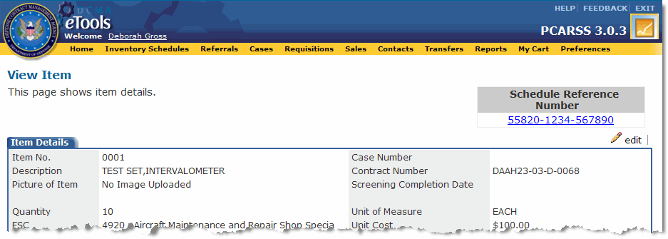
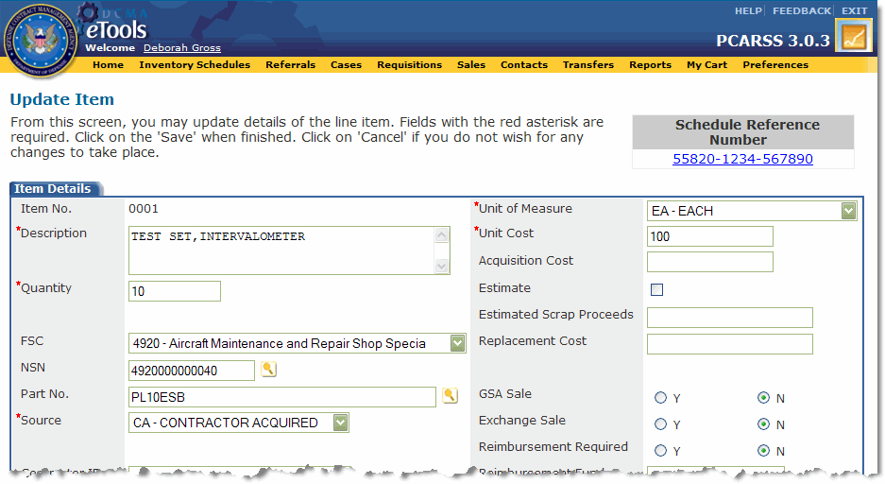
Topic Ten – Editing a Line Item
Editing a Line Item
PLCOs can edit line items on inventory as long as the inventory schedule is NOT in Disposition - Action Complete or Closed statuses. Administrators can edit any line item in PCARSS except for those on inventory schedules in Disposition – Action Complete or Closed statuses.
Editing a Line Item (Graphics 2.3.28 – 2.3.29)
1. | Start from the View Inventory Schedule page.
2. | Click the link on the item number at the bottom of the page. The View Item page appears (Graphic 2.3.28).
3. | Click the edit link on the View Item page. The Update Item page appears (Graphic 2.3.29).
4. | Edit the necessary information.
5. | Click the Save button. The View Item page appears and the changes are saved.
Graphic 2.3.28 : View Item page (top)
Graphic 2.3.29 : Update Item page (top)
66

Slide 67
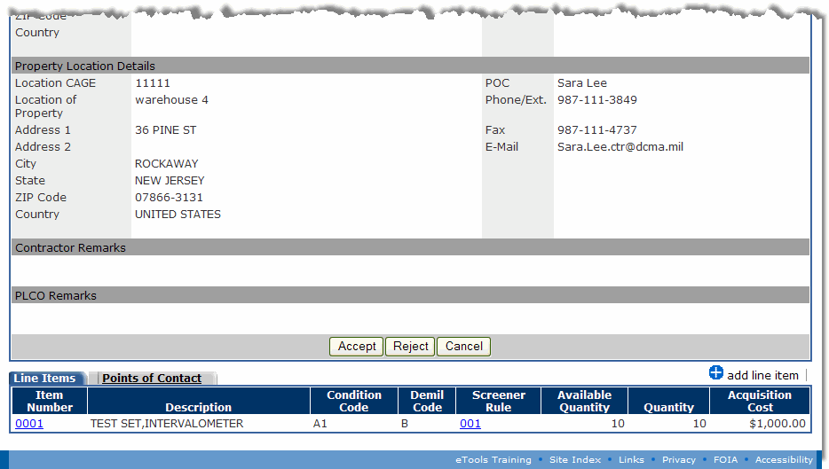
Topic Eleven – Accepting an Inventory Schedule
Accepting an Inventory Schedule
When a Contractor submits an inventory schedule to the PLCO for review, the PLCO or Administrator must accept it or reject it. Once accepted, an inventory schedule is available to be assigned to a case. You must accept or reject a submitted inventory schedule within 10 calendar days from the day you received it or it will become overdue.
Accepting an Inventory Schedule (Graphic 2.3.30)
1. | Select an inventory schedule with Submitted status. The View Inventory Schedule page appears (Graphic 2.3.30).
2. | Verify that a value for FSC is entered for each item in the inventory schedule by clicking the links on the item numbers. If FSC is blank for an item, edit the item and enter the FSC.
3. | Click the Accept button to accept the inventory schedule. The Inventory Schedules Workload appears with the inventory schedule in Accepted status.
Graphic 2.3.30 : View Inventory Schedule page (bottom)
67
Notes:
67

Slide 68
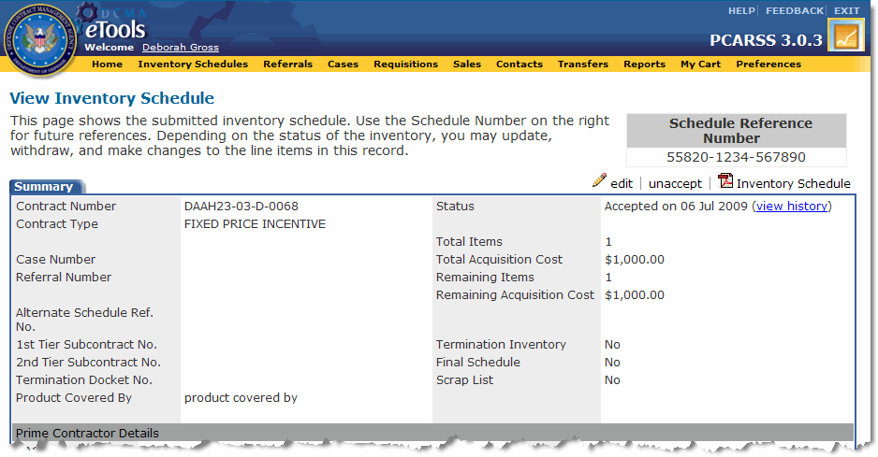
Topic Twelve – Unaccepting an Inventory Schedule
Unaccepting an Inventory Schedule
When a Contractor or PLCO submits an inventory schedule for review, the PLCO or Administrator must accept it or reject it. Once in Accepted status, the inventory schedule has the ability to be unaccepted.
Unaccepting an Inventory Schedule (Graphic 2.3.31)
1. | Select an inventory schedule with Accepted status. The View Inventory Schedule page appears (Graphic 2.3.31).
2. | Click the unaccept link on the View Inventory Schedule page. The Inventory Schedules Workload page appears and the inventory schedule returns to Submitted status.
Graphic 2.3.31 : View Inventory Schedule page (top)
68

Slide 69
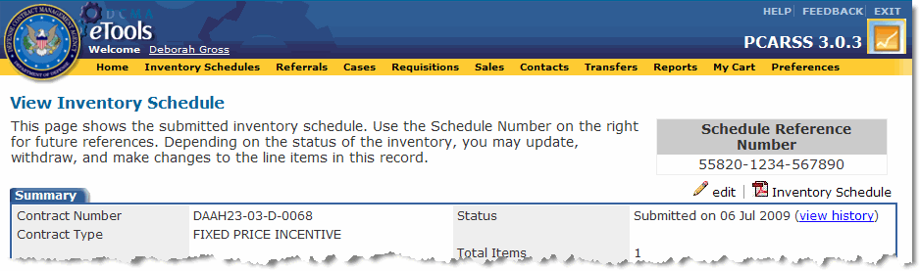
Topic Thirteen – Rejecting an Inventory Schedule
Rejecting an Inventory Schedule
When a Contractor submits an inventory schedule to the PLCO for review, the PLCO or Administrator must accept it or reject it. If the schedule is not acceptable, it should be rejected to return it to the contractor for correction or deletion. You must accept or reject a submitted inventory schedule within 10 calendar days from the day you received it or it will become overdue.
Rejecting an Inventory Schedule (Graphics 2.3.32 – 2.3.33)
1. | Select an inventory schedule with Submitted status. The View Inventory Schedule page appears (Graphic 2.3.32).
2. | Click the edit link on the View Inventory Schedule page. The Edit Inventory Schedule page appears (Graphic 2.3.33).
3. | Type comments regarding the rejection in the PLCO Remarks box.
4. | Click the Save button. The View Inventory Schedule page appears.
5. | Click the Reject button. The rejected inventory schedule appears under the Active tab in the Inventory Schedules Workload.
Graphic 2.3.32 : View Inventory Schedule page (top)
Graphic 2.3.33 : View Inventory Schedule page (bottom)
69

Slide 70
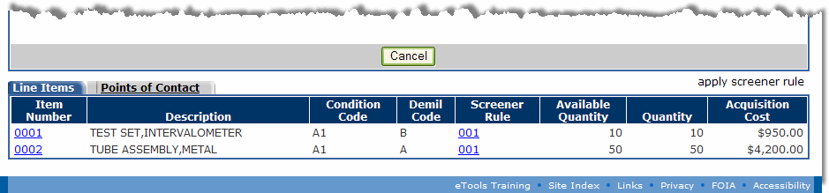
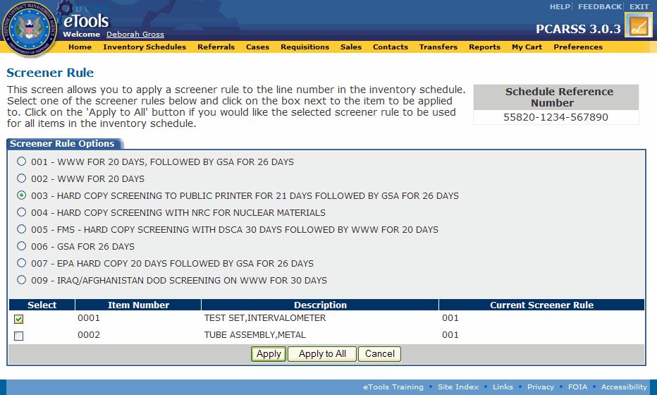
Topic Fourteen – Applying the Screener Rule
Applying the Screener Rule
Once an inventory schedule has been accepted, the PLCO or Administrator may modify the screener rule for the items on the schedule. All items are set to the default screener rule, 001 (WWW for 20 days, followed by GSA for 26 days). You will be able to modify the screener rule until the inventory schedule's status is Disposition - Action Complete.
Graphic 2.3.34: View Inventory Schedule page (bottom)
Applying the Screener Rule (Graphics 2.3.34 – 2.3.35)
1. | Start from the View Inventory Schedule page (Graphic 2.3.34).
2. | Click the apply screener rule link. The Screener Rule page appears (Graphic 2.3.35).
3. | Check the box next to an item to apply the selected screener rule to that item. You may check one, some, or all of the items.
4. | Click the Apply button to apply the screener rule to only the selected items, or Click the Apply All button to apply the screener rule to all the items in the inventory schedule, regardless of whether or not they are selected.
Graphic 2.3.35 : Screener Rule page
70
Notes:
70

Slide 71
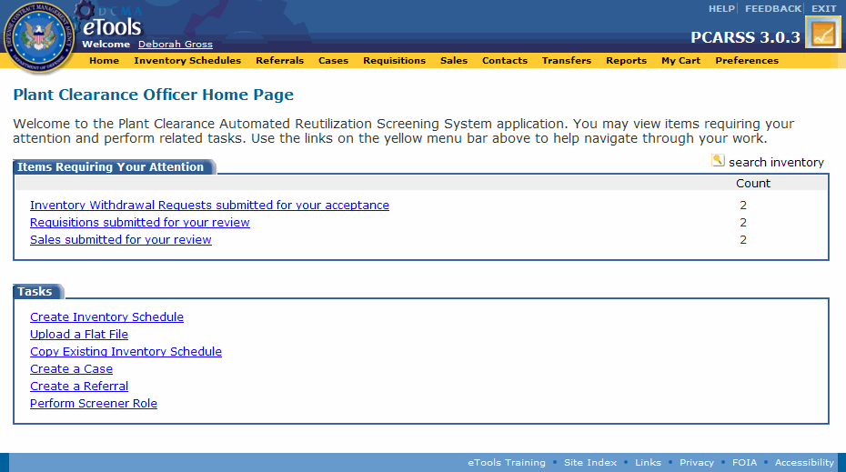
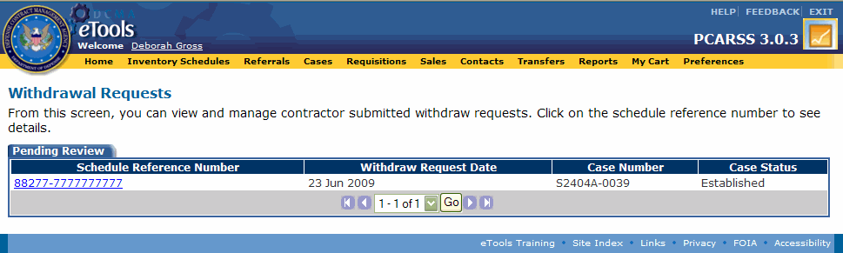
Topic Fifteen – Reviewing Submitted Withdrawal Requests
Reviewing Submitted Withdrawal Requests
When a Contractor needs to withdraw an inventory schedule or line item, he or she initiates a request for withdrawal to the PLCO. The items requested for withdrawal become unavailable when the request is submitted, and will remain unavailable unless the PLCO or Administrator disapproves the request.
Reviewing Submitted Withdrawal Requests (Graphics 2.3.36 – 2.3.40)
1. | Start from the Home Page (Graphic 2.3.36).
2. | Click the Inventory Withdrawal Requests Submitted for your Acceptance link. The Withdrawal Requests page appears (Graphic 2.3.37).
3. | Select the inventory schedule you wish to approve for withdrawal. The Withdraw Line Item page appears (Graphic 2.3.38).
Graphic 2.3.36 : Plant Clearance Officer Home Page
Graphic 2.3.37 : Withdrawal Requests page
71
Notes:
71

Slide 72
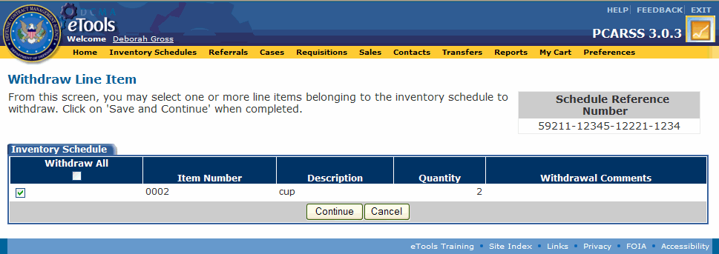
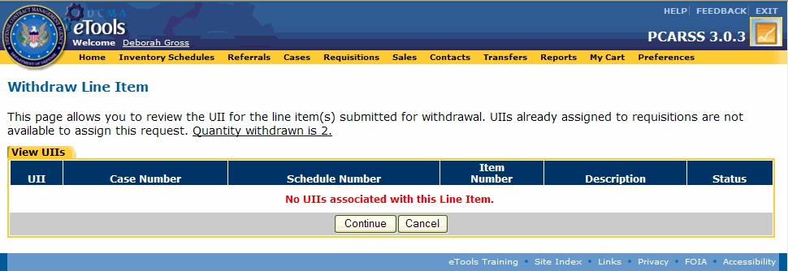
Topic Fifteen – Reviewing Submitted Withdrawal Requests
Reviewing Submitted Withdrawal Requests – Continued
Reviewing Submitted Withdrawal Requests (Graphics 2.3.36 – 2.3.40)
4. | Check the boxes next to the items you approve for withdrawal.
5. | Click the Continue button. The Withdraw Line Item page displays the UIIs being withdrawn (Graphic 2.3.39).
6. | Click the Continue button on the Withdraw Line Item page. The Update Comments page appears (Graphic 2.3.40).
Graphic 2.3.38 : Withdraw Line Item page
Graphic 2.3.39 : Withdraw Line Item page
72
Notes:
72

Slide 73

Topic Fifteen – Reviewing Submitted Withdrawal Requests
Reviewing Submitted Withdrawal Requests – Continued
Reviewing Submitted Withdrawal Requests (Graphics 2.3.36 – 2.3.40)
7. | Type comments regarding the withdrawal request to send them in an E-Mail message to the Contractor who submitted the withdrawal request.
8. | Click the Update and Send E-Mail to Contractor button. Your comments will be sent in an E-Mail message. The withdrawn item(s) will have the disposition code WD – Withdrawn assigned to them. If the entire inventory schedule was withdrawn, it will appear under the Active tab of the Inventory Schedules Workload with Disposition – Action Complete status.
Graphic 2.3.40 : Update Comments page
73

Slide 74

Topic Sixteen – Resubmitting an Inventory Schedule
Resubmitting an Inventory Schedule
PLCOs, Administrators, and Contractors can resubmit rejected inventory schedules.
Resubmitting an Inventory Schedule (Graphics 2.3.41 – 2.3.42)
1. | Start from the Inventory Schedules Workload page.
2. | Select the inventory schedule you wish to resubmit. The View Inventory Schedule page appears (Graphic 2.3.41).
3. | Click the re-submit link. The Route Work to PLCO page appears (Graphic 2.3.42).
4. | Type the E-Mail address of the PLCO or Administrator to whom you wish to route the inventory schedule, or leave the field blank to route to an internal PLCO using CMT.
5. | Click the Continue button to submit the inventory schedule. The inventory schedule appears in the Inventory Schedules Workload, under the Active tab with Submitted status.
Graphic 2.3.41 : View Inventory Schedule page (top)
Graphic 2.3.42 : Route Work to PLCO page
74
Notes:
74

Slide 75


Topic Seventeen – Viewing Disposition Instructions and Shipping Items
Viewing Disposition Instructions and Shipping Items
PLCOs, Administrators, and Contractors have the ability to ship dispositioned line items. When the PLCO issues a disposition code to an item on the inventory schedule, the schedule gains Disposition - Action Pending status.
Viewing Disposition Instructions and Shipping Items (Graphics 2.3.43 – 2.3.46)
1. | Start from the Inventory Schedules Workload page.
2. | Select the desired inventory schedule. The View Inventory Schedule page appears (Graphic 2.3.43).
3. | Click the disposition link to view the disposition details. The View Disposition page appears and displays the line items in the inventory schedule that have been issued a disposition code (Graphic 2.3.44). Items that require shipping have the Pending Shipment status and items that do not require shipping have the Shipping Not Required status.
4. | Click the view link next to an item. The Disposition Instructions page appears (Graphic 2.3.45).
Graphic 2.3.43 : View Inventory Schedule page (top)
Graphic 2.3.44 : View Disposition page
75

Slide 76

Topic Seventeen – Viewing Disposition Instructions and Shipping Items
Viewing Disposition Instructions and Shipping Items – Continued
Viewing Disposition Instructions and Shipping Items (Graphics 2.3.43 – 2.3.46)
5. | Check the boxes next to the UIIs that will be shipped.
6. | Click the Items Shipped button. The Disposition Comments page appears (Graphic 2.3.46). Note: This must be done for each item transferred or sold before the case can be closed.
Graphic 2.3.45 : Disposition Instructions page
76

Slide 77

Topic Seventeen – Viewing Disposition Instructions and Shipping Items
Viewing Disposition Instructions and Shipping Items – Continued
Viewing Disposition Instructions and Shipping Items (Graphics 2.3.43 – 2.3.46)
7. | Type comments regarding the shipment.
8. | Click the Submit button. The View Disposition page appears and displays the shipped items. If you have shipped only some of the specified UIIs, the status of the disposition is Partially Shipped. Once all the UIIs are shipped, the status of the disposition becomes Shipped - Awaiting PLCO. When the PLCO marks the disposition complete, the status of the disposition becomes Shipped.
Graphic 2.3.46 : Disposition Comments page
77

Slide 78
Lesson Three – Review
Lesson Three covered the following topics:
Topic One | Managing the Inventory Schedules Workload
Topic Two | Creating an Inventory Schedule
Topic Three | Copying an Existing Inventory Schedule
Topic Four | Submitting a Draft Inventory Schedule
Topic Five | Deleting an Inventory Schedule
Topic Six | Deleting a Line Item
Topic Seven | Searching for an Inventory Schedule
Topic Eight | Viewing Inventory Schedule History
Topic Nine | Editing an Inventory Schedule
Topic Ten | Editing a Line Item
Topic Eleven | Accepting an Inventory Schedule
Topic Twelve | Unaccepting an Inventory Schedule
78
Notes:
78

Slide 79
Lesson Three – Review
Lesson Three covered the following topics:
Topic Thirteen | Rejecting an Inventory Schedule
Topic Fourteen | Applying the Screener Rule
Topic Fifteen | Reviewing Submitted Withdrawal Requests
Topic Sixteen | Resubmitting an Inventory Schedule
Topic Seventeen | Viewing Disposition Instructions and Shipping Items
79
Notes:
79

Slide 80
Lesson Four – Referrals
Lesson Four
Referrals
80
Notes:
80

Slide 81
Lesson Four – Topics
Lesson Four Topics
Topic One | Managing the Referral Workload
Topic Two | Accepting a Referral
Topic Three | Rejecting a Referral
Topic Four | Creating a Referral
Topic Five | Editing a Referral
Topic Six | Withdrawing a Referral
Topic Seven | Searching for a Referral
81
Notes:
81

Slide 82

Topic One – Managing the Referral Workload
Managing the Referral Workload
A referral is a group of one or more submitted inventory schedules from the same prime contract, prime CAGE, 1st-tier subcontractor, 2nd-tier subcontractor and location that a PLCO or Administrator sends to another PLCO or Administrator for acceptance. When the receiver accepts the referral, the inventory schedules on it are automatically accepted and the referral becomes a draft case.
Managing the Referral Workload (Graphic 2.4.1)
1. | Click the Referrals link on the menu bar. The Referral Workload page appears (Graphic 2.4.1).
2. | Select the Incoming Referrals tab. Displays all the referrals that have been sent to you for work. Incoming referrals should be responded to within 10 calendar days. Accepted referrals remain under the Incoming Referrals tab until you have closed the case.
3. | Select the Outgoing Referrals tab. Displays the referrals that you have created and established. Accepted referrals remain under the Outgoing Referrals tab for 60 days after the case is closed by the accepting PLCO.
Graphic 2.4.1 : Referral Workload page, Incoming Referrals tab
To search for a referral within the workload, type the referral number and/or case number in the corresponding search boxes at the top right corner of the page. You may search on full or partial numbers. Then click the filter link. All tabs in the workload now display only the referrals that match the search criteria you entered and all the rest are filtered out.
To clear a search and display the full workload, remove the search criteria from the Referral No. and Case No. boxes and click the filter link. The workload tabs now display all of your referrals.
82
Notes:
82

Slide 83


Topic Two – Accepting a Referral
Accepting a Referral
PLCOs and Administrators may view referral details by clicking the link on a referral number.
The Accept and Reject buttons will appear on the View Referral Details page for incoming referrals that have not yet been reviewed. These referrals have the Active – Action Required status.
Accepting a Referral (Graphics 2.4.2 – 2.4.3)
1. | Start from the Referral Workload page.
2. | Select an incoming referral with the status Active – Action Required. The View Referral Details page appears (Graphic 2.4.2).
3. | Click the Accept button to accept the referral. The Create a Referral Case Number page appears (Graphic 2.4.3).
4. | Enter values in the required fields.
5. | Click the Submit button. The referral is now a Draft case and appears in your Case Workload under the Active tab. The case number generated by the referral appears on the View Referral Details page.
Graphic 2.4.2 : View Referral Details page
Graphic 2.4.3 : Create a Referral Case Number page
83
Notes:
83

Slide 84

Topic Three – Rejecting a Referral
Rejecting a Referral
PLCOs and Administrators may view referral details by clicking the link on a referral number.
The Accept and Reject buttons will appear on the View Referral Details page for incoming referrals that have not yet been reviewed. These referrals have the Active – Action Required status.
Rejecting a Referral (Graphics 2.4.4 – 2.4.5)
1. | Start from the Referral Workload page.
2. | Select an incoming referral with the status Active – Action Required. The View Referral Details page appears (Graphic 2.4.4).
3. | Click the Reject button to reject the referral. The Reject Referral page appears (Graphic 2.4.5).
4. | Type relevant comments regarding the rejection in the Rejection Remarks box.
5. | Click the Reject Referral button. The rejected referral disappears from your Incoming Referrals tab, but remains on the Outgoing Referrals tab of the sender's workload with Rejected status.
Graphic 2.4.4 : View Referral Details page
Graphic 2.4.5 : Reject Referral page
84

Slide 85

Topic Four – Creating a Referral
Creating a Referral
On the Create a Referral page, you will type the referral details and select inventory schedules to associate with the referral. All submitted inventory schedules in your workload are available to associate with the referral. PLCOs and Administrators may create a referral by clicking either the Create a Referral link on the Home Page or clicking the
add referral link on the Referral Workload page.
Creating a Referral (Graphics 2.4.6 – 2.4.8)
1. | Start from the Referral Workload page (Graphic 2.4.6).
2. | Click the add referral link. The Create a Referral page appears (Graphic 2.4.7).
3. | Type the Referral DoDAAC. This is the DoDAAC to be used as the referral number.
4. | Type the E-Mail address of the PLCO who will receive the referral.
5. | Check the box next to an inventory schedule to associate it with the referral. Note: All inventory schedules selected must be from the same prime contract, prime CAGE, tier-1 subcontractor, tier-2 subcontractor and location.
Graphic 2.4.6 : Referral Workload page
Graphic 2.4.7 : Create a Referral page
85
Notes:
85

Slide 86

Topic Four – Creating a Referral
Creating a Referral – Continued
Creating a Referral (Graphics 2.4.6 – 2.4.8)
6. | Click the Save Draft and Continue button. The View Referral Details page appears, displaying the draft referral (Graphic 2.4.7).
7. | Click the submit referral link. The referral is sent to the receiving PLCO, and appears in your Referral Workload under the Outgoing tab with Submitted status.
Graphic 2.4.8 : View Referral Details page
86
Notes:
86

Slide 87

Topic Five – Editing a Referral
Editing a Referral
You can edit a referral as long as it is in Draft status. Once it has been submitted, you can no longer edit it.
Editing a Referral (Graphics 2.4.9 – 2.4.10)
1. | Start from the Referral Workload page.
2. | Select the Outgoing Referrals tab.
3. | Select a draft referral. The View Referral Details page appears (Graphic 2.4.8).
4. | Click the edit link. The Edit Referral page appears (Graphic 2.4.9).
5. | Modify the necessary information on the referral. Note: You may remove inventory schedules from the referral, but remember that you need at least one inventory schedule to submit the referral.
6. | Click the Save button. The View Referral Details page appears and displays your changes.
Graphic 2.4.9 : View Referral Details page
Graphic 2.4.10 : Edit Referral page
87
Notes:
87

Slide 88

Topic Six – Withdrawing a Referral
Withdrawing a Referral
You can withdraw a referral as long as it is in Submitted status. Once the referral has been accepted, you may no longer withdraw it.
Withdrawing a Referral (Graphic 2.4.11)
1. | Start from the Referral Workload page.
2. | Select the Outgoing Referrals tab.
3. | Select a submitted referral. The View Referral Details page appears (Graphic 2.4.10).
4. | Click the withdraw link. The referral is withdrawn and will appear under the Outgoing Referrals tab with Withdrawn status.
Graphic 2.4.11 : View Referral Details page
88

Slide 89



Topic Seven – Searching for a Referral
Searching for a Referral
PLCOs and Administrators can search for any referral in PCARSS. PLCOs can search for and view work belonging to other users, but they will have read-only access to the work that is not their own. Only PCARSS users with the Administrator role will be able to modify the work of any user.
Graphic 2.4.12 : Referral Workload page
Searching for a Referral (Graphics 2.4.12 – 2.4.14)
1. | Start from the Referral Workload page (Graphic 2.4.11).
2. | Click the search referrals link on the Referral Workload Page. The Search Referrals page appears (Graphic 2.4.12).
3. | Type search criteria in at least one of the search fields to find the desired referral.
4. | Click the Search button. The Referral Search Results page appears (Graphic 2.4.13).
5. | Select a referral to view the referral details and inventory schedules assigned to the referral.
Graphic 2.4.13 : Search Referrals page
Graphic 2.4.14 : Referral Search Results page
89
Notes:
89

Slide 90
Lesson Four – Review
Lesson Four covered the following topics:
Topic One | Managing the Referral Workload
Topic Two | Accepting a Referral
Topic Three | Rejecting a Referral
Topic Four | Creating a Referral
Topic Five | Editing a Referral
Topic Six | Withdrawing a Referral
Topic Seven | Searching for a Referral
90
Notes:
90

Slide 91
Lesson Five – Cases
Lesson Five
Cases
91
Notes:
91

Slide 92
Lesson Five – Topics
Lesson Five Topics
Topic One | Managing the Case Workload
Topic Two | Creating a Case
Topic Three | Establishing a Case
Topic Four | Viewing Case History
Topic Five | Searching for a Case
Topic Six | Editing a Case
Topic Seven | Withdrawing a Case
Topic Eight | Re-establishing a Withdrawn Case
Topic Nine | Deleting a Case
Topic Ten | Transferring an Individual Case
Topic Eleven | Completing an Inventory Verification Survey
Topic Twelve | Assigning a Disposition Code
92
Notes:
92

Slide 93
Lesson Five – Topics
Lesson Five Topics
Topic Thirteen | Issuing a Group Disposition
Topic Fourteen | Removing a Disposition Code
Topic Fifteen | Marking a Disposition as Complete
Topic Sixteen | Closing a Case
Topic Seventeen | Reopening a Case
Topic Eighteen | Issuing Shipping Instructions to the Case Workload
93
Notes:
93

Slide 94

Topic One – Managing the Case Workload
Managing the Case Workload
A case is a group of one or more accepted inventory schedules from the same prime contract, prime CAGE, 1st-tier subcontractor, 2nd-tier subcontractor, and location. PLCOs and Administrators have the ability to create cases and choose the inventory schedules to assign to them. Before items in an inventory schedule can be screened, requisitioned, sold, or dispositioned, the inventory schedule must be assigned to a case.
Managing the Case Workload (Graphic 2.5.1)
1. | Click the Cases link on the menu bar. The Case Workload appears (Graphic 2.5.1).
2. | Select the Active tab. Displays active cases. These cases may be in Established, Established [Disposition Required], Screening Complete, or Screening Complete [Disposition Required] statuses.
3. | Select the Draft tab. Displays cases that have been created and saved but not yet established. These cases are in Draft status.
4. | Select the Inactive tab. Displays cases that you have withdrawn or closed. These cases are in Withdrawn or Closed statuses. Note: Cases become overage after 200 days if they have not yet been assigned to a case.
Graphic 2.5.1 : Case Workload page, Inactive tab
To search for a case within the workload, type the DoDAAC and/or case number in the corresponding search boxes at the top right corner of the page. You may search on full or partial numbers. Then click the filter link. All tabs in the workload now display only the referrals that match the search criteria you entered and all the rest are filtered out.
To clear a search and display the full workload, remove the search criteria from the DoDAAC and Case No. boxes and click the filter link. The workload tabs now display all of your cases.
94
Notes:
94

Slide 95
Topic Two – Creating a Case
Creating a Case
PLCOs and Administrators assign accepted inventory schedules to cases so that the items in the inventory schedules may be screened, requisitioned, or sold, then dispositioned. You can create a case by clicking either the Create a Case link on the Home Page or the add case link on the Case Workload page.
Creating a Case (Graphics 2.5.2 – 2.5.3)
1. | Start from the Home Page (Graphic 2.5.2).
2. | Click the Create a Case link. The Create Case page appears (Graphic 2.5.3).
Graphic 2.5.2 : Plant Clearance Officer Home Page
95
Notes:
95

Slide 96

Topic Two – Creating a Case
Creating a Case – Continued
Creating a Case (Graphics 2.5.2 – 2.5.3)
3. | Type the Case DoDAAC. The 4 digit case number will be system generated using the next number available under the DoDAAC entered.
4. | Select the Case Type, whether or not Inventory Verification is required, and whether or not the case is Reportable.
5. | Type comments in the Remarks box.
6. | Check the box next to an inventory schedule to assign it. Note: All inventory schedules selected must be from the same prime contract, prime CAGE, 1st-tier subcontractor, 2nd-tier subcontractor, and location.
7. | Click the Save Draft and Continue button. The View Case Details page appears. The case is saved as a draft. A case number has been generated automatically for the new case. Case numbers are based on the following format: Your DoDAAC followed by a dash, a 3 digit sequence number beginning with 001, and the last digit of the current calendar year (e.g., S0544A-1658).
Graphic 2.5.3 : Create Case page
96

Slide 97


Topic Three – Establishing a Case
Establishing a Case
Establishing a case removes the case from Draft status and makes it active. Establishing a case makes the inventory in the case available for screening and disposition.
Establishing a Case (Graphics 2.5.4 – 2.5.5)
1. | Start from the Case Workload page.
2. | Select the Draft tab.
3. | Select the draft case you wish to establish. The View Case Details page appears (Graphic 2.5.4).
4. | Click the establish case link. The Edit Case Agency page appears where you can assign the case an agency/department (Graphic 2.5.5).
5. | Select an Agency/Department.
6. | Click the Submit button. The View Case Details page appears.
Graphic 2.5.4 : View Case Details page
Graphic 2.5.5 : Assign Case Agency page
97

Slide 98


Topic Four – Viewing Case History
Viewing Case History
PLCOs and Administrators may view the history for any case. Information regarding any change made to the case appears on the View Case History page.
Viewing Case History (Graphics 2.5.6 – 2.5.7)
1. | Start from the Case Workload page.
2. | Select a case. The View Case Details page appears (Graphic 2.5.6).
3. | Click the view history link to view the case’s history. The View Case History page appears (Graphic 2.5.7).
4. | Click the Return button on the View Case History page to return to the View Case Details page.
Graphic 2.5.6 : View Case Details page
Graphic 2.5.7 : View Case History page
98
Notes:
98

Slide 99


Topic Five – Searching for a Case
Searching for a Case
PLCOs and Administrators can search for any case in PCARSS. PLCOs can search for and view work belonging to other users, but they will have read-only access to the work that is not their own. Only PCARSS users with the Administrator role will be able to modify the work of any user.
Graphic 2.5.8 : Case Workload page
Searching for a Case (Graphics 2.5.8 – 2.5.10)
1. | Start from the Case Workload page (Graphic 2.5.8).
2. | Click the search cases link. The Search Cases page appears (Graphic 2.5.9).
3. | Type search criteria in at least one of the search fields to find the desired case.
4. | Click the Search button. The Case Search Results page appears (Graphic 2.5.10).
5. | Select a case to view the case details and inventory schedules assigned to the case.
Graphic 2.5.9 : Search Cases page
Graphic 2.5.10 : Case Search Results page
99
Notes:
99

Slide 100


Topic Six– Editing a Case
Editing a Case
PLCOs and Administrators may edit the cases in their case workloads during any status except for Closed status.
Editing a Case (Graphics 2.5.11 – 2.5.12)
1. | Start from the View Case Details page (Graphic 2.5.11).
2. | Click the edit link. The Edit Case page appears (Graphic 2.5.12).
3. | Edit the necessary information.
4. | Select an Overage Reason if necessary. Note: The Overage Reason drop-down list appears on the Edit Case page if the case is overage. An overage reason must be selected for overage cases.
5. | Associate or disassociate inventory schedules if necessary. Note: Once an inventory schedule is detached from the case, it will go back to Accepted status and be available to assign to another case. If you remove all the inventory schedules from the case, the case will revert to Draft status.
6. | Click the Submit button.
Graphic 2.5.11 : View Case Details page
Graphic 2.5.12 : Edit Case page
100
Notes:
100

Slide 101

Topic Seven – Withdrawing a Case
Withdrawing a Case
The PLCO or Administrator can withdraw a case unless any item on an inventory schedule on the case has a disposition code, requisition, or sale associated with it.
Withdrawing a Case (Graphics 2.5.13 – 2.5.14)
1. | Start from the View Case Details page (Graphic 2.5.13).
2. | Click the withdraw link. The Withdraw Case Comments page appears (Graphic 2.5.14).
3. | Type comments regarding the withdrawal.
4. | Click the Submit button. The withdrawn case appears under the Inactive tab of the Case Workload. All items on the case are marked with WD disposal code.
Graphic 2.5.13 : View Case Details page (top)
Graphic 2.5.14 : Withdraw Case
101
Notes:
101

Slide 102


Topic Eight – Re-establishing a Withdrawn Case
Re-establishing a Withdrawn Case
A withdrawn case may be re-established if you wish to make it active again. After a case is withdrawn, it has Withdrawn status and appears under the Inactive tab of the Case Workload.
Re-establishing a Withdrawn Case (Graphics 2.5.14 – 2.5.15)
1. | Start from the Case Workload page.
2. | Select the Inactive tab.
3. | Select a withdrawn case. The View Case Details page appears (Graphic 2.5.14).
4. | Click the re-establish link. The Re-establish Case Comments page appears (Graphic 2.5.15).
5. | Type comments regarding the re-establishment.
6. | Click the Submit button. The View Case Details page appears and displays the re-establish comments in the Reopen Reason field. The WD disposal code can be removed to change disposition for all or select items. The original established date is also retained.
Graphic 2.5.14 : View Case Details page (top)
Graphic 2.5.15 : Re-establish Case Comments page
102

Slide 103

Topic Nine – Deleting a Case
Deleting a Case
PLCOs and Administrators may only delete cases in Draft status. Remember that once you delete a case, you will not be able to retrieve it. Note: To delete an active case, you must remove all the inventory schedules to put the case back into draft status.
Deleting a Case (Graphics 2.5.16 – 2.5.17)
1. | Start from the Case Workload page (Graphic 2.5.16).
2. | Select the Draft tab.
3. | Select a draft case. The View Case Details page appears (Graphic 2.5.17). Note: You can also delete the case from the Case Workload page using the icon.
4. | Click the delete link. A pop-up window appears, asking you to confirm the deletion.
5. | Click the OK button on the pop-up window. The case is deleted and no longer appears in your Case Workload.
Graphic 2.5.16 : Case Workload page, Draft tab
Graphic 2.5.17 : View Case Details page
103
Notes:
103

Slide 104

Topic Ten – Transferring an Individual Case
Transferring an Individual Case
Transferring an individual case will also transfer all of its associated inventory schedules, referrals, requisitions, and sales.
PLCOs and Administrators may transfer one or more cases using the transfer function in PCARSS (see the Transfers lesson in the PLCO module), or they may transfer an individual case from the case’s View Case Details page.
Graphic 2.5.18 : View Case Details page (top)
Transferring an Individual Case (Graphics 2.5.18 – 2.5.20)
1. | Start from the Case Workload page.
2. | Select a case to transfer. The View Case Details page appears (Graphic 2.5.18).
3. | Click the transfer link. The Transfer Case page appears (Graphic 2.5.19).
4. | Type the E-Mail address of the PLCO who will receive the case in the Transfer to E-Mail box.
Graphic 2.5.19 : Transfer Cases page
104
Notes:
104

Slide 105

Topic Ten – Transferring an Individual Case
Transferring an Individual Case – Continued
Transferring an Individual Case (Graphics 2.5.18 – 2.5.20)
5. | Click the icon. PCARSS will search for the user in the database and populate his or her name next to the text box.
6. | Type comments in the Comments box.
7. | Click the Transfer button. The Transfer Confirmation page appears (Graphic 2.5.20).
8. | Click the OK button. The case and any associated inventory schedules, referrals, requisitions, and sales have been removed from your workloads and transferred to the specified user.
Graphic 2.5.20 : Transfer Confirmation page
105
Notes:
105

Slide 106
Topic Eleven – Completing an Inventory Verification Survey
Completing an Inventory Verification Survey
If the completion of an inventory verification survey is required for a case, the PLCO or Administrator will not be able to close the case until the survey is completed. The PLCO or Administrator may complete the survey or send it to the Quality Assurance Representative for completion. Remember that you cannot begin the inventory survey process until the case has been established.
Completing an Inventory Verification Survey (Graphics 2.5.21 – 2.5.24)
1. | Start from the View Case Details page (Graphic 2.5.21).
2. | Click the verification survey link. The Create Inventory Verification Survey page appears (Graphic 2.5.22).
Graphic 2.5.21 : View Case Details page (top)
106
Notes:
106

Slide 107

Topic Eleven – Completing an Inventory Verification Survey
Completing an Inventory Verification Survey – Continued
Completing an Inventory Verification Survey (Graphics 2.5.21 – 2.5.24)
3. | Answer the questions in the Technical Verification section. An asterisk denotes that if you choose that answer, you must provide a comment regarding it in the Surveyor Remarks box at the bottom of the page.
4. | Check the Completion of this section is required checkbox at the top of the Termination Inventory section if answers to the questions in the Termination Inventory section are required. When this box is checked, the answers to the question in this section become available for selection.
5. | Answer the questions in the Termination Inventory Section. An asterisk denotes that if you choose that answer, you must provide a comment regarding it in the Surveyor Remarks box at the bottom of the page.
Graphic 2.5.22 : Create Inventory Verification Survey page
107

Slide 108

Topic Eleven – Completing an Inventory Verification Survey
Completing an Inventory Verification Survey – Continued
Completing an Inventory Verification Survey (Graphics 5.1.5-5.1.8)
Click the Save Draft button to save the survey as a draft and work on it again later.
Click the Submit and Complete button to submit and complete the survey.
Click the Close button to exit the survey and return to the View Case Details page.
Click the Send E-Mail to Surveyor button to send the survey to a Quality Assurance Representative (QAR) for completion. The E-Mail to Surveyor page appears (Graphic 5.1.8). Type the QAR's E-Mail address in the QAR E-Mail Address box. Note that you can only type one E-Mail address in this box. Click the Send E-Mail button.
Graphic 2.5.23 : Create Inventory Verification Survey page buttons
Graphic 2.5.24 : E-Mail to Surveyor page
108

Slide 109

Topic Twelve – Assigning a Disposition Code
Assigning a Disposition Code
The PLCO or Administrator may issue a disposition for items in a case that are not going to be sold or requisitioned. The disposition may be issued for either a full or partial quantity of the item.
Assigning a Disposition Code (Graphics 2.5.25 – 2.5.29)
1. | Start from the View Case Details page (Graphic 2.5.25).
2. | Click the disposition link. The Manage Disposition page appears (Graphic 2.5.26).
3. | Click the link on the inventory schedule number for an item that has the Action Needed! status in the Disposition column. The Update Disposition page appears (Graphic 2.5.26).
Graphic 2.5.25 : View Case Details page
Graphic 2.5.26 : Manage Disposition page
109
Notes:
109

Slide 110

Topic Twelve – Assigning a Disposition Code
Assigning a Disposition Code – Continued
The Update Disposition page allows you to type a quantity for disposition and apply a disposition code to the line item.
Assigning a Disposition Code (Graphics 2.5.25 – 2.5.29)
4. | Type the quantity you would like to disposition in the Quantity box.
5. | Select the disposition code. Note: Additional fields may appear based on the disposition code you select.
6. | Check the Shipping Required box if shipping is required for the disposition.
7. | Type comments relevant to the disposition in the PLCO Remarks box.
8. | Click the Continue button. The Disposition – Assign UII page appears (Graphic 2.5.28) if the item has UIIs and you are dispositioning a partial quantity. Otherwise, the Disposition Shipping Information page will appear if shipping is required (Graphic 2.5.29). If shipping is not required AND the item has no UIIs or you are dispositioning full quantity, the Manage Disposition page appears and the disposition code is issued.
Graphic 2.5.27 : Update Disposition page
110

Slide 111


Topic Twelve – Assigning a Disposition Code
Assigning a Disposition Code
Assigning a Disposition Code (Graphics 2.5.25 – 2.5.29)
9. | Check the boxes next to the UIIs you wish to disposition on the Disposition – Assign UII page.
10. | Click the Submit button. If shipping is required, the Disposition Shipping Information page appears (Graphic 2.5.29). Otherwise, the Manage Disposition page appears and the disposition code is issued.
11. | Type information in the required fields on the Disposition Shipping Information page.
12. | Click the Submit button. The Manage Disposition page appears and the disposition code is issued.
Graphic 2.5.28 : Disposition – Assign UII page
Graphic 2.5.29 : Disposition Shipping Information page
111

Slide 112
Topic Thirteen – Issuing a Group Disposition
Issuing a Group Disposition
Issuing a group disposition is similar to assigning a disposition code, except in a group disposition you may apply one disposition code to more than one item on one or all of the inventory schedules.
Issuing a Group Disposition (Graphics 2.5.30 – 2.5.34)
1. | Start from the View Case Details page (Graphic 2.5.30).
2. | Click the disposition link. The Manage Disposition page appears (Graphic 2.5.31).
3. | Click the group disposition link. The Group Update page appears (Graphic 2.5.32).
Graphic 2.5.30 : View Case Details page (top)
Graphic 2.5.31 : Manage Disposition page
112
Notes:
112

Slide 113

Topic Thirteen – Issuing a Group Disposition
Issuing a Group Disposition – Continued
Issuing a Group Disposition (Graphics 2.5.30 – 2.5.34)
4. | Select the schedule reference number if the items you are dispositioning are all associated with the same inventory schedule.
5. | Select the disposition code. Note: Additional fields may appear based on the disposition code you select. If you choose either the MO – Transfer to DRMO or PM – Transfer to DRMO for Precious Metal Recovery disposition codes, you will be required to enter disposition shipping information.
6. | Type comments relevant to the disposition in the PLCO Remarks box.
7. | Check the boxes next to the items you wish to disposition. Note: The full available quantity is automatically populated in the Disposition Quantity box upon selecting the item.
8. | Modify the disposition quantities, if necessary.
Graphic 2.5.32 : Group Update page
113

Slide 114

Topic Thirteen – Issuing a Group Disposition
Issuing a Group Disposition – Continued
Issuing a Group Disposition (Graphics 2.5.30 – 2.5.34)
9. | Click the Continue button. The Group Disposition – Assign UII page appears (Graphic 2.5.33) if any of the items have UIIs and you are dispositioning a partial quantity of the item. Otherwise, the Disposition Shipping Information page will appear if shipping is required (Graphic 2.5.34). If shipping is not required AND the item has no UIIs or you are dispositioning full quantity, the Manage Disposition page appears and the disposition code is issued.
10. | Check the boxes next to the UIIs you wish to assign to the specified item’s disposition on the Disposition – Assign UII page.
11. | Click the Continue button. If there is another item on the requisition with UIIs and a partial quantity, the Group Disposition – Assign UII page will appear again, displaying a UII selection for that item. Note: You may click the Skip button to assign UIIs for that item later.
Graphic 2.5.33 : Group Disposition – Assign UII page
114

Slide 115
Topic Thirteen – Issuing a Group Disposition
Issuing a Group Disposition – Continued
Issuing a Group Final Disposition (Graphics 2.5.30 – 2.5.34)
12. | Click the Submit button. If shipping is required, the Disposition Shipping Information page appears (Graphic 2.5.34). Otherwise, the Manage Disposition page appears and the disposition code is issued.
13. | Type information in the required fields on the Disposition Shipping Information page.
14. | Click the Submit button. The Manage Disposition page appears and the disposition code is issued.
15. | Type information in the required fields on the Disposition Shipping Information page.
Graphic 2.5.34 : Disposition Shipping Information page
115

Slide 116
Topic Fourteen – Removing a Disposition Code
Removing a Disposition Code
You may remove either a full or partial quantity of an item from a selected disposition code. Keep in mind that you cannot remove requisitioned or sold inventory from a disposition code.
Removing a Disposition Code (Graphics 2.5.35 – 2.5.39)
1. | Start from the View Case Details page (Graphic 2.5.35).
2. | Click the disposition link. The Manage Disposition page appears (Graphic 2.5.36).
3. | Select the disposition that needs to be removed. The Update Disposition page appears (Graphic 2.5.37).
Graphic 2.5.35 : View Case Details page (top)
Graphic 2.5.36 : Manage Disposition page
116
Notes:
116

Slide 117
Topic Fourteen – Removing a Disposition Code
Removing a Disposition Code – Continued
Removing a Disposition Code (Graphics 2.5.35 – 2.5.39)
4. | Change the quantity to the quantity of the item you wish to keep on the selected disposition code.
5. | Click the Continue button. The Disposition – Assign UII page appears if the item has UIIs and you are removing a partial quantity from disposition (Graphic 2.5.38).
Graphic 2.5.37 : Update Disposition page
117
Notes:
117

Slide 118
Topic Fourteen – Removing a Disposition Code
Removing a Disposition Code – Continued
Removing a Disposition Code (Graphics 2.5.35 – 2.5.39)
6. | Uncheck the UIIs that are affected by the removal of the disposition code. Note: If you changed the quantity to zero, you will need to uncheck all of the UIIs.
7. | Click the Submit button. The Disposition Shipping Information page appears if shipping was required for the disposition (Graphic 2.5.39).
8. | Click the Submit button. The Manage Disposition page appears and the quantity no longer applied to the disposition code is displayed with Action Needed! In the Disposition column. If you chose to keep some of the quantity applied to the disposition code, the original disposition will also appear and be updated to reflect the new quantity.
Graphic 2.5.38 : Disposition – Assign UII page
Graphic 2.5.39 : Disposition Shipping Information page
118
Notes:
118

Slide 119

Topic Fifteen – Marking a Disposition as Complete
Marking a Disposition as Complete – Verifying Shipment
Once a disposition code has been issued, and all of the items on the disposition have been shipped, the PLCO will need to mark the disposition as complete. The first step in this process is to make sure the items have been shipped.
Verifying Shipment (Graphic 2.5.40)
1. | Start from the Inventory Schedules Workload page.
2. | Select the inventory schedule containing the shipped items. The View Inventory Schedule page appears.
3. | Click the disposition link. The View Disposition page appears. The status Shipped – Awaiting PLCO will appear for the shipped item (Graphic 2.5.40).
Graphic 2.5.40 : View Disposition page
119
Notes:
119

Slide 120

Topic Fifteen – Marking a Disposition as Complete
Marking a Disposition as Complete – Marking Action Complete
When all of the dispositioned items have been shipped, the disposition can be marked as complete.
Marking Action Complete (Graphic 2.5.41)
1. | Start from the View Case Details page.
2. | Click the disposition link. The Manage Disposition page appears (Graphic 2.5.41).
3. | Check the boxes in the Action Complete column for the pending dispositions you wish to mark complete.
4. | Click the Mark Action Complete button. The checkboxes in the marked columns disappear and the dispositions you selected go from Pending to Completed action status.
Graphic 2.5.41 : Manage Disposition page
120

Slide 121

Topic Fifteen – Marking a Disposition as Complete
Marking a Disposition as Complete – Removing Action Complete
Once you mark a disposition as complete, the Update Disposition page is read-only and you cannot make modifications to the disposition. When you remove the Completed action status, however, the disposition is open for changes.
Removing the Action Complete (Graphic 2.5.42)
1. | Start from the View Case Details page.
2. | Click the disposition link. The Manage Disposition page appears.
3. | Click the link on the disposition you would like to remove the Action Completed disposition status. The Update Disposition page appears (Graphic 2.5.42).
4. | Click the Remove Action Complete button. The Manage Disposition page appears and the disposition's action status returns to Pending.
Graphic 2.5.42 : Update Disposition page
121

Slide 122


Topic Sixteen – Closing a Case
Closing a Case
The PLCO or Administrator may close a case when all of the items in the case have a disposition code and all of the dispositions are marked as complete. If inventory verification is required for the case, the inventory verification survey must also be completed. The close link will appear on the View Case Details page only when all the dispositions on the case are complete.
Closing a Case (Graphic 2.5.43- 2.5.44)
1. | Start from the Case Workload page.
2. | Select a case that has been fully dispositioned. It will not have [disposition required] in the status. The View Case Details page appears, displaying the close link in its list of action links (Graphic 2.5.43)..
3. | Click the close link. The Close Case page appears (Graphic 2.5.44).
4. | Type remarks in reference to the closing.
5. | Click the Submit button. The inventory disposal report (SF-1424) appears as a PDF in a new window. You can also view the SF-1424 by clicking the icon next to the closed case on the Case Workload page or on the View Case Details page.
Graphic 2.5.43 : View Case Details page (top)
Graphic 2.5.44 : Close Case Comments page
122
Notes:
122

Slide 123


Topic Seventeen – Reopening a Case
Reopening a Case
A closed case can be reopened by a PLCO or Administrator. When a closed case is reopened, it will become available for work and have the status that it had prior to closing.
Reopening a Case (Graphics 2.5.45 – 2.5.46)
1. | Start from the Case Workload page.
2. | Select the Inactive tab.
3. | Select a closed case. The View Case Details page appears (Graphic 2.5.45).
4. | Click the re-open link. The Re-open Case Comments page appears (Graphic 2.5.46).
5. | Type comments regarding the reopening.
6. | Click the Submit button. The View Case Details page appears and displays the reopen comments in the Reopen Reason field. The case is now active and ready for work.
Graphic 2.5.45 : View Case Details page (top)
Graphic 2.5.46 : Re-open Case Comments page
123
Notes:
123

Slide 124


Topic Eighteen – Issuing Shipping Instructions to the Case Workload
Issuing Shipping Instructions to the Case Workload
You can apply a single shipping address to every item in the Case Workload that requires shipping.
Issuing Shipping Instructions to the Case Workload (Graphics 2.5.47 – 2.5.48)
1. | Start from the Case Workload page (Graphic 2.5.47).
2. | Click the add shipping info link. The Add Shipping Information page appears (Graphic 2.5.48).
3. | Type information in the required fields.
4. | Select the cases to which you wish to apply shipping information.
5. | Click the Save button.
Graphic 2.5.47 : Case Workload page (top)
Graphic 2.5.48 : Add Shipping Information page
124
Notes:
124

Slide 125
Lesson Five – Review
Lesson Five covered the following topics:
Topic One | Managing the Case Workload
Topic Two | Creating a Case
Topic Three | Establishing a Case
Topic Four | Viewing Case History
Topic Five | Searching for a Case
Topic Six | Editing a Case
Topic Seven | Withdrawing a Case
Topic Eight | Re-establishing a Withdrawn Case
Topic Nine | Deleting a Case
Topic Ten | Transferring an Individual Case
Topic Eleven | Completing an Inventory Verification Survey
Topic Twelve | Assigning a Disposition Code
125
Notes:
125

Slide 126
Lesson Five – Review
Lesson Five covered the following topics:
Topic Thirteen | Issuing a Group Disposition
Topic Fourteen | Removing a Disposition Code
Topic Fifteen | Marking a Disposition as Complete
Topic Sixteen | Closing a Case
Topic Seventeen | Reopening a Case
Topic Eighteen | Issuing Shipping Instructions to the Case Workload
126
Notes:
126

Slide 127
Lesson Six – Requisitions
Lesson Six
Requisitions
127
Notes:
127

Slide 128
Lesson Six – Topics
Lesson Six Topics
Topic One | Managing the Requisition Workload
Topic Two | Approving Items on a Requisition
Topic Three | Editing Line Item Shipping Information and Approval Status
Topic Four | Rejecting a Requisition
Topic Five | Completing a Requisition
Topic Six | Searching Inventory for Requisition
Topic Seven | Viewing the Cart
Topic Eight | Creating a Requisition
Topic Nine | Editing a Requisition
Topic Ten | Canceling a Requisition
Topic Eleven | Resubmitting a Requisition
Topic Twelve | Searching for a Requisition
Topic Thirteen | Issuing a Final Disposition on Requisitioned Inventory
128
Notes:
128

Slide 129

Topic One – Managing the Requisition Workload
Managing the Requisition Workload
PLCOs and Administrators can view their Requisition Workload by clicking either the Requisitions link on the menu bar or the Requisitions Submitted for your Review link on the Home Page. The Requisition Workload has three tabs: Active, Draft, and Inactive. The Active tab appears by default.
Managing the Requisition Workload (Graphic 2.6.1)
 | Select the Active tab. Displays the requisitions you have submitted, as well as the requisitions that have been submitted to you for approval. These requisitions may be in Submitted, Request Cancel, or Shipping Instructions Issued statuses (Graphic 2.6.1).
 | Select the Draft tab. Displays the requisitions you have created and saved but not yet submitted.
 | Select the Inactive tab. Displays the requisitions you have submitted or have been submitted to you that have been cancelled, rejected, or shipped.
Graphic 2.6.1 : Requisition Workload page, Active tab
To search for a requisition within the workload, type the requisition number and/or case number in the corresponding search boxes at the top right corner of the page. You may search on full or partial numbers. Then click the filter link. All tabs in the workload now display only the requisitions that match the search criteria you entered and all the rest are filtered out.
To clear a search and display the full workload, remove the search criteria from the Requisition No. and Case No. boxes and click the filter link. The workload tabs now display all of your requisitions.
129
Notes:
129

Slide 130

Topic Two – Approving Items on a Requisition
Approving Items on a Requisition
When a Screener, PLCO, or Administrator creates a requisition on an item in your case workload, the requisition will appear under the Active tab on your Requisition Workload page. If you click the link on the requisition number, the View Requisition page appears.
Approving Multiple Items (Graphics 2.6.2 – 2.6.4)
1. | Start from the View Requisition page for a submitted requisition.
2. | Click the Approve button. The PLCO Input for Requested Item page appears (Graphic 2.6.2).
Graphic 2.6.2 : View Requisition page
130

Slide 131

Topic Two – Approving Items on a Requisition
Approving Items on a Requisition – Continued
Approving Multiple Items (Graphics 2.6.2 – 2.6.4)
3. | Check the boxes next to the items you wish to approve or check Select All to approve all items. PCARSS automatically populates the quantity requested in the Quantity Approved box for each item selected. Note: You cannot approve a quantity greater than the one requested.
4. | Modify the quantities under the Quantity Approved column if necessary. Note: Keep in mind that if partial award is acceptable, the quantity approved and the quantity rejected must equal the quantity requested.
5. | Click the Approve button when finished. If the item has UIIs and a partial quantity of that item was approved, the Assign UII to Requisition page appears (Graphic 2.6.4).
Graphic 2.6.3 : PLCO Input for Requested Item page
131
Notes:
131

Slide 132

Topic Two – Approving Items on a Requisition
Approving Items on a Requisition – Continued
Approving Multiple Items (Graphics 2.6.2 – 2.6.4)
6. | Check the boxes next to the UIIs you wish to assign to the specified item’s requisition.
7. | Click the Assign UII button. If there is another item on the requisition with UIIs and a partial quantity for requisition, the Assign UII to Requisition page will appear again, displaying a UII selection for that item. Note: You may click the Skip button to assign UIIs to this item later.
Graphic 2.6.4 : Assign UII to Requisition page
132
Notes:
132

Slide 133
Topic Three – Editing Line Item Shipping Information and Approval Status
Editing Line Item Shipping Information and Approval Status
Before a requisition is completed, PLCOs and Administrators can enter shipping instructions for the items on the requisition, and also make changes to the approval or rejection quantities.
Editing Line Item Shipping Information and Approval Status (Graphics 2.6.5 – 2.6.7)
1. | Start from the View Requisition page for a submitted requisition (Graphic 2.6.5).
2. | Click the icon next to the item you wish to edit. The PLCO Input for Requested Item page appears (Graphic 2.6.6).
Graphic 2.6.5 : View Requisition page
133
Notes:
133

Slide 134

Topic Three – Editing Line Item Shipping Information and Approval Status
Editing Line Item Shipping Information and Approval Status
Editing Line Item Shipping Information and Approval Status (Graphics 2.6.5 – 2.6.7)
3. | Edit the fields in the Line Item Shipping Information section if necessary. Note: This information will be available to the Contractor or PLCO shipping the items.
4. | Modify the quantity you are approving in the Quantity Approved box if necessary.
5. | Modify the quantity you are rejecting in the Quantity Rejected box if necessary. Note: Keep in mind that if partial award is acceptable, the quantity approved and the quantity rejected must equal the quantity requested.
6. | Click the Submit button. If the item has UIIs and a partial quantity for requisition, and you modified the approval or rejection quantities the Assign UII to Requisition page will appear, displaying a UII selection for that item (Graphic 2.6.7).
Graphic 2.6.6 : PLCO Input for Requested Item page
134
Notes:
134

Slide 135

Topic Three – Editing Line Item Shipping Information and Approval Status
Editing Line Item Shipping Information and Approval Status
Editing Line Item Shipping Information and Approval Status (Graphics 2.6.5 – 2.6.7)
7. | Modify the selected UIIs if necessary.
8. | Click the Submit button.
Graphic 2.6.7 : Assign UII to Requisition page
135
Notes:
135

Slide 136
Topic Four – Rejecting a Requisition
Rejecting a Requisition
When a Screener, PLCO, or Administrator creates a requisition on an item in your case workload, the requisition will appear under the Active tab on your Requisition Workload page. If you click the link on the requisition number, the View Requisition page appears.
Rejecting a Requisition (Graphic 2.6.8)
1. | Start from the View Requisition page for a submitted requisition.
2. | Click the Reject button. The entire requisition is rejected and appears under the Inactive tab with Rejected status.
Note: If you wish to reject only a single item on the requisition, you can click the icon next to the item you wish to reject and enter in the full quantity as the quantity rejected, much like approving an individual item.
Graphic 2.6.8 : View Requisition page
136
Notes:
136

Slide 137

Topic Five – Completing a Requisition
Completing a Requisition
After the PLCO or Administrator has approved or rejected and assigned UIIs to all of the items on a requisition, the requisition is available for completion. Completing a requisition will allow you to assign disposition codes to the requisitioned items.
Completing a Requisition (Graphic 2.6.9 – 2.6.10)
1. | Start from the View Requisition page for a requisition in which all the items have been reviewed and approved and/or rejected (Graphic 2.6.9).
2. | Click the Complete button. The E-Mail Requisition to Screener page appears (Graphic 2.6.10).
3. | Verify that the E-Mail address and message are correct and click the Send E-Mail button.
Graphic 2.6.9 : View Requisition page
137

Slide 138

Topic Five – Completing a Requisition
Completing a Requisition – Continued
Completing a Requisition (Graphic 2.6.9 – 2.6.10)
4. | Verify that the E-Mail address and message are correct and click the Send E-Mail button. An E-Mail is sent to the Screener to let him or her know the requisition has been reviewed. The requisition now has the status Shipping Instructions Issued. Note: You can skip sending the E-Mail by clicking the Skip E-Mail button.
Graphic 2.6.10 : E-Mail Requisition to Screener page
138

Slide 139

Topic Six – Searching Inventory for Requisition
Searching Inventory for Requisition
For the PLCO and Administrator, the Inventory Search page appears when you click the Add More Items to Cart button on the My Cart page or the add requisition link on the Requisition Workload page.
Searching Inventory for Requisition (Graphics 2.6.11 – 2.6.12)
1. | Start from the Inventory Search page (Graphic 2.6.11).
2. | Type search criteria in at least one of the search fields to find the desired inventory.
3. | Click the Search button. The Inventory Search Results page appears (Graphic 2.6.12).
Graphic 2.6.11 : Inventory Search page
139

Slide 140

Topic Six – Searching Inventory for Requisition
Searching Inventory for Requisition – Continued
Searching Inventory for Requisition (Graphics 2.6.11 – 2.6.12)
4. | To download the results in a Microsoft Excel spreadsheet, click the download or download (public export) links.
5. | Click the checkbox next to the item to select that item for your cart. The Quantity Desired box will automatically display the full available quantity for that item.
6. | Reduce the quantity desired if necessary. You cannot exceed the quantity available.
7. | Click the Add Items to Cart button. Note: You can modify the quantity desired and add to the cart from the case, inventory schedule, or line item levels by clicking the links on the case number, schedule number, or item number, respectively.
Graphic 2.6.12 : Inventory Search Results page
140

Slide 141

Topic Seven – Viewing the Cart
Viewing the Cart
Your cart holds all of the items you have selected for requisition that have not yet been checked out. Each time you add items to your cart, the My Cart page will appear and you will see the contents of your cart. You may also view the contents currently in your cart by clicking the My Cart link on the menu bar. When you check out the cart, you will use the same requisition information for all of the items in the cart.
Viewing the Cart (Graphic 2.6.13)
Click the icon to change the quantity desired or whether or not a partial quantity is acceptable.
Click the icon to delete an item from the cart.
Click the download link to download a list of the items in your cart in a Microsoft Excel spreadsheet.
Click the Checkout Cart button to check out the items in your cart.
Click the Add More Items to Cart button to add more items to your cart. Note: If you sign out of PCARSS without creating a requisition, items do not remain in your cart.
Graphic 2.6.13 : My Cart page
141
Notes:
141

Slide 142

Topic Eight – Creating a Requisition
Creating a Requisition
You begin the requisition process when you check out the items in your cart.
Creating a Requisition (Graphic 2.6.14)
1. | Start from the My Cart page.
2. | Click the Checkout Cart button. The Requisition Details page appears (Graphic 2.6.14). Your name appears as the POC for the requisition, along with your phone number and E-Mail address, in the Requestor (From) section.
3. | Populate all appropriate fields.
4. | Click the Save button. The Requisition Workload page, Draft tab is displayed and your requisition is saved as a draft.
5. | Open the draft requisition and verify that all the information is correct.
6. | Click the Submit Requisition button. If the requisition needs to be routed to more than one PLCO for approval, separate requisitions are created.
Graphic 2.6.14 : Requisition Details page
142
Notes:
142

Slide 143

Topic Nine – Editing a Requisition
Editing a Requisition
A PLCO or Administrator can edit the requisition details for requisitions in Draft, Submitted, Cancelled, or Rejected status.
Editing a Requisition (Graphic 2.6.15)
Start on the View Requisition page.
Click the edit link at the top of the page. The Edit Requisition page appears (Graphic 2.6.15).
Click the add items link. The Inventory Search page appears where you can search for additional inventory for the requisition.
Click the edit items link. The My Requisition page appears where you may change quantities of the items you have already selected for requisition.
Graphic 2.6.15 : Edit Requisition page
143

Slide 144
Topic Ten – Canceling a Requisition
Canceling a Requisition
A PLCO or Administrator can cancel requisitions. Screeners, on the other hand, can only request cancellation of a requisition. Requisitions under a pending cancellation request will appear in your workload with the status Request Cancel. A PLCO can cancel a requisition until shipping instructions have been issued.
Canceling a Requisition (Graphic 2.6.16)
1. | Start from the Requisition Workload page.
2. | Find the requisition you wish to cancel. The View Requisition page appears (Graphic 2.6.16).
3. | Click the cancel link. A pop-up window appears asking you to confirm the cancellation.
4. | Click the OK button on the pop-up window. The status of the requisition becomes Cancelled and will appear under the Inactive tab with Cancelled status.
Graphic 2.6.16 : View Requisition page
144

Slide 145

Topic Eleven – Resubmitting a Requisition
Resubmitting a Requisition
A PLCO or Administrator can resubmit requisitions in Cancelled or Rejected status.
Resubmitting a Requisition (Graphic 2.6.17)
1. | Start from the Requisition Workload page.
2. | Select the Inactive tab.
3. | Find the Cancelled or Rejected requisition you wish to resubmit. The View Requisition page appears (Graphic 2.6.17).
4. | Verify that all the information is correct.
5. | Click the Resubmit button. The requisition is moved to the Active tab and goes to Submitted status.
Graphic 2.6.17 : View Requisition page (bottom)
145

Slide 146



Topic Twelve – Searching for a Requisition
Searching for a Requisition
Only Administrators can search for requisitions in PCARSS and modify work belonging to any user.
Searching for a Requisition (Graphics 2.6.18 – 2.6.20) )
 | Click the search requisition link on the Requisition Workload page (Graphic 2.6.18). The Requisition Search page appears (Graphic 2.6.19).
 | Type search criteria in at least one of the search fields to find the desired requisition.
 | Click the Search button. The Requisition Search Results page appears (Graphic 2.6.20).
4. | Select a requisition to view the requisition details and line items associated with the requisition.
Graphic 2.6.18 : Requisition Search Results page
Graphic 2.6.19 : Requisition Search page
Graphic 2.6.20 : Requisition Search Results page
146
Notes:
146

Slide 147

Topic Thirteen – Issuing a Final Disposition on Requisitioned Inventory
Issuing a Final Disposition on Requisitioned Inventory
After a requisition has been approved and completed, you will need to issue a final disposition to the requisitioned items.
Issuing a Final Disposition on Requisitioned Inventory (Graphics 2.6.21 – 2.6.24)
1. | Start from the View Case Details page.
2. | Click the disposition link. The Manage Disposition page appears (Graphic 2.6.21).
3. | Click the link on the inventory schedule number for the requisition. The Update Disposition page appears (Graphic 2.6.22). Note: The requisitions will have Requisitioned - Action Needed! in the Disposition column.
Graphic 2.6.21 : Manage Disposition page
147
Notes:
147

Slide 148

Topic Thirteen – Issuing a Final Disposition on Requisitioned Inventory
Issuing a Final Disposition on Requisitioned Inventory
After a requisition has been approved and completed, you will need to issue a final disposition to the requisitioned items.
Issuing a Final Disposition on Requisitioned Inventory (Graphics 2.6.21 – 2.6.24)
4. | Select a disposition code from the Apply Disposition Code drop-down list.
5. | Type comments in the PLCO Remarks box.
6. | Notice that the quantity of the item approved appears in the Quantity box and shipping is automatically required. This information cannot be modified.
7. | Click the Continue button. The Disposition – Assign UII page appears if UIIs were selected for the requisition (Graphic 2.6.23).
Graphic 2.6.22 : Update Disposition page
148
Notes:
148

Slide 149


Topic Thirteen – Issuing a Final Disposition on Requisitioned Inventory
Issuing a Final Disposition on Requisitioned Inventory
Issuing a Final Disposition on Requisitioned Inventory (Graphics 2.6.21 – 2.6.24)
8. | Notice that the UIIs you assigned to the requisition are already checked.
9. | Verify these UIIs are correct.
10. | Click the Submit button. If you selected Donation - Requisition Attached as your disposition code, the Create Disposition page will appear where you will select a school to donate the inventory (Graphic 2.6.24). Otherwise, the Manage Disposition page and displays the disposition code you selected.
Graphic 2.6.23 : Disposition – Assign UII page
Graphic 2.6.24 : Create Disposition page
149

Slide 150
Lesson Six – Review
Lesson Six covered the following topics:
Topic One | Managing the Requisition Workload
Topic Two | Approving Items on a Requisition
Topic Three | Editing Line Item Shipping Information and Approval Status
Topic Four | Rejecting a Requisition
Topic Five | Completing a Requisition
Topic Six | Searching Inventory for Requisition
Topic Seven | Viewing the Cart
Topic Eight | Creating a Requisition
Topic Nine | Editing a Requisition
Topic Ten | Canceling a Requisition
Topic Eleven | Resubmitting a Requisition
Topic Twelve | Searching for a Requisition
Topic Thirteen | Issuing a Final Disposition on Requisitioned Inventory
150
Notes:
150

Slide 151
Lesson Seven – Sales
Lesson Seven
Sales
151
Notes:
151

Slide 152
Lesson Seven – Topics
Lesson Seven Topics
Topic One | Managing the Sales Workload
Topic Two | Creating a Sales Authorization
Topic Three | Editing a Sale
Topic Four | Searching for a Sale
Topic Five | Managing Sales Lots
Topic Six | Searching for Existing Bidders
Topic Seven | Creating a New Bidder
Topic Eight | Entering Bids
Topic Nine | Viewing the Bid Summary
Topic Ten | Awarding the Sale
Topic Eleven | Collecting Proceeds
Topic Twelve | Issuing a Final Disposition on Sold Inventory
152
Notes:
152

Slide 153

Topic One – Managing the Sales Workload
Managing the Sales Workload
PLCOs and Administrators can view the Sales Workload by clicking either the Sales link on the menu bar or Sales Submitted for your Review link on the Home Page. The Sales Workload has three tabs: Active, Draft, and Completed. The Active tab displays your workload and appears by default.
Managing the Sales Workload (Graphic 2.7.1)
 | Select the Active tab. Displays the sales you have authorized for your assigned DoDAACs and CAGEs. Some are being entered by you on the contractor’s behalf and others are being conducted by the Contractor. All of the sales will require your award decision and closing.
2. | Select the Draft tab. Displays the sales authorizations that you have created but not yet submitted.
3. | Select the Completed tab. Displays your closed sales.
Graphic 2.7.1 : Sales Workload page, Active tab
To search for a sale within the workload, type the sale number and/or case number in the corresponding search boxes at the top right corner of the page. You may search on full or partial numbers. Then click the filter link. All tabs in the workload now display only the requisitions that match the search criteria you entered and all the rest are filtered out.
To clear a search and display the full workload, remove the search criteria from the Sale No. and Case No. boxes and click the filter link. The workload tabs now display all of your requisitions.
153
Notes:
153

Slide 154

Topic Two – Creating a Sales Authorization
Creating a Sales Authorization
PLCOs and Administrators may authorize sales that can either be conducted by themselves or by the Contractor.
Creating a Sales Authorization (Graphics 2.7.2 – 2.7.6)
1. | Start from the Sales Workload page (Graphic 2.7.2).
2. | Click the create sales authorization link. The Create Sales Authorization page appears (Graphic 2.7.3).
3. | Type the prime CAGE for the inventory you wish to sell.
4. | Click the icon next to the Prime CAGE field. The company name is populated next to the field.
5. | Enter values for all the other fields.
6. | Click the Save and Continue button. The Create Sales Authorization – Step 2 page appears and displays all the available inventory from your case workload. (Graphic 2.7.4)
Graphic 2.7.2 : Sales Workload page
Graphic 2.7.3 : Create Sales Authorization page
154
Notes:
154

Slide 155

Topic Two – Creating a Sales Authorization
Creating a Sales Authorization – Continued
Creating a Sales Authorization (Graphics 2.7.2 – 2.7.6)
7. | Check the boxes next to the items you wish to sell. The full available quantity is populated in the Sale Quantity box for the checked items .
8. | Modify the quantity of each item if necessary.
9. | Click the Save and Continue button. The View Sale page appears (Graphic 2.7.5).
Graphic 2.7.4 : Create Sales Authorization – Step 2 page
155

Slide 156


Topic Two – Creating a Sales Authorization
Creating a Sales Authorization – Continued
Creating a Sales Authorization (Graphics 2.7.2 – 2.7.6)
10. | Click the PLCO Conducts Sale button to conduct the sale yourself, or Click the Send to Contractor button to notify the contractor of the sales authorization and have them conduct the sale. The E-Mail to Contractor page appears (Graphic 2.7.6).
11. | Verify that the E-Mail address and message are correct and click the Send E-Mail button.
Graphic 2.7.5 : View Sale page for Draft Sale
Graphic 2.7.6 : E-Mail to Contractor page
156

Slide 157


Topic Three – Editing a Sale
Editing a Sale – Editing Sale Information
From the View Sale page, PLCOs and Administrators can edit the sale information. This can no longer be done once all bids have been completed.
Editing Sale Information (Graphics 2.7.7 – 2.7.8)
1. | Start from the Sales Workload page.
2. | Select a sale that is still pending action. The View Sale page appears (Graphic 2.7.7).
3. | Click the edit sale link. The Edit Sale page appears (Graphic 2.7.8).
4. | Modify the necessary information.
5. | Click the Save and Continue button. The View Sale page appears and displays your changes.
Graphic 2.7.7 : View Sale page (top)
Graphic 2.7.8 : Edit Sale page
157
Notes:
157

Slide 158


Topic Three – Editing a Sale
Editing a Sale – Editing Line Items for Sale
From the View Sale page, PLCOs and Administrators can modify the inventory for sale. This can no longer be done once all bids have been completed.
Editing Line Items for Sale (Graphics 2.7.9 – 2.7.10)
1. | Start from the Sales Workload page.
2. | Select a sale that is still pending action. The View Sale page appears (Graphic 2.7.9).
3. | Click the edit inventory link. The Edit Sale Line Items page appears (Graphic 2.7.10).
4. | Modify the item quantities as necessary. Note: You can also use this opportunity to add more items to the sale.
5. | Click the Save and Continue button. The View Sale page appears and displays your changes.
Graphic 2.7.9 : View Sale page (bottom)
Graphic 2.7.10 : Edit Sale Line Items page
158
Notes:
158

Slide 159



Topic Four – Searching for a Sale
Searching for a Sale
Only Administrators can search for sales in PCARSS and modify work belonging to any user.
Searching for a Sale (Graphics 2.7.11 – 2.7.13)
 | Click the search sales link on the Sales Workload Page (Graphic 2.7.11). The Sale Search page appears (Graphic 2.7.12).
 | Type search criteria in at least one of the search fields to find the desired sale.
 | Click the Search button. The Sale Search Results page appears (Graphic 2.7.13).
4. | Select a sale to view the sales details and line items associated with the sale.
Graphic 2.7.11 : Sale Search Results page
Graphic 2.7.12 : Sale Search page
Graphic 2.7.13 : Sale Search Results page
159
Notes:
159

Slide 160

Topic Five – Managing Sales Lots
Managing Sales Lots
A lot is a group of line items that will be sold as a bundle for a price. Creating sales lots is the first step in the sales process.
Managing Sales Lots (Graphics 2.7.14 – 2.7.15)
1. | Start from the Sales Workload page.
2. | Select a sale that is pending action. The View Sale page appears.
3. | Click the manage lots link. The Manage Lots page appears (Graphic 2.7.14).
4. | Click the create lot link. The Create/Update Lot page appears (Graphic 2.7.15).
Graphic 2.7.14 : Manage Lots page
160
Notes:
160

Slide 161

Topic Five – Managing Sales Lots
Managing Sales Lots – Continued
Managing Sales Lots (Graphics 2.7.14 – 2.7.15)
5. | Type a description in the Lot Description box.
6. | Check the boxes next to the items you wish to include in the lot. The Allocated box automatically displays the full available quantity for that item.
7. | Modify the quantity of each item you wish to include if necessary.
8. | Click the Submit button. Note: You may repeat these steps until you have no items left to assign to lots.
Graphic 2.7.15 : Create/Update Lot page
161
Notes:
161

Slide 162


Topic Six – Searching for Existing Bidders
Searching for Existing Bidders
Once you have created one or more lots for the sale, the assign bidders link appears at the top of the page. The Assign Bidders page lists the bidders assigned to purchase the lots on the sale and appears by default on the Assign Bidders page.
Searching for Existing Bidders (Graphics 2.7.16 – 2.7.18)
1. | Start from the Sales Workload page.
2. | Select a sale that is pending action. The View Sale page appears.
3. | Click the assign bidders link. The Assign Bidders page appears (Graphic 2.7.16).
4. | Click the add bidder link. The Search Bidders page appears (Graphic 2.7.17).
5. | Type search criteria in at least one field.
6. | Click the Search button. The Bidder Search Results page appears (Graphic 2.7.18).
Graphic 2.7.16 : Assign Bidders page
Graphic 2.7.17 : Search Bidders page
162

Slide 163

Topic Six – Searching for Existing Bidders
Searching for Existing Bidders
Searching for Existing Bidders (Graphics 2.7.16 – 2.7.18)
7. | Check the box next to the bidders’ names to add them to the sale.
8. | Click the Add Bidder(s) to Sale button. The Assign Bidders page appears and lists the bidders assigned to purchase the lots on the sale.
To search for bidders again, click the search again link.
Graphic 2.7.18 : Bidder Search Results page
163

Slide 164

Topic Seven – Creating a New Bidder
Creating a New Bidder
If you can’t find your desired bidder in the search results, you can create a new bidder.
Creating a New Bidder (Graphics 2.7.19 – 2.7.20)
1. | Start from the Bidder Search Results page (Graphic 2.7.19).
2. | Click the add new bidder link. The Create/Update Bidder Information page appears (Graphic 2.7.20).
3. | Type the bidder details.
4. | Click the Submit button. The bidder is not yet added to the sale, however it has been added to the database and will be available to search for and add.
5. | Perform the steps for Searching for Existing Bidders.
Graphic 2.7.19 : Bidder Search Results page
Graphic 2.7.20 : Create/Update Bidder Information page
164

Slide 165


Topic Eight – Entering Bids
Entering Bids
Once you have assigned one or more bidders to the sale, the conduct sales link appears at the top of the page. Clicking the conduct sales link will allow you enter bids on the sales lots.
Entering Bids (Graphic 2.7.21 – 2.7.24)
1. | Start from the Sales Workload page.
2. | Select a sale that is pending action. The View Sale page appears.
3. | Click the conduct sales link. The Conduct Sales page appears (Graphic 2.7.21).
4. | Click the enter bids by bidder link. The Enter Bids page appears (Graphic 2.7.22).
Graphic 2.7.21 : Conduct Sales page
Graphic 2.7.22 : Enter Bids page
165
Notes:
165

Slide 166

Topic Eight – Entering Bids
Entering Bids – Continued
Entering Bids (Graphic 2.7.21 – 2.7.24)
5. | Select a bidder from the Bidder Name drop-down list.
6. | Check the box for either No Bid or No Response or type the amount of the bidder’s bid.
7. | Select a date if you typed a bid amount or selected the No Bid option.
8. | Repeat Steps 5-7 for each bidder.
9. | Click the Save and Continue button to save your changes. The Conduct Sales page appears (Graphic 2.7.24). Note: Once all the bidders have either a bid, no bid, or no response selected for each lot, the All Bids Completed button appears on the Conduct Sales page.
10. | Click the All Bids Completed button. Once you click the All Bids Completed button, the sale’s status will change to All Bids Complete and you will no longer be able to modify lots, bidders, or bid amounts.
Graphic 2.7.23 : Enter Bids page
Graphic 2.7.24 : Conduct Sales page with bids entered for all items
166
Notes:
166

Slide 167

Topic Nine – Viewing the Bid Summary
Viewing the Bid Summary
At any time during or after the bid entry process, you may view a summary of the bids already entered. The bid summary link appears on the Enter Bids page during the bid entry process, but is moved to the Conduct Sales page once all bids are complete.
Viewing the Bid Summary (Graphics 2.7.25 – 2.7.26)
1. | Start from the View Sale page.
2. | Select the conduct sales link. If the conduct sales link is grayed out because all bids are complete, select the Conduct Sales tab. The Conduct Sales page appears.
3. | Click the bid summary link. The link is displayed on the Conduct Sales page only after all bids are complete. Otherwise, click the enter bids by bidder link. The Enter Bids page appears (Graphic 2.7.26).
4. | Click the bid summary link. Each lot and bidder, along with their bid amount and date of bid appears (Graphic 2.7.15)
5. | Click the OK button to return to the previous page.
Graphic 2.7.25 : Bids Summary page
Graphic 2.7.26 : Bids Summary page
167

Slide 168

Topic Ten – Awarding the Sale
Awarding the Sale
The PLCO or Administrator has the ability to award sales. While the Contractor is able to conduct the sale, he or she cannot award the lots. A sale ready to be awarded will have the status All Bids Complete.
Awarding the Sale (Graphics 2.7.27 – 2.7.29)
1. | Start from the Sales Workload page.
2. | Select a sale with the All Bids Complete or Awarded status. The View Award page appears (Graphic 2.7.27).
3. | Click the updated link next to a lot with the Pending Award Decision status. The Award Decision page appears (Graphic 2.7.38).
Graphic 2.7.27 : View Award page
168
Notes:
168

Slide 169

Topic Ten – Awarding the Sale
Awarding the Sale – Continued
Awarding the Sale (Graphics 2.7.27 – 2.7.29)
4. | Check the box next to the bidder you wish to award.
5. | Click the Save Changes button to save the changes without actually issuing the award, or Click the Issue Award button to award the bidder. If you chose Issue Award, the Assign UII to Sale page appears (Graphic .2.7.29)
6. | Check the boxes next to the UIIs you wish to include in the lot.
7. | Click the Submit button. The lot is now awarded to the bidder you selected and its status is Pending Award Collections.
Graphic 2.7.28 : Award Decision page
169

Slide 170

Topic Ten – Awarding the Sale
Awarding the Sale – Continued
Awarding the Sale (Graphics 2.7.27 – 2.7.29)
8. | Check the boxes next to the UIIs you wish to include in the lot.
9. | Click the Submit button. The View Award page appears. The lot is now awarded to the bidder you selected and its status is Pending Award Collections.
Graphic 2.7.29 : Assign UII to Sale page
170

Slide 171


Topic Ten – Awarding the Sale
Awarding the Sale – Awarding to Another Bidder
Remember that you cannot re-award a lot after proceeds have been collected for that lot.
Awarding to Another Bidder (Graphics 2.7.30 – 2.7.31)
1. | Start from the View Award page (Graphic 2.7.30).
2. | Click the updated link next to a lot with the Pending Award Collections status. The Award Decision page appears. (Graphic 2.7.31)
3. | Click the award to another bidder link. The checkboxes become available for selection.
4. | Check the box next to the bidder you wish to award.
5. | Click the Re-Issue Award button. The View Award page appears and the Awarded bidder has been changed. Note: You can also click the cancel award link to completely remove the award from the lot instead of changing the awardees.
Graphic 2.7.30 : View Award page
Graphic 2.7.31 : Award Decision page
171

Slide 172
Topic Eleven – Collecting Proceeds
Collecting Proceeds
Either the PLCO, Administrator, or Contractor can collect the proceeds for a sale. Once proceeds have been collected for all the lots in the sale, the status of the sale becomes Closed and the sale appears under the Closed tab.
Collecting Proceeds (Graphic 2.7.32 – 2.7.33)
1. | Start from the Sales Workload page.
2. | Select a sale with the Awarded status. The View Award page appears (Graphic 2.7.32).
3. | Click the updated link next to a lot with the Pending Award Collections status. The Award Decision page appears (Graphic 2.7.33).
4. | Click the Proceeds Collected button. The View Award page appears and the status of the lot is not Awarded Proceeds Collected.
Graphic 2.7.32 : View Award page
Graphic 2.7.33 : Award Decision page
172

Slide 173

Topic Twelve – Issuing a Final Disposition on Sold Inventory
Issuing a Final Disposition on Sold Inventory
After an item has been sold, you will need to disposition the sold item.
Issuing a Final Disposition on Sold Inventory (Graphics 2.7.34 – 2.7.37)
1. | Start from the View Case Details page.
2. | Click the disposition link. The Manage Disposition page (Graphic 2.7.34).
3. | Click the link on the inventory schedule number for the sale lot. The Update Disposition page appears (Graphic 2.7.35) Note: The sale method and type are the disposition code for the item.
Graphic 2.7.34 : Manage Disposition page
173
Notes:
173

Slide 174

Topic Twelve – Issuing a Final Disposition on Sold Inventory
Issuing a Final Disposition on Sold Inventory – Continued
Issuing a Final Disposition on Sold Inventory (Graphics 2.7.34 – 2.7.37)
4. | Type comments in the PLCO Remarks box.
5. | Notice that the quantity of the item approved appears in the Quantity box and the sale method and type appear as the disposition code. Shipping is also automatically required. None of this information can be modified.
6. | Click the Continue button. The Disposition – Assign UII page appears if UIIs were selected for the lot (Graphic 2.7.36).
Graphic 2.7.35 : Update Disposition page
174
Notes:
174

Slide 175

Topic Twelve – Issuing a Final Disposition on Sold Inventory
Issuing a Final Disposition on Sold Inventory – Continued
Issuing a Final Disposition on Sold Inventory (Graphics 2.7.34 – 2.7.37)
7. | Notice that the UIIs you assigned to the sale are already checked.
8. | Verify these UIIs are correct.
9. | Click the Submit button. The Disposition Shipping Information page appears and is populated with the address information of the winning bidder (Graphic 2.7.37). You may edit the information on this page as necessary.
10. | Click the Submit button. The sold items on the lot are now ready for shipment. Refer to Lesson 3, Topic 17 for instruction on shipping items.
Graphic 2.7.36 : Disposition – Assign UII page
Graphic 2.7.37 : Disposition Shipping Information page
175

Slide 176
Lesson Seven – Review
Lesson Seven covered the following topics:
Topic One | Managing the Sales Workload
Topic Two | Creating a Sales Authorization
Topic Three | Editing a Sale
Topic Four | Searching for a Sale
Topic Five | Managing Sales Lots
Topic Six | Searching for Existing Bidders
Topic Seven | Creating a New Bidder
Topic Eight | Entering Bids
Topic Nine | Viewing the Bid Summary
Topic Ten | Awarding the Sale
Topic Eleven | Collecting Proceeds
Topic Twelve | Issuing a Final Disposition on Sold Inventory
176
Notes:
176

Slide 177
Lesson Eight – Transfers
Lesson Eight
Transfers
177
Notes:
177

Slide 178
Lesson Eight – Topics
Lesson Eight Topics
Topic One | Performing a Workload Mass Transfer
Topic Two | Transferring Cases
Topic Three | Transferring Inventory Schedules
178
Notes:
178

Slide 179


Topic One – Performing a Workload Mass Transfer
Performing a Mass Transfer
Performing a mass transfer will send all of the cases, inventory schedules, referrals, requisitions, and sales from one PLCO or Administrator to another. Only the Administrator role can perform a mass transfer.
Performing a Mass Transfer (Graphics 2.8.1 – 2.8.3)
1. | Click the Admin link on the menu bar. The Administration Tasks page appears (Graphic 2.8.1).
2. | Click the Mass Transfer link. The Mass Transfer page appears (Graphic 2.8.2).
3. | Type the E-Mail address of the PLCO whose work is being transferred in the Transfer from PLCO E-Mail box.
4. | Click the icon next to the Transfer from PLCO E-Mail box. PCARSS will search for the user in the database and populate his or her name next to the text box.
Graphic 2.8.1 : Administration Tasks page
Graphic 2.8.2 : Mass Transfer page
179

Slide 180
Topic One – Performing a Workload Mass Transfer
Performing a Mass Transfer – Continued
Performing a Mass Transfer (Graphics 2.8.1 – 2.8.3)
5. | Type the E-Mail address of the PLCO who will receive the work in the Transfer to E- Mail box.
6. | Click the icon next to the Transfer to E-Mail box. PCARSS will search for the user in the database and populate his or her name next to the text box.
7. | Type comments in the Transfer Comments box.
8. | Click the Transfer Workload button. The Home Page appears and the case, inventory schedule, referral, requisition, and sales workloads have been transferred from one PLCO to the other.
Graphic 2.8.3 : Mass Transfer page
180

Slide 181

Topic Two – Transferring Cases
Performing a Case Transfer
Transferring a case will also transfer all of its associated inventory schedules, referrals, requisitions, and sales. PLCOs can only transfer their own cases, but Administrators can transfer cases belonging to any user.
Performing a Case Transfer (Graphics 2.8.4 – 2.8.12)
1. | If you are a PLCO, click the Transfers link on the menu bar. The Transfer Tasks page appears (Graphic 2.8.4). If you are an Administrator, click the Admin link on the menu bar. The Administration Tasks page appears (Graphic 2.8.5).
2. | Click the Case Transfer link. The Cases Transfer page appears (Graphic 2.8.6).
Graphic 2.8.4 : Transfer Tasks page
Graphic 2.8.5 : Administration Tasks page
181

Slide 182


Topic Two – Transferring Cases
Performing a Case Transfer – Continued
Performing a Case Transfer (Graphics 2.8.4 – 2.8.8)
3. | Type search criteria in at least one of the boxes provided.
4. | Click the Search button. The Case Transfer - Search Results page appears (Graphic 2.8.7).
5. | Check the boxes next to the cases you wish to transfer. To transfer all of the cases found, check the Select All box at to the top.
6. | Click the Continue button. The Transfer Case(s) page appears (Graphic 2.8.8).
Graphic 2.8.6 : Search Cases for Transfer page
Graphic 2.8.7 : Case Transfer – Search Results page
182

Slide 183
Topic Two – Transferring Cases
Performing a Case Transfer – Continued
Performing a Case Transfer (Graphics 2.8.4 – 2.8.8)
7. | Type the E-Mail address of the PLCO to whom you wish to transfer the case(s) in the Transfer To E-Mail box.
8. | Click the icon. PCARSS will search for the user in the database and populate his or her name next to the text box.
9. | Type relevant comments in the Transfer Comments box.
10. | Click the Transfer button. The selected cases, as well as their associated inventory schedules, requisitions, and sales are transferred to the specified user.
Graphic 2.8.8 : Transfer Case(s) page
183

Slide 184
Topic Three – Transferring Inventory Schedules
Performing an Inventory Schedule Transfer
PLCOs can only transfer inventory schedules that are in their own workloads, as long as they are not on a case. Administrators, on the other hand, can transfer inventory schedules belonging to any user.
Performing an Inventory Schedule Transfer (Graphics 2.8.9 – 2.8.13)
1. | If you are a PLCO, click the Transfers link on the menu bar. The Transfer Tasks page appears (Graphic 2.8.9). If you are an Administrator, click the Admin link on the menu bar. The Administration Tasks page appears (Graphic 2.8.10).
2. | Click the Inventory Schedule Transfer link. The Inventory Schedule Transfer page appears (Graphic 2.8.11).
Graphic 2.8.9 : Transfer Tasks page
Graphic 2.8.10 : Administration Tasks page
184

Slide 185


Topic Three – Transferring Inventory Schedules
Performing an Inventory Schedule Transfer – Continued
Performing an Inventory Schedule Transfer (Graphics 2.8.9 – 2.8.13)
3. | Type search criteria in at least one of the boxes provided.
4. | Click the Search button. The Inventory Schedule Transfer - Search Results page appears (Graphic 2.8.12).
5. | Check the boxes next to the inventory schedules you wish to transfer. To transfer all of the inventory schedules found, check the Select All box at to the top.
6. | Click the Continue button. The Transfer Inventory Schedule(s) page appears (Graphic 2.8.13).
Graphic 2.8.11 : Inventory Schedule Transfer page
Graphic 2.8.12 : Inventory Schedule Transfer – Search Results page
185

Slide 186

Topic Three – Transferring Inventory Schedules
Performing an Inventory Schedule Transfer – Continued
Performing an Inventory Schedule Transfer (Graphics 2.8.9 – 2.8.12)
7. | Type the E-Mail address of the PLCO to whom you wish to transfer the inventory schedule(s) in the Transfer To E-Mail box.
8. | Click the icon. PCARSS will search for the user in the database and populate his or her name next to the text box.
9. | Type relevant comments in the Transfer Comments box.
10. | Click the Transfer Inventory Schedule(s) button. The selected inventory schedules are transferred to the specified user.
Graphic 2.8.13 : Transfer Inventory Schedule(s) page
186

Slide 187
Lesson Eight – Review
Lesson Eight covered the following topics:
Topic One | Performing a Workload Mass Transfer
Topic Two | Transferring Cases
Topic Three | Transferring Inventory Schedules
187
Notes:
187

Slide 188
Lesson Nine – Support PLCO Request Process
Lesson Nine
Support PLCO Request Process
188
Notes:
188

Slide 189
Lesson Nine – Topics
Lesson Nine Topics
Topic One | Requesting a PLCO to Support
Topic Two | Logging in as a PLCO
Topic Three | Approving a Support Request
Topic Four | Revoking a Support Request
189
Notes:
189

Slide 190

Topic One – Requesting a PLCO to Support
Requesting a PLCO to Support
To support a PLCO, you will first need to request the ability to log into PCARSS as that PLCO. When you log in as yourself, the PCARSS Support PLCO Home Page appears (Graphic 9.1.1).
Requesting a PLCO to Support (Graphic 2.9.1)
1. | Type the E-Mail address of the PLCO you wish to support in the PLCO Access by E-Mail box.
2. | Click the Request button. The request is displayed under the Requests tab with Submitted status.
Graphic 2.9.1 : PCARSS Support PLCO Home Page

Slide 191

Topic Two – Logging in as a PLCO
Logging in as a PLCO
Once you have been approved to support a PLCO you have requested, the approval will appear under the Requests tab.
Logging in as a PLCO (Graphic 2.9.2)
1. | Select the PLCO you wish to log in as from the PLCO Access drop-down list.
2. | Click the Login button. The Plant Clearance Officer Home Page appears for the PLCO you are logging in as.
Graphic 2.9.2 : PCARSS Support PLCO Home Page

Slide 192

Topic Three – Approving a Support Request
Approving a Support Request
As an Administrator, you receive requests from Support PLCOs. Upon receipt of a request, you will need to either approve or disapprove it.
Approving a Support Request (Graphic 2.9.3 – 2.9.4)
1. | Click the Admin link on the menu bar. The Administration Tasks page appears (Graphic 2.9.3).
2. | Click the Support PLCO Requests link. The Support PLCO Requests Workload page appears with the Submitted tab displayed (Graphic 2.9.4).
3. | Check the box next to the support request you wish to approve.
4. | Click either the Approve or Disapprove buttons. An approved support request is displayed under the Active tab of the Support PLCO Requests Workload.
Graphic 2.9.3 : Administration Tasks page
Graphic 2.9.4 : Support PLCO Requests Workload page, Submitted tab

Slide 193

Topic Four – Revoking a Support Request
Revoking a Support Request
As an Administrator, you may revoke a PLCO support request.
Revoking a Support Request (Graphic 2.9.5 – 2.9.6)
1. | Click the Admin link on the menu bar. The Administration Tasks page appears (Graphic 2.9.5).
2. | Click the Support PLCO Requests link. The Support PLCO Requests Workload page appears with the Submitted tab displayed.
3. | Select the Active tab. The Active tab is displayed (Graphic 2.9.6).
4. | Check the box next to the support request you wish to revoke.
5. | Click the Revoke button. The support request is removed from the workload.
Graphic 2.9.5 : Administration Tasks page
Graphic 2.9.6 : Support PLCO Requests Workload page, Active tab

Slide 194
Lesson Nine – Review
Lesson Nine covered the following topics:
Topic One | Requesting a PLCO to Support
Topic Two | Logging in as a PLCO
Topic Three | Approving a Support Request
Topic Four | Revoking a Support Request
194
Notes:
194

Slide 195
Module Two – Review
Module Two covered the following lessons:
Lesson One | Common Tasks
Lesson Two | Contacts
Lesson Three | Inventory Schedules
Lesson Four | Referrals
Lesson Five | Cases
Lesson Six | Requisitions
Lesson Seven | Sales
Lesson Eight | Transfers
Lesson Nine | Support PLCO Request Process
195

Slide 196
Module Three – Contractor Role
Module Three
Contractor Role
196

Slide 197
Module Three Lessons – Contractor Role
Module Three Lessons
Lesson One | Common Tasks
Lesson Two | Contacts
Lesson Three | Inventory Schedules
Lesson Four | Sales
197

Slide 198
Lesson One – Contractor Common Tasks
Lesson One
Contractor Common Tasks
198

Slide 199
Lesson One – Topics
Lesson One Topics
Topic One | Viewing the Contactor Home Page
Topic Two | Uploading Flat Files
199

Slide 200

Topic One – Viewing the Contractor Home Page
Viewing the Contractor Home Page
The Contractor Home Page appears when you log into the PCARSS application through EWAM as a Contractor.
The following tabs appear on the Contractor Home Page:
  Items Requiring your Attention - Items requiring your immediate attention appear under this tab. The number next to a category is the number of items requiring your attention in that category, and the count is updated based on your workloads. PCARSS will not display categories with a count of zero, and if all categories have a count of zero, this tab will not appear at all.
  Tasks - The links under this tab allow you to perform different tasks.
Graphic 3.1.1 : Contractor Home Page
200

Slide 201

Topic Two – Uploading Flat Files
Uploading Flat Files
The upload flat file function allows you to upload multiple inventory schedules in one file. PLCOs, Administrators, and Contractors have the ability to upload flat files. You may upload flat files by clicking either the Upload Flat Files link on the Home Page or the upload flat file link on the My Work page.
For more information on how to create a valid flat file, see the PCARSS Flat File Instructions topic in the PCARSS 3.1 users manual or online help.
Uploading Flat Files (Graphics 3.1.2 – 3.1.5)
 | Start from the Home Page (Graphic 3.1.2).
 | Click the Upload Flat Files link. The Upload Flat File page appears (Graphic 3.1.3).
 | Click the Browse button. The file selection box appears.
 | Search for and select the desired flat file.
5. | Click the Open button on the file selection box. The file name and path appear on the Upload Flat File page (Graphic 3.1.3).
Graphic 3.1.2 : Contractor Home Page
Graphic 3.1.3 : Upload Flat File page with filename and path
201
Notes:
201

Slide 202


Topic Two – Uploading Flat Files
Uploading Flat Files – Continued
Uploading Flat Files (Graphics 3.1.2 – 3.1.5)
6. | Click the Upload button. The file uploads and appears under the File Upload Status tab with Submitted status (Graphic 3.1.4)
The flat file process runs every 15 minutes. While the process is running, the submitted flat file will have Pending status.
Once the flat file process has finished, the flat file will have Processed status (Graphic 2.1.9). When the flat file has been processed, if the file does not contain errors, you will be able to find your uploaded inventory schedules in the Inventory Schedules Workload under the Draft tab. If the file contained errors that prevented the schedules from uploading, the errors will be displayed under Results.
A flat file will be removed from the File Upload Status tab after 10 days.
Graphic 3.1.4 : Upload Flat File page with submitted flat file
Graphic 3.1.5 : Upload Flat File page with processed flat file
202

Slide 203
Lesson One – Review
Lesson One covered the following topics:
Topic One | Viewing the Contactor Home Page
Topic Two | Uploading Flat Files
203

Slide 204
Lesson Two – Contacts
Lesson Two
Contacts
204

Slide 205
Lesson Two – Topics
Lesson Two Topics
Topic One | Adding a Contact
Topic Two | Editing and Deleting a Contact
205

Slide 206


Topic One – Adding a Contact
Adding a Contact
Every Contractor, PLCO, and Administrator has their own set of contacts that they maintain. The contacts listed on the My Contacts page are available to associate with the inventory schedules you create.
Adding a Contact (Graphics 3.2.1 – 3.2.2)
 | Click the Contacts link on the menu bar. The My Contacts page appears (Graphic 3.2.1).
 | Click the add contact link. The Add Contact page appears (Graphic 3.2.2).
 | Enter the contact’s E-Mail address and click the find link. The contact’s name, contact type, and phone number are populated if the contact was found in the database.
 | Type information in all appropriate fields if the information was not found.
5. | Click the Save Contact button. The contact is saved in your contacts list.
Graphic 3.2.1: My Contacts page
Graphic 3.2.2 : Add Contact page
206
Notes:
206

Slide 207

Topic Two – Editing and Deleting a Contact
Editing and Deleting a Contact
You can create new contacts to add to your contacts list on the My Contacts page, as well as edit the information for the contacts already on your list. The icon allows you to edit a contact and the icon deletes a contact.
Editing and Deleting a Contact (Graphics 3.2.3 – 3.2.4)
1. | Click the Contacts link on the menu bar. The My Contacts page appears (Graphic 3.2.3).
2. | Click the icon to the left of the contact. The Edit Contacts page appears (Graphic 3.2.4).
3. | Edit appropriate fields.
4. | Click the Save Contact button. The changes made are reflected in the contacts list.
Graphic 3.2.3 : My Contacts page
Graphic 3.2.4 : Edit Contact page
207
Notes:
207

Slide 208
Lesson Two – Review
Lesson Two covered the following topics:
Topic One | Adding a Contact
Topic Two | Editing and Deleting a Contact
208

Slide 209
Lesson Three – Inventory Schedules
Lesson Three
Inventory Schedules
209

Slide 210
Lesson Three – Topics
Lesson Three Topics
Topic One | Managing the Inventory Schedules Workload
Topic Two | Creating an Inventory Schedule
Topic Three | Copying an Existing Inventory Schedule
Topic Four | Submitting a Draft Inventory Schedule
Topic Five | Deleting an Inventory Schedule
Topic Six | Deleting a Line Item
Topic Seven | Viewing Inventory Schedule History
Topic Eight | Editing an Inventory Schedule
Topic Nine | Editing a Line Item
Topic Ten | Requesting Withdrawal of an Inventory Schedule
Topic Eleven | Requesting Withdrawal of a Line Item
Topic Twelve | Resubmitting an Inventory Schedule
Topic Thirteen | Viewing Disposition Instructions and Shipping Items
210

Slide 211

Topic One – Managing the Inventory Schedules Workload
Managing the Inventory Schedules Workload
Contractors may view the My Work page by clicking the My Work link on the menu bar. The My Work page has three tabs: Active, Draft, and Inactive. The Active tab appears by default.
Managing the Inventory Schedules Workload (Graphic 3.3.1)
 | Select the Active tab. Displays inventory schedules in Submitted, Accepted, Rejected, Case Assigned, Disposition-Action Pending, and Disposition-Action Complete statuses (Graphic 3.3.1).
2. | Select the Draft tab. Displays inventory schedules in Draft status.
3. | Select the Inactive tab. Displays inventory schedules in Withdrawn, Closed, and Rejected statuses.
Graphic 3.3.1 : My Work page, Active tab
To search for an inventory schedule within the workload, type the schedule number and/or case number in the corresponding search boxes at the top right corner of the page. You may search on full or partial numbers. Then click the filter link. All tabs in the workload now display only the inventory schedules that match the search criteria you entered and all the rest are filtered out.
To clear a search and display the full workload, remove the search criteria from the Schedule No. and Case No. boxes and click the filter link. The workload tabs now display all of your inventory schedules.
A submitted inventory schedule becomes overdue after 10 calendar days if it has not been accepted or rejected. When an inventory schedule is overdue, the word, Overdue, will appear with the status.
A rejected inventory schedule remains under the Active tab for 60 days after rejection, then it goes to the Inactive tab.
211

Slide 212
Topic Two – Creating an Inventory Schedule
Creating an Inventory Schedule – Entering the Schedule Reference Number
A Contractor may create an inventory schedule by clicking either the Create Inventory Schedule link on the Home Page or the add inventory link on the Inventory Schedules Workload page.
Entering the Schedule Reference Number (Graphics 3.3.2 – 3.3.3)
 | Start from the Home Page (Graphic 3.3.2).
 | Click the Create Inventory Schedule link. The Add New Inventory Schedule page appears (Graphic 3.3.3).
 | Type the Prime CAGE.
 | Type the Reference Number. Note: This number can be in any format up to 20 characters in length. Remember that the reference number you enter must be unique to the prime CAGE.
5. | Click the Save button. You have just created the schedule reference number. The schedule reference number will have the format CAGE-Reference Number (e.g., 55820-12345678).
Steps for entering contract data are continued on the next slide.
Graphic 3.3.2 : Contractor Home Page
Graphic 3.3.3 : Add New Inventory Schedule page
212
Notes:
212

Slide 213


Topic Two – Creating an Inventory Schedule
Creating an Inventory Schedule – Entering Contract Data
The Add New Inventory Schedule page (Graphic 3.3.4) appears after you have finished creating the schedule reference number and allows you to type the basic contract information regarding the inventory schedule. The Add New Inventory Schedule page contains six sections: Contract Data, Prime Contractor Details, 1st-Tier Details, 2nd-Tier Details, Property Location Details, and Remarks. The Contract Data section is displayed at the top of the page.
Entering Contract Data (Graphics 3.3.4 – 3.3.5)
1. | Type information in appropriate fields. Fields marked with an asterisk are required. Note: Some of the fields have an icon next to them. Selecting the icon will populate adjacent field(s).
2. | Click the Save and Continue button. The Property Item Details page appears.
Steps for adding line items are continued on the next slide.
Graphic 3.3.4 : Add New Inventory Schedule page (top)
Graphic 3.3.5 : Add New Inventory Schedule page (bottom)
213
Notes:
213

Slide 214

Topic Two – Creating an Inventory Schedule
Creating an Inventory Schedule – Adding Line Items
The Property Item Details page (Graphic 3.3.6) allows you to type the details regarding each line item in the new inventory schedule.
The item number is automatically generated for the item being created. You are not able to change this number.
Adding Line Items (Graphic 3.3.6)
1. | Click the icon to look up item information using the WebFLIS service, or enter an NSN in the NSN box or a part number in the Part Number box and click the icon. Note: See the next slide for information on looking up the NSN or Part Number.
2. | Type information in appropriate fields. Fields marked with an asterisk are required.
3. | Click the Save and Continue button to continue to the POCs page, or Click the Add Another Item button to add another item to the inventory schedule. Note: do not click Save and Continue if you need to enter another item.
Steps for using the NSN/Part Number Lookup and Selection tool are continued on the next slide.
Graphic 3.3.6 : Property Item Details page
214

Slide 215

Topic Two – Creating an Inventory Schedule
Creating an Inventory Schedule – Using the NSN/Part Number Lookup
When you type the NSN on the Property Item Details page, you must click the icon. PCARSS will search for the NSN in WebFLIS. If WebFLIS finds a match, it populates the Part Number, Demil Code, Precious Metal Code, and CIIC in their corresponding fields. The part number is only populated when the field is blank. If PCARSS finds more than one match for the NSN you entered, you will be asked to resolve the conflict. The Resolve Multiple NSNs page appears (Graphic 3.3.7).
Using the NSN/Part Number Lookup (Graphics 3.3.7 – 3.3.9)
To select one of the items on the list, click the radio button next to the appropriate item and click the Save button.
To confirm that none of these items match the NSN you entered, click the No Selection button. You will not be prompted again to resolve the conflict if you choose No Selection.
To skip making a selection at this time, click the Cancel button.
Steps for using the NSN/Part Number Lookup and Selection tool are continued on the next slide.
Graphic 3.3.7 : Resolve Multiple NSNs page
215

Slide 216


Topic Two – Creating an Inventory Schedule
Creating an Inventory Schedule – Using the NSN/Part Number Lookup – Continued
Using the NSN/Part Number Lookup (Graphics 3.3.7 – 3.3.9)
1. | Click the icon next to either the NSN or Part Number fields on the Property Item Details page, leaving the fields blank. The NSN/Part Number Lookup page appears (Graphic 3.3.8).
2. | Type information in the fields. Note: Part number searches must contain at least 3 alphanumeric characters, including the * wild card entry. A CAGE is also required when performing a part number search. Part description searches may not contain more than 3 keywords.
3. | Click the Submit button on the NSN/Part Number Lookup page. The NSN/Part Number Search Response page appears and displays a maximum of 200 results (Graphic 3.3.9).
4. | Select an item.
5. | Click the Select NSN button. The Property Item Details page reappears. The NSN, Part Number, Demil Code, Precious Metal Code, Hazardous Material Code, and CIIC are populated in their corresponding fields.
Steps for adding POCs are continued on the next slide.
Graphic 3.3.8 : NSN/Part Number Lookup page
Graphic 3.3.9 : NSN/Part Number Search Response page
216
Notes:
216

Slide 217

Topic Two – Creating an Inventory Schedule
Creating an Inventory Schedule – Selecting Points of Contact
You may select POCs to associate with your inventory schedule. All of your contacts are displayed under the Points of Contact tab (Graphic 3.3.10) and are available to associate with the inventory schedule.
Selecting Points of Contact (Graphic 3.3.10)
1. | Check the boxes next to the contacts you wish to associate. Note: This step is optional. You do not have to select any contacts.
2. | Click the Save &Submit button to submit the inventory schedule, or Click the Save Schedule & Submit Later button if you wish to save the inventory schedule as a draft.
Steps for routing the inventory schedule are continued on the next slide.
Graphic 3.3.10 : Inventory Schedule Points of Contact page
217
Notes:
217

Slide 218

Topic Two – Creating an Inventory Schedule
Creating an Inventory Schedule – Routing the Inventory Schedule
When you click the Save & Submit button on the Inventory Schedule Points of Contact page, the Route Work to PLCO page appears (Graphic 3.3.11). The Route Work to PLCO page allows you to route work directly to a PLCO or an Administrator by typing their E-Mail address. For internal DCMA PLCOs, you may leave this field blank and send the inventory schedule to a PLCO based on CAGE cognizance in CMT. Note: Recommend using email address for all routing.
Graphic 3.3.11 : Route Work to PLCO page
Routing the Inventory Schedule (Graphic 3.3.11)
1. | Type the E-Mail address of the PLCO or Administrator to whom you wish to route the inventory schedule, or leave the field blank to route to an internal PLCO using CMT.
2. | Click the Continue button to submit the inventory schedule. The inventory schedule appears in the Inventory Schedules Workload, under the Active tab with Submitted status.
218
Notes:
218

Slide 219

Topic Three – Copying an Existing Inventory Schedule
Copying an Existing Inventory Schedule
Contractors, PLCOs, and Administrators can copy existing inventory schedules and their line items to create new inventory schedules. Copying an existing inventory schedule will take contract data and the selected line items (with the exception of UII entries) from an existing inventory schedule to create a new draft inventory schedule.
Copying an Existing Inventory Schedule (Graphics 3.3.12 – 3.3.14)
1. | Start from the Home Page (Graphic 3.3.12).
2. | Click the Copy Existing Inventory Schedule link. The Copy Inventory Schedule page appears (Graphic 3.3.13).
3. | Click the Copy link next to any inventory schedule under the Active, Draft, or Inactive tabs. The Copy Line Item page appears (Graphic 3.3.14).
Graphic 3.3.12 : Contractor Home Page
Graphic 3.3.13 : Copy Inventory Schedule page
219

Slide 220

Topic Three – Copying an Existing Inventory Schedule
Copying an Existing Inventory Schedule – Continued
Copying an Existing Inventory Schedule (Graphics 3.3.12 – 3.3.14)
4. | Check the boxes next to the items you would like to copy. You may copy all, some, or none of the items. To copy all the items, click the Select All checkbox.
5. | Type the quantity you wish to have of each item you are copying.
6. | Click the Save and Continue button. The View Inventory Schedule page appears. If you navigate away from this page, you can find the inventory schedule under the Draft tab of the Inventory Schedules Workload.
7. | Remember that PCARSS does not copy UIIs from the original line items when using the copy function.
Graphic 3.3.14 : Copy Line Item page
220

Slide 221


Topic Four – Submitting a Draft Inventory Schedule
Submitting a Draft Inventory Schedule
An inventory schedule with Draft status has been created but not yet submitted. You can edit inventory schedule and line item details on a draft inventory schedule, as well as add new line items and POCs.
Submitting a Draft Inventory Schedule (Graphics 3.3.15 – 3.3.16)
 | Click the My Work link on the menu bar.
 | Select the Draft tab (Graphic 3.3.15).
 | Select the inventory schedule you wish to submit. The View Inventory Schedule page appears (Graphic 3.3.16).
4. | Click the submit to PLCO link. The Route to PLCO page appears.
5. | Type the E-Mail address of the PLCO to whom you wish to route the inventory schedule. You may leave this field blank or send the inventory schedule to an internal DCMA PLCO based on CAGE cognizance in the CMT.
6. | Click the Continue button.
Graphic 3.3.15 : View Inventory Schedule page
Graphic 3.3.16 : Route Work to PLCO page
221

Slide 222
Topic Five – Deleting an Inventory Schedule
Deleting an Inventory Schedule
Contractors can delete inventory schedules in Draft or Rejected status. Remember that once you delete an inventory schedule, you will not be able to retrieve it.
Deleting an Inventory Schedule (Graphics 3.3.17 – 3.3.18)
 | Click the My Work link on the menu bar.
2. | Select the Draft tab (Graphic 3.3.17). Note: You can use the icon to delete the inventory schedule.
3. | Select the inventory schedule you wish to delete. The View Inventory Schedule page appears (Graphic 3.3.18).
4. | Click the delete link on the View Inventory Schedule page. A pop-up window appears asking you to confirm the deletion.
5. | Click the OK button on the pop-up window. The inventory schedule is deleted and no longer appears in your Inventory Schedules Workload.
Graphic 3.3.17 : My Work page, Draft tab
Graphic 3.3.18 : View Inventory Schedule page (top)
222
Notes:
222

Slide 223


Topic Six – Deleting a Line Item
Deleting a Line Item
Contractors can delete line items in Draft or Rejected status. Remember that once you delete a line item, you will not be able to retrieve it.
Deleting a Line Item (Graphics 3.3.19 – 3.3.20)
 | Start from the View Inventory Schedule page.
2. | Scroll down to the Line Items tab (Graphic 3.3.19). Note: You can use the icon to delete the line item.
3. | Select the line item you wish to delete. The View Item page appears (Graphic 3.3.20).
4. | Click the delete link on the View Item page. A pop-up window appears asking you to confirm the deletion.
5. | Click the OK button on the pop-up window. The line item is deleted and no longer appears on your inventory schedule.
Graphic 3.3.19 : View Inventory Schedule page, Line Items tab
Graphic 3.3.20 : View Item page (top)
223
Notes:
223

Slide 224

Topic Seven – Viewing Inventory Schedule History
Viewing Inventory Schedule History
Contractors may view the history for any inventory schedule. Information regarding any change made to the inventory schedule appears on the View Inventory Schedule History page.
Viewing Inventory Schedule History (Graphics 3.3.21 – 3.3.22)
1. | Start from the My Work page.
2. | Select an inventory schedule. The View Inventory Schedule page appears (Graphic 3.3.21).
3. | Click the view history link to view the inventory schedule’s history. The View Inventory Schedule History page appears (Graphic 3.3.22).
4. | Click the Return button to return to the View Inventory Schedule page.
Graphic 3.3.21 : View Inventory Schedule page (top)
Graphic 3.3.22 : View Inventory Schedule History page

Slide 225

Topic Eight – Editing an Inventory Schedule
Editing an Inventory Schedule
Contractors can only edit inventory schedules in Draft or Rejected statuses.
Editing an Inventory Schedule (Graphics 3.3.23 – 3.3.24)
1. | Start from the View Inventory Schedule page (Graphic 3.3.23).
2. | Click the edit link. The Edit Inventory Schedule page appears (Graphic 3.3.24).
3. | Edit the necessary information. Note: You cannot change the prime CAGE.
4. | Click the Save button. The View Inventory Schedule page appears and the changes are saved.
Graphic 3.3.23 : View Inventory Schedule page (top)
Graphic 3.3.24 : Edit Inventory Schedule page (top)
225
Notes:
225

Slide 226

Topic Nine – Editing a Line Item
Editing a Line Item
Contractors can only edit line items on inventory schedules in Draft or Rejected statuses.
Editing a Line Item (Graphics 3.3.25 – 3.3.26)
1. | Start from the View Inventory Schedule page.
2. | Click the link on the item number at the bottom of the page. The View Item page appears (Graphic 3.3.25).
3. | Click the edit link on the View Item page. The Update Item page appears (Graphic 3.3.26).
4. | Edit the necessary information.
5. | Click the Save button. The View Item page appears and the changes are saved.
Graphic 3.3.25 : View Item page (top)
Graphic 3.3.26 : Update Item page (top)
226

Slide 227


Topic Ten – Requesting Withdrawal of an Inventory Schedule
Requesting Withdrawal of an Inventory Schedule
The Contractor may submit an inventory schedule withdrawal request as long as the schedule has been assigned to a case and does not have any pending or completed dispositions, requisitions, or sales. When requesting a withdrawal at the inventory schedule level, you may withdraw an entire inventory schedule or the full quantity of one or more line items.
Requesting Withdrawal of an Inventory Schedule (Graphics 3.3.27 – 3.3.29)
1. | Start from the My Work page.
2. | Select an inventory schedule in Case Assigned status. The View Inventory Schedule page appears (Graphic 3.3.27).
3. | Click the withdraw link. The Withdraw Line Item page appears (Graphic 3.3.28).
4. | Check the box next to the line item(s) you wish to withdraw. Note: Withdrawing a line item will withdraw the full quantity of the item.
5. | Click the Save and Continue button. The Comments for Withdraw Inventory Schedule page appears (Graphic 3.3.29).
Graphic 3.3.27 : View Inventory Schedule page (top)
Graphic 3.3.28 : Withdraw Line Item page
227

Slide 228

Topic Ten – Requesting Withdrawal of an Inventory Schedule
Requesting Withdrawal of an Inventory Schedule – Continued
Requesting Withdrawal of an Inventory Schedule (Graphics 3.3.27 – 3.3.29)
6. | Type comments regarding the withdrawal request.
7. | Click the Submit button. These comments will be available when the PLCO reviews the withdrawal request. The items requested for withdrawal are now unavailable, and will remain unavailable unless the request is disapproved.
Graphic 3.3.29 : Comments for Withdraw Inventory Schedule page
228

Slide 229


Topic Eleven – Requesting Withdrawal of a Line Item
Requesting Withdrawal of a Line Item
The Contractor may submit a line item withdrawal request as long as the schedule it is on has been assigned to a case and the line item does not have any pending or completed dispositions, requisitions, or sales. When requesting a withdrawal at the line item level, you may withdraw the entire line item or a partial quantity.
Requesting Withdrawal of a Line Item (Graphics 3.3.30 – 3.3.33)
1. | Start from the View Inventory Schedule page.
2. | Scroll down to the Line Items tab at the bottom of the page.
3. | Click the link on the item number for the item you wish to withdraw. The View Item page appears (Graphic 3.3.30).
4. | Click the withdraw link. The Withdraw Line Item page appears (Graphic 3.3.31).
5. | Check the box next to the line item to withdraw it.
6. | Modify the Withdraw Quantity if necessary. You may withdraw the entire quantity or a partial quantity.
7. | Click the Save and Continue button The Assign UII to Withdrawal page appears (Graphic 3.3.32).
Graphic 3.3.30 : View Item page
Graphic 3.3.31 : Withdraw Line Item page
229

Slide 230


Topic Eleven – Requesting Withdrawal of a Line Item
Requesting Withdrawal of a Line Item – Continued
Requesting Withdrawal of a Line Item (Graphics 3.3.30 – 3.3.33)
4. | Check the boxes next to the UIIs you wish to withdraw. Note: The Assign UII to Withdrawal page will not appear if the item does not have UIIs or if you are withdrawing the full remaining quantity.
5. | Click the Submit button. The Comments for Withdraw Line Item page appears (Graphic 3.3.33).
6. | Type comments in reference to the withdrawal request.
7. | Click the Submit button. These comments will be available when the PLCO reviews the withdrawal request. The items requested for withdrawal are now unavailable, and will remain unavailable unless the request is disapproved.
Graphic 3.3.32 : Assign UII to Withdrawal page
Graphic 3.3.33 : Comments for Withdraw Line Item page
230

Slide 231

Topic Twelve – Resubmitting an Inventory Schedule
Resubmitting an Inventory Schedule
Contractors, PLCOs, and Administrators can resubmit rejected inventory schedules.
Resubmitting an Inventory Schedule (Graphics 3.3.34 – 3.3.35)
1. | Start from the My Work page.
2. | Select the inventory schedule you wish to resubmit. The View Inventory Schedule page appears (Graphic 3.3.34).
3. | Click the re-submit link. The Route Work to PLCO page appears (Graphic 3.3.35).
4. | Type the E-Mail address of the PLCO or Administrator to whom you wish to route the inventory schedule, or leave the field blank to route to an internal PLCO using CMT.
5. | Click the Continue button to submit the inventory schedule. The inventory schedule appears in the Inventory Schedules Workload, under the Active tab with Submitted status.
Graphic 3.3.34 : View Inventory Schedule page (top)
Graphic 3.3.35 : Route Work to PLCO page
231

Slide 232


Topic Thirteen – Viewing Disposition Instructions and Shipping Items
Viewing Disposition Instructions and Shipping Items
Contractors, PLCOs, and Administrators have the ability to ship dispositioned line items. When the PLCO issues a disposition code to an item in the inventory schedule, the schedule gains Disposition - Action Pending status.
Viewing Disposition Instructions and Shipping Items (Graphics 3.3.36 – 3.3.39)
1. | Start from the Inventory Schedules Workload page.
2. | Select the desired inventory schedule. The View Inventory Schedule page appears (Graphic 3.3.36).
3. | Click the disposition link to view the disposition details. The View Disposition page appears and displays the line items in the inventory schedule that have been issued a disposition code (Graphic 3.3.37). Items that require shipping have the Pending Shipment status and items that do not require shipping have the Shipping Not Required status.
4. | Click the view link next to an item. The Disposition Instructions page appears (Graphic 3.3.38).
Graphic 3.3.36 : View Disposition page (top)
Graphic 3.3.37 : View Disposition page
232

Slide 233

Topic Thirteen – Viewing Disposition Instructions and Shipping Items
Viewing Disposition Instructions and Shipping Items – Continued
Viewing Disposition Instructions and Shipping Items (Graphics 3.3.36 – 3.3.39)
5. | Check the boxes next to the UIIs that will be shipped.
6. | Click the Items Shipped button. The Disposition Comments page appears (Graphic 3.3.39).
Graphic 3.3.38 : Disposition Instructions page
233

Slide 234

Topic Thirteen – Viewing Disposition Instructions and Shipping Items
Viewing Disposition Instructions and Shipping Items – Continued
Viewing Disposition Instructions and Shipping Items (Graphics 3.3.36 – 3.3.39)
7. | Type comments regarding the shipment.
8. | Click the Submit button. The View Disposition page appears and displays the shipped items. If you have shipped only some of the specified UIIs, the status of the disposition is Partially Shipped. Once all the UIIs are shipped, the status of the disposition becomes Shipped - Awaiting PLCO. When the PLCO marks the disposition complete, the status of the disposition becomes Shipped.
Graphic 3.3.39 : Disposition Comments page
234

Slide 235
Lesson Three – Review
Lesson Three covered the following topics:
Topic One | Managing the Inventory Schedules Workload
Topic Two | Creating an Inventory Schedule
Topic Three | Copying an Existing Inventory Schedule
Topic Four | Submitting a Draft Inventory Schedule
Topic Five | Deleting an Inventory Schedule
Topic Six | Deleting a Line Item
Topic Seven | Viewing Inventory Schedule History
Topic Eight | Editing an Inventory Schedule
Topic Nine | Editing a Line Item
Topic Ten | Requesting Withdrawal of an Inventory Schedule
Topic Eleven | Requesting Withdrawal of a Line Item
Topic Twelve | Resubmitting an Inventory Schedule
Topic Thirteen | Viewing Disposition Instructions and Shipping Items
235

Slide 236
Lesson Four – Sales
Lesson Four
Sales
236

Slide 237
Lesson Four – Topics
Lesson Four Topics
Topic One | Managing the Sales Workload
Topic Two | Managing Sales Lots
Topic Three | Searching for Existing Bidders
Topic Four | Creating a New Bidder
Topic Five | Entering Bids
Topic Six | Viewing the Bid Summary
Topic Seven | Collecting Proceeds
237

Slide 238

Topic One – Managing the Sales Workload
Managing the Sales Workload
Contractors can view the Sales Workload by clicking either the Sales link on the menu bar or Sales Submitted link on the Home Page. The Sales Workload has two tabs: Active and Closed. The Active tab appears by default and displays sales assigned to you, sales on the inventory in your workload, and the sales for your assigned CAGE(s).
Managing the Sales Workload (Graphic 3.4.1)
 | Select the Active tab. Displays sales assigned to you, sales on the inventory in your workload, and the sales for your assigned CAGE(s) (Graphic 3.4.1).
2. | Select the Closed tab. Displays your closed sales.
Graphic 3.4.1 : Sales Workload page, Active tab
To search for a sale within the workload, type the sale and/or case number in the corresponding search boxes at the top right corner of the page. You may search on full or partial numbers. Then click the filter link. All tabs in the workload now display only the sales that match the search criteria you entered and all the rest are filtered out.
To clear a search and display the full workload, remove the search criteria from the Sale No. and Case No. boxes and click the filter link. The workload tabs now display all of your inventory schedules.
238

Slide 239

Topic Two – Managing Sales Lots
Managing Sales Lots
A lot is a group of line items that will be sold as a bundle for a price. Creating sales lots is the first step in the sales process.
Managing Sales Lots (Graphics 3.4.2 – 3.4.4)
1. | Start from the Sales Workload page.
2. | Select a sale that is pending action. The View Sale page appears (Graphic 3.4.2).
3. | Click the manage lots link. The Manage Lots page appears (Graphic 3.4.3).
Graphic 3.4.2 : View Sale page
239

Slide 240


Topic Two – Managing Sales Lots
Managing Sales Lots – Continued
Managing Sales Lots (Graphics 3.4.2 – 3.4.4)
4. | Click the create lot link. The Create/Update Lot page appears (Graphic 3.4.4).
5. | Type a description in the Lot Description box.
6. | Check the boxes next to the items you wish to include in the lot. The Allocated box automatically displays the full available quantity for that item.
7. | Modify the quantity of each item you wish to include if necessary.
8. | Click the Submit button. Note: You may repeat these steps until you have no items left to assign to lots.
Graphic 3.4.3 : Manage Lots page
Graphic 3.4.4 : Create/Update Lot page
240
Notes:
240

Slide 241


Topic Three – Searching for Existing Bidders
Searching for Existing Bidders
Once you have created one or more lots for the sale, the assign bidders link appears at the top of the page. The Assign Bidders page lists the bidders assigned to purchase the lots on the sale and appears by default on the Assign Bidders page.
Searching for Existing Bidders (Graphics 3.4.5 – 3.4.7)
1. | Start from the Sales Workload page.
2. | Select a sale that is pending action. The View Sale page appears.
3. | Click the assign bidders link. The Assign Bidders page appears (Graphic 3.4.5).
4. | Click the add bidder link. The Search Bidders page appears (Graphic 3.4.6).
5. | Type search criteria in at least one field.
6. | Click the Search button. The Bidder Search Results page appears (Graphic 3.4.7).
Graphic 3.4.5 : Assign Bidders page
Graphic 3.4.6 : Search Bidders page
241

Slide 242

Topic Three – Searching for Existing Bidders
Searching for Existing Bidders
Searching for Existing Bidders (Graphics 3.4.5 – 3.4.7)
7. | Check the box next to bidders’ names to add them to the sale.
8. | Click the Add Bidder(s) to Sale button. The Assign Bidders page appears and lists the bidders assigned to purchase the lots on the sale.
To search for bidders again, click the search again link.
Graphic 3.4.7 : Bidder Search Results page
242

Slide 243

Topic Four – Creating a New Bidder
Creating a New Bidder
If you can’t find your desired bidder in the search results, you can create a new bidder.
Creating a New Bidder (Graphics 3.4.8 – 3.4.9)
1. | Start from the Bidder Search Results page (Graphic 3.4.8).
2. | Click the add new bidder link. The Create/Update Bidder Information page appears (Graphic 3.4.9).
3. | Type the bidder details.
4. | Click the Submit button. The bidder is not yet added to the sale, however it has been added to the database and will be available to search for and add.
5. | Perform the steps for Searching for Existing Bidders.
Graphic 3.4.8 : Bidder Search Results page
Graphic 3.4.9 : Create/Update Bidder Information page
243

Slide 244


Topic Five – Entering Bids
Entering Bids
Once you have assigned one or more bidders to the sale, the conduct sales link appears at the top of the page. Clicking the conduct sales link will allow you enter bids on the sales lots.
Entering Bids (Graphics 3.4.10 – 3.4.13)
1. | Start from the Sales Workload page.
2. | Select a sale that is pending action. The View Sale page appears.
3. | Click the conduct sales link. The Conduct Sales page appears (Graphic 3.4.10).
4. | Click the enter bids by bidder link. The Enter Bids page appears (Graphic 3.4.11).
Graphic 3.4.10 : Conduct Sales page
Graphic 3.4.11 : Enter Bids page
244

Slide 245

Topic Five – Entering Bids
Entering Bids – Continued
Entering Bids (Graphics 3.4.10 – 3.4.13)
5. | Select a bidder from the Bidder Name drop-down list.
6. | Check the box for either No Bid or No Response or type the amount of the bidder’s bid.
7. | Select a date if you typed a bid amount or selected the No Bid option.
8. | Repeat Steps 5-7 for each bidder.
9. | Click the Save and Continue button to save your changes. The Conduct Sales page appears (Graphic 3.4.13). Note: Once all the bidders have either a bid, no bid, or no response selected for each lot, the All Bids Completed button appears on the Conduct Sales page.
10. | Click the All Bids Completed button. Once you click the All Bids Completed button, the sale's status will change to All Bids Complete and you will no longer be able to modify lots, bidders, or bid amounts.
Graphic 3.4.12 : Enter Bids page
Graphic 3.4.13 : Conduct Sales page
245
Notes:
245

Slide 246

Topic Six – Viewing the Bid Summary
Viewing the Bid Summary
At any time during or after the bid entry process, you may view a summary of the bids already entered. The bid summary link appears on the Enter Bids page during the bid entry process, but is moved to the Conduct Sales page once all bids are complete.
Viewing the Bid Summary (Graphics 3.4.14 – 3.4.15)
1. | Start from the View Sale page.
2. | Select the conduct sales link. If the conduct sales link is grayed out because all bids are complete, select the Conduct Sales tab. The Conduct Sales page appears.
3. | Click the bid summary link. This link is displayed on the Conduct Sales page only after all bids are complete. Otherwise, click the enter bids by bidder link. The Enter Bids page appears (Graphic 3.4.14).
4. | Click the bid summary link. Each lot and bidder, along with their bid amount and date of bid appears (Graphic 3.4.15).
5. | Click the OK button to return to the previous page.
Graphic 3.4.14 : Enter Bids page
Graphic 3.4.15 : Bids Summary page
246

Slide 247


Topic Seven – Collecting Proceeds
Collecting Proceeds
While the Contractor is able to conduct the sale, he or she cannot award the sale. Sales are awarded by the PLCO or Administrator conducting the sale.
Collecting Proceeds (Graphics 3.4.16 – 3.4.17)
1. | Start from the Sales Workload page.
2. | Select a sale with Awarded status. The View Award page appears (Graphic 3.4.16).
3. | Click the updated link next to a lot with the Pending Award Collections status. The Award Decision page appears (Graphic 3.4.17).
4. | Click the Proceeds Collected button. The View Award page appears and the status of the lot is now Awarded Proceeds Collected.
Graphic 3.4.16 : Collecting Proceeds
Graphic 3.4.17 : Award Decision page
247

Slide 248
Lesson Four – Review
Lesson Four covered the following topics:
Topic One | Managing the Sales Workload
Topic Two | Managing Sales Lots
Topic Three | Searching for Existing Bidders
Topic Four | Creating a New Bidder
Topic Five | Entering Bids
Topic Six | Viewing the Bid Summary
Topic Seven | Collecting Proceeds
248

Slide 249
Module Three – Review
Module Three covered the following lessons:
Lesson One | Common Tasks
Lesson Two | Contacts
Lesson Three | Inventory Schedules
Lesson Four | Sales
249

Slide 250
Module Four – Screener Role
Module Four
Screener Role
250

Slide 251
Module Four – Lessons
Module Four Lessons
Lesson One | Common Tasks
Lesson Two | Requisitions
Lesson Three | Alerts
251

Slide 252
Lesson One – Screener Common Tasks
Lesson One
Screener Common Tasks
252

Slide 253
Lesson One – Topic
Lesson One Topic
Topic One | Viewing the Property Screener Home Page
Topic Two | Viewing the Property Read-only Screener Home Page
253

Slide 254

Topic One – Viewing the Property Screener Home Page
Viewing the Property Screener Home Page
The Property Screener Home Page appears when you log into the PCARSS application through IWAM or EWAM as a Screener (Graphic 4.1.1).
The following tabs appear on the PLCO Home Page:
  Items Requiring your Attention - Items requiring your immediate attention appear under this tab. The number next to a category is the number of items requiring your attention in that category, and the count is updated based on your workloads. PCARSS will not display categories with a count of zero, and if all categories have a count of zero, this tab will not appear at all.
  Tasks - The links under this tab allow you to perform different tasks.
Graphic 4.1.1 : Screener Home Page
254

Slide 255

Topic Two – Viewing the Read-only Screener Home Page
Viewing the Read-only Screener Home Page
The Property View Only Screener Home Page appears when you log into the PCARSS application through IWAM or EWAM as a Read-only Screener (Graphic 4.1.2).
The following tabs appear on the Property View Only Screener Home Page:
  Items Requiring your Attention - Items requiring your immediate attention appear under this tab. The number next to a category is the number of items requiring your attention in that category, and the count is updated based on your workloads. PCARSS will not display categories with a count of zero, and if all categories have a count of zero, this tab will not appear at all.
  Tasks - The links under this tab allow you to perform different tasks.
Graphic 4.1.2 : Property View Only Screener Home Page
255

Slide 256
Lesson One – Review
Lesson One covered the following topic:
Topic One | Viewing the Property Screener Home Page
Topic Two | Viewing the Property Read-only Screener Home Page
256

Slide 257
Lesson Two – Requisitions
Lesson Two
Requisitions
257

Slide 258
Lesson Two – Topics
Lesson Two Topics
Topic One | Managing the Requisition Workload
Topic Two | Searching Inventory for Requisition
Topic Three | Viewing the Cart
Topic Four | Creating a Requisition
Topic Five | Editing a Requisition
Topic Six | Requesting Cancellation of a Requisition
Topic Seven | Resubmitting a Requisition
258

Slide 259

Topic One – Managing the Requisition Workload
Managing the Requisition Workload
Screeners can view their Requisition Workload by clicking the Requisitions link on the menu bar. Read-only Screeners do not have a Requisition Workload.
Managing the Requisition Workload (Graphics 4.2.1)
 | Select the Active tab. Displays the requisitions you have submitted (Graphic 4.2.1).
 | Select the Draft tab. Displays the requisitions you have created and saved but not yet submitted.
 | Select the Inactive tab. Displays the requisitions you have submitted that have been cancelled, rejected, or shipped.
Graphic 4.2.1 : Requisition Workload page, Active tab
To search for a requisition within the workload, type the requisition number and/or case number in the corresponding search boxes at the top right corner of the page. You may search on full or partial numbers. Then click the filter link. All tabs in the workload now display only the requisitions that match the search criteria you entered and all the rest are filtered out.
To clear a search and display the full workload, remove the search criteria from the Requisition No. and Case No. boxes and click the filter link. The workload tabs now display all of your requisitions.
259

Slide 260

Topic Two – Searching Inventory for Requisition
Searching Inventory for Requisition
For the Screener, the Inventory Search page appears when you click the Search Inventory link on the Home page or the add requisition link on the Requisition Workload page. For the Read-only Screener, the Inventory Search page appears when you click the Search Inventory link on the Home Page.
Searching Inventory for Requisition (Graphics 4.2.2 – 4.2.3)
1. | Start from the Inventory Search page (Graphic 4.2.2).
2. | Type search criteria in at least one of the search fields to find the desired inventory.
3. | Click the Search button. The Inventory Search Results page appears (Graphic 4.2.3). Items with the screener rule 999 – No Screening are excluded from the search results for the Screener.
Graphic 4.2.2 : Inventory Search page
260

Slide 261

Topic Two – Searching Inventory for Requisition
Searching Inventory for Requisition – Continued
Searching Inventory for Requisition (Graphics 4.2.2 – 4.2.3)
4. | To download the results in a Microsoft Excel spreadsheet, click the download or download (public export) links.
5. | Click the checkbox next to the item to select that item for your cart. The Quantity Desired box will automatically display the full available quantity for that item.
6. | Reduce the quantity desired if necessary. You cannot exceed the quantity available.
7. | Click the Add Items to Cart button. Note: You can modify the quantity desired and add to the cart from the case, inventory schedule, or item levels by clicking the links on the case number, schedule number, or item number, respectively.
Graphic 4.2.3 : Inventory Search Results page
261

Slide 262

Topic Three – Viewing the Cart
Viewing the Cart
Your cart holds all of the items you have selected for requisition that have not yet been checked out. Each time you add items to your cart, the My Cart page will appear and you will see the contents of your cart. You may also view the contents currently in your cart by clicking the My Cart link on the menu bar. When you check out the cart, you will use the same requisition details for all of the items in the cart.
Viewing the Cart (Graphic 4.2.4)
Click the icon to change the quantity desired or whether or not a partial quantity is acceptable.
Click the icon to delete an item from the cart.
Click the download cart link to download a list of the items in your cart in a Microsoft Excel spreadsheet.
Click the Checkout Cart button to check out the items in your cart.
Click the Add More Items to Cart button to add more items to your cart.
Click the Clear Cart link to remove all the items from your cart. Note: If you sign out of PCARSS without creating a requisition, items will not remain in your cart.
Graphic 4.2.4 : My Cart page
262
Notes:
262

Slide 263

Topic Four – Creating a Requisition
Creating a Requisition
You begin the requisition process when you check out the items in your cart.
Creating a Requisition (Graphic 4.2.5)
1. | Start from the My Cart page.
2. | Click the Checkout Cart button. The Requisition Details page appears (Graphic 4.2.5). Your name appears as the POC for the requisition, along with your phone number and E-Mail address, in the Requestor (From) section.
3. | Populate all appropriate fields.
4. | Click the Save button. The Requisition Workload page, Draft tab is displayed and your requisition is saved as a draft.
5. | Open the draft requisition and verify that all the information is correct.
6. | Click the Submit Requisition button. If the requisition needs to be routed to more than one PLCO for approval, separate requisitions are created.
Graphic 4.2.5 : Requisition Details page
263

Slide 264

Topic Five – Editing a Requisition
Editing a Requisition
A Screener can edit the requisition details for requisitions in Draft, Cancelled, or Rejected statuses.
Editing a Requisition (Graphic 4.2.6)
Start on the View Requisition page.
Click the edit link at the top of the page. The Edit Requisition page appears (Graphic 4.2.6).
Click the add items link. The Inventory Search page appears where you can search for additional inventory for the requisition.
Click the edit items link. The My Requisition page appears where you may change quantities of the items you have already selected for requisition.
Graphic 4.2.6 : Edit Requisition page
264

Slide 265

Topic Six – Requesting Cancellation of a Requisition
Requesting Cancellation of a Requisition
Screeners have the ability to request cancellation of a submitted requisition. Cancellation requests are sent to the PLCO. The PLCO will cancel the requisition for you.
Requesting Cancellation of a Requisition (Graphics 4.2.7 – 4.2.8)
1. | Start from the Requisition Workload page.
2. | Find the submitted requisition for which you wish to request cancellation. The View Requisition page appears (Graphic 4.2.7).
3. | Click the request cancel link. A pop-up window appears asking you to confirm the request for cancellation.
4. | Click the OK button on the pop-up window. The status of the requisition becomes Request Cancel. Once the PLCO has cancelled it, the requisition will appear under the Inactive tab with Cancelled status.
Note: You can also use the request cancel link on the Active tab to request cancellation of a submitted requisition (Graphic 4.2.8).
Graphic 4.2.7 : View Requisition page (top)
Graphic 4.2.8 : Requisition Workload page
265

Slide 266

Topic Seven – Resubmitting a Requisition
Resubmitting a Requisition
Screeners can resubmit any requisition in Cancelled or Rejected status. You have the ability to edit these requisitions before resubmitting.
Resubmitting a Requisition (Graphic 4.2.9)
1. | Start from the Requisition Workload page.
2. | Select the Inactive tab.
3. | Find the Cancelled or Rejected requisition you wish to resubmit. The View Requisition page appears (Graphic 4.2.9).
4. | Verify that all the information is correct.
5. | Click the Resubmit button. The requisition is moved to the Active tab and goes to Submitted status.
Graphic 4.2.9 : View Requisition page (bottom)
266

Slide 267
Lesson Two – Review
Lesson Two covered the following topics:
Topic One | Managing the Requisition Workload
Topic Two | Searching Inventory for Requisition
Topic Three | Viewing the Cart
Topic Four | Creating a Requisition
Topic Five | Editing a Requisition
Topic Six | Requesting Cancellation of a Requisition
Topic Seven | Resubmitting a Requisition
267

Slide 268
Lesson Three – Alerts
Lesson Three
Alerts
268

Slide 269
Lesson Three – Topics
Lesson Three Topics
Topic One | Managing the List of Alerts
Topic Two | Creating a New Alert
Topic Three | Viewing Alert Details
269

Slide 270

Topic One – Managing the List of Alerts
Managing the List of Alerts
Alerts are saved search criteria that generate search results on their own. Screeners have the ability to create alerts that will be used to search for available inventory in PCARSS. When the status of an alert is active, it will keep a list of available items that match the specified alert criteria. You will receive an E-Mail each time your alert generates a new search result.
You may view the alerts you have saved by clicking the Alerts link on the menu bar. The List of Alerts page appears.
The List of Alerts page shows the list of alerts you have saved and if they have returned any items. You are limited to saving 25 alerts.
Graphic 4.3.1 : List of Alerts page
Managing the List of Alerts (Graphic 4.3.1)
Click the icon to delete an alert.
Click the icon to edit an alert.
Click the add alert link to create an alert.
270

Slide 271

Topic Two – Creating a New Alert
Creating a New Alert
You can create a new alert from your Home Page by clicking the Create New Alert link under the Tasks tab. Required fields on this page are marked with an asterisk.
Creating a New Alert (Graphic 4.3.2)
1. | Type the name of your alert in the Alert Name box. This name may not be the same as any other alert in your list of alerts.
2. | Type your E-Mail address in the Your E-Mail Address box.
3. | Change the Alert Status if necessary by selecting a status from the Alert Status drop-down list box. The default status for new alerts is always set to Active.
4. | Type any combination of information in the remaining fields.
5. | Click the Save Alert button.
Graphic 4.3.2 : Add Alert page
271

Slide 272

Topic Three – Viewing Alert Details
Viewing Alert Details
When you click the link on the alert name on the List of Alerts page, the View Alert page appears. The View Alert page displays all of the search criteria you typed for the alert. If multiple contract numbers or FSCs were included in your alert criteria, they are displayed in drop-down list boxes.
Viewing Alert Details (Graphic 4.3.3)
Click the activate/deactivate link to change the status of the alert.
Click the icon to delete the alert.
Click the icon to edit the alert.
Click the View Alert Results button to view the Inventory Search Results page, where you may add any of the resulting items to your cart.
Graphic 4.3.3 : View Alert page
272

Slide 273
Lesson Three – Review
Lesson Three covered the following topics:
Topic One | Managing the List of Alerts
Topic Two | Creating a New Alert
Topic Three | Viewing Alert Details
273

Slide 274
Module Four – Review
Module Four covered the following lessons:
Lesson One | Common Tasks
Lesson Two | Requisitions
Lesson Three | Alerts
274

Slide 275
Module Five – QAR Role
Module Five
QAR Role
275

Slide 276
Module Five – Lesson
Module Five Lesson
Lesson One | Common Tasks
276

Slide 277
Lesson One – QAR Common Tasks
Lesson One
Common Tasks
277

Slide 278
Lesson One – Topics
Lesson One Topics
Topic One | Viewing an Inventory Verification Survey
Topic Two | Completing an Inventory Verification Survey
278

Slide 279


Topic One – Viewing an Inventory Verification Survey
Viewing an Inventory Verification Survey
The My Work page appears when you click the My Work link on the menu bar. It displays the inventory verification surveys sent to you by the PLCO or Administrator.
Viewing Inventory Verification Surveys (Graphic 5.1.1 – 5.1.2)
1. | Click the My Work link on the menu bar. The My Work page appears.
2. | Select the Surveys tab. Displays incomplete inventory verification surveys (Graphic 5.1.1).
3. | Select the Completed tab. Displays completed inventory verification surveys (Graphic 5.1.2).
Graphic 5.1.1 : My Work page, Surveys tab
Graphic 5.1.2 : My Work page, Completed tab
279

Slide 280

Topic One – Viewing an Inventory Verification Survey
Viewing an Inventory Verification Survey – Continued
Starting from the My Work page, Surveys tab (Graphic 5.1.3), click the link on the case number to view the inventory verification survey in a read-only format. The View Inventory Verification Survey page appears (Graphic 5.1.4).
Graphic 5.1.3 : My Work page, Surveys tab
Graphic 5.1.4 : View Inventory Verification Survey page
280
Notes:
280

Slide 281
Topic Two – Completing an Inventory Verification Survey
Completing an Inventory Verification Survey
If inventory verification is required for a case, the PLCO or Administrator may wish for you to complete the survey, so he or she will send the survey to a QAR for completion.
Completing an Inventory Verification Survey (Graphics 5.1.5 – 5.1.8)
1. | Start from the My Work page, Surveys tab (Graphic 5.1.5).
2. | Click the icon next to the survey you wish to complete. The Edit Inventory Verification Survey page appears (Graphic 5.1.6).
Graphic 5.1.5 : My Work page, Surveys tab
281
Notes:
281

Slide 282

Topic Two – Completing an Inventory Verification Survey
Completing an Inventory Verification Survey – Continued
Completing an Inventory Verification Survey (Graphics 5.1.5 – 5.1.8)
3. | Answer the questions in the Technical Verification section. An asterisk denotes that if you choose that answer, you must provide a comment regarding it in the Surveyor Remarks box at the bottom of the page.
4. | Check the Completion of this section is required checkbox at the top of the Termination Inventory section if answers to the questions in the Termination Inventory section are required. When this box is checked, the answers to the question in this section become available for selection.
5. | Answer the questions in the Termination Inventory Section. An asterisk denotes that if you choose that answer, you must provide a comment regarding it in the Surveyor Remarks box at the bottom of the page.
Graphic 5.1.6 : Edit Inventory Verification Survey page
282

Slide 283

Topic Two – Completing an Inventory Verification Survey
Completing an Inventory Verification Survey – Continued
Completing an Inventory Verification Survey (Graphics 5.1.5-5.1.8)
Click the Save Draft button to save the survey as a draft and work on it again later.
Click the Submit and Complete button to submit and complete the survey.
Click the Close button to exit the survey and return to the View Case Details page.
Click the Send E-Mail to Surveyor button to send the survey to another Quality Assurance Representative (QAR) for completion. The E-Mail to Surveyor page appears (Graphic 5.1.8). Type the QAR's E-Mail address in the QAR E-Mail Address box. Note that you can only type one E-Mail address in this box. Click the Send E-Mail button.
Graphic 5.1.7 : Edit Inventory Verification Survey page buttons
Graphic 5.1.8 : E-Mail to Surveyor page
283

Slide 284
Lesson One – Review
Lesson One covered the following topics:
Topic One | Viewing an Inventory Verification Survey
Topic Two | Completing an Inventory Verification Survey
284

Slide 285
Module Five – Review
Module Five covered the following lesson:
Lesson One | Common Tasks
285

Slide 286
PCARSS Training Guide – Review
The PCARSS Training Guide covered the following modules:
Module One | PCARSS Overview
Module Two | PLCO, Support PLCO, and Administrator Roles
Module Three | Contractor Role
Module Four | Screener and Read-only Screener Roles
Module Five | QAR Role
286

