Slide 2
Course Topics
Course Topics
Note: Links will only work in PowerPoint's slide show view.
ECARS Enhancements
Lesson One | Super User Role
Topic One | Selecting a Role: IFBT or CMO
Lesson Two | NASA Contract Information
Topic One | Assigning NASA Programs to NASA Requests
Topic Two | Maintaining the NASA Program List
Lesson Three | Funding History
Topic One | Viewing Funding History
Lesson Four | Funding Attachments
Topic One | Attaching Files to Funding Documents
Lesson Five | Request ID Data Status
Topic One | Activating and Deactivating Data Status
Lesson Six | CMO Response Date
Topic One | Resetting the CMO Response Date
Lesson Seven | Adding and Removing Services
Topic One | Adding and Removing Services
Lesson Eight | NASA HQ Role
Topic One | Selecting a NASA Organization

Slide 3
Course Objective
At the end of this training you should be able to:
  Understand apply the new features brought to you by the ECARS Enhancement
Course Topics
Notes:
3

Slide 4
ECARS Enhancements Training – Course Lessons
ECARS Enhancements Training – Course Lessons
Lesson One | Super User Role
Lesson Two | NASA Contract Information
Lesson Three | Funding History
Lesson Four | Funding Attachments
Lesson Five | Request ID Data Status
Lesson Six | CMO Response Date
Lesson Seven | Adding and Removing Services
Lesson Eight | NASA HQ Role
Course Topics
6
Notes:
4

Slide 5
Lesson One – Super User Role
Lesson One
Super User Role
Course Topics

Slide 6
Lesson One – Topic
Lesson One Topic
Topic One | Selecting a Role: IFBT or CMO
Course Topics
Notes:
6

Slide 7
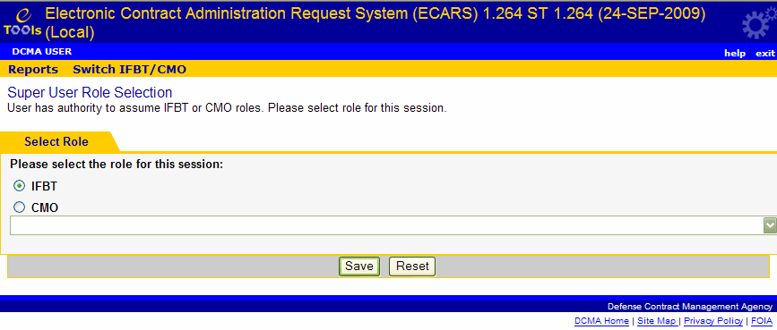
Topic One – Selecting a Role: IFBT or CMO
Selecting a Role: IFBT or CMO
The Super User Role can perform the roles of the IFBT User or the CMO user. The role performed is selected upon logging into ECARS.
Selecting a Role: IFBT or CMO
1. | Log on as the Super User role. The Super User Role Selection page appears (Graphic 1.1).
2. | Select whether you want to act as an IFBT or CMO.
3. | If you chose to act as a CMO user, select a DoDAAC from the drop-down list.
4. | Click the Save button.
5. | Switch roles by clicking the Switch IFBT/CMO link on the menu bar.
Graphic 1.1: Super User Role Selection page
Course Topics
7
Notes:
7

Slide 8
Lesson One – Review
Lesson One covered the following topic:
Topic One | Selecting a Role: IFBT or CMO
Course Topics
Notes:
8

Slide 9
Lesson Two – NASA Contract Information
Lesson Two
NASA Contract Information
Course Topics

Slide 10
Lesson Two – Topics
Lesson Two Topics
Topic One | Assigning NASA Programs to NASA Requests
Topic Two | Maintaining the NASA Program List
Course Topics
Notes:
10

Slide 11
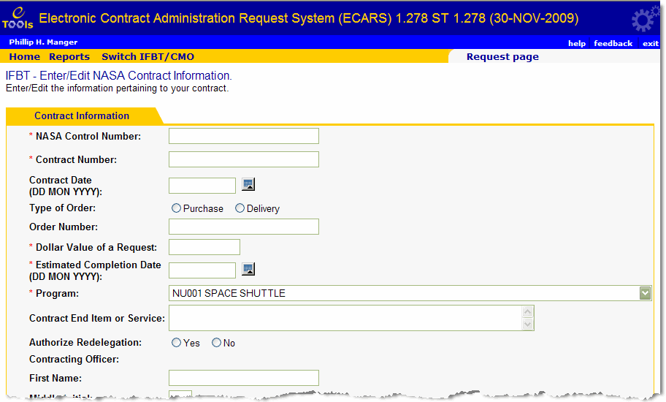
Topic One – Assigning NASA Programs to NASA Requests
Assigning NASA Programs to NASA Requests
IFBT and CMO users will now need to assign NASA Programs to NASA requests. Use the new NASA Program field on the NASA Contract Information page (Graphic 2.1). This drop-down list contains only active NASA programs.
Graphic 2.1 : Enter/Edit NASA Contract Information page
Course Topics
11
Notes:
11

Slide 12
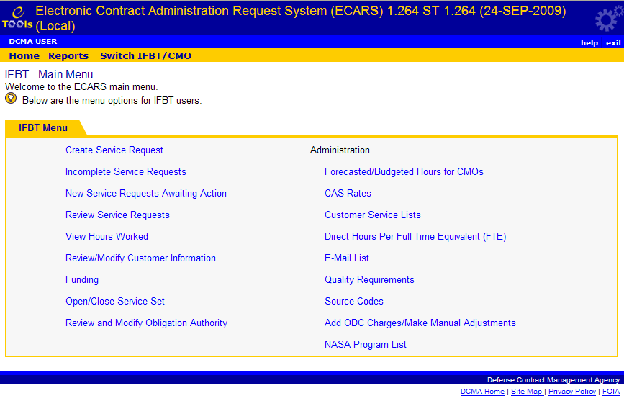
Topic Two – Maintaining the NASA Program List
Maintaining the NASA Program List
IFBT users can maintain the list of NASA programs currently in ECARS.
Maintaining the NASA Program List
1. | Click the NASA Program List link on the IFBT Main Menu (Graphic 2.2). The Browse NASA Program Records page appears (Graphic 2.3).
Graphic 2.2 : IFBT – Main Menu page
Course Topics
12
Notes:
12

Slide 13
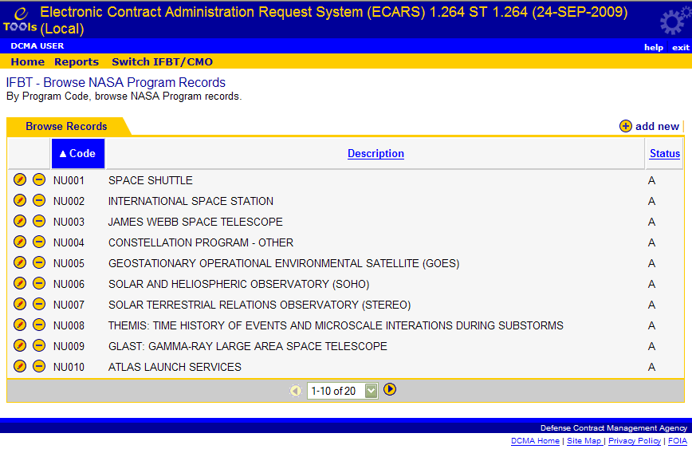
Topic Two – Maintaining the NASA Program List
Maintaining the NASA Program List
The Browse NASA Program Records page displays a list of the NASA programs currently in ECARS (Graphic 2.3). The Browse NASA Program Records page allows you to add new NASA programs, edit existing NASA programs, and deactivate NASA programs.
Edit a program by clicking the icon
Deactivate a program by clicking the icon.
Add a new NASA program to the list by clicking the link.
  In edit mode you can make changes to the Description field only
  In add mode, you can enter the Program Code and Description for a new program
Graphic 2.3 : Browse NASA Program Records
Course Topics
13
Notes:
13

Slide 14
Lesson Two – Review
Lesson Two covered the following topics:
Topic One | Assigning NASA Programs to NASA Requests
Topic Two | Maintaining the NASA Program List
Course Topics
Notes:
14

Slide 15
Lesson Three – Funding History
Lesson Three
Funding History
Course Topics

Slide 16
Lesson Three – Topic
Lesson Three Topic
Topic One | Viewing Funding History
Course Topics
Notes:
16

Slide 17
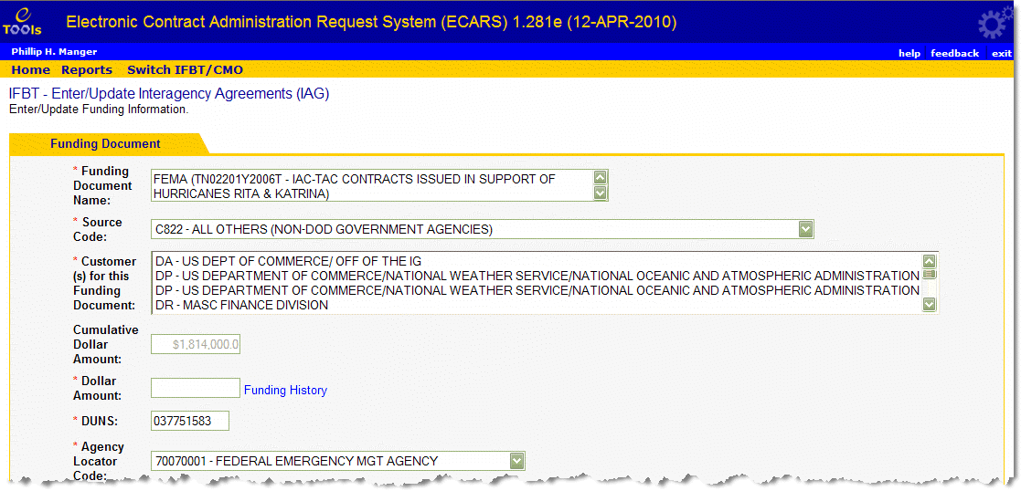
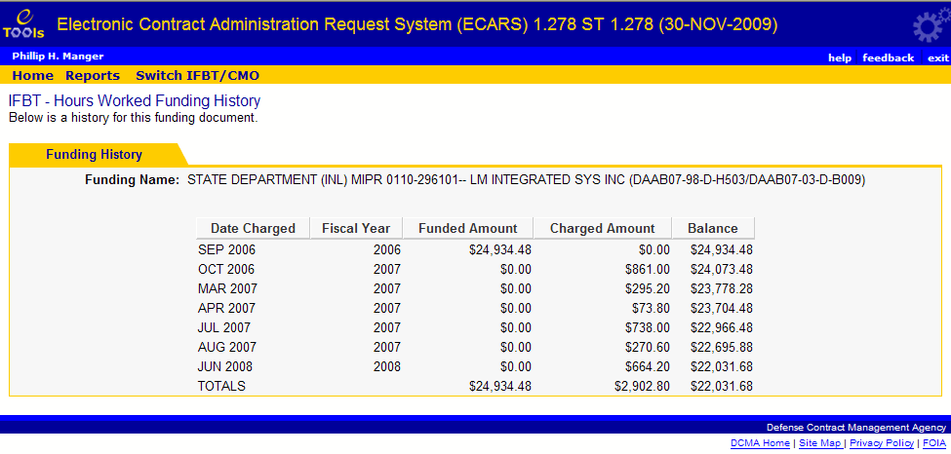
Topic One – Viewing Funding History
Viewing Funding History
IFBT users can access funding history by clicking the Funding History link on the Enter/Edit Funding Document page (Graphic 3.1). The Funding History page displays the monthly history of funding increments and decrements in the Funded Amount column. It also displays the amounts that have been charged against the funding document through PLAS, manual adjustments in ECARS, or ODCs in ECARS. The end-of-month balance is displayed in the Balance column (Graphic 3.2).
Graphic 3.1 : Enter/Update Funding Document
Course Topics
Graphic 3.2 : Funding History
17
Notes:
17

Slide 18
Lesson Three – Review
Lesson Three covered the following topic:
Topic One | Viewing Funding History
Course Topics
Notes:
18

Slide 19
Lesson Four – Funding Attachments
Lesson Four
Funding Attachments
Course Topics

Slide 20
Lesson Four – Topic
Lesson Four Topic
Topic One | Attaching Files to Funding Documents
Course Topics
Notes:
20

Slide 21
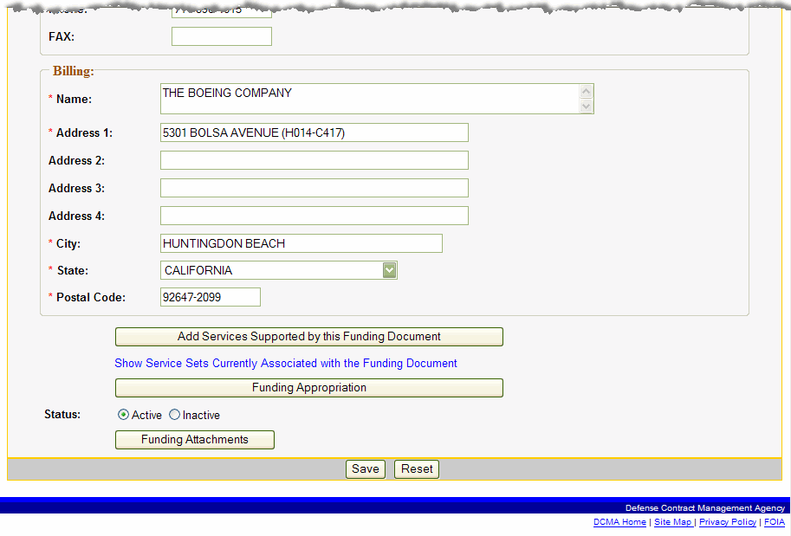
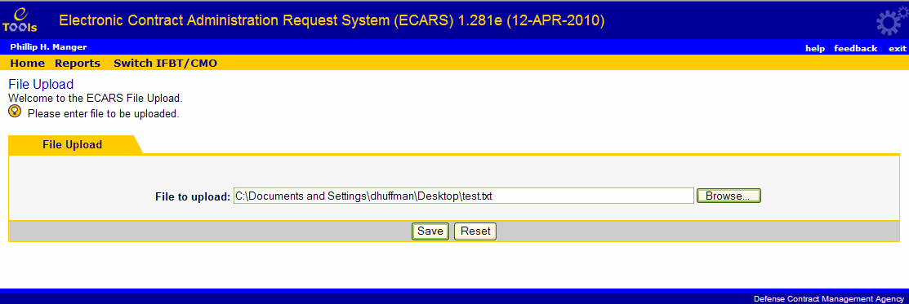
Topic One – Attaching Files to Funding Documents
Attaching Files to Funding Documents
From the Enter/Update Funding Information page, IFBT users can now upload funding attachments to funding documents.
Adding Files to Funding Documents
1. | Edit a funding document or create a new funding document. The Enter/Edit Funding Document page appears (Graphic 4.1).
2. | Click the Funding Attachments button at the bottom of the page. The File Upload page appears (Graphic 4.2).
 | Click the Browse button to select a file to add. The filename and path appear in the File to Upload box.
4. | Click the Save button to add the funding attachment to the funding document.
Graphic 4.1 : Enter/Update Funding Information page (bottom portion only)
Course Topics
Graphic 4.2 : File Upload page
21
Notes:
21

Slide 22
Lesson Four – Review
Lesson Four covered the following topic:
Topic One | Attaching Files to Funding Documents
Course Topics
Notes:
22

Slide 23
Lesson Five – Request ID Data Status
Lesson Five
Request ID Data Status
Course Topics

Slide 24
Lesson Five – Topic
Lesson Five Topic
Topic One | Activating and Deactivating Data Status
Course Topics
Notes:
24

Slide 25
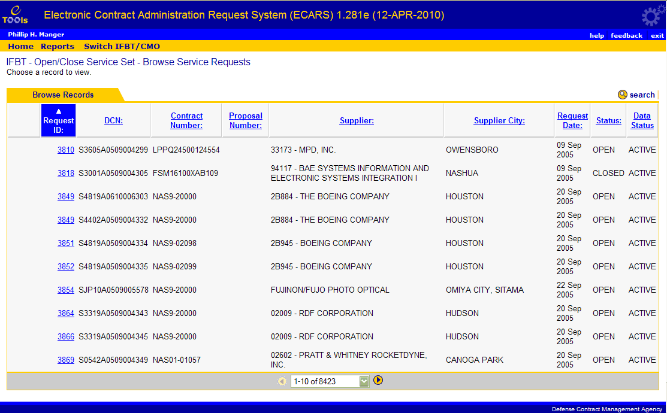
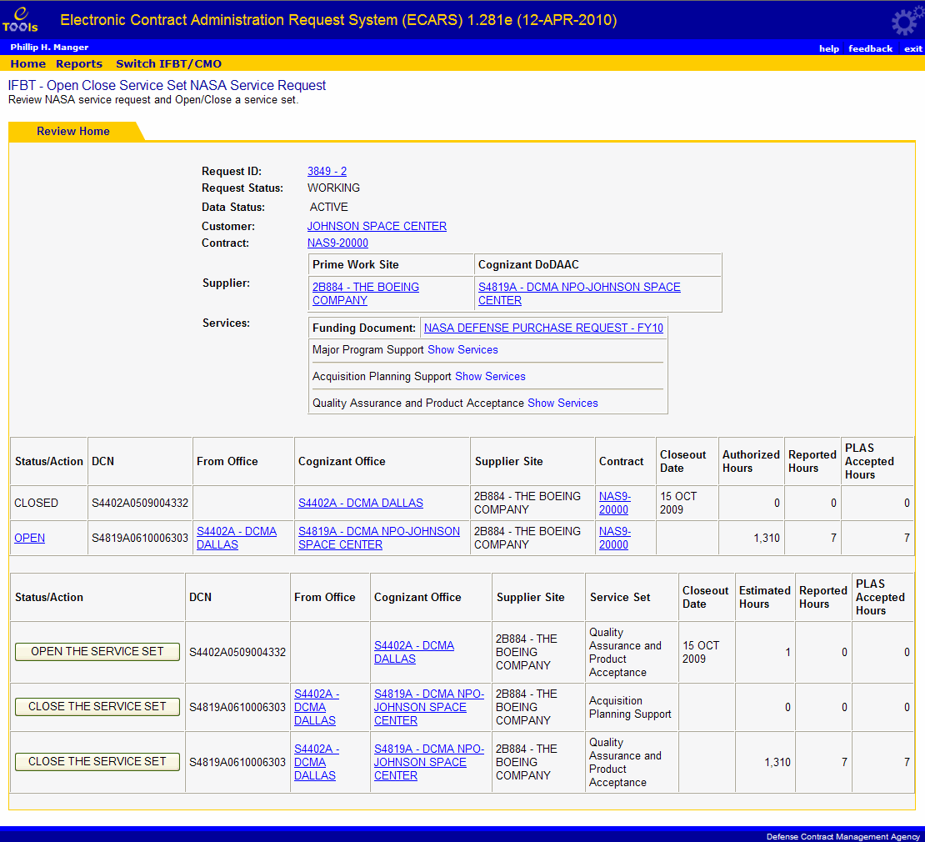
Topic One – Activating and Deactivating Data Status
Activating and Deactivating Data Status
Notice the column for Data Status on the Open Close Service Set – Browse page (Graphic 5.1). The Data Status line indicates whether or not the data associated with this Request ID can be changed (Active) or not (Inactive). To change the data status, click the link on the Request ID. The Open Close Service Set page appears (Graphic 5.2).
You can open or close a service set by clicking the Open the Service Set or Close the Service Set buttons next to a DCN. To close a DCN, all the service sets on the DCN must be closed. Once all the DCNs are closed, the request status is closed.
If the Data Status is Active and the request status is closed, IFBT or CMO users can change the data status to Inactive by closing all the DCNs under the request. If the Data Status is Inactive, it can be re-activated by opening a service set under the request.
Note: If the request has been closed for 180 days, the data status will automatically be changed to Inactive.
Graphic 5.1 : Open Close Service Set – Browse page
Course Topics
Graphic 5.2 : Open Close Service Set page
25
Notes:
25

Slide 26
Lesson Five – Review
Lesson Five covered the following topic:
Topic One | Activating and Deactivating Data Status
Course Topics
Notes:
26

Slide 27
Lesson Six – CMO Response Date
Lesson Six
CMO Response Date
Course Topics

Slide 28
Lesson Six – Topic
Lesson Six Topic
Topic One | Resetting the CMO Response Date
Course Topics
Notes:
28

Slide 29
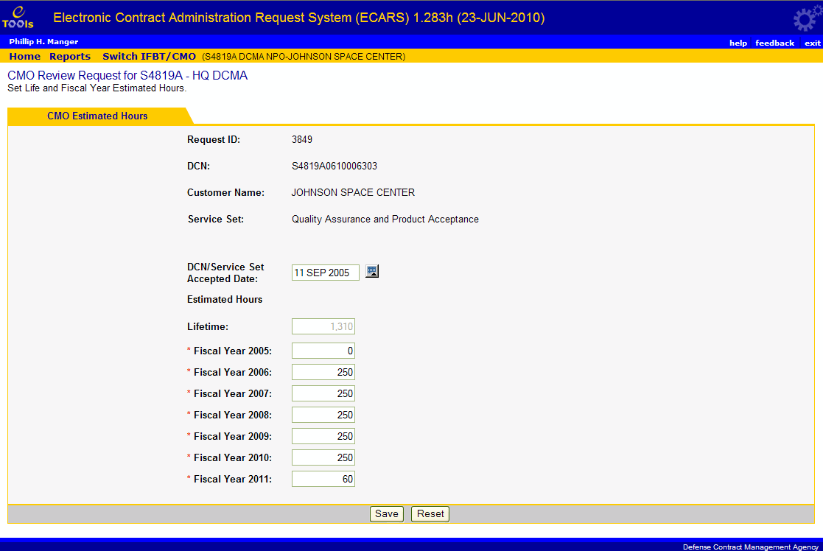
Topic One – Resetting the DCN/Service Set Accepted Date
Resetting the DCN/Service Set Accepted Date
The DCN/Service Set Accepted Date line indicates the date on which the CMO accepted the delegation in ECARS. This function is limited to Super Users and can be done only from the CMO Review Request page.
Resetting the CMO Response Date
1. | Review a service request.
2. | Click the Estimated Hours link. The Estimate Fiscal Year Hours page appears (Graphic 6.1). Note: The DCN/Service Set Accepted Date is read-only if the user is NOT a Super User.
 | Modify the DCN/Service Set Accepted Date.
4. | Click the Save button.
Graphic 6.1 : Estimate Fiscal Year Hours page
Course Topics
29
Notes:
29

Slide 30
Lesson Six – Review
Lesson Six covered the following topic:
Topic One | Resetting the CMO Response Date
Course Topics
Notes:
30

Slide 31
Lesson Seven – Adding and Deleting Services
Lesson Seven
Adding and Removing Services
Course Topics

Slide 32
Lesson Seven – Topics
Lesson Seven Topics
Topic One | Adding and Removing Services
Course Topics
Notes:
32

Slide 33
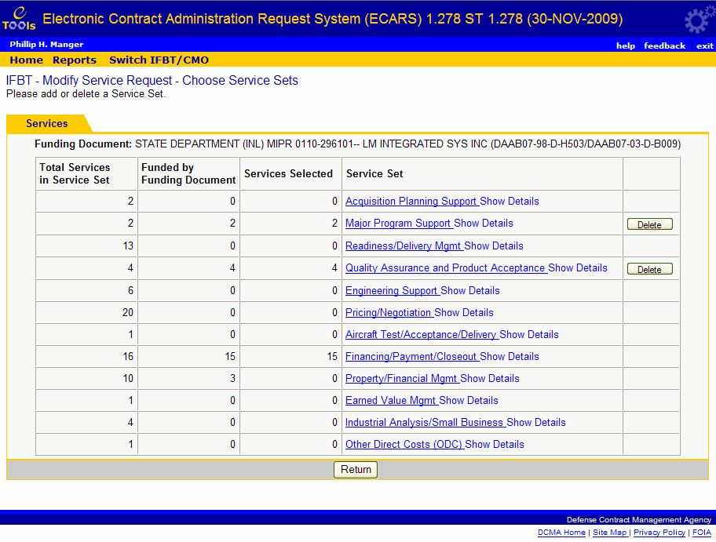
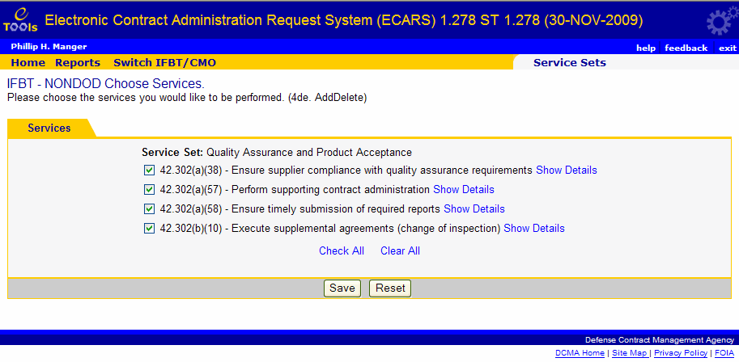
Topic One – Adding and Removing Services
Adding and Removing Services
IFBT users, as well as Super Users selecting the IFBT role, have the capability to add and delete service sets from existing delegations.
Adding and Removing Services
1. | Click the DCN on the Review Service Request page to select a delegation. The Choose Service Sets page appears (Graphic 7.1).
2. | Click the link on the service set to add individual services for that service set. The Choose Services page appears (Graphic 7.2).
3. | Check the boxes next to the services you wish to add.
3. | Click the Save button to save your changes. The Choose Service Sets page appears, displaying the number of services you selected in the Services Selected column.
Click the Delete button next to a service set to automatically remove all the services in that service set.
Graphic 7.1 : Choose Service Sets page
Course Topics
Graphic 7.2 : Choose Services page
33
Notes:
33

Slide 34
Lesson Seven – Review
Lesson Seven covered the following topics:
Topic One | Adding and Removing Services
Course Topics
Notes:
34

Slide 35
Lesson Eight – NASA HQ Role
Lesson Eight
NASA HQ Role
Course Topics

Slide 36
Lesson Eight – Topics
Lesson Eight Topics
Topic One | Selecting a NASA Organization
Course Topics
Notes:
36

Slide 37
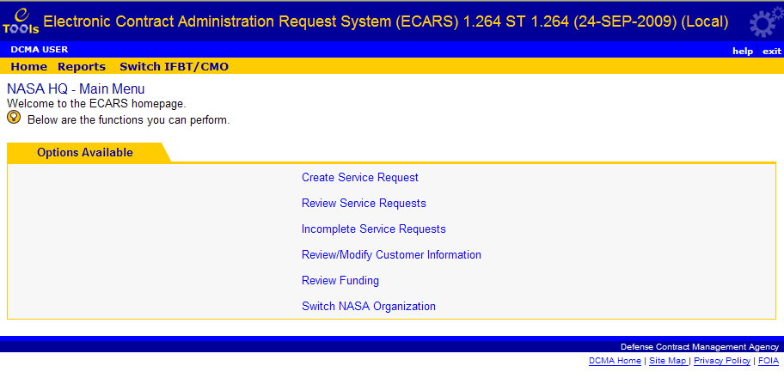
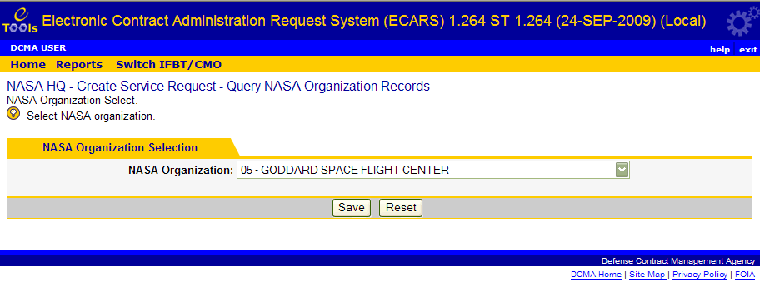
Topic Two – Selecting a NASA Organization
Selecting a NASA Organization
NASA HQ users can use ECARS at both the HQ and organization levels, but not both at the same time. Therefore, the NASA HQ Main Menu includes an option to select the level and organization you want to represent.
Note: If you attempt to create a service request or review/modify customer information before selecting a NASA Organization, you may be forced to select one before you can continue.
Selecting a NASA Organization
1. | Click the Switch NASA Organization link on the NASA HQ Main Menu (Graphic 8.1). The Query NASA Organization Records page appears (Graphic 8.2).
2. | Select a NASA organization from the drop-down list. It can be either a NASA HQ or NASA Center organization.
 | Click the Save button.
Graphic 8.1 : NASA HQ – Main Menu page
Graphic 8.2 : Query NASA Organization Records page
Course Topics
37
Notes:
37

Slide 38
Lesson Eight – Review
Lesson Eight covered the following topics:
Topic One | Selecting a NASA Organization
Course Topics
Notes:
38

Slide 39
ECARS Enhancements Training – Course Lessons
The ECARS Enhancement Training covered the following lessons:
Lesson One | Super User Role
Lesson Two | NASA Contract Information
Lesson Three | Funding History
Lesson Four | Funding Attachments
Lesson Five | Request ID Data Status
Lesson Six | CMO Response Date
Lesson Seven | Adding and Deleting Services
Lesson Eight | NASA HQ Role
Course Topics
Notes:
39

