Slide 1
Contract Audit Follow-Up (CAFU) 3.5
External Users
February 2010

Slide 2
Course Topics
Course Topics
Note: Links will only work in PowerPoint’s slide show view.
Module One | CAFU 3.5 Overview
Lesson One | Overview of CAFU 3.5
Topic One | CAFU 3.5
Topic Two | Enhancement Areas for CAFU 3.5
Topic Three | Reportable and Non-Reportable Audits
Lesson Two | CAFU Functions by Role
Topic One | Contracting Officer (CO) Functions
Topic Two | Major Command (MC) Monitor Functions
Topic Three | District Monitor Functions (DCMA Only)
Topic Four | Headquarters Monitor Functions
Course Topics

Slide 3
Course Topics
Course Topics
Note: Links will only work in PowerPoint’s slide show view.
Module One | CAFU 3.5 Overview (continued)
Lesson Three | Layout Screen
Topic One | Look and Feel
Topic Two | Header
Topic Three | Content Area
Topic Four | Footer
Topic Five | Common Indicators
Topic Six | Calendar
Topic Seven | User Profile
Topic Eight | Modifying Browser Text Size
Topic Nine | Application Messages
Lesson Four | Home Page
Topic One | Home Page
Lesson Five | Work Screen Layout
Topic One | My Work Screen
Topic Two | View My Activity
Course Topics

Slide 4
Course Topics
Course Topics
Note: Links will only work in PowerPoint’s slide show view.
Module Two | Workgroup Audits
Lesson One | My Workgroup Overview
Topic One | About My Workgroup
Topic Two | DCMA
Topic Three | Army
Topic Four | Navy
Topic Five | TRICARE
Topic Six | Air Force
Course Topics

Slide 5
Course Topics
Course Topics
Note: Links will only work in PowerPoint’s slide show view.
Module Three | Audits
Lesson One | Audits
Topic One | Workgroup Audits Screen
Lesson Two | Viewing Audit Details and Actions
Topic One | Viewing Audit Details and Actions Overview
Topic Two | From Audits
Topic Three | From My Work
Lesson Three | Printing the Audit
Topic One | Printing the Audit
Course Topics

Slide 6
Course Topics
Course Topics
Note: Links will only work in PowerPoint’s slide show view.
Module Four | Working with Audit Records
Lesson One | CAFU Pipeline
Topic One | Work Flow Diagram
Lesson Two | Working with Audit Records Overview
Topic One | Common Actions
Topic Two | Validation Error
Lesson Three | Searching for Audits
Topic One | Searching for Audits Overview
Topic Two | Using the Search Screen
Topic Three | Search Results
Course Topics

Slide 7
Course Topics
Course Topics
Note: Links will only work in PowerPoint’s slide show view.
Module Four | Working with Audit Records
Lesson Four | Add New Audits by Monitor
Topic One | Add New Audit
Topic Two | Plan
Topic Three | Resolve
Topic Four | Disposition or Defer Layout
Topic Five | Forward / Send Document
Topic Six | Forwarded
Topic Seven | Correction by Monitors
Topic Eight | Take Over an Audit from the View Audit Follow-Up Screen
Topic Nine | Update Remarks by CO and Monitors
Topic Ten | Update Revised Target Date (CO and Monitors)
Topic Eleven | Deleting Audits
Topic Twelve | Transferring an Audit
Course Topics

Slide 8
Course Topics
Course Topics
Note: Links will only work in PowerPoint’s slide show view.
Module Five | Milestones
Lesson One | Milestones Overview
Topic One | Milestones Overview
Topic Two | Adding Milestones
Topic Three | Updating and Deleting Milestones
Topic Four | Viewing Milestones from View Audit Follow-Up Screen
Module Six | Activity Logging
Lesson One | Activity Overview
Topic One | Activity Overview
Topic Two | Activity Logging per Audit Report
Topic Three | Activity Logging per User
Module Seven | Frequently Asked Questions
Topic One | CAFU 3.5 Frequently Asked Questions
Course Topics

Slide 9
Course Objectives
At the end of this training you should be able to:
Enter all key information for tracking reportable and non-reportable audit records in a single web-based database with the Single Sign On (SSO) feature
Collect information and create reports for management of CAFU and reporting to the DoD IG for each semi-annual reporting period
Provide alert notifications to users on audit records needing attention for completing the required tasks of Resolution and Disposition, as well as, new assignments
Course Topics
Notes:
9

Slide 10
Course Modules
Course Modules
Module One | CAFU 3.5 Overview
Module Two | Workgroup Audits
Module Three | Audits
Module Four | Working with Audit Records
Module Five | Milestones
Module Six | Activity Logging
Module Seven | Frequently Asked Questions
Course Topics

Slide 11
Module One – CAFU 3.5 Overview
Module One
CAFU 3.5 Overview
Course Topics
Notes:
11

Slide 12
Module One – CAFU 3.5 Overview
Module One Lessons
Lesson One | Overview of CAFU 3.5
Lesson Two | CAFU Functions by Role
Lesson Three | Layout Screen
Lesson Four | Home Page
Lesson Five | Work Screen Layout
Course Topics
Notes:
12

Slide 13
Lesson One – Overview of CAFU 3.5
Lesson One
Overview of CAFU 3.5
Course Topics

Slide 14
Lesson One – Overview of CAFU 3.5
DCMA is responsible for compliance with DoD Instruction (DoD I) 7640.02 (previously Directive 7640.2) which requires that all audit reports be tracked. In addition, DCMA is responsible for reporting to the DoD IG the status of those contracts (semi-annually) which are deemed reportable by the directive. The reportable audits are closely monitored to ensure that the status has the most current information and the audit reports are progressing through all the milestones stated in DoD I 7640.02
DoD I 7640.02 was modified and now requires users to capture detailed information on interest and penalties
Administrators and users of the system have identified changes and additional functionality needed in the system.
Course Topics

Slide 15
Lesson One – Topics
Lesson One Topics
Topic One | CAFU 3.5
Topic Two | Enhancement Areas for CAFU 3.5
Topic Three | Reportable and Non-Reportable Audits
Course Topics
Notes:
15

Slide 16
Topic One – CAFU 3.5
CAFU 3.5
  The CAFU 3.5 web application has been constructed in consonance with the independent, decision-making role of the Contracting Officer (CO), and the financial advisory role of the Contract Auditor. It is designed to receive new audit reports from the Defense Contract Auditing Agency (DCAA) and audits to Contracting Officers (COs) and Monitors. The system assigns audits to Monitors also, if the ACO is not available for the DoDAAC. CAFU supports the following agencies:
              AIR FORCE
              ARMY
              DCMA
              NAVY
              TRICARE
              DoD IG
  .
Course Topics
Notes:
16

Slide 17
Topic Two - Enhancement Areas for CAFU 3.5
CAFU Enhancements
New E-Mail Notifications
      Notification of New Audit Record(s) - When new audit records are loaded into the eTools system.
      Notification to Update Audit Record(s) - When the ACO/Monitor has not updated a record and it is at least four months old.
      Notification to fill Resolution Date(s) - When an Actual Resolution Date has not been filled in and it becomes six months old.
      Reminder: CAFU cut-off date - When the audit record has reached 30 days before the cut-off date of the semi-annual reports. The cut-off date for updating is September 30th close of the business, and March 31st close of business.
Forward Features Added and Modified
      Forward feature has been made a requirement when entering a Disposition Actual Date (Only for Reportables).
      A notice has been added when using the Forward feature (Only for Reportables).
Course Topics
17
Notes:
17

Slide 18
Topic Two - Enhancement Areas for CAFU 3.5
CAFU Enhancements
New Data Fields (Received from DCAA)
      Qualified or Unresolved Cost - Will be YES or NO. For existing records with no value it will be shown as blank.
      Questioned Cost Subject to Penalty - Will display the value from DCAA data load. A default value of $0.00 will be shown when this field does not have any value.
      Update Data Field – Increased the following character allowance on any screen that contains the Remarks field from 500 to 2,500 characters.
Screen Modification
      Disposition Audit Follow-Up Record has been changed to Disposition or Defer Audit Follow-Up Record.
Updated Reports
      New data fields have been added in the CAFU Semi-Annual Open Report .
      New data fields have been added in the CAFU Semi-Annual Closed Report.
      The width of the drop-down box in the report viewer is increased.
Course Topics

Slide 19
Topic Three – Reportable and Non-Reportable
Audits
Reportable audits are identified as:
  Those containing findings and recommendations, whether or not the findings are qualified, covering estimating system surveys, accounting and related internal control system reviews, defective pricing reviews, Cost Accounting Standards (CAS) issues, CAS cost impact statement reviews, and real-time deficiencies (flash) reports
  Those covering operations reviews, incurred costs including final indirect cost rates or auditor-determined final indirect cost rates referred to the CO for final decision, final pricing submissions, termination settlement proposals, and claims, if reported costs or rates questioned or qualified equal $100,000 or more
  Those Contractor Insurance and Pension Review (CIPR) Contractor Insurance Pension Review) reports issued by the DCMA identifying instances of contractor noncompliance with (CAS), and all CIPR reports with questioned or qualified costs of $100,000 or more
Course Topics

Slide 20
Topic Three – Reportable and Non-Reportable
Audits
Non-Reportable audits are identified as:
  Reports covering pre-award proposals; forward pricing labor, overhead, and other advance rate proposals; progress payments; pre-award surveys; proposals for change orders or modifications; assist audits; and closing statements are not to be reported
Course Topics

Slide 21
Module One – Lesson One - Review
Lesson One Covered the Following Topics:
Topic One | CAFU 3.5
Topic Two | Enhancement Areas for CAFU 3.5
Topic Three | Reportable and Non-Reportable Audits
Course Topics
Notes:
21

Slide 22
Lesson Two – CAFU Functions by Role
Lesson Two
CAFU Functions by Role
Course Topics

Slide 23
Lesson Two -Topics
Lesson Two Topics
Topic One | Contracting Officer (CO) Functions
Topic Two | Major Command (MC) Monitor Functions
Topic Three | District Monitor Functions (DCMA Only)
Topic Four | Headquarters Monitor Functions
Course Topics
Notes:
23

Slide 24
Topic One – Contracting Officer (CO) Functions
Contracting Officer (CO) Functions
Plan Audits
Resolve Audits
Disposition Audits
Defer Audits
Disposition Audits After Deferral
Transfer Audit to Another User within the Agency
View & Edit Audits Assigned to You
Forward Audits
Update Remarks
Update Revised Disposition Target Date
Add Milestones
View CAFU Enhancements & CAFU Features
View Activities & Audits Assigned to COs in Your Workgroup (this may include audits that have been transferred out of the user's work list)
Course Topics
Table 1.2.1.1: Contracting Officer Functions
Notes:
24

Slide 25
Topic Two – Major Command (MC) Monitor Functions
Major Command (MC) Monitor Functions
Assign Audits by Transferring or Adding New Audits
Search and Print Audits
Add Audits within the MC Workgroup
Correct Audits
View, Edit, Search and Sort Audits
View Reports
View CAFU Enhancements & CAFU Features
Update Remarks
Update Revised Disposition Target Date
Add Milestones
Transfer Audits within Agency
Take Over Audits to their My Work
Course Topics
Table 1.2.2.1: Major Command Functions
25
Notes:
25

Slide 26
Topic Three – District Monitor Functions (DCMA Only)
District Monitor Functions (DCMA Only)
Assign audits by transferring or adding new audits
Add Audits within the MC Workgroup
Search and Print Audits
Correct Audits
View, Edit, and Search Audits
View Reports
View CAFU Enhancements and CAFU Features
Update Remarks
Delete Audits
Update Revised Disposition Target Date
Add Milestones
Transfer Audits within own agency
Take Over Audits to their My Work
Table 1.2.3.1: District Monitor Functions (DCMA only)
Course Topics
Note: This Role is for information purposes only. It is a DCMA Internal Role.
Notes:
26

Slide 27
Topic Four – Headquarters Monitor Functions
Headquarters Monitor Functions
View, Search, and Print Audits
Correct Audits
Take Over Audits
View Reports
View CAFU Enhancements and CAFU Current Features
Transfer Audits within own Agency OR to Another Agency
Delete Audits
Update Remarks Field
Add, Modify, or Delete Milestones
Table 1.2.4.1: Headquarters Monitor Functions
Course Topics
27
Notes:
27

Slide 28
Module One – Lesson Two - Review
Lesson Two Covered the Following Topics:
Topic One | Contracting Officer (CO) Functions
Topic Two | Major Command (MC) Monitor Functions
Topic Three | District Monitor Functions (DCMA Only)
Topic Four | Headquarters Monitor Functions
Course Topics
Notes:
28

Slide 29
Lesson Three – Layout Screen
Lesson Three
Layout Screen
Course Topics

Slide 30
Lesson Three -Topics
Lesson Three Topics
Topic One | Look and Feel
Topic Two | Header
Topic Three | Content Area
Topic Four | Footer
Topic Five | Common Indicators
Topic Six | Calendar
Topic Seven | User Profile
Topic Eight | Modifying Brower Text Size
Topic Nine | Application Messages
Course Topics
Notes:
30

Slide 31
Topic One – Look and Feel
Look and Feel
This section covers the overall Look and Feel of the CAFU 3.5 Application.
    There are three main sections to the application layout:
      Header
      Content Area
      Footer
Course Topics
Notes:
31

Slide 32
Topic Two – Header
Header
The Header consists of the Title Bar and Menu Bar. The following list highlights
the differences between the Title Bar and Menu Bar:
Title Bar | Menu Bar
Branding: e-Tools logo and application name with version | Provide links for easy navigation throughout the application
User Name: Clicking on the user's name shows user's profile | Main application links: High-level links that allow the user to access the main features of the CAFU application
Help: Provides access to the help files | Context sensitive links: Provide access to cross-reference information and content related to current page
Exit: Quits the CAFU application
Table 1.3.2.1: CAFU 3.5 Header
Course Topics
Notes:
32

Slide 33

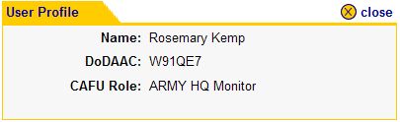
Topic Two – Header
Header (continued)
The Header consist of the Title Bar and the Menu Bar.
Title Bar
Menu Bar
Header (Graphics 1.3.2.2 - 1.3.2.3)
1 | Click on the user name. User Profile appears (Graphic 1.3.2.3) User Profile shows user DoDAAC, and CAFU role
Graphic 1.3.2.2: CAFU 3.5 Header Title and Menu Bar
Graphic 1.3.2.3: CAFU 3.5 User Profile
Course Topics
33
Notes:
33

Slide 34
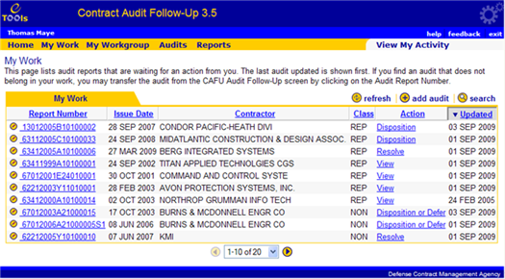
Topic Three – Content Area
Content Area
This page lists audit reports that are waiting for an action from you. The last audit updated is shown first. If you find an audit that does not belong in your work, you may transfer the audit from the CAFU Audit Follow-Up screen by clicking on the Audit Report Number.
Title and Description
This section displays the title and description of the page. It also provides the purpose of the page and the actions that the user can perform.
Data Table
This section displays a table of records related to the page. It also provides actions that can be performed on the table, such as refresh and search. Data Table is only used on pages that need to display records (Graphic 1.3.3.1).
Content Area Title and Description (Graphic 1.3.3.1)
1. | Click the My Work link in the Menu Bar. The My Work Page opens (Highlighted in yellow)
Graphic 1.3.3.1: Title and Description Table
Record Scroller - The record scroller displays the number of records in the current view and allows the user to scroll through the pages of records. The record scroller is only used in conjunction with a Data Table; it is omitted if there are no records.
Course Topics
34
Notes:
34

Slide 35
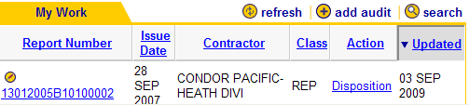
Topic Three – Content Area
Dynamic Sorting by Column Header
This feature allows users to arrange the records in
any preferred order.
Sorting by Column Header (Graphic 1.3.3.2)
1. | Click on the Report Number header.
 | The Report Number field will sort ascending or descending
3. | Click on the Contractor Name heading.
 | The result will be records sorted by Reportable first, then Contractor Name second
1.3.3.2: Sorting by Column Header
Note: Reportable records are presented first when presenting an audit list to the user.
This applies regardless of a user's selected sort order.
Course Topics
35
Notes:
35

Slide 36

Topic Four – Footer
Footer
The footer provides links to standard DCMA web sites:
Graphic 1.3.4.1: Footer
Course Topics
36
Notes:
36

Slide 37
Topic Five – Common Indicators
Common Indicators
Standard icons and indicators are used throughout the application to provide consistent behavior and improve usability. The following are some of the most commonly used icons:
Icon Name Description
 | Calendar | Display the calendar in a pop-up window to help user select a date.
 | Edit | Edit the record.
 | Close | Close a pop-up window.
 | Error | Indicates a validation error that must be fixed by the user.
 | Hint | Shows usage hint(s) related to the current page.
 | Print | Print the current page.
 | Refresh | Refresh the related Data Table.
 | Search | Search within the related Data Table.
 | Add | Add a new record.
 | Delete | Delete the record.
 | Jump down | Jump down to a bookmark on the page. This icon is also used to denote the order of sorting.
 | Jump up | Jump up to a bookmark on the page. This icon is also used to denote the order of sorting.
 | Next | Jumps to the next page or record.
 | Previous | Jumps to the previous page or record.
Course Topics
Graphic 1.3.5.1: CAFU Common Indicators
37
Notes:
37

Slide 38

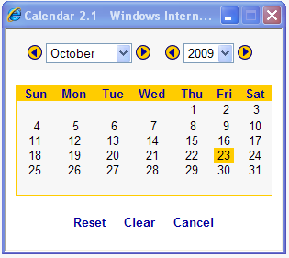
Topic Six – Calendar
Calendar
The calendar provides a convenient way of inputting dates. It ensures that the format of the date will be accurate and consistent.
Calendar (Graphics 1.3.6.1 – 1.3.6.2)
1. | Click the Calendar icon. The Calendar opens
2. | Select the month desired . The arrow on the left or right surrounding the month
 | Click on the arrows on either side of the years field.
4. | Click the drop down box for the Month. Select the desired month and year
5. | Click the desired day. The current date will be highlighted The date will be automatically populated in the correct format. 23 OCT 2009
Graphic 1.3.6.1: Calendar Icon
Graphic 1.1.6: Calendar
Graphic 1.3.6.2: Calendar
Course Topics
38
Notes:
38

Slide 39
Topic Seven – User Profile
User Profile
Your user profile can be accessed from any screen in the application (except for confirmation pages). To access your profile follow these steps:
Graphic 1.3.7.1: User Name
User Profile (Graphics 1.3.7.1 – 1.3.7.2)
1. | Click on your name in the light blue section of the header. Your User Profile will appear in a pop-up window.
 | Click on close in the upper right hand corner of the window to exit.
Graphic 1.3.7.2: User Profile
Course Topics
39
Notes:
39

Slide 40
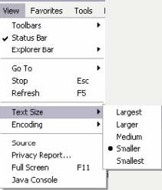
Topic Eight – Modifying Browser Text Size
Modifying Browser Text Size
Text size can be modified from the Internet Explorer menu bar. Please note that the default text size is Medium.
Graphic 1.3.8.1: Modifying Browser Text Size
Modifying Browser Text Size (Graphics 1.3.8.1 - 1.3.8.2)
1. | Select View from the menu bar.
2. | Select Text Size from the view list. A list of text sizes will display
3. | Choose the desired text size.
Graphic 1.3.8.2: Modifying Browser Text Size
Course Topics
40
Notes:
40

Slide 41
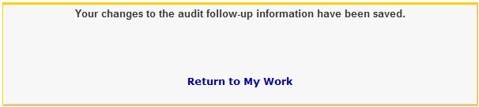

Topic Nine – Application Messages
Application Messages
If you have selected Submit, Cancel or an action on a Data Table, you will receive a message informing you that the system has performed the appropriate action. The confirmation will direct you to the screen from which you originated or to a related screen .
System Time Out
Graphic 1.3.9.1: Application Message – Successful Submit Confirmation
If the user has taken no action in CAFU
(i.e. click on link or button) for 4 hours, the system will automatically log the user out of the application. At this point, you must log back in.
Graphic 1.3.9.2: Application Message – Cancellation Confirmation
Course Topics
41
Notes:
41

Slide 42
Lesson Three – Review
Lesson Three Covered the Following Topics:
Topic One | Look and Feel
Topic Two | Header
Topic Three | Content Area
Topic Four | Footer
Topic Five | Common Indicators
Topic Six | Calendar
Topic Seven | User Profile
Topic Eight | Modifying Browser Text Size
Topic Nine | Application Messages
Course Topics
Notes:
42

Slide 43
Lesson Four– Home Page
Lesson Four
Home Page
Course Topics

Slide 44
Lesson Four – Topics
Lesson Four Topics
Topic One | Home Page
Course Topics
Notes:
44

Slide 45
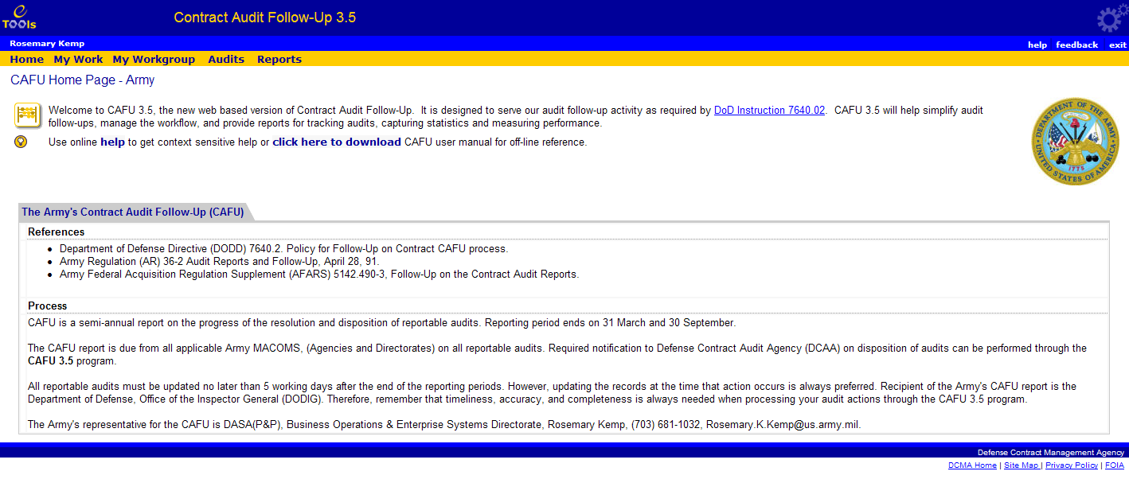
Topic One – Home Page Content
Home Page Content
The Home Page is the first page that the user will see when they access CAFU. Your Home Page will be unique for your particular Service.
Course Topics
Graphic 1.4.1.1: Home Page Content
Notes:
45

Slide 46
Lesson Four – Review
Lesson Four Covered the Following Topics:
Topic One | Home Page
Course Topics
Notes:
46

Slide 47
Lesson Five – Work Screen Layout
Lesson Five
Work Screen Layout
Course Topics

Slide 48
Lesson Five – Topics
Lesson Five Topics
Topic One | My Work Screen
Topic Two | View My Activity
Course Topics
Notes:
48

Slide 49
Topic One – My Work Screen
My Work Screen
    My Work displays audits that are waiting for an action to be completed by you
    Monitors are responsible for assignment, correction, and adding (HQ and MACOM) and deleting (HQ) audits assigned to them or audits taken-over from their workgroup. COs are responsible for the follow-up activities from planning to forwarding the memo
    There are only three roles for Non-DCMA agencies:
        HQ Monitors
        Major Command Monitors
        COs
The workgroup for service agencies, include all users within the agency.
Course Topics
Notes:
49

Slide 50
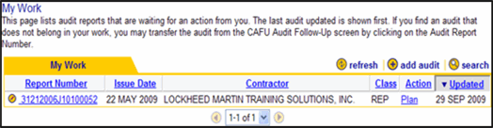
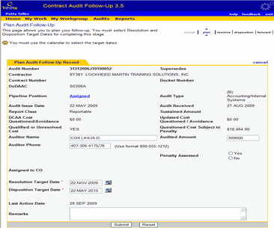
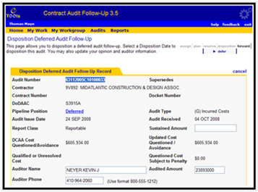
Topic One – My Work Screen
My Work Screen (continued)
To jump to the edit audit screen follow the directions below. The work flow explains the difference in pipeline positions shown
when editing the record.
My Work Screen (Graphics 1.5.1.1 – 1.5.1.2)
1. | Click the Edit Pencil Icon. Clicking on the Audit Report Number takes you to the View Audit Follow-Up screen that shows the details about the audit Clicking on the Contractor name shows details about the Contractor (if available) Clicking on the Action link takes you to the CAFU Work Flow Diagram. (The Work Flow Diagram is discussed in Module Four Lesson One
Graphic 1.5.1.1: Edit Pencil Icon
Course Topics
Graphic 1.5.1.2: Disposition Deferred Audit Follow-UP
Notes:
50

Slide 51
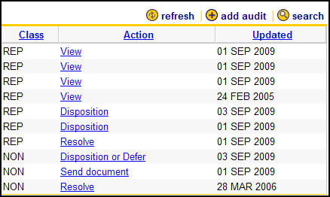
Topic One – My Work Screen
My Work Screen (continued)
Follow the directions below for information on the Refresh, Add Audit, and Search Buttons.
My Work Screen (Graphic 1.5.1.3)
1 | Click on the refresh link to have the system look for newly assigned audits.
2 | The add audit feature is available to CMO, District and MC Monitors. If you have received an audit report from DCAA that is not in your work, please have your CMO, HQ or MACOM/District add it to the system.
3 | You can filter this list to locate specific audits by using the search link. Note that using the search feature here will only search within the audits in your work.
Graphic 1.5.1.3: Refresh, Add Audit and Search Links
Course Topics
Notes:
51

Slide 52
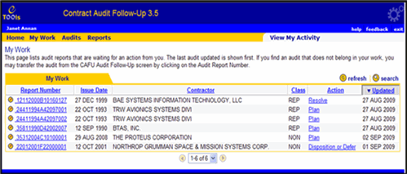
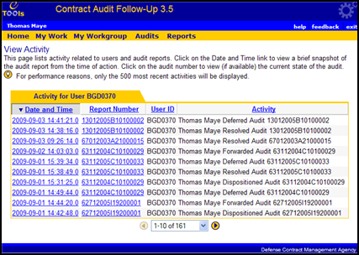
Topic Two – View My Activity
View My Activity
  View My Activity displays activities for the current user.
View My Activity Steps (Graphics 1.5.2.1 – 1.5.2.2)
1. | Click the View My Activity Link from the My Work window. The View Activity window opens
 | Click on the Date and Time column for a snapshot of the Audit Report, if available.
 | Click on the Audit Report Number to access the View Audit Follow-Up screen.
Graphic 1.5.2.1: My Work Window
Course Topics
Graphic 1.5.2.2: View My Activity Window
52
Notes:
52

Slide 53
Module One – Lesson Five - Review
Lesson Five Covered the Following Topics:
Topic One | My Work Screen
Topic Two | View My Activity
Course Topics
Notes:
53

Slide 54
Module One – Review
Module One Covered the Following Lessons:
Lesson One | Overview of CAFU 3.5
Lesson Two | CAFU Functions by Role
Lesson Three | Layout Screen
Lesson Four | Home Page
Lesson Five | Work Screen Layout
Course Topics
Notes:
54

Slide 55
Module Two – Workgroup Audits
Module Two
Workgroup Audits
Course Topics
Notes:
55

Slide 56
Module Two – Workgroup Audits
Module Two Lessons
Lesson One | My Workgroup Overview
Course Topics
Notes:
56

Slide 57
Lesson One – My Workgroup Overview
Lesson One
My Workgroup Overview
Course Topics

Slide 58
Lesson One – Topics
Lesson One Topics
Topic One | About My Workgroup
Topic Two | DCMA
Topic Three | Army
Topic Four | Navy
Topic Five | TRICARE
Top Six | Air Force
Course Topics
Notes:
58

Slide 59
Topic One – About My Workgroup
About My Workgroup
Workgroup Audits provides information about your CAFU account, your workgroup, and members of your workgroup
A workgroup is defined by a group of people working at different levels functioning as a logical group for audit follow-up. You can click on the activity link for a workgroup member to see his/her activity
Actions pertaining to a role cannot be taken directly from My Workgroup
Only Monitors have the option to take over an audit from their workgroup, at which time, actions can be taken against an audit directly from My Work screen
For each user in your workgroup, a list of their activities can be viewed by clicking on the activity link located in the Show Activity column
Table 2.1.1.1: My Workgroup
Note: **Invalid** may appear in the Role column when a user does not have proper access privileges
Course Topics
Notes:
59

Slide 60
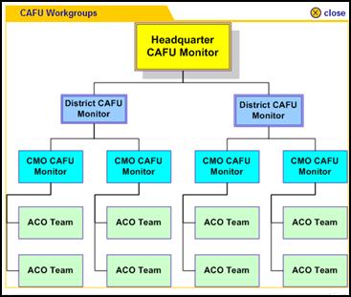
Topic Two – DCMA
DCMA Workgroup
This page provides information about your CAFU account, your workgroup, and members of your workgroup.
The CAFU workgroup consists of two roles and three levels as illustrated in the organization chart to the right.
Monitors are responsible for assignment, correction, and adding (CMO and District) and deleting (District) audits within their workgroup.
ACOs are responsible for the follow-up activities from planning to forward the memo.
Graphic 2.1.2.1: DCMA Workgroup
Course Topics
Note: This Workgroup is for information purposes only. It is a DCMA Internal Workgroup.
60
Notes:
60

Slide 61
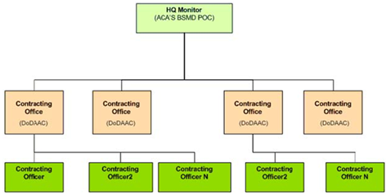
Topic Three – Army
Army Workgroup
The Army CAFU workgroup consists of two roles and three levels, as illustrated in the following organization chart:
Graphic 2.1.3.1: Army Workgroup
Course Topics
Notes:
61

Slide 62
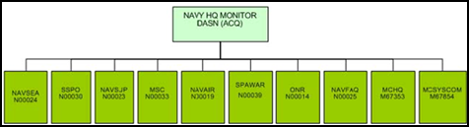
Topic Four – Navy
Navy Workgroup
This page provides information about your CAFU account, your workgroup, and members of your workgroup. The Navy CAFU workgroup consists of two roles and two levels, as illustrated in the following organization chart:
Graphic 2.1.4.1: Navy Workgroup
Course Topics
62
Notes:
62

Slide 63
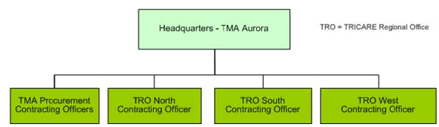
Topic Five – TRICARE
TRICARE Workgroup
The TRICARE CAFU workgroup consists of two roles and two levels, as illustrated in the following organization chart:
Graphic 2.1.5.1: TRICARE Workgroup
Course Topics
63
Notes:
63

Slide 64
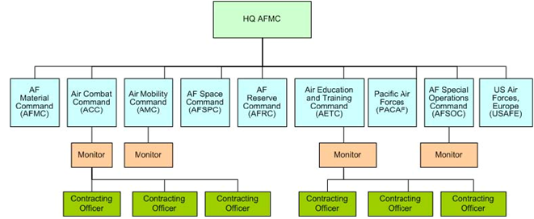
Topic Six – Air Force
Air Force Workgroup
The Air Force CAFU workgroup consists of two roles and four levels, as illustrated in the following organization chart:
Graphic 2.1.6.1: Air Force Workgroup
Course Topics
64
Notes:
64

Slide 65
Module Two – Lesson One – Review
Lesson One Covered the Following Topics:
Topic One | About My Workgroup
Topic Two | DCMA
Topic Three | Army
Topic Four | Navy
Topic Five | TRICARE
Topic Six | Air Force
Course Topics
Notes:
65

Slide 66
Module Two – Review
Module Two Covered the Following Lesson:
Lesson One | My Workgroup Overview
Course Topics
Notes:
66

Slide 67
Module Three – Audits
Module Three
Audits
Course Topics
Notes:
67

Slide 68
Module Three – Audits
Module Three Lessons
Topic One | Audits
Topic Two | Viewing Audit Details and Actions
Topic Three | Printing the Audit
Course Topics
Notes:
68

Slide 69
Lesson One – Audits
Lesson One
Audits
Course Topics

Slide 70
Lesson One – Topics
Lesson One Topics
Topic One | Workgroup Audits Screen
Course Topics
Notes:
70

Slide 71
Topic One – Workgroup Audits Screen
Workgroup Audits Screen
  Accessible from the home page through the Audits link, this screen provides a list of all audits that are in your workgroup.
  For Non-DCMA agencies, the workgroup consists of users within the agency (By default, DCMA District and HQ Monitors do not see any audits in the Audits screen).
Course Topics
Notes:
71

Slide 72
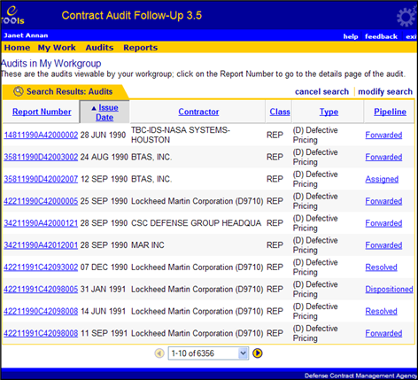
Topic One – Workgroup Audits Screen
Workgroup Audits Screen (continued)
You can filter this list to locate specific audits by using the search link.
Workgroup Audits Screen (Graphic 3.1.1.1)
1. | Click the Report Number. The View Workgroup Audit Follow-Up screen opens with audit details
2. | Click the Pipeline Column. This shows the CFU Work Flow Diagram (The Work Flow Diagram is discussed in Module Four Lesson One) The CAFU Work Flow Diagram will display the description of the pipeline that the audit has completed
Graphic 3.1.1.1: Workgroup Audits Screen
Note: Audits in your workgroup cannot be edited. To edit an Audit it must be assigned to you and
appear under your My Work screen.
Course Topics
Notes:
72

Slide 73
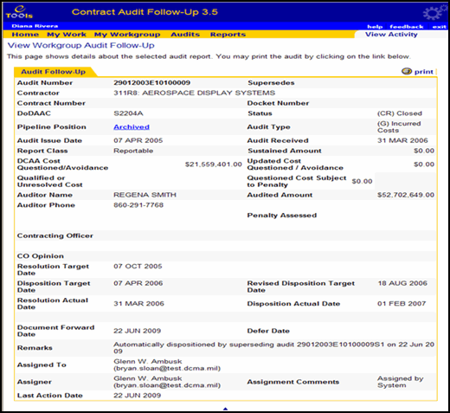
Topic One – Workgroup Audits Screen
Workgroup Audits Screen (continued)
The View Workgroup Audit Follow-Up screen opens with audit details after user click the report number.
NOTE: The audits listed in the workgroup audits screen not only includes audits that are assigned to individuals in the user's workgroup, but also includes audits that are assigned to the current user.
Course Topics
Graphic 3.1.1.2: Workgroup Audits Follow-Up Screen
Notes:
73

Slide 74
Module Three – Lesson One - Review
Lesson One Covered the Following Topics:
Topic One | Workgroup Audits Screen
Course Topics
Notes:
74

Slide 75
Lesson Two – Viewing Audit Details and Actions
Lesson Two
Viewing Audit Details and Actions
Course Topics

Slide 76
Lesson Two – Topics
Lesson Two Topics
Topic One | Viewing Audit Details and Actions Overview
Topic Two | From Audits
Topic Three | From My Work
Course Topics
Notes:
76

Slide 77
Topic One – Viewing Audit Details and Actions Overview
Viewing Audit Details and Actions Overview
    The View Audit Follow-Up screen provides details about the audit. It also provides links to common actions that can be taken on an audit outside of the pipeline
    The View Audit Follow-Up screen displays all of the information about an audit report for read only purposes; none of the fields are editable
    There are two versions of the View Audit Follow-Up screen; one available from the Audits screen and the other from My Work screen
Course Topics
Notes:
77

Slide 78
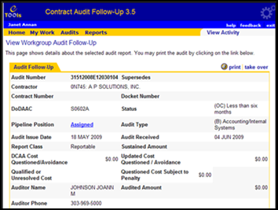
Topic Two – From Audits
From Audits Screen
The Audits screen lists audits from the entire workgroup and may include audits that are not assigned to you.
Note: This aspect of View Audit Follow-Up will not give you links for update milestones, update remarks or edit.
Graphic 3.2.2.1: Search Results Audits in My Workgroup
Audit Follow-Up (Graphics 3.2.2.1 – 3.2.2.2 )
1. | Click on a Report Number from the Audits in My Workgroup window . This will open up the View Workgroup Audit Follow- Up screen.
Course Topics
Graphic 3.2.2.2: Audit Follow-Up Screen
78
Notes:
78

Slide 79
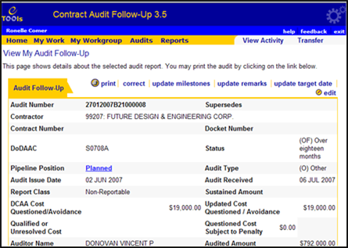
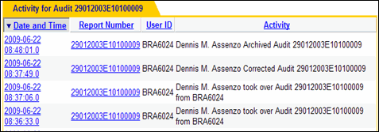
Topic Three – From My Work
From My Work
The My Work version of the View Audit Follow-Up screen provides links for print, correct, update milestones, update remarks, update target date and edit.
Note: The delete action is only available to DCMA
& Service HQ Monitors; correct is available
to MC/Service HQ and DCMA District Monitors.
My Work Tab (Graphics 3.2.3.1 – 3.2.3.2 )
1. | Click on View Activity link to view activity for a specific audit. This will open up the View Activity screen with the Activity for Audit tab This page lists activity related to users and audit reports
 | Click on the Date and Time link to view a brief snapshot of the audit report from the time of action.
 | Click on the Report Number to view the current state of the audit (if available).
Graphic 3.3.3. Search Results Audits in My Work
Graphic 3.2.3.1: My Work View My Audit Follow-Up Screen
Course Topics
Graphic 3.2.3.2: Activity for Audit Tab
79
Notes:
79

Slide 80
Module Three – Lesson Two - Review
Lesson Two Covered the Following Topics:
Topic One | Viewing Audit Details and Actions Overview
Topic Two | From Audits
Topic Three | From My Work
Course Topics
Notes:
80

Slide 81
Lesson Three – Printing the Audit
Lesson Three
Printing the Audit
Course Topics

Slide 82
Lesson Three – Topic
Lesson Three Topic
Topic One | Printing the Audit
Course Topics
Notes:
82

Slide 83
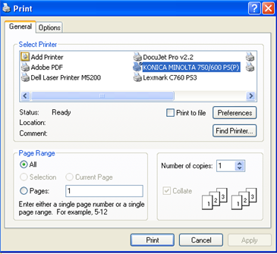
Topic One – Printing the Audit
Printing the Audit
Printing the Audit (Graphics 3.3.1.1 – 3.3.1.2)
1. | Click on the print link from the Audit Follow-Up tab. The print dialog box for your default printer will be displayed
 | Click on the Print button.
2. | To print pages other than View Audit Follow-Up, click on the print button from your browser (such as Internet Explorer or Netscape) toolbar or from the File menu.
Graphic 3.3.1.1: Print the Audit
Course Topics
Graphic 3.3.1.2: Print Dialog box
83
Notes:
83

Slide 84
Module Three – Lesson Three - Review
Lesson Three Covered the Following Topic:
Topic One | Printing the Audit
Course Topics
Notes:
84

Slide 85
Module Three – Review
Module Three Covered the Following Lessons:
Lesson One | Audits
Lesson Two | Viewing Audit Details and Actions
Lesson Three | Printing the Audit
Course Topics
Notes:
85

Slide 86
Module Four – Working with Audit Records
Module Four
Working with Audit Records
Course Topics
Notes:
86

Slide 87
Module Four – Working with Audit Records
Module Four Lessons
Lesson One | CAFU Pipeline
Lesson Two | Working with Audit Records Overview
Lesson Three | Searching for Audits
Lesson Four | Add New Audits by Monitor
Course Topics
Notes:
87

Slide 88
Lesson One – CAFU Pipeline
Lesson One
CAFU Pipeline
Course Topics

Slide 89
Lesson One – Topic
Lesson One Topic
Topic One | Work Flow Diagram
Course Topics
Notes:
89

Slide 90
Topic One – Work Flow Diagram
Work Flow Diagram
The CAFU Pipeline is defined as the work flow that an audit goes through in the
Contract Audit Follow-Up process. Each activity in the work flow is referred to
as a position in the pipeline. The application enforces business rules such as
who can do what to an audit for each position.
Course Topics
Notes:
90

Slide 91
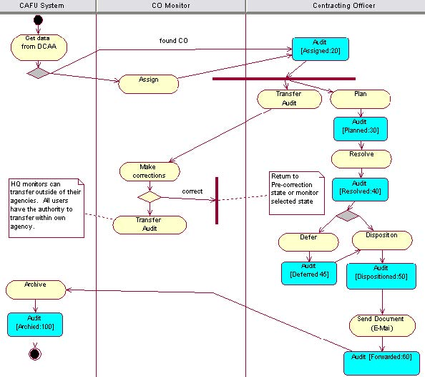
Topic One – Work Flow Diagram
Work Flow Diagram
This diagram illustrates the
CAFU Work Flow.
Course Topics
Graphic 4.1.1.1: CAFU Work Flow Diagram

Slide 92
Topic One – Work Flow Diagram
Work Flow Table
This following table provides a brief description of each activity:
Activity | Performed By | Description
Plan | CO | CO inputs the planned resolution and disposition dates
Resolve | CO | CO inputs the resolution actual date
Disposition or Defer | CO | CO inputs the disposition actual date. In the case of Litigation or Criminal Investigation, CO inputs defer date and reason to defer
Disposition after Defer | CO | CO inputs the disposition actual date after a deferral
Forward | CO | CO sends the memo to DCAA external to CAFU and inputs the date it was forwarded. The audit will no longer be available for editing in his/her work. The audit appears in his/her workgroup audits list as viewable only. Once a forward date is entered, the CO has an option to have the CAFU application to generate an E-Mail for them
Archive/Forwarded | CAFU System | CAFU System archives the audit after it has been dispositioned for 2 years
Course Topics
Table 4.1.1.2: Work Flow Table
Notes:
92

Slide 93
Topic One – Work Flow Diagram
Work Flow Exceptions
This following table provides activities to handle exceptions :
Activity | Performed By | Description
Correction | Monitor | Monitor corrects the audit based on a user's transfer or Monitor's Take Over of an Audit. Monitors may actively correct an audit without a transfer being completed
Add Audit Monitor | Monitor | Add an audit to the CAFU System to handle cases of missing DCAA records for Audit Reports received but not sent electronically
Delete Audit HQ Monitor | HQ Monitor | Delete an audit that does not belong in CAFU or was incorrectly added
Transfer CO, Monitor | CO, Monitor | CAFU user assigns an audit that is assigned to Audit himself/herself and assigns it to another CAFU user within own agency. Only HQ Monitors can transfer audits outside of his/her agency. When transferring an audit outside the user's agency, the audit will inherit the assignees DoDAAC
Table 4.1.1.3: Work Flow Exceptions
Course Topics
Notes:
93

Slide 94
Topic One – Work Flow Diagram
Work Flow Exceptions
This following table provides activities to handle exceptions :
Activity | Performed By | Description
Take Over Monitor | Monitor | Monitor may view audits assigned to a CAFU user Audit his/her agency and actively assign any number of those audits to himself/herself. This type of assignment is referred to as a Take Over.
View | Monitor, CO | Once an audit is forwarded, CAFU users can still see the audit in his/her workgroup audits list. No edits are allowed at this stage and an attempt to edit the record will result in an error message indicating that the record is for viewing only. Note: In CAFU 3.5, Monitors inherit CO privileges.
Table 4.1.1.4: Work Flow Exceptions
Course Topics
Notes:
94

Slide 95

Topic One – Work Flow Diagram
Work Flow Diagram
Pipeline Meter
The Pipeline Meter is a handy visual tool available on edit screens that show which pipeline position the audit is currently in, which activities have been completed and what remains to be done on the audit to complete the work flow. Graphic 4.1.1.5 shows the audit in the forward position.
Graphic 4.1.1.5: Pipeline Meter
Course Topics
95
Notes:
95

Slide 96
Module Four – Lesson One - Review
Lesson One Covered the Following Topic:
Topic One | Work Flow Diagram
Course Topics
Notes:
96

Slide 97
Lesson Two – Working with Audit Records Overview
Lesson Two
Working with Audit Records Overview
Course Topics

Slide 98
Lesson Two – Topics
Lesson Two Topics
Topic One | Common Actions
Topic Two | Validation Error
Course Topics
Notes:
98

Slide 99
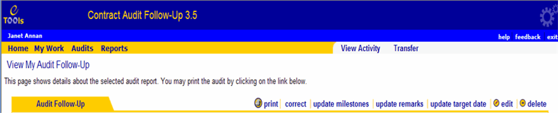
Topic One – Common Actions
Common Actions
This section provides a detailed explanation of all the actions that can be performed on an audit for each pipeline position. Follow the directions below to edit an audit.
Edit (Graphic 4.2.1.1)
1. | From the View My Audit Follow-Up screen, Click on the edit icon.
Graphic 4.2.1.1: Common Actions Edit
Course Topics
Notes:
99

Slide 100
Topic One – Common Actions
Common Actions
  Following are the common actions that can be performed in most pipeline positions:
Common Actions | Description
Auditor Name | Allows the user to change the auditor’s name
Auditor Phone Number | Allows the user to change the auditor's phone number
Input Remarks | This is an open entry text field that allows the user to add notes, and remarks that are important to the audit report. The remarks text field is limited to 2500 characters
Revise Target Date | Allows the user to change the Disposition Target Date
Reset | This action returns all fields to their value when the screen was accessed. This action does not leave the edit screen
Cancel | This action cancels any change made to the form and leaves the edit audit screen
Refresh | This action updates the information with the latest information that has been modified
Table 1.1.3 Common Actions
Table 4.2.1.2: Common Actions
Course Topics
Notes:
100

Slide 101

Topic One – Common Actions
Common Actions
All other changes or modifications that a CO or Monitor can make on an audit
depend on the position of the audit in the pipeline. (For more information on
the pipeline see the CAFU Pipeline Module Four Lesson One)
Graphic 4.2.1.3: Required Fields Example
Note: An asterisk (*) next to an input field denotes that an input is required before an audit report can be submitted to the next stage in the pipeline.
Course Topics
Notes:
101

Slide 102
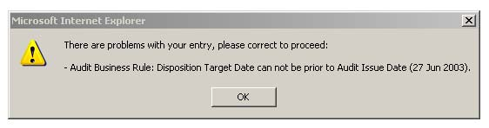
Topic Two – Validation Error
Validation Error
A validation error will occur when a user inputs data that does not pass all the required business rules. The Error message will pop-up (when applicable) and appear at the top of the page. You must correct the problem and pass all business rules to be able to complete the action.
Graphic 4.2.2.1:Validation Error
Course Topics
Notes:
102

Slide 103
Module Four – Lesson Two - Review
Lesson Two Covered the Following Topics:
Topic One | Common Actions
Topic Two | Validation Error
Course Topics
Notes:
103

Slide 104
Lesson Three – Searching for Audits
Lesson Three
Searching for Audits
Course Topics

Slide 105
Lesson Three – Topics
Lesson Three Topics
Topic One | Searching for Audits Overview
Topic Two | Using the Search Screen
Topic Three | Search Results
Course Topics
Notes:
105

Slide 106
Topic One – Searching for Audits Overview
Searching for Audits Overview
CAFU has a convenient way of locating audits that you may be interested in. A search can be performed based on one or more criteria. The Search feature can be accessed from the My Work screen or the Audits screen.
From My Work Screen:
Graphic 4.3.1.1: Search Criteria window
From Audits screen:
Graphic 4.3.1.2: Search Criteria window
Note: Add audit is only available to CMO, MC and District Monitors.
Course Topics
Notes:
106

Slide 107
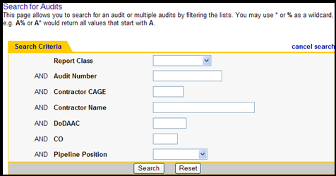
Topic Two – Using the Search Screen
Using the Search Screen
The search screen allows you to filter the audits in My Work or Workgroup Audits based on one or more criteria.
Search Screen (Graphic 4.3.2.1)
1. | Enter your search criteria. You may search for an audit by using as much or as little information as needed Your search will be narrowed the more information you entered You may use the wildcard feature when performing a search *.*
2. | Click the Search button.
 | Click the cancel search link to clear the search and show everything available in the table.
Graphic 4.3.2.1: Search Criteria window
Note: Monitors have more criteria, such as DoDAAC and CO, for finding audits.
These options help find audits assigned to specific COs.
Course Topics
107
Notes:
107

Slide 108
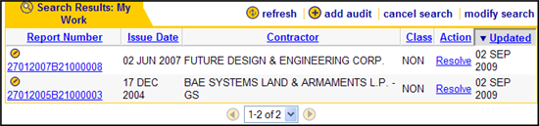
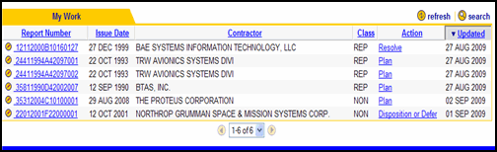
Topic Three – Search Results
Search Results
When a search is in effect, the My Work or Audits table shows a magnifying glass icon to inform the user that only some of the audits (based on the criteria) are being displayed.
Graphic 4.3.3.1: Search Results Screen
Search Results (Graphics 4.3.3.1 – 4.3.3.2)
1. | Click cancel search to turn off the search and show all audits in the table.
2. | Click the modify search link to change the search parameters.
Graphic 4.3.3.2: My Work Screen
Course Topics
108
Notes:
108

Slide 109
Lesson Three – Review
Lesson Three Covered the Following Topics:
Topic One | Searching for Audits Overview
Topic Two | Using the Search Screen
Topic Three | Search Results
Course Topics
Notes:
109

Slide 110
Lesson Four– Add New Audits by Monitor
Lesson Four
Add New Audits by Monitor
Course Topics

Slide 111
Lesson Four – Topics
Lesson Four Topics
Topic One | Add New Audit
Topic Two | Plan
Topic Three | Resolve
Topic Four | Disposition or Defer Layout
Topic Five | Forward / Send Document
Topic Six | Forwarded
Topic Seven | Correction by Monitors
Topic Eight | Take Over an Audit from the View Audit Follow-Up Screen
Course Topics
Notes:
111

Slide 112
Lesson Four – Topics
Lesson Four Topics (continued)
Topic Nine | Update Remarks by CO and Monitors
Topic Ten | Update Revised Target Date (CO and Monitors)
Topic Eleven | Deleting Audits
Topic Twelve | Transferring an Audit
Course Topics
Notes:
112

Slide 113
Topic One – Add New Audit
Add New Audit
  The Monitor is authorized to add new audits to the CAFU system. This feature is provided to handle audit reports that are received by each agency (DCMA, Army, Navy, Air Force, and TRICARE) that do not have a record in the CAFU system.
Course Topics
Notes:
113

Slide 114

Topic One – Add New Audit
Add New Audit (continued)
Follow the directions below to add new audits:
Add New Audit (Graphics 4.4.1.1 – 4.4.1.2)
1. | Click on the My Work tab.
2. | Click on the Add Audit link. The Search Criteria tab opens
Graphic 4.4.1.1: Add New Audit
Graphic 4.4.1.2: Search Criteria Tab
Note: At least three letters of the contractor name must be entered to start a search.
Course Topics
114
Notes:
114

Slide 115
Topic One – Add New Audits
Add New Audit
To ensure data integrity and to minimize errors use the Add Audit Feature:
Steps | Action | Description
Step 1 | Search for Contractor | Enter the name of the Contractor for which the new audit is being created. The system will search for existing audits for the Contractor to use as a template. You can enter partial names and wildcards as * or %
Step 2 | Select Contractor | The system will search for audits based on the Contractor Name provided in Step 1. It will then list the different variations of the contractor name that MCs and COs used for that Contractor in the past. You can click on the CAGE code to select the variation to use as a template for the new Audit If no matching contractors are found, click on search again and enter a different name If you are unable to find existing audits for the Contractor, you can click on new contractor
Step 3 | Enter Audit Details | The third and final step allows you to enter the required details about the audit
Course Topics
Table 4.4.1.3: Add Audit feature three steps table
Notes:
115

Slide 116
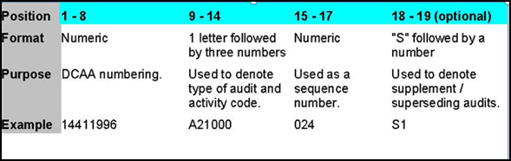
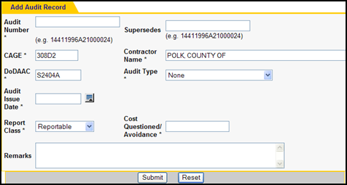
Topic One – Add New Audit
Add New Audit
Format of Audit Numbers
Business Rules
If you enter a superseded audit number, the superseded audit must exist in the system.
  The DoDAAC must belong to your workgroup
  Cost Questioned / Avoidance must be entered. You must enter 0 if it doesn't apply
  Audit report number must be valid and unique
After all the rules are validated, a new record is created and the audit is transferred to Monitor for verification and assignment.
Graphic 4.4.1.4: Format of Audit Numbers
Note: New Contractor - If no contractor was found during Step 2, you can still add a new audit by clicking on new contractor.
Course Topics
Graphic 4.4.1.5: Format of Audit Numbers
116
Notes:
116

Slide 117
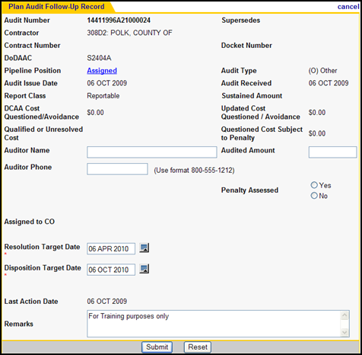
Topic Two – Plan
Plan
At this stage the audit report has been assigned to the appropriate CO. This page allows the CO to enter the target date for resolution and disposition.
Required Fields
  Resolution Target Date
  Disposition Target Date
Business Rules
  The Resolution Target Date and Disposition Target Date cannot be prior to the Audit Issue Date.
  The Resolution Target Date cannot be later than six months from the Audit Issue Date.
  The Disposition Target Date cannot be later than one year from the Audit Issue Date.
  The Disposition Target Date cannot be prior to the Resolution Target Date.
You must use the calendar to select the target dates.
Course Topics
Graphic 4.4.2.1: Plan Audit Follow-Up Record
117
Notes:
117

Slide 118
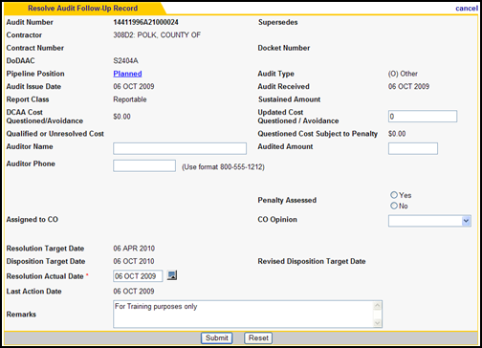
Topic Three – Resolve
Resolve
At this stage the audit has been planned, and resolution or pre-negotiation has been achieved. The CO must input the Resolution Actual Date to resolve.
Required Fields
  Resolution Actual Date
Optional Fields
Updated Cost Questioned / Avoidance
Revised Disposition Target Date
DCAA Opinion – Two new opinions are added in the system as part of CAFU 3.5.
  Qualified, Reportable means Report contains qualification
  Not Acceptable means the system is not acceptable
Business Rules
The Resolution Actual Date cannot be a future date
The Resolution Actual Date cannot be prior to Audit Issue Date
Graphic 4.4.3.1: Resolve Audit Follow Up Record
Course Topics
118
Notes:
118

Slide 119
Topic Four– Disposition or Defer Layout
Disposition or Defer Layout
Optional Fields
  Sustained Amount
  Updated Cost Questioned / Avoidance
  CO
  Revised Disposition Target Date
Business Rules
Disposition
  The Disposition Actual Date cannot be prior to the Audit Issue Date.
  The Disposition Actual Date cannot be prior to the Resolution Actual Date.
  The Disposition Actual Date cannot be a future date.
  The Revised Disposition Date cannot be prior to the Audit Issue Date.
  The Revised Disposition Date cannot be prior to the Resolution Actual Date.
  The Revised Disposition Date cannot be more than 12 months after the Audit Issue Date.
Defer
  Defer Date cannot be prior to Audit Issue Date.
  Defer Date cannot be prior to Resolution Actual Date.
  Defer Date cannot be a future date.
At this stage the audit has been resolved. To disposition, the CO must enter a Disposition Actual Date. If the Audit is undergoing Litigation or Criminal Investigation, the CO must select a reason to defer and the defer date.
Required Fields
Disposition
  Disposition Actual Date
  Penalty Assessed (if Questioned Cost Subject to Penalty greater than zero)
  Penalty Amount (if Penalty Assessed is YES)
  Penalty Waiver Date (if Penalty Assessed is NO, Optional but not Mandatory)
  Sustained Amount (if Cost Questioned / Avoidance greater than zero)
  OR
  Reason to Defer
    Litigation or Criminal Investigation
    Defer Date
Course Topics
119
Notes:
119

Slide 120
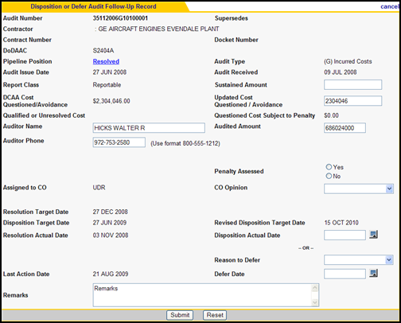
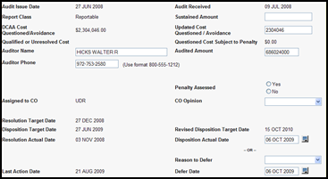
Topic Four– Disposition or Defer Layout
Disposition or Defer Layout (continued)
Disposition after Defer
Once an audit report comes out of the deferred stage, it can be dispositioned. To disposition, the CO must enter a Disposition Actual Date.
Required Field
  Disposition Actual Date
  Sustained Amount (if cost questioned / avoidance greater than zero)
Optional Fields
  Revised Disposition Target Date
Business Rules
  The Disposition Actual Date cannot be prior to the Audit Issue Date
  The Disposition Actual Date must be equal to or after the Resolution Actual Date
  The Disposition Actual Date must be equal to or after the Defer Date
  The Disposition Actual Date cannot be a future date
Graphic 4.4.4.1: Disposition or Defer Audit Follow-Up Record
Graphic 4.4.4.2: Disposition after Defer
Course Topics

Slide 121
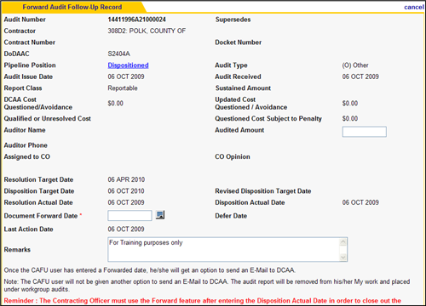
Topic Five – Forward / Send Document
Forward / Send Document
At this stage, the audit has been dispositioned. This screen allows the CO to record a document forward date to document that the memo has been sent to DCAA. This action completes the follow-up of the audit.
Required Field
Document Forward Date
Business Rules
  The Document Forward Date cannot be prior to the Audit Issue Date
  The Document Forward Date must be equal to or after the Disposition Actual Date
  The Document Forward Date cannot be a future date
Graphic 4.4.5.1: Forward Audit Follow-Up Record
Note: Reminder is for Reportables Only
Course Topics
121
Notes:
121

Slide 122
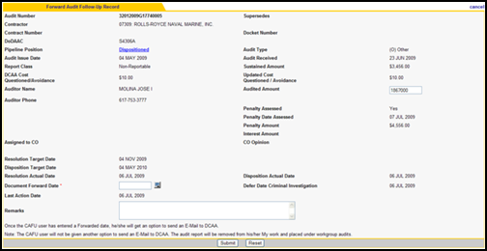
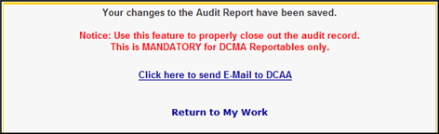
Topic Five – Forward / Send Document
Forward / Send Document
The following screen shows Forward Audit Follow-Up Record screen for Non-Reportables .
Once the CAFU user has entered a Forwarded date, he/she will get an option to send an E-Mail to DCAA.
NOTE: The CAFU user will not be given another option to send an E-Mail to DCAA. The audit report will be removed from his/her My Work and placed under workgroup audits.
Graphic 4.4.5.2: Forward Audit Follow-Up Record /Non-Reportable
Graphic 4.4.5.3: Send E-Mail option to DCAA
Course Topics
122
Notes:
122

Slide 123
Topic Six – Forwarded
Forwarded
  At the Forwarded Pipeline Position, the audit follow-up process has been completed. The audit will be available for viewing from the Audits screen for three years after entering the Document Forward Date. The audit will be in the Forwarded Pipeline Position for the first two years and in the Archived Pipeline Position during the third year. An audit will be deleted from CAFU during the month end processing 36 full months after the audit's Document Forward Date
  For an audit with a Document Forward Date of 15 Dec 2002, date ranges examples are provided below which show exactly when it’s Pipeline Position would change. In addition to archiving, each automated month end processing includes capturing the end-of-month state of all audits for historical reports and metrics
  Pipeline Rule for Archiving Example Date Range Position
  Forwarded 0 - 23 full months after Document Forward 15 Dec 2002 to 30 Nov 2004 Date
  Archived 24 - 35 full months after Document Forward 1 Dec 2004 to 30 Nov 2005 Date
  Not Available 36 full months after Document Forward Date 1 Dec 2005
Course Topics
Notes:
123

Slide 124
Topic Seven – Correction by Monitors
Correction by Monitors
CAFU Monitors can "correct" an Audit Report that is either in their "My Work" or has been taken-over by the Monitor. A CAFU Monitor can use the Correction screen to make changes. The correction screen allows several fields to be modified. This enables a Monitor to perform many actions, including:
    Update Contractor Information, Contract Number, and Docket Number
    Assign audit to a different DoDAAC
    Change the pipeline position of the audit report
    Change report class (reportable / non-reportable)
    Update auditor information (ie: Auditor Name, Auditor Phone)
    Modify Sustained Amount and Updated Cost Questioned / Avoidance Amount
    Modify target and actual dates
    Modify Reason to Defer Date as well as the Defer Date
    Modify remarks section
Course Topics
Notes:
124

Slide 125

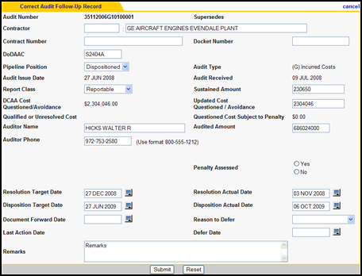
Topic Seven – Correction by Monitors
Correction by Monitors
This page allows a CAFU Monitor to
make corrections on all editable fields
in the audit record.
Business Rules
DoDAAC and CO combination must
be valid if the Pipeline Position is
related to a CO activity
Business rules related to the selected Pipeline Position will be enforced
Graphic 4.4.7.1: View My Audit Follow-Up Correct link
Correction by Monitors (Graphics 4.4.7.2 - 4.4.7.3)
1. | Click the My Work link.
2. | Click on a report number. View My Audit Follow-Up screen opens
3 | Click the correct link. Correct Audit Follow-Up Record opens
Course Topics
Graphic 4.4.7.2: Correct Audit Follow-Up Record
Notes:
125

Slide 126
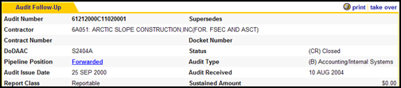
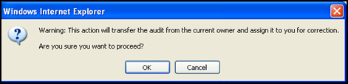

Topic Eight – Take Over an Audit from the View
Audit Follow-Up Screen
Take Over by Monitors
Monitors are authorized to Take Over an audit. This feature allows you to transfer any audit in your workgroup from the current owner or assignee to your My Work. The audit has to take place within an agency.
Windows Explorer will open a warning screen to make sure Monitor wants to transfer and assign the audit.
Graphic 4.4.8.1: Monitor Take Over
A confirmation shown below is provided, which allows the CAFU user the options to immediately go to the correction screen, view his/her work, or return to his/her workgroup audit list.
Graphic 4.4.8.2: Take Over Warning
Graphic 4.4.8.3: Take Over Confirmation
Course Topics
126
Notes:
126

Slide 127
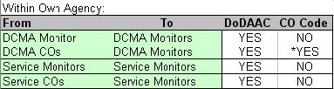
Topic Eight – Take Over an Audit from the View
Audit Follow-Up Screen
Take Over by Monitors continued
Business Rule
When an audit is taken over, the audit will inherit one or both of the following items from the new user. The graphic displayed shows various DoDAAC and CO Code possible scenarios.
Graphic 4.4.8.4: Take Over Roles
Note: CO Code will update to an empty string since Monitors do not have CO Codes.
Course Topics
127
Notes:
127

Slide 128
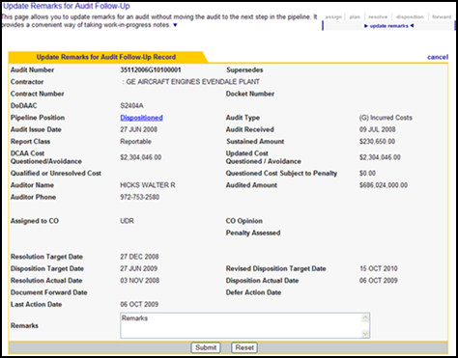
Topic Nine – Update Remarks by CO and
Monitors
Updating Remarks by CO and Monitors
The Update Remarks allows a CO or Monitor to update remarks for an audit record without completing a pipeline activity.
Clicking on Submit will update the remarks without moving the audit to the next stage. For example, if the audit is in the Resolution stage, the new remarks will be saved and the audit will remain in the Resolution stage. A history of remarks can be viewed by clicking view activity and following the instructions for Activity Logging.
Graphic 4.4.9.1: Audit Follow-Up date Remarks link
Updating Remarks (Graphics 4.4.9.1 – 4.4.9.2)
1. | Start from the My Work tab,
 | Click on the Audit Report Number to access View Audit Follow-Up screen.
 | Click on update remarks link. Update Remarks for Audit Follow-Up screen opens
Graphic 4.4.9.2: Update Remarks for Audit Follow-Up Record
Course Topics
128
Notes:
128

Slide 129
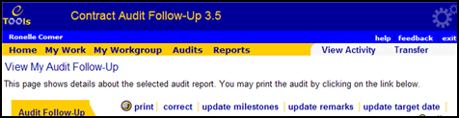
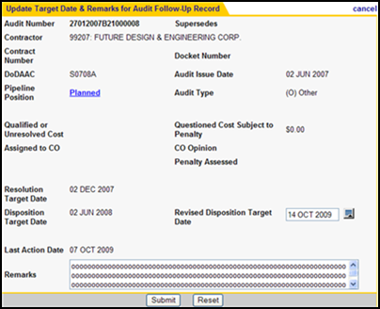
Topic Ten – Update Revised Target Date
(CO and Monitors)
Updating Revised Target Date (CO and Monitors)
The option to Update Target Date allows a CO or MC Monitor to add or update the Disposition Target Date for an audit record without completing a pipeline activity, as well as, update remarks
Clicking on Submit will update the revised disposition target date without moving the audit to the next stage. For example, if the audit is in the Resolution stage, the revised target date will be saved and the audit will remain in the Resolution stage.
Graphic 4.4.10.1: Audit Follow-Up Update Target Date ink
The Revised Disposition Target Date will be available. The user will have the option to revise an audit once it has been Planned and before a Resolution Actual Date has been entered.
Updating Target Date (Graphics 4.4.10.1 – 4.4.10.2)
1. | Click on update target date link. Update Target Date & Remarks for Audit Follow-Up screen opens
Course Topics
Graphic 4.4.10.2: Update Target Date and Remarks for Audit Follow-Up Record
129
Notes:
129

Slide 130
Topic Eleven – Deleting Audits
Deleting Audits
Service HQ Monitors are authorized to delete an audit. The delete audit link is available to these Monitors on the View Audit Follow-Up screen.
Graphic 4.4.11.1: Delete Audit Follow-Up screen
WARNING: Use this feature with caution. Deleted Audits will not be recoverable without Database Administrator intervention.
Course Topics
130
Notes:
130

Slide 131
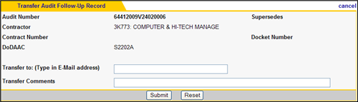
Topic Twelve – Transferring an Audit
Transferring an Audit
At this state the audit has been assigned to the user. This page allows users to transfer an audit report to any user within their agency.
Note: ONLY HQ Monitors can
transfer outside their agencies
Graphic 4.4.12.1: Transfer Audit Follow-Up Record
Required Field
  Transfer to E-Mail address
  Transfer comments
Business Rule
  CAFU users can transfer any audit that is assigned to them to another CO as long as the CO is part of the user's agency
Course Topics
131
Notes:
131

Slide 132
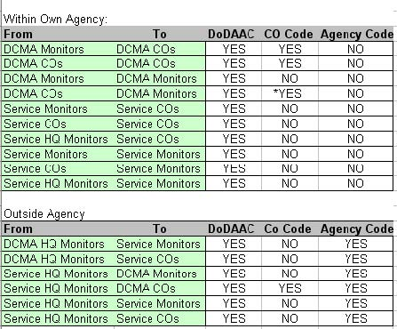
Topic Twelve – Transferring an Audit
Transferring an Audit (continued)
Business Rule
When transferring an audit within or outside an agency, the current audit will inherit one or more of the following items from the new user: Refer to Graphic 4.4.12.2
  1. DoDAAC
  2. CO
  3. Agency Code
Graphic 4.4.12.2: Transfer Audit Follow-Up Record
Note: CO Code will update to an empty string since Monitors do not have CO Codes
Course Topics
132
Notes:
132

Slide 133
Lesson Four – Review
Lesson Four Covered the Following Topics:
Topic One | Add New Audit
Topic Two | Plan
Topic Three | Resolve
Topic Four | Disposition or Defer Layout
Topic Five | Forward / Send Document
Topic Six | Forwarded
Topic Seven | Correction by Monitors
Topic Eight | Take Over an Audit from the View Audit Follow-Up Screen
Course Topics
Notes:
133

Slide 134
Lesson Four – Review
Lesson Four Covered the Following Topics (continued):
Topic Nine | Update Remarks by CO and Monitors
Topic Ten | Update Revised Target Date (CO and Monitors)
Topic Eleven | Deleting Audits
Topic Twelve | Transferring an Audit
Course Topics
Notes:
134

Slide 135
Module Four – Review
Module Four Covered the Following Lessons:
Lesson One | CAFU Pipeline
Lesson Two | Working with Audit Records Overview
Lesson Three | Searching for Audits
Lesson Four | Add New Audit by Monitor
Course Topics
Notes:
135

Slide 136
Module Five – Milestones
Module Five
Milestones
Course Topics
Notes:
136

Slide 137
Module Five – Milestones
Module Five Lesson
Lesson One | Milestones Overview
Course Topics
Notes:
137

Slide 138
Lesson One – Milestone Overview
Lesson One
Milestones Overview
Course Topics

Slide 139
Lesson One – Topics
Lesson One Topics
Topic One | Milestones Overview
Topic Two | Adding Milestones
Topic Three | Updating and Deleting Milestones
Topic Four | Viewing Milestones from View Audit Follow-Up Screen
Course Topics
Notes:
139

Slide 140
Topic One – Milestones Overview
Milestones Overview
  Milestones are intermediate steps in the Follow-Up process associated with an audit. This feature is provided in CAFU to help COs set intermediate goals with target dates, remarks, actual, and revised dates. Monitors can view the milestones attached to audits from the View Audit Follow-Up page. The milestone feature can help the workgroup manage the audits more effectively and improve performance.
Course Topics
Notes:
140

Slide 141

Topic One – Milestones Overview
Milestone | Pipeline Position
Request legal review | Planned Planned Planned Planned Resolved Deferred Deferred
Receive legal reply
Contact contractor
Receive contractor response
Complete negotiations
Start litigation or criminal investigation
Complete litigation or criminal investigation
Milestones Overview continued
The following table (Graphic 5.1.1.1) shows the available milestones along with the pipeline position in which it can be used.
You can access the Audit Milestones page by clicking on the Audit Report Number from My Work to access the View Audit Follow-Up page.
Graphic 5.1.1.1: Milestone and Pipeline Position Chart
Adding Milestone (Graphics 5.1.2.1 – 5.1.2.2 )
1. | Click on update milestones link. The Update Milestones for Audit screen opens
Graphic 5.1.1.2: View Audit Follow-Up screen / update milestones link
Graphic 5.1.1.3: Update Milestones for Audit screen
Note: Generic milestones can be added at any time for goals not in the above list
Course Topics
141
Notes:
141

Slide 142
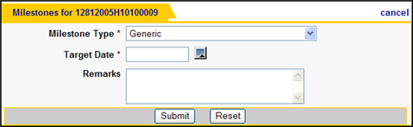
Topic Two – Adding Milestones
Adding Milestones
As a CO, you can add milestones to an audit currently assigned to you. To add a milestone, click on Add Milestone from the update milestones for audit.
Graphic 5.1.2.1: Add Milestone link
You can select the type of milestone, the target date, and the remarks. The type of milestone you can add depends on the pipeline position of the audit
Adding Milestone (Graphics 5.1.2.1 – 5.1.2.2 )
1. | Click on Add Milestone link. Add Milestone for Audit screen opens This page allows the user to add milestones for an audit
Graphic 5.1.2.2: Add Milestone link
Course Topics
142
Notes:
142

Slide 143
Topic Two – Adding Milestones
Adding Milestones (continued)
The type of milestone you can add depends on the pipeline position of the audit.
Adding Milestones (Graphic 5.1.2.3)
1. | Select the Milestone Type from the drop-down menu.
2. | Click the Calendar icon to enter the Target Date.
 | Add Remarks if applicable.
 | Click the Submit button.
Graphic 5.1.2.3: Add Milestone link
Required Fields
  Milestone Type
  Target Date
Optional Field
  • Remarks (The remarks text field is
  limited to 2500 characters)
Business Rules
  Milestone Type drop down is based on
  the pipeline position of the audit and
  milestones already added
  Target Date cannot be in the past
Note: You can enter the Actual Date and the Revised Date later but you will not be able to change the original Target Date.
Course Topics
143
Notes:
143

Slide 144
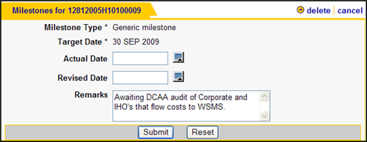
Topic Three – Updating and Deleting Milestones
Updating and Deleting Milestones
You can update the target date by entering a Revised Date. You can enter the Actual Date when a milestone has been completed. If you want to remove the milestone, simply click on the delete link.
Optional Fields
  Actual Date
  Revised Date
  Remarks (The remarks text field is
  limited to 2500 characters)
Business Rule
• Actual Date cannot be a future date.
Graphic 5.1.3.1: Updating and Deleting Milestones
Update Milestones (Graphic 5.1.3.1)
1. | From the My Work tab, Click on the Audit Report Number to access the View Audit Follow-Up screen.
2. | Click on update milestones.
 | Click on the edit icon for the milestone.
 | You can update the milestone or delete by clicking the delete icon
Course Topics
Notes:
144

Slide 145

Topic Four – Viewing Milestones from View Audit Follow-Up Screen
Viewing Milestones from View Audit Follow-Up Screen
To view milestones for an audit in your workgroup that is not assigned to you, you can access the View Audit Follow-Up from the Audits screen.
Graphic 5.1.4.1: Graphic Viewing Milestones
Viewing Milestones (Graphics 5.1.4.1 – 5.1.4.2)
1. | Click on Milestones link. This will allow you to see the milestones at the bottom of the page
Graphic 5.1.4.2: Graphic Viewing Milestones
Course Topics
145
Notes:
145

Slide 146
Lesson One – Review
Lesson One Covered the Following Topics:
Topic One | Milestones Overview
Topic Two | Adding Milestones
Topic Three | Updating and Deleting Milestones
Topic Four | Viewing Milestones from View Audit Follow-Up Screen
Course Topics
Notes:
146

Slide 147
Module Five – Review
Module Five Covered the Following Lesson:
Lesson One | Milestones
Course Topics
Notes:
147

Slide 148
Module Six – Activity Logging
Module Six
Activity Logging
Course Topics
Notes:
148

Slide 149
Module Six – Activity Logging
Module Six Lessons
Lesson One | Activity Overview
Course Topics
Notes:
149

Slide 150
Lesson One – Activity Overview
Lesson One
Activity Overview
Course Topics

Slide 151
Lesson One – Topics
Lesson One Topics
Topic One | Activity Overview
Topic Two | Activity Logging per Audit Report
Topic Three | Activity Logging per User
Course Topics
Notes:
151

Slide 152
Topic One – Activity Overview
Activity Overview
  The Activity Logging feature allows CAFU users to view all activity related to a
  user or an audit report. This information helps track the history of an audit as it
  goes through the workflow by listing what action was taken on the audit, who
  took the action, and when it was completed.
  The activity screen shows a table with the date and time the action was
  taken, Audit Report Number of the audit on which the action was taken, the
  user that took the action, the pipeline position of the audit after the action
  was completed, and the description of the activity.
Note: For performance reasons, only the 500 most recent activities will be displayed.
Course Topics
Notes:
152

Slide 153



Topic One – Activity Overview
Activity Overview (continued)
Activity related to milestones are not logged.
Graphic 6.1.1.1: View Activity screen
Activity Overview (Graphics 6.1.1.1 – 6.1.1.2)
1. | Click the Date and Time link of an activity to see the details of the activity and a snapshot of some fields from the audit report.
2. | Click the Report Number link to view current state of the audit.
Graphic 6.1.1.2: Date and Time Activity info screen
Course Topics
Graphic 6.1.1.3: Current State of Audit screen
153
Notes:
153

Slide 154





Topic Two – Activity Logging per Audit Report
Activity Logging per Audit Report
From Audits:
You can view activity of an individual audit report from both the My Work or Audits screen. The Activity data will be the same.
Activity Logging per Audit Report (Graphics 6.1.2.1 – 6.1.2.2)
1. | Click the Report Number to view the activity of an individual audit report.
2. | Click on the View Activity link to view the audit.
Graphic 6.1.2.1: Activity Logging From Audits
From My Work:
Course Topics
Graphic 6.1.2.2: Activity Logging From My Work
154
Notes:
154

Slide 155

Topic Three – Activity Logging per User
Activity Logging per User
Activity logging per user shows the list of actions completed by a user. This feature is helpful in viewing your own activity for reminders and tracking your work (Graphic 6.1.6). You can also view the activity of members in your workgroup to trace transfers.
Activity for other members of the workgroup can be accessed from the My Workgroup page. Note that this screen also provides a quick way of searching for audits assigned to a CO in your workgroup (Graphic 6.1.7).
Graphic 6.1.6: Activity for User Screen
Activity Logging per User (Graphics 6.1.6 – 6.1.7)
1. | To view your activity, Click on the View My Activity link in the context menu of the My Work page The Activity for User screen opens (Graphic 6.1.6).
2. | (Refer to Module Two for Workgroup Overview) To see a workgroup member activity
 | Click on the activity link under Show Activity column in the Workgroup Members menu This will open the View Activity for a particular user
Graphic 6.1.7: Workgroup Members Screen
Course Topics
155
Notes:
155

Slide 156
Lesson One – Review
Lesson One Covered the Following Topics:
Topic One | Activity Overview
Topic Two | Activity Logging per Audit Report
Topic Three | Activity Logging per User
Course Topics
Notes:
156

Slide 157
Module Six – Review
Module Six Covered the Following Lesson:
Lesson One | Activity Overview
Course Topics
Notes:
157

Slide 158
Module Seven – Frequently Asked Questions
Module Seven
Frequently Asked Questions
Course Topics
Notes:
158

Slide 159
Module Seven - CAFU 3.5 Frequently Asked Questions
Listed below are just a few questions that users have asked about CAFU:
Question: I am getting no records back when I use the search feature, what should I do? Answer: If you use the search action from My Work, the system will only search within audits currently assigned to you. To search for all audits in your workgroup, make sure you use the search action from the Audits screen. See Searching for Audits for details.
Question: I am trying to update remarks but the system keeps prompting me for other inputs. What other inputs should I use? Answer: If you want to update remarks without completing a pipeline activity, such as resolve or disposition, you must use the update remarks feature. Updating remarks from the edit screen requires satisfying all business rules. See Updating Remarks for details.
Question: I just completed the Forward Document activity on my audit and it disappeared from My Work screen. Have I lost the document? Answer: As a CO, once you complete the Forward Document activity, you are done with the audit; hence it is no longer assigned to you. You can still find the audit in the Workgroup Audits screen. See Forward Document and Workgroup Audits Screen for details.
Course Topics
Notes:
159

Slide 160
CAFU 3.5 Course Summary
Upon completion of this CAFU 3.5 Training you will have learned to:
    Understand the application functionality
    Understand the CO and HQ/ Monitors roles
    Understand how to maneuver between the work screens
    Understand how each workgroups conduct an audit (DCMA, Army, Navy, TRICARE and Air Force).
    Work with Audit records
    Work with Milestones
    Understand how to log an activity as a user and per Audit Report

