Slide 1



ITCSO Training Academy
Contract Audit Follow-Up (CAFU) 3.5
Pre-Defined & Ad hoc Reports
November 2009
Notes:
1

Slide 2
Course Topics
Course Topics
Note: Links will only work in PowerPoint's slide show view.
Module One | Pre-Defined Reports
Lesson One | Overview Of Pre-Defined Reports
Topic One | How to Access Pre-Defined Reports
Topic Two | Report Formats
Topic Three | Running Pre-Defined Reports
Module Two | Ad hoc Reports
Lesson One | Overview of Ad hoc Reports
Topic One | Ad hoc Reports Overview
Topic Two | How to Access Ad hoc Reports
Topic Three | Saved Query List
Topic Four | Query Studio Components
Lesson Two | Query Studio
Topic One | Query Studio Main Menu
Topic Two | Query Studio Toolbar
Topic Three | Creating Ad hoc Reports
Topic Four | Running Ad hoc Reports

Slide 3
Module One – Pre-Defined Reports
Module One
Pre-Defined Reports
Notes:
3

Slide 4
Module One – Objectives
At the end of Module One you should be able to:
Access Pre-Defined Reports
View Reports in Four Different Formats
Run Pre-Defined Reports
Notes:
4

Slide 5
Lesson One – Overview of Pre-Defined Reports
Lesson One Topics
Topic One | How to Access Pre-Defined Reports
Topic Two | Report Formats
Topic Three | Running Pre-Defined Reports
Notes:
5

Slide 6
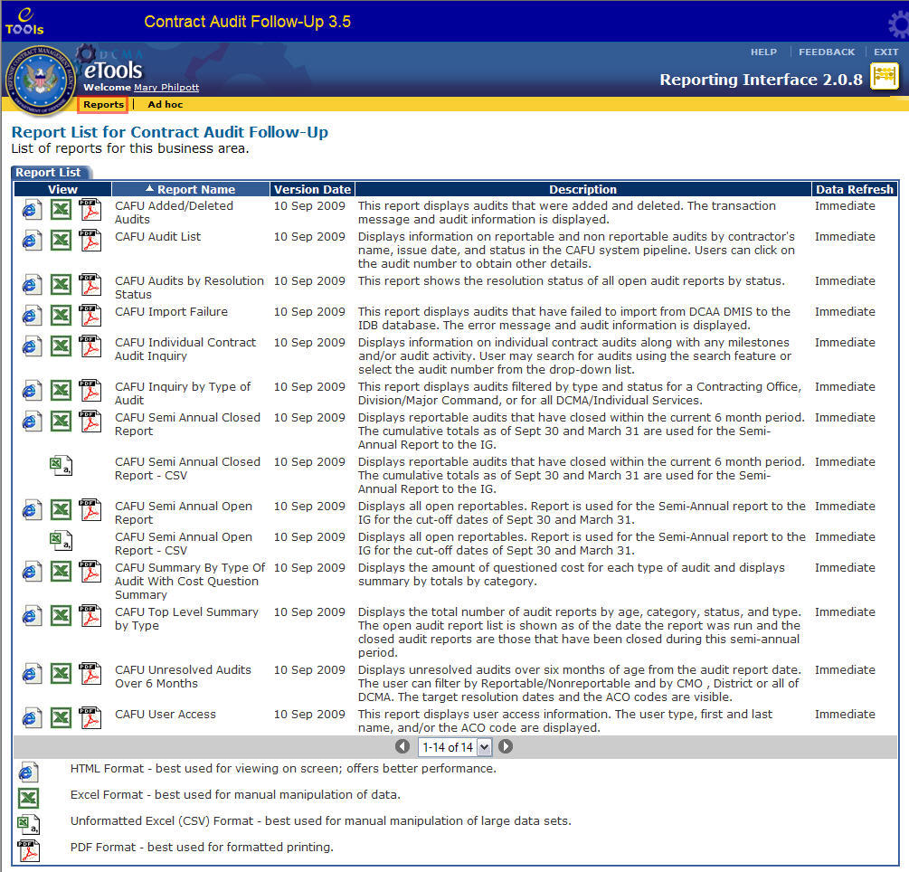
Topic One – How to Access Pre-Defined Reports
Accessing CAFU Pre- Defined Reports
CAFU Reporting Interface opens with the Report List displayed (Graphic 1.1).
1
How to Access the Reports List from within the CAFU Reporting Interface. (Graphic 1.1)
 | Click the Reports link from the reports menu bar. The Reports List will appear.
Graphic 1.1: CAFU 3.5 Reports Page
Notes:
6

Slide 7
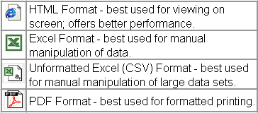
Topic Two – Report Formats
Four Report Formats
Graphic 1.2 shows the Pre-Defined reports for CAFU 3.5. You can view these reports in any of the following four formats (Graphic 1.3):
Graphic 1.3: Report Formats
Graphic 1.2: Report List
Notes:
7

Slide 8
Topic Three – Running Pre-Defined Reports
Select Report and Format Type – Step 1
Locate the Report you would like to view from the Report List.
For demonstration purposes, the “CAFU Audits by Resolution Status” Report will be selected.
How to select the report format. (Graphic 1.4)
1. | Click the HTML button next to the report name. The report will appear in HTML format
2. | Click the PDF button next to the report name. The Reports will appear in PDF format
3. | Click the Excel button next to the report name. The Reports will appear in Excel format From Excel, the file can be saved in CSV format also
Graphic 1.4: CAFU 3.5 Reports Page
Notes:
8

Slide 9
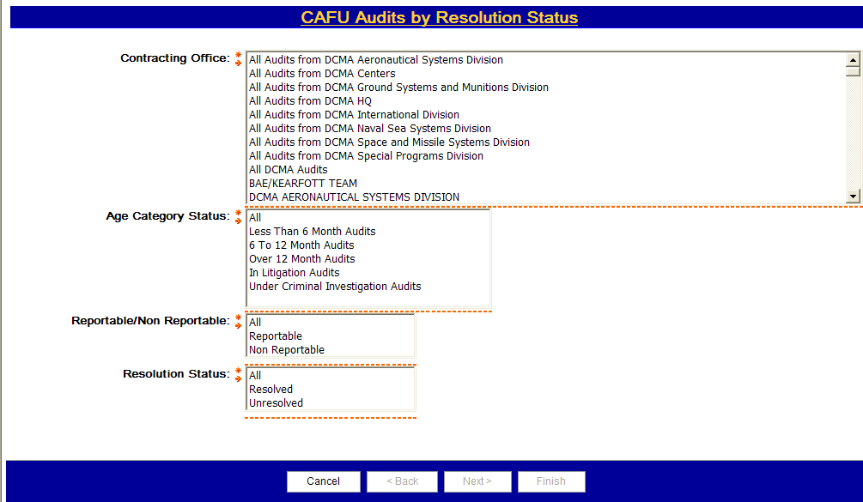
Topic Three – Running Pre-Defined Reports
Setting Report Filters - Step 2
After clicking the report type and view format, the report filter page appears. This page allows you to select specific criteria’s for filtering the data you will see on your report.
Filter common elements:
Fields with an * are required
A red arrow will appear next to required lists prompting users to make a selection
Clicking the Select all link selects all of the items in the list
Clicking the Deselect all link deselects all of the selected items from the list
It is recommended NOT to select all items for “Optional” lists as it may cause an error or take time to process
Dynamic lists are not populated until data in a prior list is selected and the cascading prompt button is clicked
Graphic 1.5: CAFU Report Filter Page
Notes:
9

Slide 10
Topic Three – Running Pre-Defined Reports
Setting Report Filters (Continued)
How to filter the CAFU Audits by Resolution Status Report. (Graphic 1.6)
 | Select the Contracting Office from the list.
 | Select the Age Category Status.
3. | Select the Reportable/Non-Reportable.
. | Select the Resolution Status from the list.
. | Click on the Finish button.
1
2
3
4
5
Graphic 1.6: CAFU Audits by Resolution Status Report Filter Page
Notes:
10

Slide 11
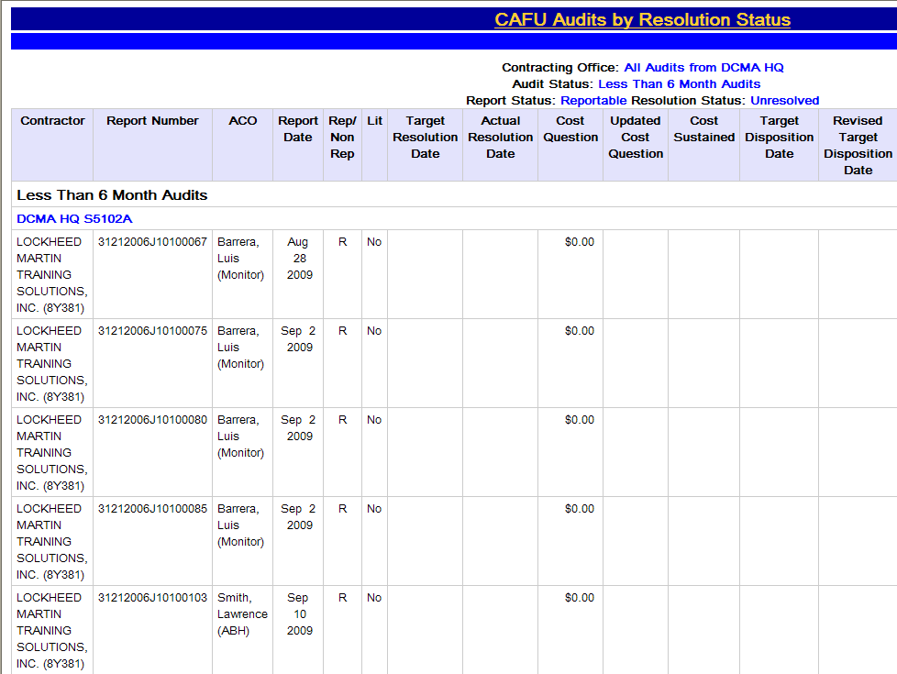
Topic Three – Running Pre-Defined Reports
Viewing Your Completed Report – Step 3
All Reports can be run in a similar process as the steps illustrated in the previous slides.
The results will look similar to those in Graphic 1.7 below.
Graphic 1.7: CAFU Audit s by Resolution Status Report Results
Notes:
11

Slide 12
Module One Review
Module One Covered the Following Topics:
Topic One | How to Access Pre-Defined Reports
Topic Two | Report Formats
Topic Three | Running Pre-Defined Reports
Notes:
12

Slide 13
Module Two – Ad hoc Reports
Module Two
Ad hoc Reports
Notes:
13

Slide 14
Module Two – Objectives
At the end of Module Two you should be able to:
Navigate through Ad hoc Reports
Access the Components of an Ad hoc Report
Utilize the Main Menu to Create and Run Reports
Use the Toolbar Options to Perform Report Functions
Notes:
14

Slide 15
Module Two – Ad hoc Reports
Module Two Lessons
Lesson One | Overview of Ad hoc Reports
Lesson Two | Query Studio
Notes:
15

Slide 16
Lesson One – Overview of Ad hoc Reports
Lesson One Topics
Topic One | Ad hoc Reports Overview
Topic Two | How to Access Ad hoc Reports
Topic Three | Saved Query List
Topic Four | Query Studio Components
Notes:
16

Slide 17
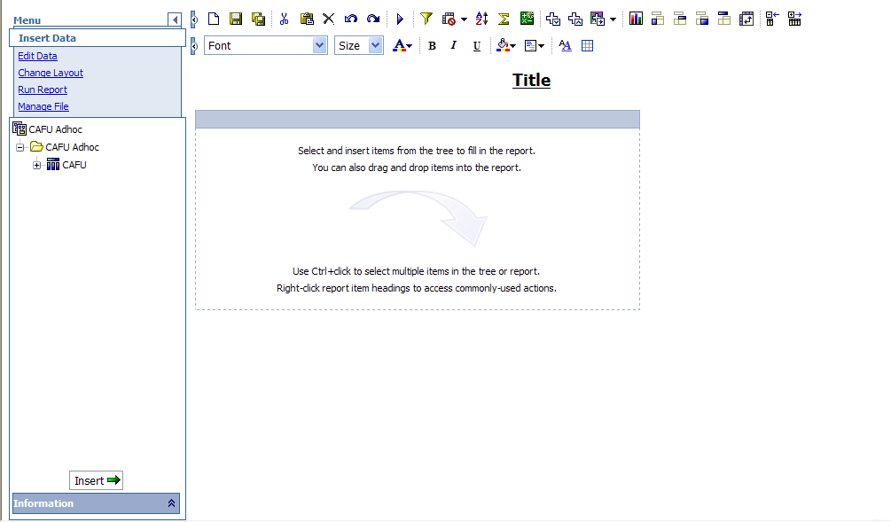
Topic One – Ad hoc Reports Overview
Ad hoc Reports Allow:
The user to customize a data query in real time
The user to select specific fields and define the search criteria
The user to create a report view.
The user to select the web location to publish and save
Graphic 2.1: Ad hoc Main Page
Notes:
17

Slide 18

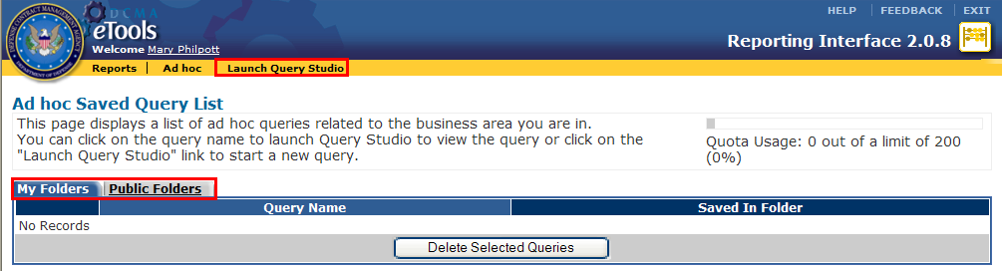
Topic Two – How to Access Ad hoc Reports
Accessing Ad hoc Reports from within CAFU Reporting Interface
How to access Ad hoc reports. (Graphics 2.2 -2.5)
 | Click on Ad hoc on the menu bar. This action will open the Ad hoc Saved Query List page.
 | To view a saved Ad hoc report from the My Folders or Public Folders tabs, select the report by clicking on the Query Name link. (Graphic 2.3). Graphic 2.4 describes the folder tabs further. OR, To create a new Ad hoc report, click on the Launch Query Studio link to be directed to the Query Studio interface. (Graphic 2.5)
1
Graphic 2.2: Reports Main Menu
2
Graphic 2.3: Ad hoc Main Menu
Notes:
18

Slide 19
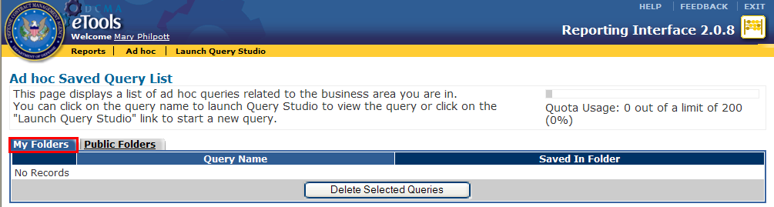
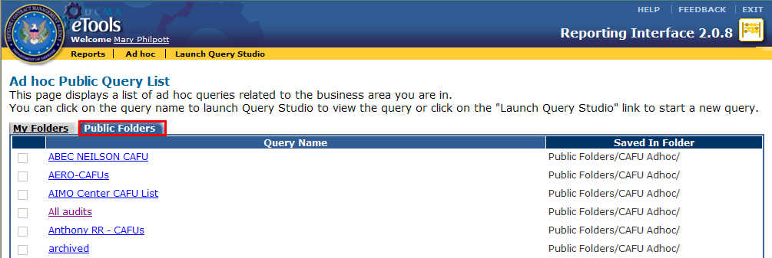
Topic Three – Saved Query List
Saved Query List
My Folders Only Administrator and the report creator can access reports contained within this tab. (Graphic 2.4)
Public Folders Anyone with access to CAFU can run reports in this tab It is the default folder for saving Ad hoc reports. (Graphic 2.5)
Graphic 2.4: Ad hoc Saved Query List
Graphic 2.5 Ad hoc Saved Query List
Notes:
19

Slide 20
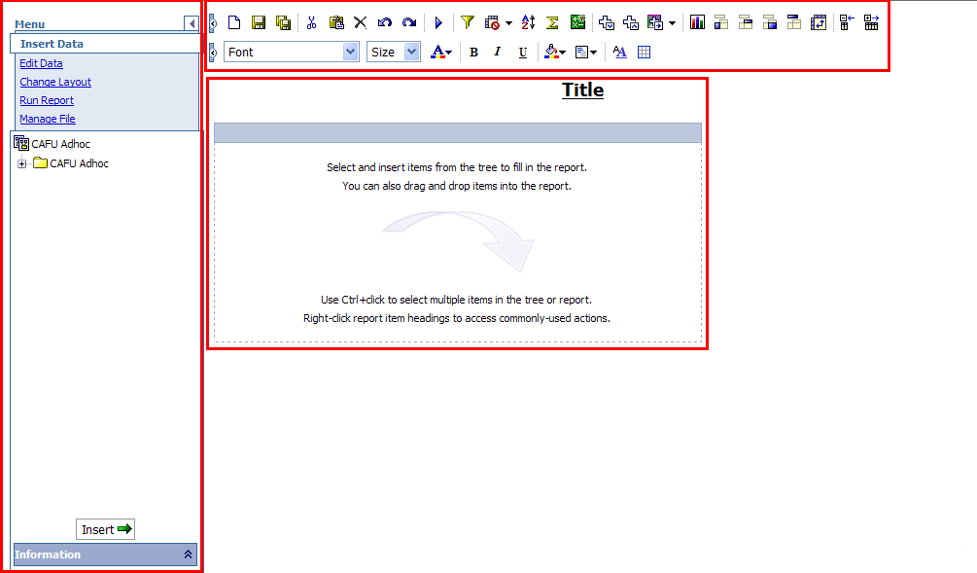
Topic Four – Query Studio Components
Query Studio Components
This diagram depicts the different components for Ad hoc reporting.
  Toolbar
  Main Menu
  Reports Area
The Toolbar provides a shortcut to some of the Main Menu functionality.
1
2
3
Graphic 2.6: Ad hoc Components
Notes:
20

Slide 21
Lesson Two – Query Studio
Lesson Two Topics
Topic One | Query Studio Main Menu
Topic Two | Query Studio Toolbar
Topic Three | Creating Ad hoc Reports
Topic Four | Running Ad hoc Reports
Notes:
21

Slide 22
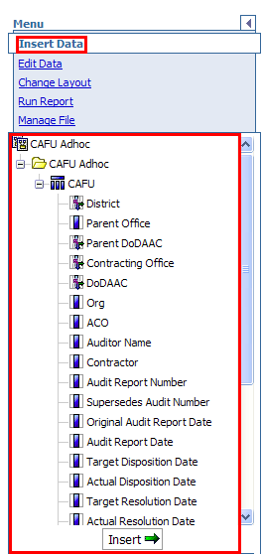
Topic One – Query Studio Main Menu
Query Studio Main Menu
1
How to access Main Menu. (Graphic 2.7)
1. | Click on the Insert Data hyperlink. This will bring up the data options in the menu that will appear below
Graphic 2.7: Query Studio Main Menu
Notes:
22

Slide 23
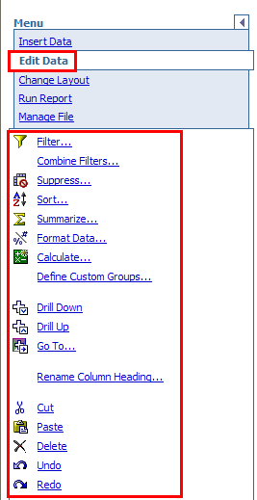
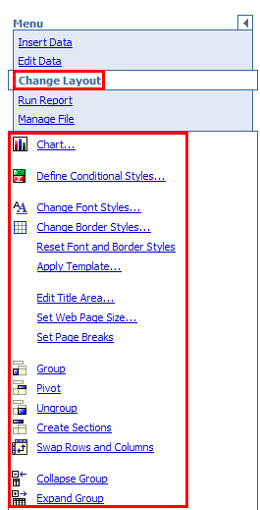
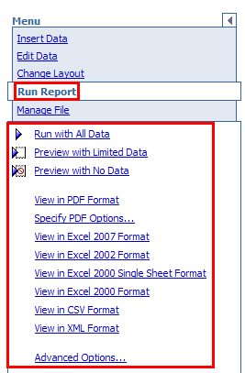
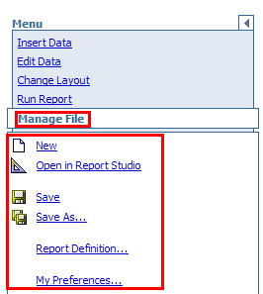
Topic One – Query Studio Main Menu
Query Studio Main Menu (Continued)
Graphic 2.8 to 2.11 depicts the different main menu options and the corresponding main menu hyperlinks.
Graphic 2.11: Query Studio Manage File Main Menu
Graphic 2.8: Query Studio Edit Data Main Menu
Graphic 2.9: Query Studio Change Layout Main Menu
Graphic 2.10: Query Studio Run Data Main Menu
Notes:
23

Slide 24
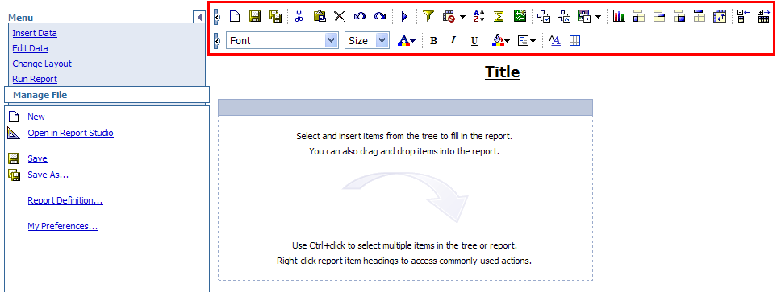
Topic Two – Query Studio Toolbar
Using the Query Studio Toolbar
Graphic 2.12 shows the Ad hoc toolbar.
Graphic 2.13 highlights the most frequently used icons.
The (save and save as ) icons are used to save reports.
The (cut and paste) icons are used to cut and paste data anywhere on the report.
The (undo and redo ) icons are used to undo and redo last changes.
The (run with all data and re-prompt) icon allows you to run the report or re-prompt the report.
The (filter and sort icons) allow you to filter and sort on specific data.
These icons are used to summarize and calculate.
Graphic 2.12: Ad hoc Toolbar
Graphic 2.13: Ad hoc Toolbar
Notes:
24

Slide 25
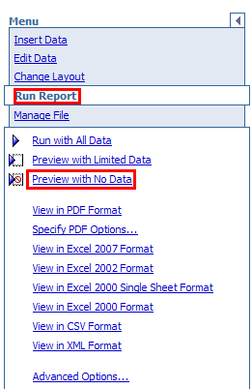
Topic Three – Creating Ad hoc Reports
Selecting No Data before Design – Step 1
The Run Report link will give you data view options, allowing you to build a report with all data, limited data, or with no data.
In order to optimize the load time while designing the report, it is recommended to select the Preview with No Data options.
1
2
How to preview reports with no data. (Graphic 2.14)
1. | Click Run Report.
2. | Select Preview with No Data.
Graphic 2.14: Ad hoc Run Report Menu
Notes:
25

Slide 26
Topic Three – Creating Ad hoc Reports
Selecting Data – Step 2
1
How to select data. (Graphics 2.15)
1. | Select “+” or “-” to expand or collapse the data folders, which contain numerous data tables Data table is represented by icon Data table can be expanded to reveal data items
2. | Double-click the table to insert all fields in the table or double-click an individual data item to only select that table item. OR, Click the item that will be used in the report and navigate to the bottom of the page and click on the Insert link. OR, Drag the data item or folder to the report area.
2
Graphic 2.15: Ad hoc Insert Data Menu
Notes:
26

Slide 27
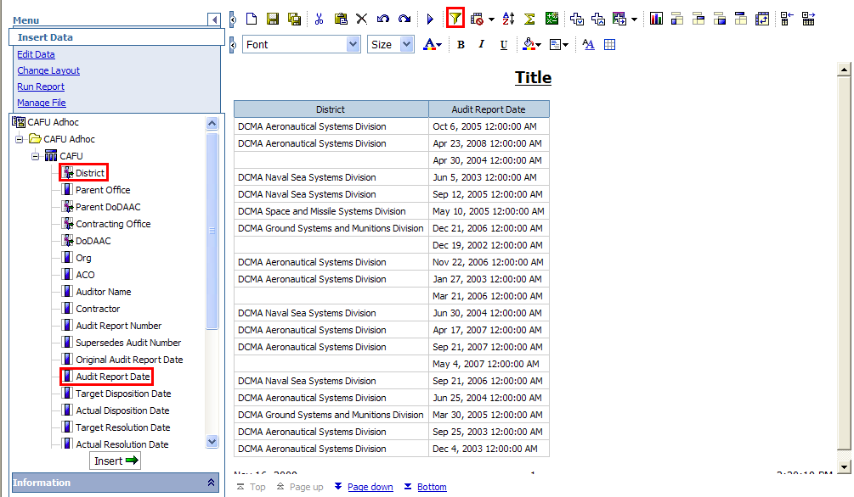
Topic Three – Creating Ad hoc Reports
Filtering Data – Step 3
3
How to filter data. (Graphic 2.16)
1. | Add the District field and Audit Report Date to the report area.
2. | Click the District column header to select the column. The District column will now be highlighted.
3. | Click the icon.
2
1
Graphic 2.16: Unfiltered Report
Notes:
27

Slide 28
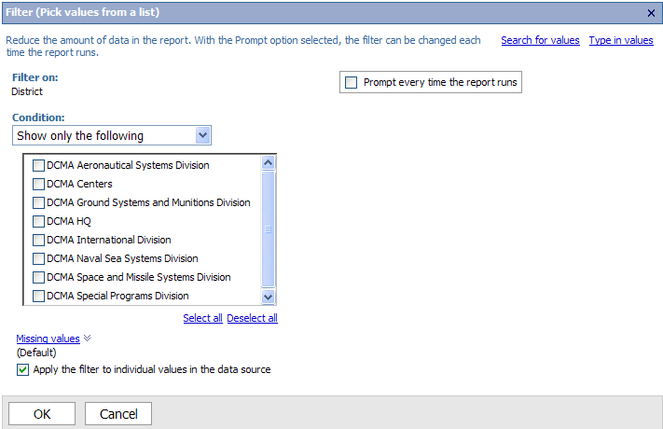
Topic Three – Creating Ad hoc Reports
Filtering Data – Step 3 (Continued)
How to filter data. (Graphic 2.17)
4. | Check DCMA Aeronautical Systems Division and click on the OK button to apply the filter.
4
Note: Report data should be filtered to avoid retrieving too many records and causing a fatal error.
Graphic 2.17: Filter Screen
Notes:
28

Slide 29
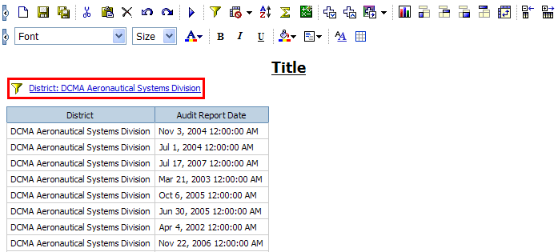
Topic Three – Creating Ad hoc Reports
Removing a Filter
How to remove a filter. (Graphic 2.18)
1. | Click the Filter link. The Filter screen (Graphic 2.17) will be displayed with the current filter option checked
2. | Click the box to the left of DCMA Aeronautical Systems Division to remove the check mark.
3. | Click the OK button to remove the filter.
1
Graphic 2.18: Filtered Report
Notes:
29

Slide 30
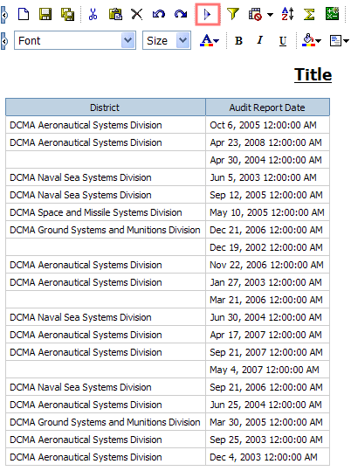
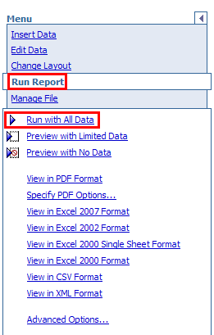
Topic Four – Running Ad hoc Reports
How to Run Ad hoc Reports With All Data
The Run Report link will give you data view options, allowing you to build a report with all data, limited data, or with no data.
Once you are satisfied with the layout of your report you are ready to run the report with all data.
1
2
How to run report with all data. (Graphic 2.19 – 2.20)
1. | Click Run Report.
2. | Select Run with All Data or click on the toolbar.
3. | Use the link to view additional report pages.
Graphic 2.19: Ad hoc Run Report Menu
3
Graphic 2.20: Report with All Data
Notes:
30

Slide 31
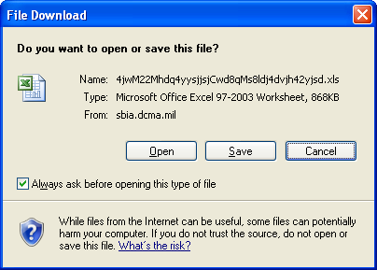
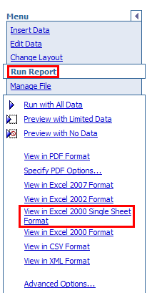
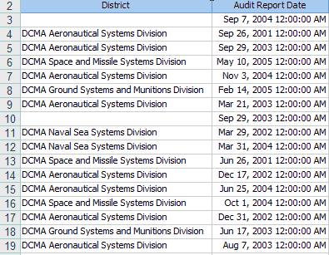
Topic Four – Running Ad hoc Reports
Exporting Data
The second set of links of the Run Report Main Menu allow the report to be exported in PDF, Excel, CVS or XML format.
Note: Reports exported to PDF, Excel, CVS or XML format are saved to the users hard drive.
1
How to export report to Excel. (Graphics 2.21-2.23)
1. | Click Run Report.
2. | Select View in Excel 2000 Single Sheet Format. Click Open to view the Excel report Click Save to save the report to your hard drive as an Excel file
3. | View the exported Excel spreadsheet.
Graphic 2.22: Report with All Data
3
2
Graphic 2.21: Ad hoc Run Report Menu
Graphic 2.23: Report Exported to Excel
Notes:
31

Slide 32
Module Two Review
Module Two Covered the Following Lessons:
Lesson One | Overview of Ad hoc Reports
Lesson Two | Query Studio
Notes:
32

